Slide 1
3. Task Analysis
Task analysis is the process of analyzing the way people perform their jobs: the things they do, the things they act on and the things they need to know.

Slide 2
Create a WhatsApp group on Android
Tap on … icon
Tap on new group
Add participant (loop: at least 1 less than 255)
  3.1 Search member name
  3.2 Select it
  3.3 Tap done
Enter group name
Enter group description (Optional)
Upload picture (Optional)
Tap create

Slide 3
Create a WhatsApp group on Android
Tap on … icon
Tap on new group
Add participant (loop: at least 1 less than 255)
  3.1 scroll through your address book
  3.2 click check box for desired participant (loop)
  3.3 tap done

Slide 4
Hierarchal Task Analysis (HTA)
Creating a whatsapp group
  Tap on :
  Tap on new group
  Enter group name
  Enter group desc if you want
  Upload group pic (optional)
  Add as many members as you want
  Tap done

Slide 5
Creating a whatsapp group
Tap on :
Tap on new group
Add participant
Enter group name
Enter group description (optional)
Upload pic if you want to
Tap done

Slide 6
Task Analysis
Task analysis gathers both declarative and procedural knowledge
  Declarative: objects and relationships
  Procedural: task sequences, goals and sub-goals
  Also dependencies and constraints
Originally a tool for writing training manuals, now used more widely in business process analysis
Emphasizes users + existing tasks, rather than desired system as in systems analysis
Emphasizes observable behavior and whole job, rather than internal mental state and “unit” tasks as in cognitive models

Slide 7
Task Analysis: An Example
In order to clean the house
    get the vacuum cleaner out
    fix the appropriate attachments
    clean the rooms
    when the dust bag gets full, empty it
    put the vacuum cleaner and tools away
Must know about:
    vacuum cleaners, their attachments, dust bags, cupboards, rooms etc.

Slide 8
Hierarchical Task Analysis
Complex planning tasks can be represented as a hierarchy of operations and plans
Hierarchy of Operations (tasks)
  different things that people must do within a system and
  a hierarchy of tasks and subtasks
Plans
  in what order and under what conditions subtasks are performed

Slide 9
Textual HTA description
Hierarchy description ...
0. in order to clean the house
1. get the vacuum cleaner out
2. get the appropriate attachment
3. clean the rooms
3.1. clean the hall
3.2. clean the living rooms
3.3. clean the bedrooms
4. empty the dust bag
5. put vacuum cleaner and attachments away
... and plans
Plan 0: do 1 - 2 - 3 - 5 in that order. when the dust bag gets full do 4
Plan 3: do any of 3.1, 3.2 or 3.3 in any order depending on which rooms need cleaning

Slide 10
Generating the hierarchy
Get list of tasks
    start with stating the overall objective that the person has to achieve.
Re-describe into a set of sub-operations and the plan specifying when they are carried out.
    group tasks into higher level tasks
    decompose lowest level tasks further
    Each sub-operation can be re-described further if the analyst requires

Slide 11
Stopping rules
How do we know when to stop?
  Is “empty the dust bag” simple enough?
  Purpose: expand only relevant tasks
  Motor actions: lowest sensible level
P × C rule
  If the probability of making a mistake in the task (P) multiplied by the cost of the mistake (C) is below a threshold, then stop expanding.
  That is, simple tasks need not be expanded, unless they are critical.

Slide 12
Restructuring HTA
Restructuring and finding the appropriate and meaningful hierarchy, is part of the process of HTA.
For Example:
  If we know that we only ever notice the bag is full when we are actively using the machine, we might choose to put subtask 4 ‘empty the dust bag’ within 3 ‘clean the rooms’.

Slide 13
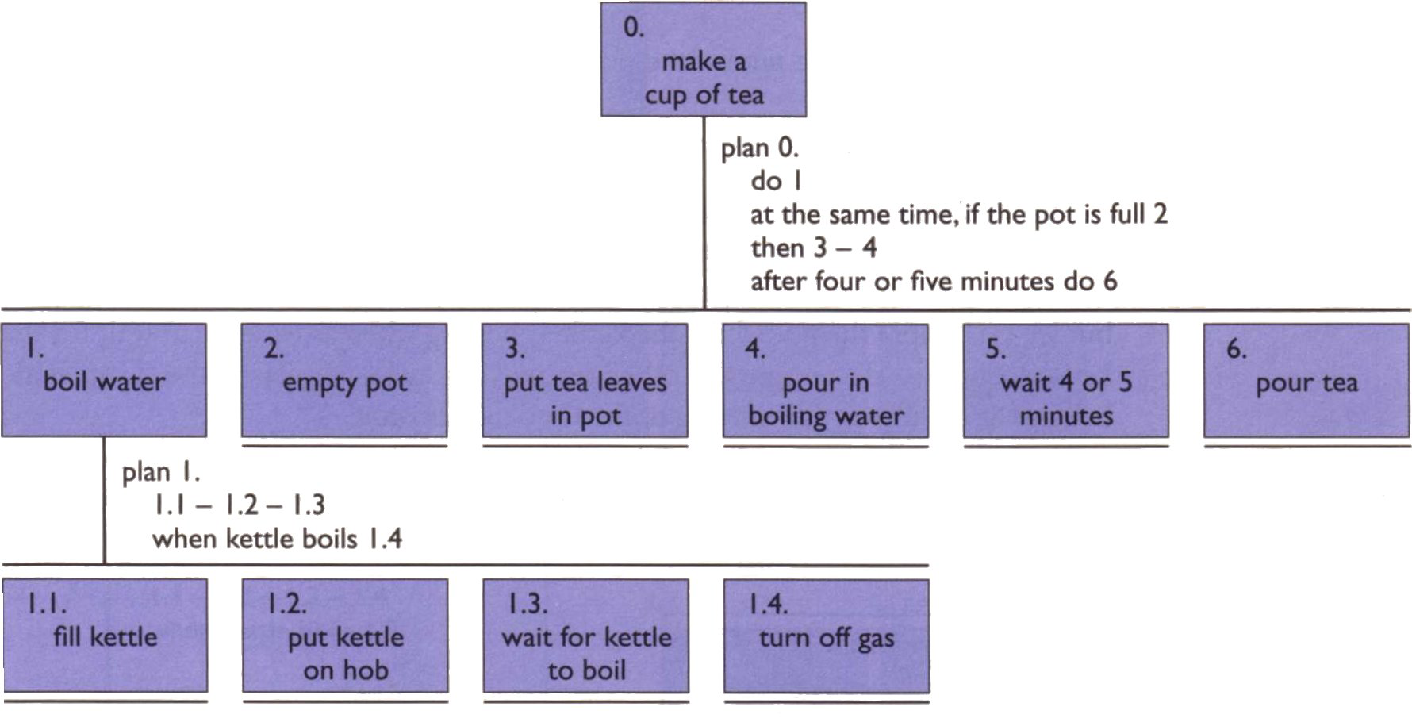
An Example HTA

Slide 14
Refining HTA
Given initial HTA (textual or diagram)
  How to check / improve it?
Some heuristics:
  paired actions e.g., where is `turn on gas'
  restructure e.g., generate task `make pot'
  balance e.g., is `pour tea' simpler than making pot?
  generalise e.g., make one cup ….. or more

Slide 15
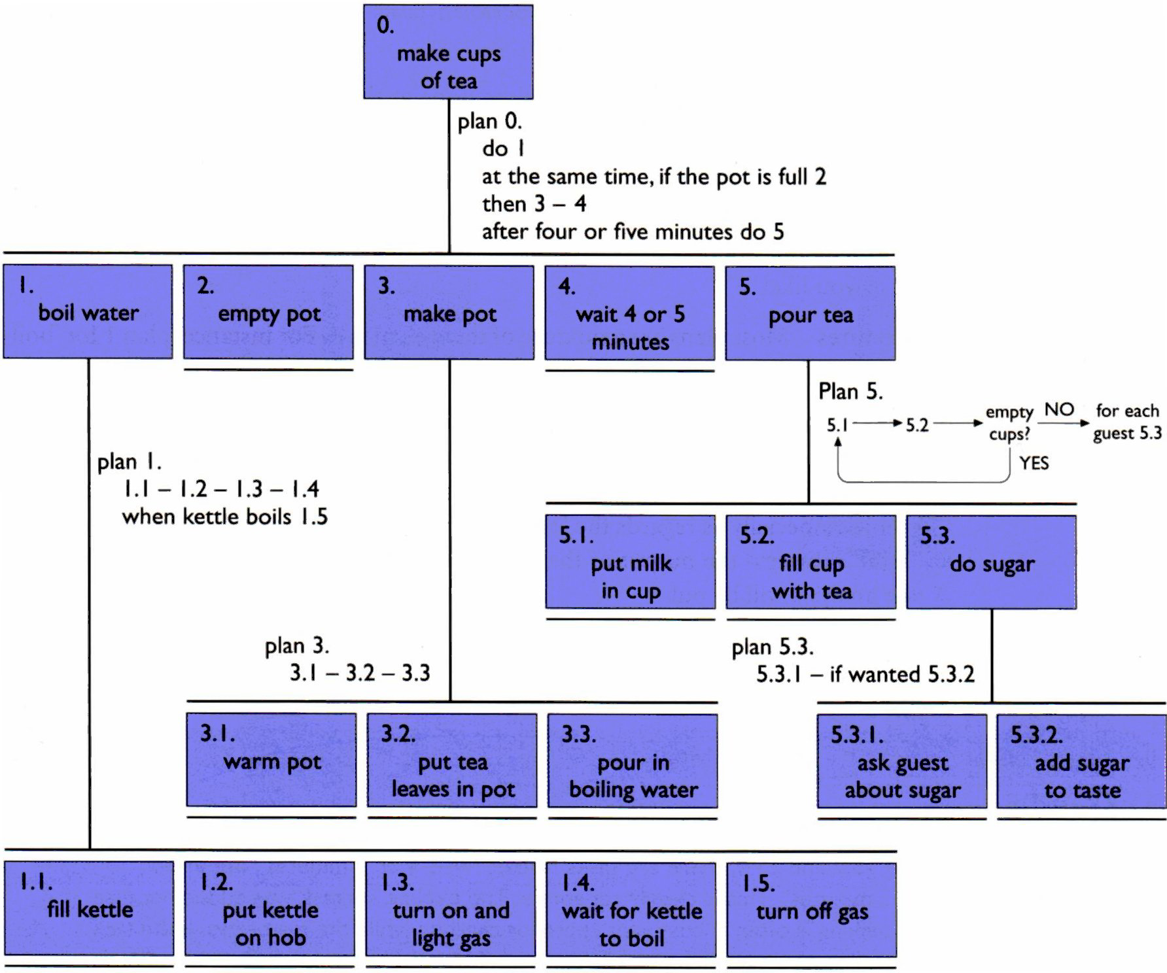
Refined HTA
Notes:
Sequence => 1.1 then 1.2 then 1.3
Optional => if the pot is full 2
Wait => when kettle boils, do 1.4
Cycles => do 5.1 5.2 while there are still empty cups
Parallel => do 1; at the same time ...
Discretionary => do any of 1.3.1, 1.3.2 or 1.3.3 in any order
Mixtures => mixture of above

Slide 16
Types of Plans
Sequence
    1.1 then 1.2 then 1.3
Optional
    if the pot is full 2
Wait
    when kettle boils, do 1.4
Cycles
    do 5.1 5.2 while there are still empty cups
Parallel
    do 1; at the same time ...
Discretionary
    do any of 1.3.1, 1.3.2 or 1.3.3 in any order
Mixtures
    Mixtures of above

Slide 17
Waiting …
is waiting part of a plan?
… or a task?
generally
  task – if ‘busy’ wait
    you are actively waiting
  plan – if end of delay is the event
    e.g. “when alarm rings”, “when reply arrives”
in this example …
  perhaps a little redundant …
  TA not an exact science

Slide 18
HTA Pros
Economical method of gathering and organizing information
Enables the analyst to focus on crucial aspects of the task
Allows functional objectives to be specified at the higher levels of the analysis prior to final decisions
A collaboration between the task analyst and people involved in operations.
Can be used as a starting point for using various error analysis methods to examine the error potential

Slide 19
HTA Cons
The analyst needs to develop a measure of skill in order to analyze the task effectively since the technique is not a simple procedure that can be applied immediately.
Because HTA has to be carried out in collaboration with workers, supervisors and engineers, it entails commitment of time and effort from busy people

Slide 20
Class Activity
Consider the activity of making a telephone call. Record the actions in an HTA diagram or textually. Start off simply, assuming you know the number to dial, but then add more complicated situations: finding the number in address book, or what to do when the number is engaged.

