Slide 1
Component Project
Online Web Casino
Admin's Panel
Matteo Belenchia
Marcin Massalski
Software Engineering
11/14/2018, 8:30am-10:00am
2018/2019

Slide 2
Purpose and guidelines
Purpose
Create an easy to use web application administration panel and a chat service
Guidelines
Graphical user interface for ease to use
Control panel to enforce administration powers
Visualize statistics to let administrators know what is going on
Global chat where users and admins can communicate

Slide 3
Functional requirements
The Admin’s panel component shall:
Allow the admin to kick players
Allow the admin to close game sessions
Allow the admin to change any attribute of any user
Allow the admin to change the minimum allowed bet
Allow the admin to set the maximum number of concurrently connected users
Show connected users and admin(s)
Show currently running game sessions

Slide 4
Functional requirements
The Admin’s panel component shall:
Show, for each game type:
House losses and gains total
Average and minimum bet
Number of game sessions
Profitability

Slide 5
Functional requirements
The Admin’s panel component shall:
Show today’s :
Aggregated house losses and gains
House losses and gains per game type
Number of game sessions
Profitability

Slide 6
Functional requirements
The Admin’s panel component shall:
Show total:
Aggregated house losses and gains
Number of game sessions
Profitability

Slide 7
Functional requirements
The Admin’s panel component shall:
Show player’s :
Anagraphic data
Total losses, gains and current balance
Show all daily stats (history) in the last month
Refresh the shown data periodically without any user input

Slide 8
Functional requirements
The Admin’s panel component shall:
Allow joining and leaving the chat
Read latest messages in the global chat
Let admins and users alike send messages in the global chat
Let users delete their own messages as long as they are shown in the chat
Let admins delete any message as long as they are shown in the chat

Slide 9
Non-functional requirements
The Admin’s panel component shall:
Not allow a negative minimum bet
Limit the number of concurrently connected users
Refresh shown statistics once every 5 minutes
Assign an ID to each chat message for identification and selection
Set the chat message timestamp as the server's local time upon receipt
Limit the number of messages shown on the chat

Slide 10
Non-functional requirements
The Admin’s panel component shall:
Keep deleted messages on the DB
Highlight admin messages in the chat
Delegate the DB access for the editing of the users' data, kicking players, editing of the server properties and the management of the chat to the User Management Component by using the appropriate interface
Delegate the DB access for closing games, setting the minimum bet and querying statistics to the Game Management Component by using the appropriate interface
Have a user-friendly graphical user interface

Slide 11
Modifications of requirements
Functional requirements
The Admin’s panel component shall, instead of merely kicking, let the admins ban a player until a certain time in the future. Set this time to the current time to kick a player and let him or her promptly reconnect without waiting.
The Admin’s panel component could allow the submission of custom read-only queries by the admin.

Slide 12
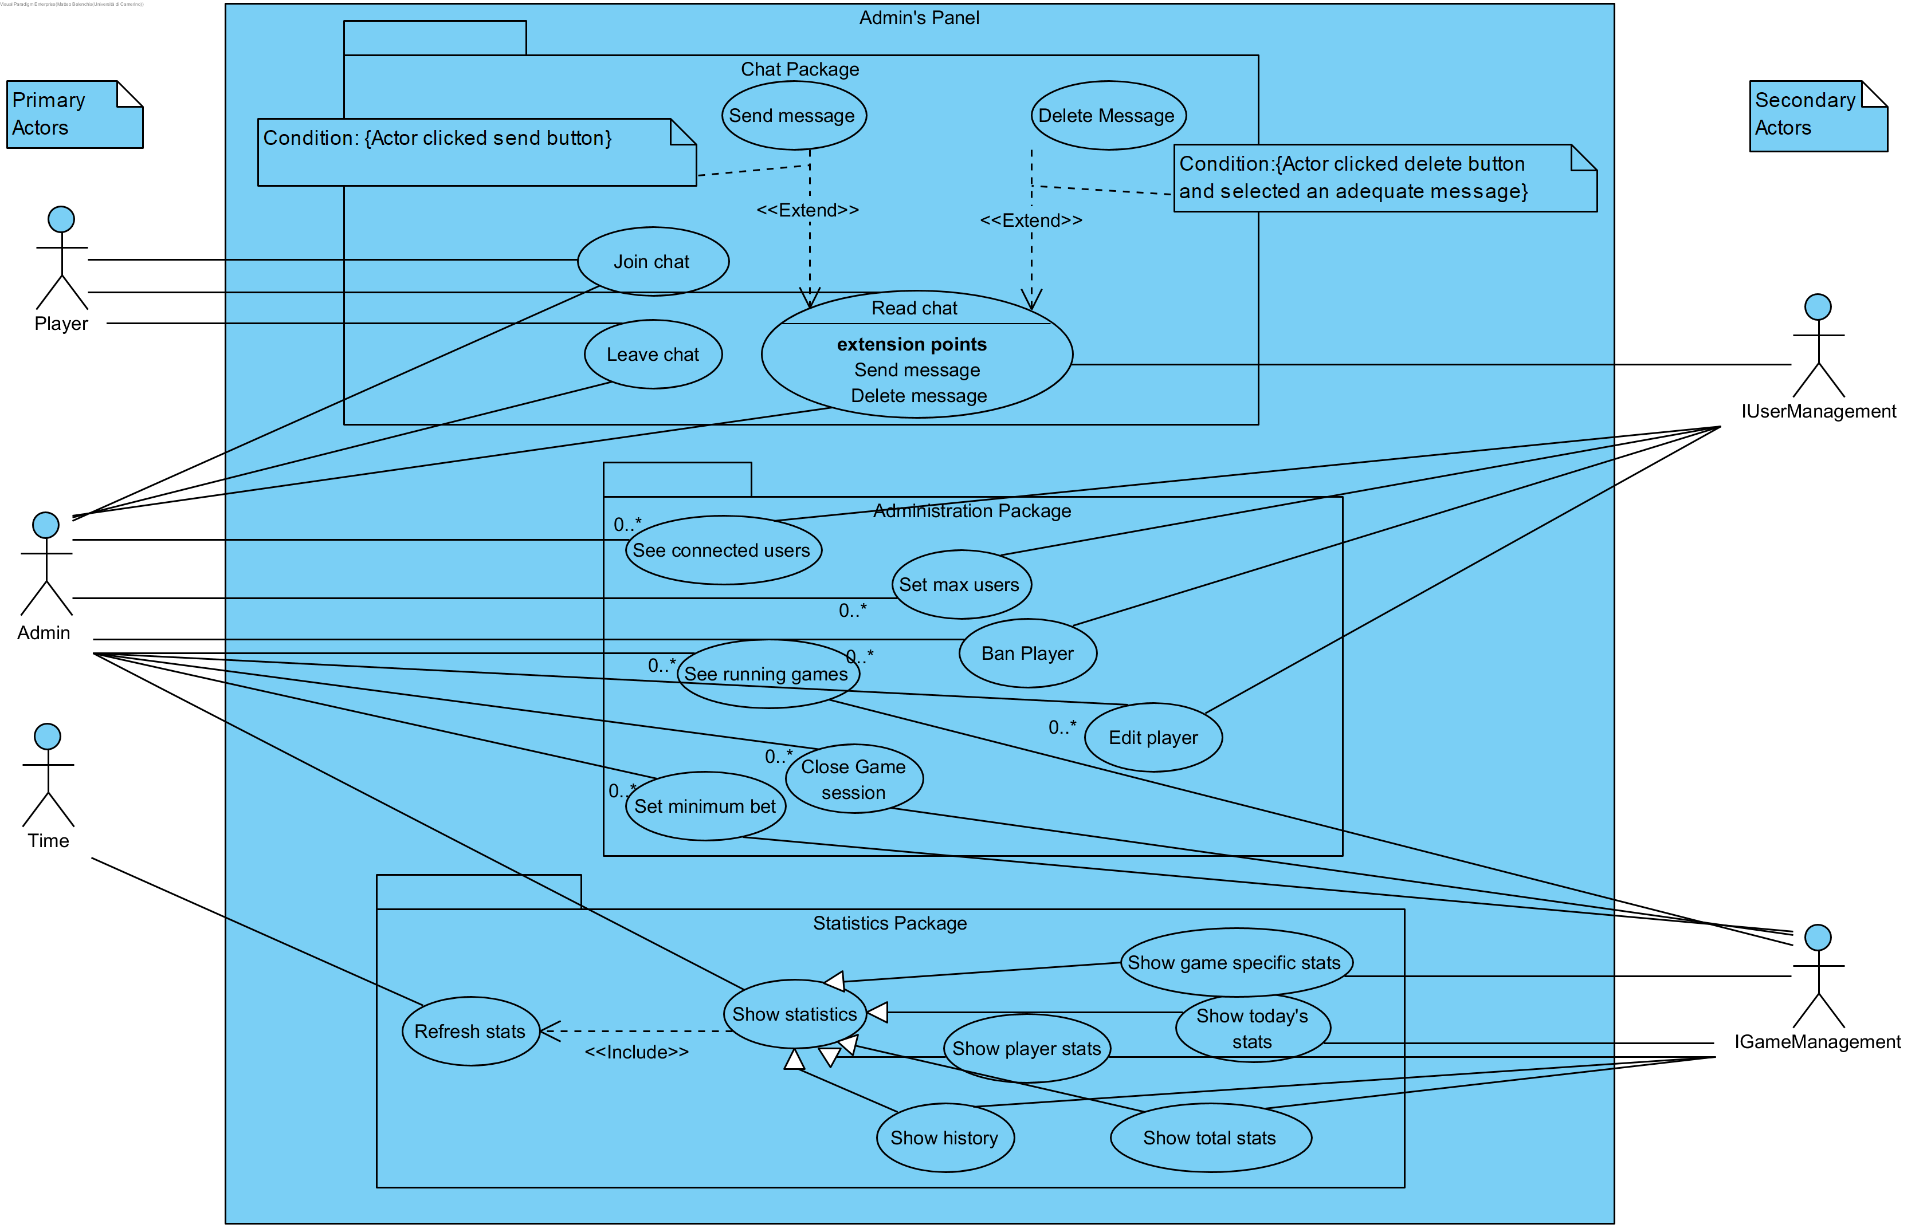
Use case diagram

Slide 13
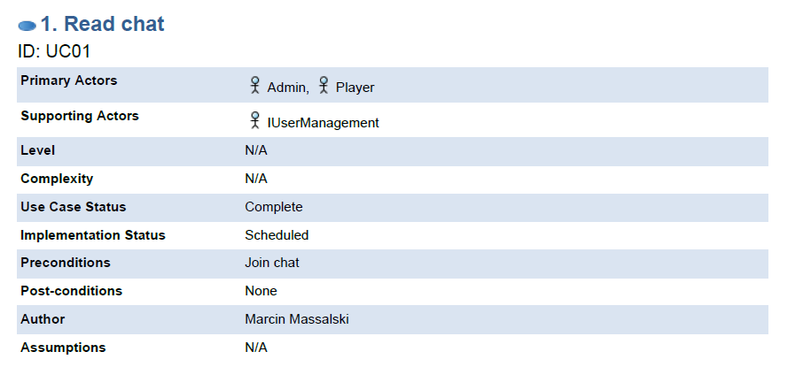
Use case specification – Read Chat

Slide 14
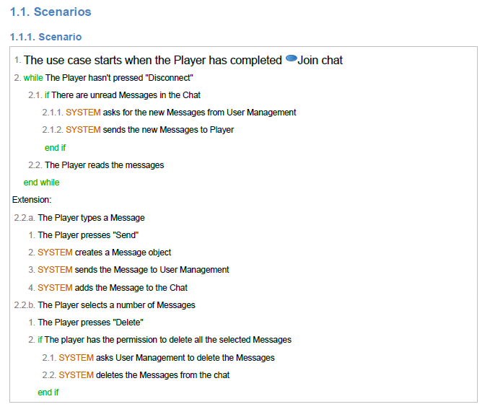
Use case specification – Read Chat

Slide 15
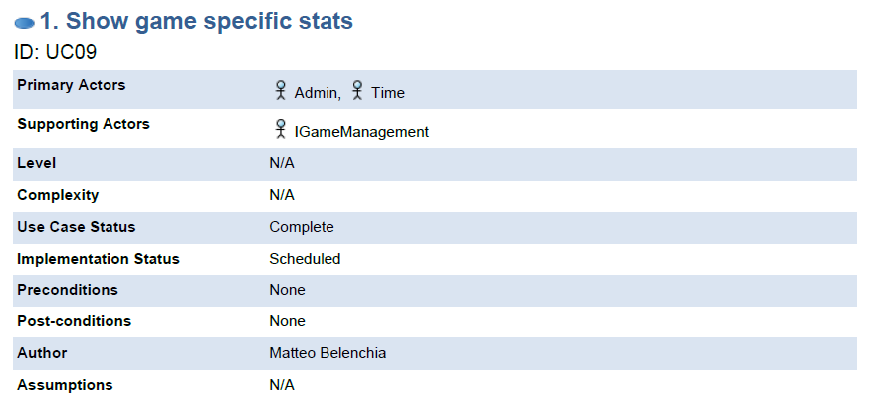
Use case specification – Show game specific statistics

Slide 16
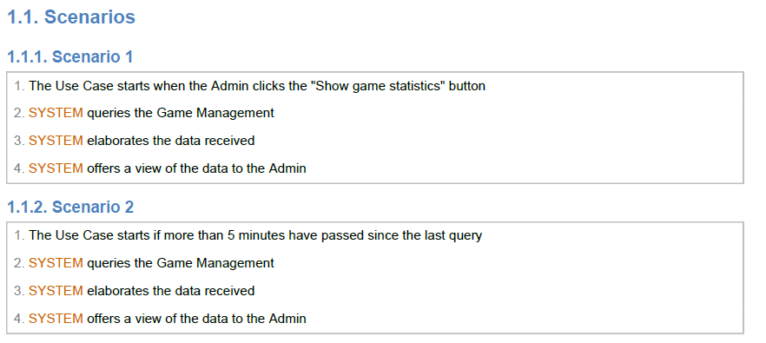
Use case specification – Show game specific statistics

Slide 17
Relations with other components
User Management
Receives the command to ban a player
Receives the proposed edits to user profiles to carry out
Receives the chat messages to register in the DB
Is queried to show the logged users

Slide 18
Relations with other components
Game Management
Receives the command to close a game session
Receives the minimum bet parameter to enforce in the adequate game sessions
Receives the database queries to carry out and is expected to return their results
Is queried to show the active game sessions

Slide 19
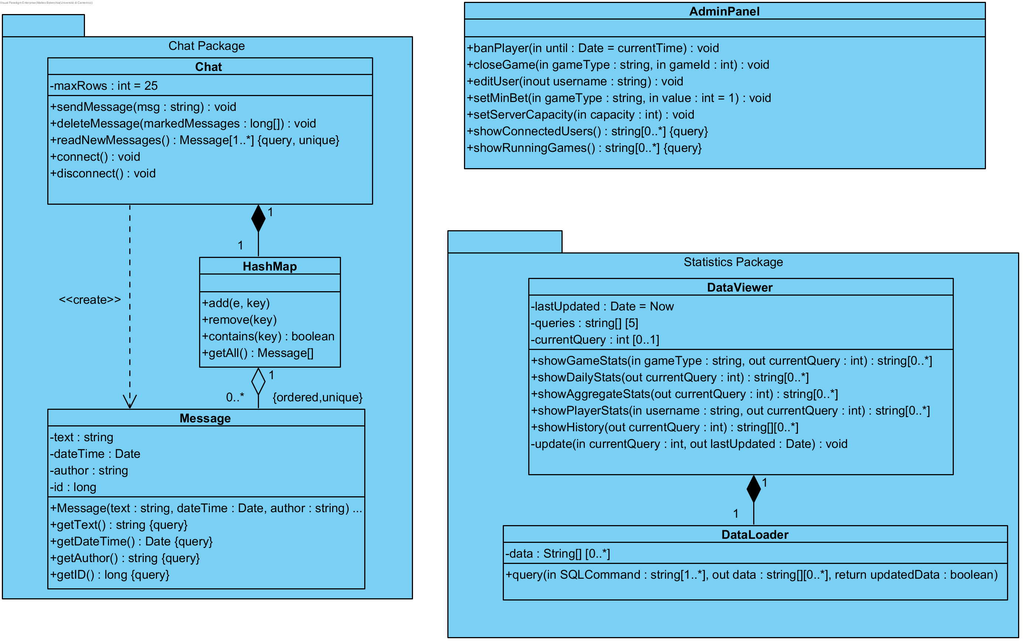
Class diagram

Slide 20
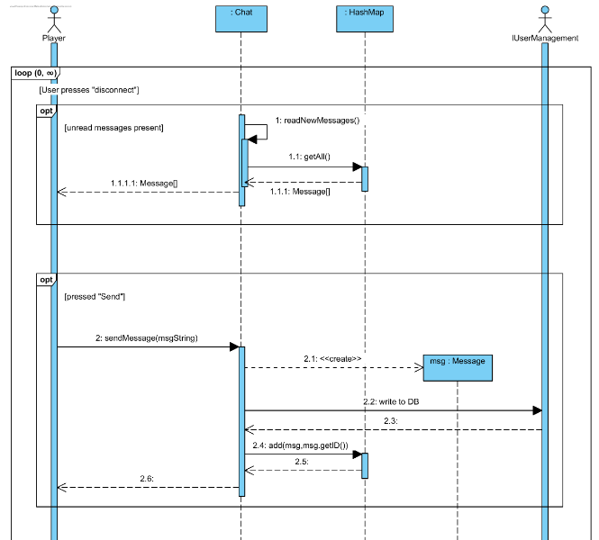
Interaction diagram – Read chat(1)

Slide 21
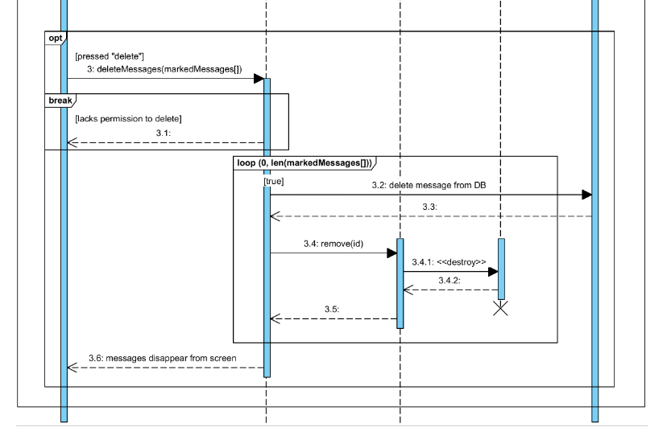
Interaction diagram – Read chat(2)

Slide 22
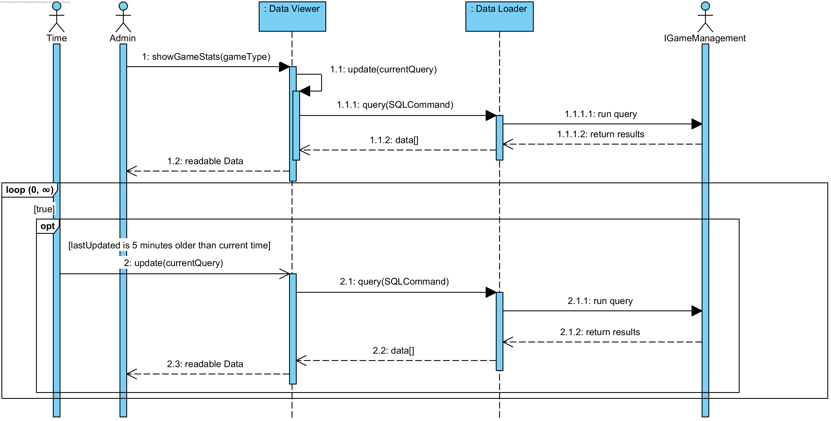
Interaction diagram – Show game specific statistics

Slide 23
Realization of guidelines and requirements
The Chat package takes care of the global chat requirements by offering the classes to keep track of messages and to provide the basic chat functionalities of reading, writing and deleting messages.
The AdminPanel class offers a range of administration powers that covers, other than the typical server settings, editing of user data, banning players, closing game sessions and changing the minimum bet for each class of games.
The DataLoader class is tasked with gathering and storing the data required while the DataViewer class elaborates and offers a readable view of it.

Slide 24
Realization of relations with other components
As shown on its sequence diagram, all Chat functions require a call to User Management to log the request, let it be a connection, disconnection, read, write or delete request.
Likewise, showing the selected statistics implies querying the DB using the Game Management as a middle man, an example of which is shown on the second sequence diagram.
In the case of the administration functions the requests will be routed to the adequate Component, as shown on the Use Case Diagram.

