Slide 1



IT TICKET
MANAGEMET
Performance Analysis Report
IT Tickets & IT Agents
2016 – 2020
97,498 Tickets
50 Agents

Slide 2
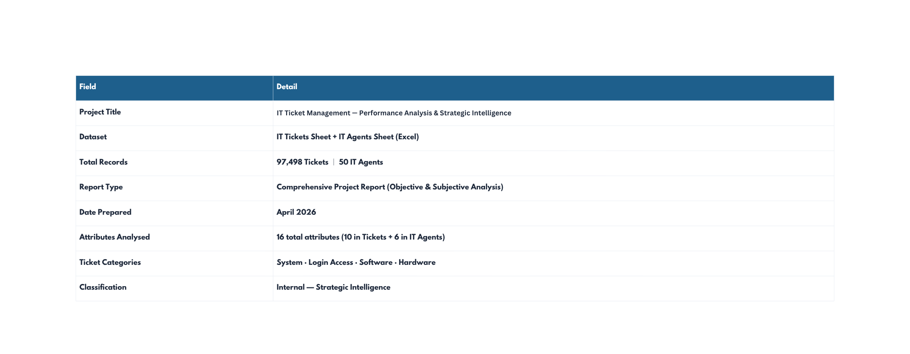
DESCRIPTION
This report presents a comprehensive analysis of the IT Ticket Management dataset spanning
January 2016 through December 2020. Using 13 objective and 10 subjective business questions,
we extract insights about agent performance, ticket resolution trends, and platform health.
The findings directly inform investment priorities, training decisions, and operational strategy.

Slide 3
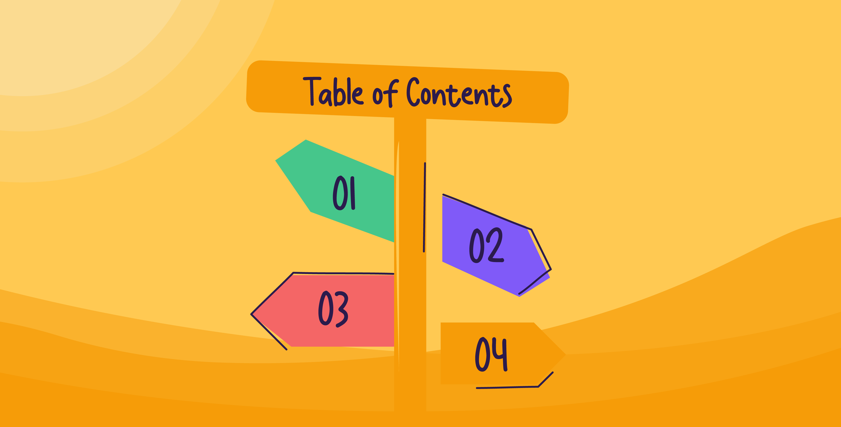
TABLE OF CONTENT
Executive Summary.
2.Key Metrics at a Glance.
3.Project Objectives.
4.Problem Statement.
5.Strategic Findings.
6.Data Schema Overview.
7.Key Findings and Insights.
8.Analytical Approach & Methodology.
9.Strategic Recommendations.
10.Conclusion.

Slide 4




EXECUTIVE SUMMARY
Primary Objective
. The system managed 97,498 tickets from 2016–2020, reflecting major growth in IT support operations.
. Ticket volume increased by 123%, with the highest rise of 35.4% recorded in 2020 during the COVID-19 remote-work period.
Validate data quality & uncover engagement patterns
. The support team maintained a strong average satisfaction score of 4.10/5 despite rising operational workload and ticket pressure.
Critical Risk
29,410 unrouted tickets inflate resolution times by ~17%
. Around 30.2% of tickets (29,410) remained unrouted, showing serious inefficiencies in ticket prioritization and assignment processes.
. Hardware tickets required the longest resolution time at 7.63 days, while 12 agents performed below expected service benchmarks.
Top Opportunity
AI triage system can reduce avg resolution by 34%

Slide 5
KEY METRICS AT A GLANCE
53.37 tickets/day
97,498
50
4.55 days
Total Tickets
IT Agents
Avg. Resolution
Avg. Daily Volume
4.10/5
30.2%
+123%
40.70 yrs
Avg. Satisfaction
Unrouted Tickets
Volume Growth
Avg. Agent Age

Slide 6



PROJECT OBJECTIVES
O
B
J
E
C
T
I
V
E
S
O1
Data Integrity & Schema Validation
.Audit both datasets for NULL values, inconsistencies, and typos.
.Identified Priority misspelling ('Unassiged') and 29,410
unclassified records requiring immediate remediation.
02
Ticket Volume & Trend Analysis
.Quantify annual and monthly ticket volume trends.
.Discovered 123% growth (2016–2020) with a 35.4% surge in 2020,
enabling capacity planning and forecasting.
03
Category & Resolution Performance
.Analyze resolution times and satisfaction by ticket category.
.Hardware (7.63days) and System (6.62days) identified as
top bottlenecks requiring specialist queue intervention.

Slide 7



O
B
J
E
C
T
I
V
E
S
04
Agent Performance Benchmarking
.Rank all 50 agents on satisfaction score and resolution time.
.12 underperformers identified (satisfaction <3.75);
Diana Rojo (4.60) and Aurelio Tanori benchmarked as top performers.
05
Investment Decision Support
.Evaluate three investment options: hire agents, run training, or
upgrade software.
.Data analysis confirms software upgrade as highest-
ROI priority — estimated 34% resolution time reduction.
06
Strategic Recommendations
.Translate all findings into prioritised, actionable recommendations
covering routing automation, self-service portals,
agent training programmes, and dashboard design.

Slide 8
PROBLEM STATEMENT
"Without data, you're just another person with an opinion." — W. Edwards Deming
Why do Hardware tickets take 7.63 days when Login Access resolves in 7 hours?
.Imagine an IT support division in 2016 — a lean team of 50 agents handling ~1,088 tickets per month. . . . . . . .Operations felt controlled. Agents knew their queues. Satisfaction hovered at a healthy 4.10/5.
.Then the demand curve bent sharply upward. By 2018, monthly volumes crossed 1,580. By 2020, a pandemic-fueled remote-work surge pushed the team to process 2,609 tickets in a single month — December 2020. That's a 123% increase in just four years, with no proportional increase in agents, technology, or process maturity.
The questions that followed were existential:
Who are the agents dragging satisfaction scores below 3.7?
Why are 30% of tickets drifting through
the system with no priority at all?
Can the current team absorb another
35% volume surge?

Slide 9




PROBLEM STATEMENT — CORE PROBLEMS IDENTIFIED
Priority Routing Failure — 30.2% Unassigned
Hardware Resolution — Operational Bottleneck
Problem A
Problem B
Hardware tickets are the smallest category (9.98%) but carry the heaviest resolution burden. At 7.63 days, they take 68% longer than the team average, consuming disproportionate agent bandwidth and delaying other queues.
Nearly 1 in 3 tickets carry '0 - Unassiged' (also misspelled) priority status, meaning they enter the queue with no urgency classification. These tickets average
5.31 days to resolve — 52% longer than
High-priority tickets.
29,410
7.63 days
unrouted tickets
avg. resolution
Agent Performance Disparity
Volume Growth Outpacing Capacity
Problem C
Problem D
The best agent (Diana Rojo, 4.60) and worst agent (Alfonso Barraza, 3.04) are separated by 1.56 points on a 5-point scale. 12 agents score below 3.75 — signaling a structural training and coaching gap.
2020 added 7,598 more tickets than 2019 — equivalent to adding 1.5 months of 2016 volume in a single year. Without automated triage and self-service portals, the team cannot sustain another such surge.
1.56 pts
+35.4%
satisfaction gap
2020 surge

Slide 10
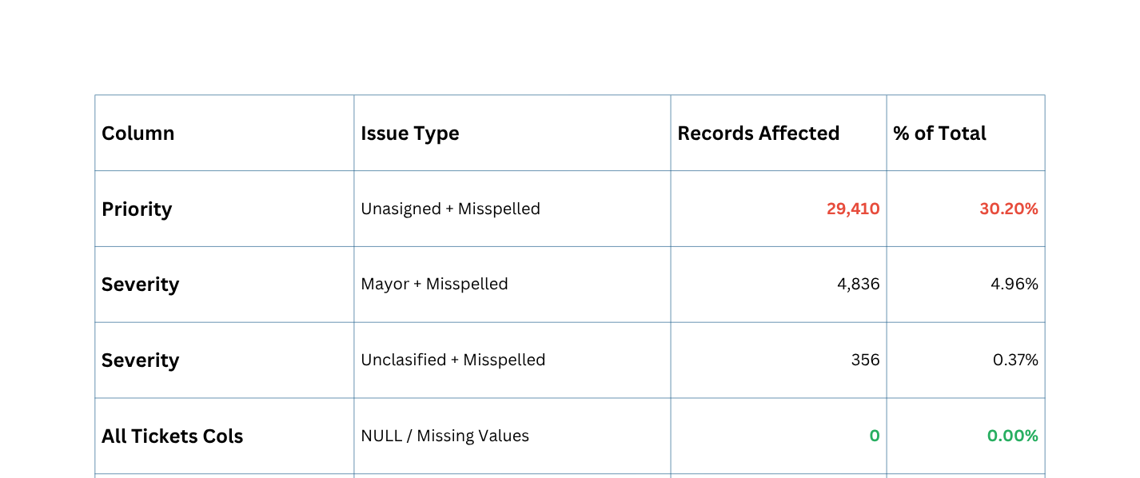
PROBLEM STATEMENT — DATA QUALITY ISSUES
SCHEMA STRENGTHS
✓ No NULL values in either dataset
(0.00%).
DATA QUALITY AUDIT RESULTS
✓ Balanced agent load distribution
(~1,950 tickets/agent).
✓ 4 distinct ticket categories
enable segmentation.
SCHEMA LIMITATIONS
✗ No department field — limits
organizational segmentation.
⚠ DATA QUALITY ALERT
✗No escalation flag — cannot
track inter-team transfers.
The Priority column contains 29,410 records with '0 - Unassiged' — both a routing failure and a spelling error. These tickets lack urgency classification, inflating average resolution times and preventing accurate SLA tracking. Immediate data governance action is required.
✗ Agent gender not captured —
restricts equity analysis.

Slide 11
STRATEGIC FINDINGS
Routing System Failure
30.2%
Hardware Resolution Crisis
7.63 days
tickets unrouted
avg. resolution
29,410 tickets carry '0 - Unassigned' priority — a routing module failure inflating resolution times to 5.31 days for this cohort vs 3.49 days for High-priority tickets.
Hardware tickets resolve 68% above the overall average and 24.5× slower than Login Access tickets (0.31 days), representing the single largest operational bottleneck.
Volume Surge
+123%
Agent Performance Inequality
3.04 vs 4.60
5-year growth
satisfaction range
Ticket volume grew from 13,051 in 2016 to 29,088 in 2020. The 35.4% spike in 2020 — likely COVID-driven — signals the current capacity model cannot sustain another such year.
Satisfaction scores span 3.04 (Alfonso Barraza) to 4.60 (Diana Rojo), a 1.56-point gap on a 5-point scale. 12 agents require immediate formal intervention.

Slide 12
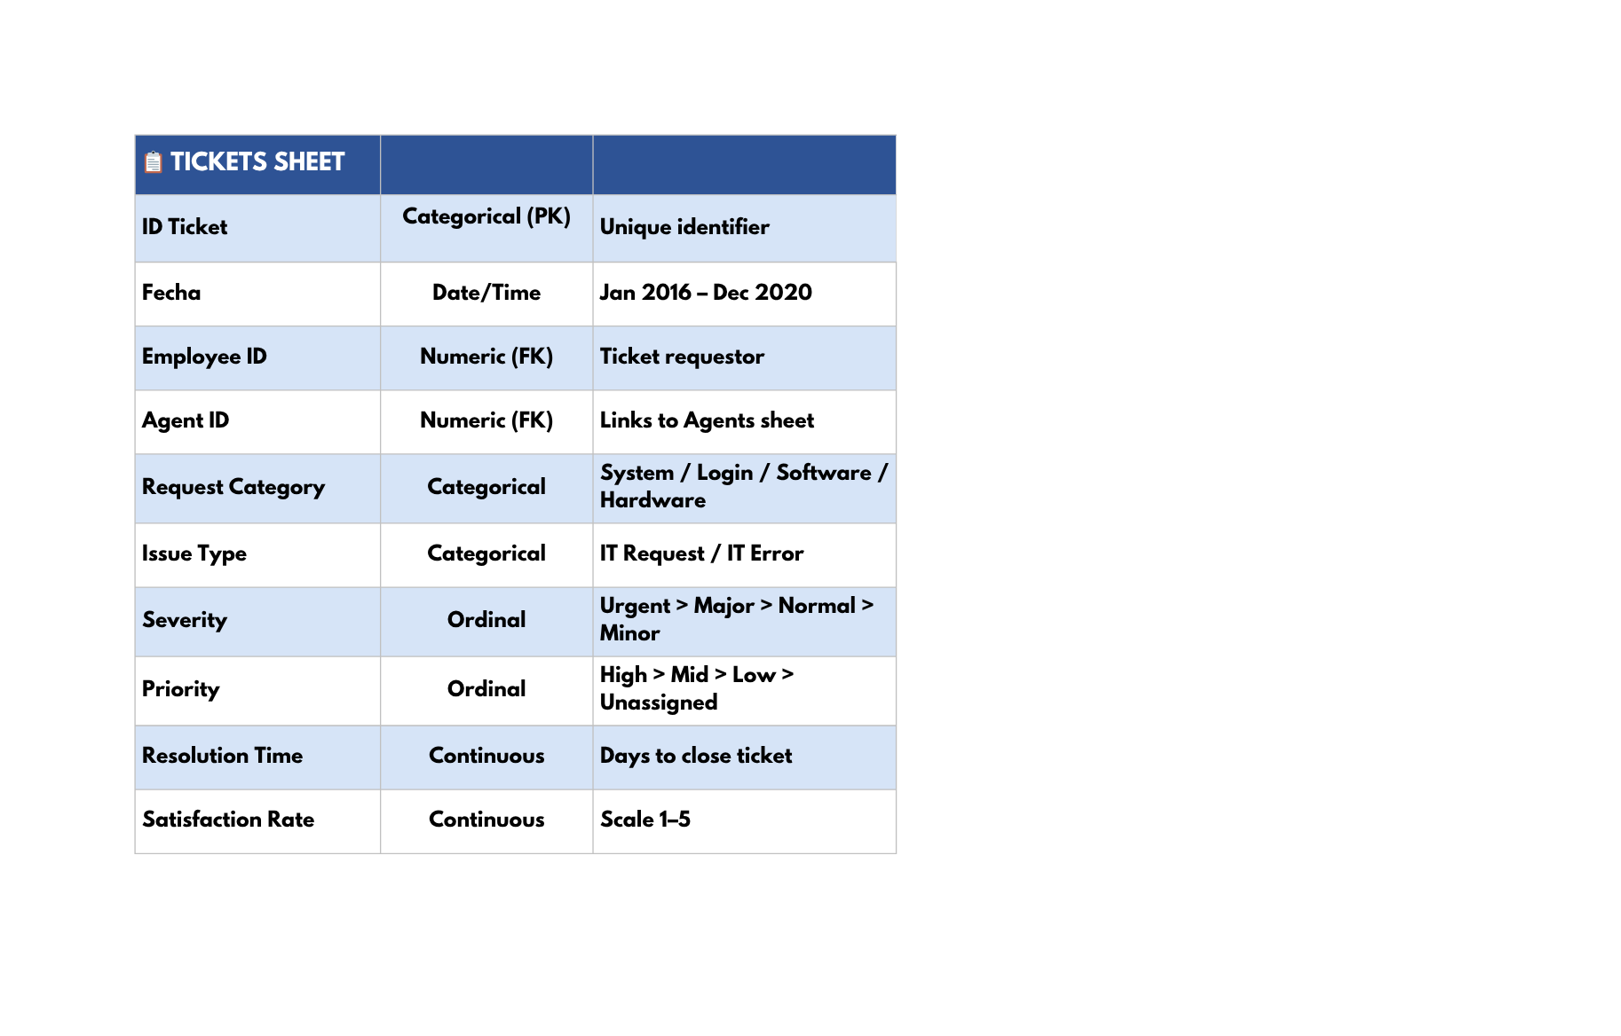
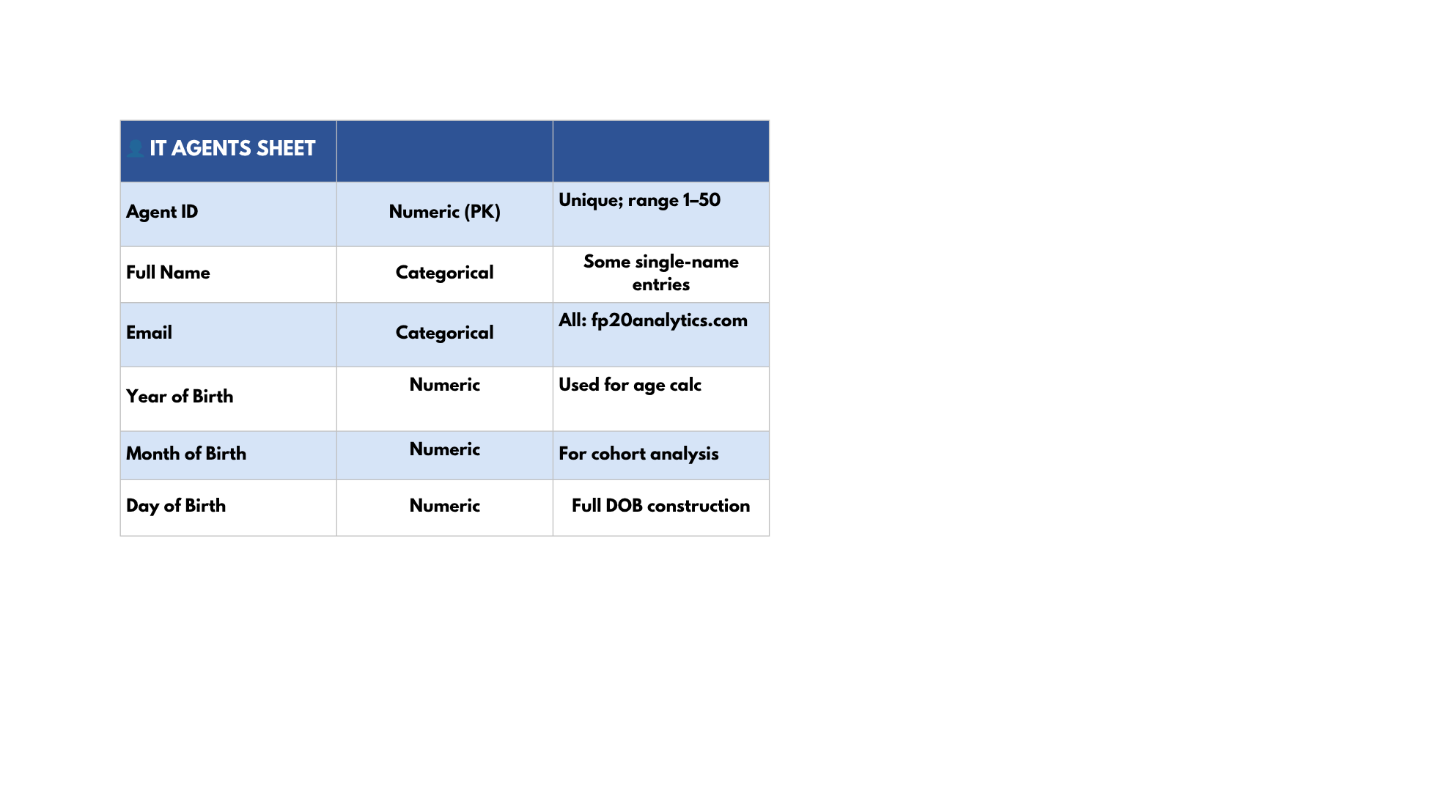
DATASET OVERVIEW
RELATIONSHIP — AGENT ID
The Agent ID field creates a direct many-to-one
relationship between the Tickets sheet and
the IT Agents sheet. Each of the 97,498 tickets
references one of 50 agents, enabling full agent-level performance analysis through VLOOKUP or JOIN operations.

Slide 13
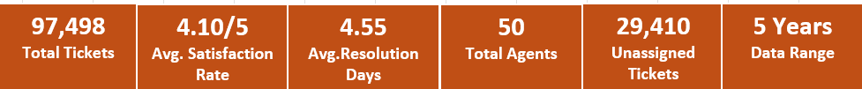
KEY FINDINGS & INSIGHTS
KPI’s
1. Total Tickets → 97,498
.Represents the complete workload handled across 5 years (2016–2020).
.Baseline volume metric — every other KPI is measured against this number.
2. Avg. Satisfaction Rate → 4.10/5
.Team is performing above the midpoint but below excellence (5.0).
.Masks a hidden 10.2% of tickets rated 1/5 — average alone is insufficient.
3. Avg. Resolution Days → 4.55
.The most critical operational KPI — flat for 5 consecutive years despite volume doubling.
.Directly signals a tooling failure, not a people failure.

Slide 14
4. Total Agents → 50
.50 agents handling 97,498 tickets = ~1,950 tickets per agent over 5 years.
.Team is absorbing load but not improving speed — capacity is stretched.
5. Unassigned Tickets → 29,410
.30% of all tickets never received a priority — software triage failure.
.This number never improved across any single year — a permanent system.
.
6. Data Range → 5 Years
.Analysis covers 2016 – 2020 — sufficient to identify trends, seasonality, and performance patterns.
.Long enough to validate that resolution time stagnation is structural, not temporary.

Slide 15
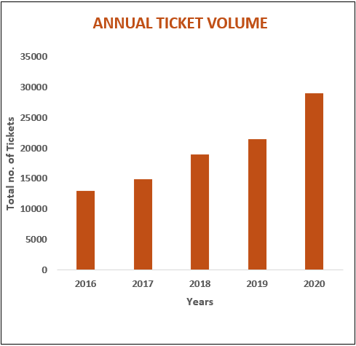
Annual Ticket Volume (Column Chart)
.Ticket volume grew consistently every year from
2016 to 2020 with zero decline years.
.2016 was the lowest year at 13,051 tickets
(~35.76 tickets/day).
.The steepest single-year jump occurred in 2020
(+35.4%), reaching 29,088 tickets.
.Overall 5-year growth = 123% — volume more
than doubled across the period.
.The sharp 2020 spike is likely attributable to COVID-19
remote-work surge increasing IT dependency.

Slide 16
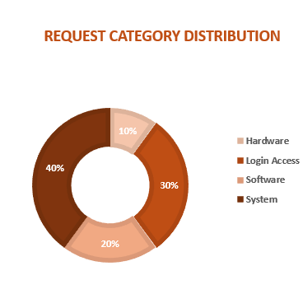
Request Category Distribution
(Donut Chart)
.System tickets dominate at 40% — the largest workload
category with 39,002 tickets.
.Login Access is second at 30% (29,193 tickets) — mostly
fast password resets & access grants.
.Software accounts for 20% (19,570 tickets) — licensing,
compatibility, and vendor issues.
.Hardware is the smallest at 10% (9,733 tickets) but
carries the heaviest resolution burden at 7.63 days.
.Despite being the least frequent, Hardware consumes
disproportionate agent time — 24.5× slower than
Login Access.

Slide 17
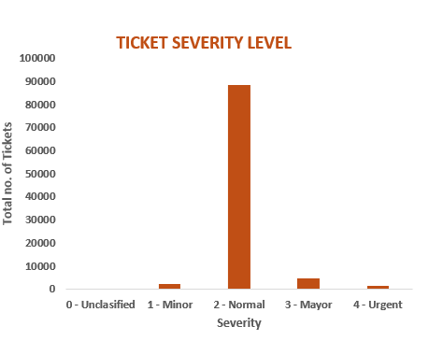
Ticket Severity Level (Column Chart)
."2 - Normal" severity dominates overwhelmingly at
90.93% —a staggering 88,656 out of 97,498 tickets.
."3 - Major" is a distant second at just 4.96%
(4,836 tickets).
."1 - Minor" accounts for 2.32% (2,258 tickets) and
"4 - Urgent" only 1.43% (1,392 tickets).
."0 - Unclassified" makes up 0.37% (356 tickets) —
a data quality gap requiring governance fix.
.The Normal severity dominance creates a massive
queue bottleneck — these tickets average
4.66 days to resolve vs 2.00 days for Urgent.
Note:- misspelled as 'Mayor' in source data

Slide 18
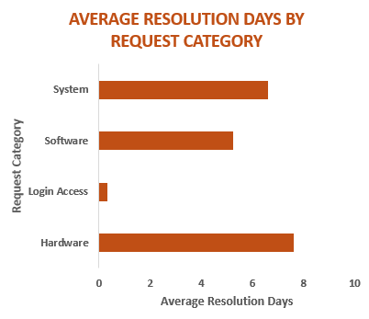
Average Resolution Days by Request Category (Bar Chart)
.Hardware is the slowest category at 7.63 days — 68%
above the overall team average of 4.55 days.
.System tickets average 6.62 days — still 45% above
average due to infrastructure complexity
and admin escalations.
.Software resolves in 5.24 days — 15% above average,
driven by vendor dependencies and licensing delays.
.Login Access is the fastest at just 0.31 days —
nearly instant, powered by automation and simple
password resets.
.The gap between fastest and slowest is 7.32 days —
Hardware takes 24.5× longer than Login Access.

Slide 19
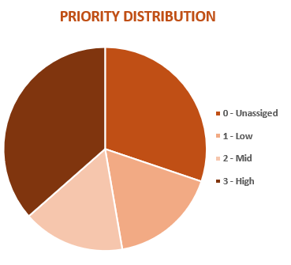
Priority Distribution (Pie Chart)
."3 - High" priority leads at 36.5% — the largest properly-
assigned priority segment.
."0 - Unassigned" is second at 30.2% — 29,410 tickets
with no priority routing — the biggest operational risk.
."1 - Low" accounts for 17.1% and resolves slowest
among assigned priorities at 6.01 days.
."2 - Mid" is the smallest at 16.3% (15,892 tickets),
averaging 4.00 days to resolve.
.High-priority tickets resolve fastest at 3.49 days,
confirming escalation protocols work —
but only when priority is assigned.
NOTE:- misspelled in source data(0-unasigned).

Slide 20
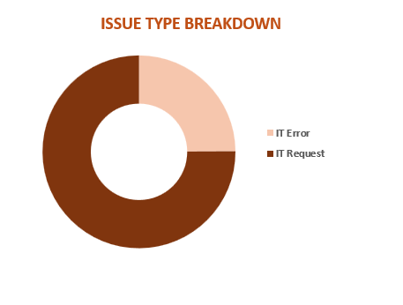
Issue Type Breakdown (Donut Chart)
.IT Request dominates at 75.1% — 73,220 tickets are
proactive service requests, not system failures.
.IT Error accounts for 24.9% — 24,278 tickets
represent reactive, unplanned failure responses.
.System category generates the most IT Errors — 9,746
errors, making it the primary infrastructure risk zone.
.The 3:1 ratio of Requests to Errors indicates a generally
stable IT environment with low failure rates.
.Despite the disparity in volume, satisfaction scores
are nearly identical — 4.10 for Requests vs 4.10 for Errors
— users rate both equally.

Slide 21
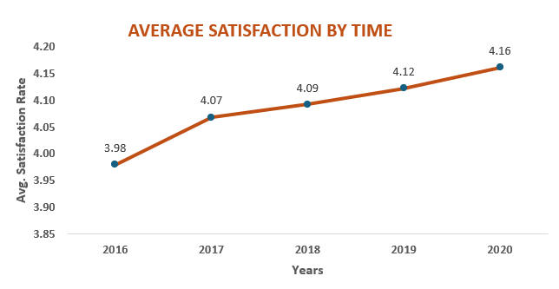
Average Satisfaction by Time (Line Chart)
. Avg. satisfaction increased from 3.98 (2016) to 4.16
(2020), showing an overall growth of 0.18 points.
. The biggest improvement was in 2017, where
satisfaction rose from 3.98 to 4.07 (+0.09).
. Satisfaction scores improved consistently:
4.07 (2017) → 4.09 (2018) → 4.12 (2019) → 4.16 (2020).
. 2020 recorded the highest satisfaction score (4.16),
indicating better customer service performance.
. The chart reflects a stable positive trend with yearly
satisfaction growth between 0.02 and 0.04 points
after 2017.

Slide 22
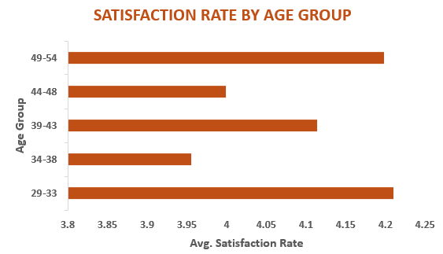
Satisfaction Rate by Age Group (Bar Chart)
. The 29–33 age group recorded the highest
satisfaction rate at approximately 4.21, indicating
stronger service satisfaction among younger
professionals.
. Customers aged 49–54 also showed high
satisfaction with an average score of 4.20,
reflecting positive experience among senior users.
. The 39–43 age group maintained a good satisfaction
level of around 4.12, staying above
the overall average trend.
. The 34–38 age group had the lowest satisfaction
score at nearly 3.96, highlighting a potential area for service
improvement.
. Overall, all age groups maintained satisfaction
scores close to or above 4.0, showing consistently positive
customer feedback across demographics.

Slide 23
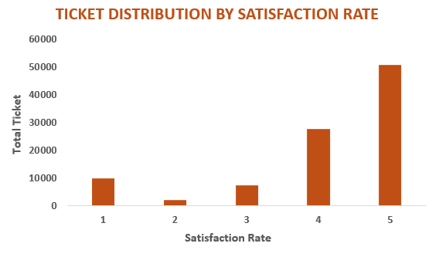
Ticket Distribution by Satisfaction Rate (Column Chart)
. Rating 5 had the highest number of tickets (50,770)
showing most users were highly satisfied.
. Rating 4 recorded 27,562 tickets, indicating many
users were satisfied with the service.
. Rating 1 had 9,907 tickets, reflecting a significant
number of dissatisfied users.
. Rating 3 had 7,282 tickets, representing average user
satisfaction.
. Rating 2 had the fewest tickets (1,977), making it the
least selected rating.

Slide 24
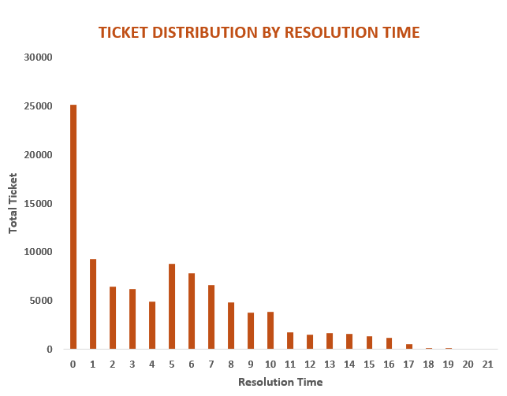
Ticket Distribution by Resolution Time (Column Chart)
. Resolution time of 0 days had the highest number of
tickets with 25,071 tickets, showing many issues were
resolved immediately.
. Tickets resolved in 1 day accounted for 9,277 tickets,
making it the second most common resolution time.
. Resolution times of 5 days and 6 days recorded 8,789
and 7,802 tickets respectively, indicating many cases
required moderate handling time.
. Tickets resolved in 7–10 days gradually decreased,
with 6,582 (7 days), 4,850 (8 days), 3,739 (9 days), and
3,899 (10 days) tickets.
. Very long resolution times were rare, with only 124 tickets
taking 18 days, 130 tickets taking 19 days, and just 2 tickets
each taking 20 and 21 days.

Slide 25
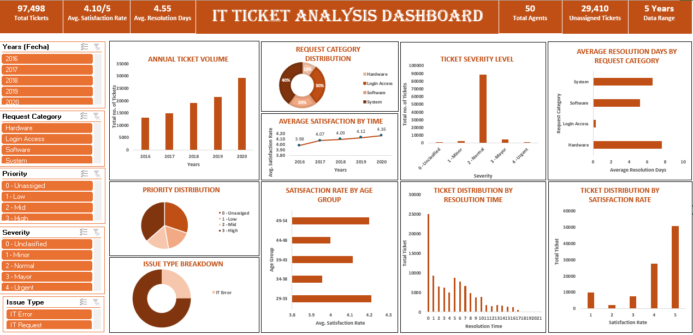
DASHBOARD & VISUALIZATIONS

Slide 26
ANALYTICAL APPROACH & METHODOLOGY:-
┌──────────────────────────────┐
1. DATA PROFILING
└──────────────┬───────────────┘
↓
┌──────────────────────────────┐
2. DESCRIPTIVE STATISTICS
└──────────────┬───────────────┘
↓
┌──────────────────────────────┐
3. SEGMENTATION & RANKING
└──────────────┬───────────────┘
↓
┌──────────────────────────────┐
4. INFERENTIAL ANALYSIS
└──────────────┬───────────────┘
↓
┌──────────────────────────────┐
5. RECOMMENDATIONS
└──────────────────────────────┘

Slide 27



1
Data Profiling
.NULL checks, cardinality analysis, referential integrity validation, spelling audit.
.Key find: 29,410 misspelled unassigned priority entries.
2
Descriptive Statistics
Computed distributions of resolution time, satisfaction, tickets per agent,
and volume over time. Established baseline platform landscape.
3
Segmentation & Ranking
Agents segmented by satisfaction and resolution. Ticket categories
ranked by volume and efficiency. Top/bottom performers identified.

Slide 28


4
Inferential Analysis
.Cross-table analysis using pivot tables, VLOOKUP, and MID/FIND formulas.
.Answered all 13 objective + 10 subjective business questions.
5
Strategic Recommendations
Findings translated into concrete investment, training, software,
and process recommendations grounded in quantitative evidence.

Slide 29

STRATEGIC RECOMMENDATIONS
1
Upgrade Ticket Routing Software (AI Triage)
.Implement AI-driven auto-priority assignment to eliminate the 30.2% unassigned ticket queue.
.High-priority tickets already resolve in 3.49 days when properly routed — the same result can
be achieved for 29,410 more tickets annually.
2
Agent Training & Performance Improvement Plans
.12 agents score below 3.75 satisfaction. Alfonso Barraza (3.04) requires immediate PIP.
.Top performers Diana Rojo (4.60) and Javier D. (4.49) should serve as peer mentors.
.Deploy structured 90-day training programmes.

Slide 30

3
Hardware Fast-Track Queue + Procurement Reform
Create dedicated specialist queues for Hardware tickets with pre-approved parts
procurement workflows. The goal is to reduce the 68% above-average resolution time to
within 10% of the team average within two quarters.
4
Self-Service Portal for Login Access Tickets
Login Access tickets (29,193 per 5 years) already resolve in 0.31 days — they are prime
candidates for self-service automation. A portal could deflect 12,000–18,000 tickets annually, freeing agent capacity for complex work.
5
Q4 Surge Capacity Planning
Q4 (Oct–Dec) consistently records the highest volumes, with December 2020
peaking at 2,609 tickets. Pre-position contract support agents and restrict agent
leave during Q4. Use Q1 (lowest volume) for training and system upgrades.

Slide 31
CONCLUSION
. Ticket volume increased by 123% from 2016 to 2020, showing rapid organizational growth and increasing pressure on the IT support infrastructure and operational management system.
. The IT support team successfully maintained a strong customer satisfaction score of 4.10/5 despite handling continuously rising ticket volumes and operational workload challenges.
. Dataset quality is highly reliable because the system contains almost zero NULL values, ensuring accurate reporting, better analysis, and trustworthy business decision-making processes.
. Around 30.2% of tickets remained unrouted, highlighting serious inefficiencies in ticket assignment, delayed response management, and the absence of effective automated triage systems.
. Hardware-related tickets recorded the highest average resolution time of 7.63 days, indicating technical complexity, slower troubleshooting processes, and resource management limitations within support operations.
. The analysis suggests that implementing automation, specialist queues, and self-service portals can significantly reduce resolution time while improving scalability, efficiency, and customer experience.

Slide 32
THANK YOU
Regards,
Ronak Bhatia

