Slide 1






BANK CUSTOMER churn analysis
Retention Strategy Framework

Slide 2
PROJECT DESCRIPTION
Customer retention is a critical success factor in banking, as losing customers directly impacts revenue, deposits, and long-term profitability. Analysis of 10,000 customers revealed a 20.37% churn rate, with 2,037 customers exiting, highlighting a significant retention challenge concentrated within specific customer segments
This project leverages customer demographic, financial, and behavioral data to identify key churn drivers and high-risk groups. The analysis found that Germany (32.4% churn), customers aged 50+ (44.6% churn), and inactive members (26.9% churn) represent the most vulnerable segments. These insights provide a data-driven foundation for targeted retention strategies and improved business decision-making.
Project Type | BANK CUSTOMER CHURN ANALYSIS
Domain | Banking & Financial Services — Customer Analytics
Tools Used | Excel, SQL, Power BI
Dataset Size | 10,000 Customer Records | 7 Relational Tables

Slide 3

TABLE OF CONTENT
EXECUTIVE SUMMARY.
PROBLEM STATEMENT.
PROJECT OBJECTIVES.
STRATEGIC FINDINGS.
DATASET OVERVIEW.
KEY FINDINGS & INSIGHTS.
ANALYTICAL APPROACH & METHODOLOGY.
STRATEGIC RECOMMENDATION.
CONCLUSION.

Slide 4


EXECUTIVE SUMMARY
PRIMARY OBJECTIVE
Analysis of 10,000 customers identified 2,037 churned customers, resulting in a 20.37% churn rate, while 7,963 customers (79.63%) were retained. Churn peaked at 22.35% in 2017 before improving to 19.86% in 2019, indicating progress but persistent retention challenges. The highest-risk segment is female customers aged 50+ in Germany, with a 67.0% churn rate, while inactivity and single-product ownership further elevate churn risk.
Reduce Customer Churn Through Data-Driven Retention Strategies.
CRITICAL RISK
Germany records the highest churn rate (32.4%) and highest average customer balance ($120,361), making it the most critical retention market. Key opportunities include cross-selling 5,084 single-product customers and reactivating 3,547 inactive customers. Targeted interventions across these segments can significantly reduce churn and strengthen long-term customer value.
Germany-Based 50+ Female Customers (67.0% Churn Rate).
TOP OPPORTUNITY
Cross-Sell & Reactivate High-Potential Customers.

Slide 5


Problem STATEMENT
Despite strong customer acquisition growth, the organization continues to experience significant customer attrition, with 2,037 customers leaving and an overall 20.37% churn rate, reducing the long-term value generated from new customer acquisition.
The business is not only losing customers but also losing valuable relationships, as churned customers maintain an average balance of $91K+, while high-risk segments such as Germany-based and 50+ customers exhibit exceptionally high churn rates.
Limited product engagement and customer inactivity are emerging as major warning signs, with single-product customers (27.7% churn) and inactive members (26.9% churn) significantly more likely to leave than engaged customers.
To protect profitability and future growth, the organization needs a data-driven framework to identify high-risk customers early, understand the key drivers of churn, and implement targeted retention strategies before customers decide to leave.

Slide 6

PROJECT OBJECTIVES
> Customer Churn & Risk Assessment
Churn Performance Assessment
• Measure overall customer attrition by analyzing 10,000 customers, including 2,037 exited customers, to establish baseline churn performance and yearly trends from 2016–2019.
2. High-Risk Customer Identification
• Identify customer segments contributing most to churn, including Germany (32.4% churn), customers aged 50+ (44.6% churn), and female customers in Germany (67.0% churn).

Slide 7
> Customer & Financial Impact Analysis
3. Financial Exposure Quantification
• Assess the financial impact of churn by evaluating customer balances, where churned customers maintain an average balance exceeding $91K, compared to $73K for retained customers.
4. Churn Driver Analysis
• Analyze key churn drivers across geography, age, activity status, and product ownership, including inactive customers (26.9% churn) and single-product customers (27.7% churn).
> Strategic Decision-Making Framework
5. Risk Segmentation & Scoring
• Develop a customer risk framework to classify and prioritize high-risk customers, enabling proactive intervention across the 2,521 customers identified within high-risk segments.
6. Strategic Retention Framework Development
• Design a phased retention strategy targeting key opportunities, including 5,084 single-product customers and 3,547 inactive retained customers, to reduce preventable churn and strengthen customer loyalty.

Slide 8
STRATEGIC FINDINGS
Geographic Churn Concentration:
Germany records a 32.4% churn rate, significantly higher than France (16.2%) and Spain (16.7%), while churned customers maintain an average balance of $120,361.
Demographic Risk Exposure:
Customers aged 50+ exhibit a 44.6% churn rate, with Female customers aged 50+ in Germany reaching 67.0% churn, making them the most vulnerable customer segment.
Product Engagement Effectiveness:
Customers holding 1 product churn at 27.7%, compared to only 7.6% for customers with 2 products, while 5,084 customers remain in the high-risk single-product category.

Slide 9
Customer Activity Impact:
Inactive customers churn at 26.9%, nearly double the 14.3% churn rate of active customers, with 3,547 inactive retained customers representing future churn exposure.
Customer Value Vulnerability:
Churned customers maintain an average balance of $91K, compared to $73K for retained customers, indicating that higher-value relationships are disproportionately being lost.
Predictive Risk Segmentation:
The High-Risk customer segment (2,521 customers) records a 36.7% churn rate, compared to 11.6% for Low-Risk customers, validating the effectiveness of the risk assessment framework.

Slide 10
DATASET OVERVIEW
Dataset contains demographic, financial, behavioral, and account-level variables enabling comprehensive churn
analysis.
Attribute | Detail
Total Records | 10,000 customer records
Total Tables | 7 relational tables
Geography Coverage | 3 countries: France, Germany, Spain
Time Coverage | 2016–2019 (4-year observation window)
Churn Prevalence | 2,037 exits (20.37% of total)
Missing Values | Zero — all 10,000 records fully complete
The dataset consists of 10,000 customer records collected across France, Germany, and Spain during the period 2016–2019. Structured through 7 relational tables, it captures customer demographics, financial attributes, account details, and behavioral characteristics, providing a comprehensive view of customer relationships and banking activity.
The dataset includes key variables such as Age, Gender, Geography, Credit Score, Balance, Product Ownership, Tenure, and Activity Status, with Exited serving as the target variable for churn analysis. With zero missing values and a churn prevalence of 20.37% (2,037 exited customers), the dataset provides a strong foundation for customer segmentation, churn risk assessment, and retention strategy development.

Slide 11
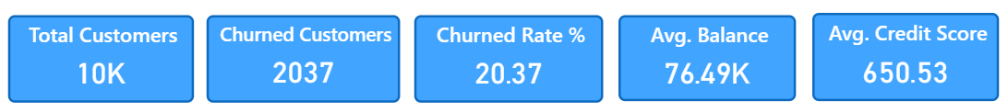

Key Findings & INSIGHTS
Customer Retention Requires Immediate Attention:
Out of 10,000 customers, 2,037 customers have churned, resulting in a 20.37% churn rate, which means nearly one in every five customers is being lost.
Customer Base Remains Strong:
Despite churn, the organization has successfully retained 7,963 customers (79.63%), providing a strong foundation for targeted retention and loyalty initiatives.
High-Value Portfolio at Stake:
The customer base maintains an average balance of $76.49K, indicating that even a small reduction in churn can protect a significant amount of customer deposits and revenue potential.

Slide 12

Churn Creates Significant Financial Exposure:
With 2,037 customers exiting from a portfolio averaging $76.49K per customer, customer attrition represents a substantial loss of financial value and future business opportunities.
Customer Credit Profile Is Relatively Stable:
An average credit score of 650.53 suggests that the overall customer base has moderate creditworthiness, indicating that retention challenges are likely driven more by customer engagement and experience than by credit risk alone.
Retention Improvement Can Deliver Significant Impact:
Reducing the current 20.37% churn rate by just 5 percentage points could help retain approximately 500 additional customers, protecting substantial customer value and strengthening long-term profitability.

Slide 13
Dashboard - 1
Customers Demographics

Slide 14
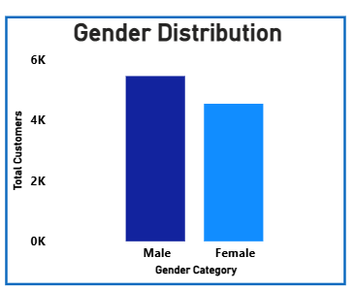
Gender Distribution
Balanced Customer Portfolio – Male customers account for approximately 5.4K (54%) of the customer base, while females contribute around 4.6K (46%), indicating a well-balanced portfolio.
Male Customer Majority – Male customers exceed female customers by approximately 908 customers, making them the largest demographic segment in the dataset.
Strong Demographic Coverage – Both genders contribute nearly equally to the customer base, ensuring broad market representation and reducing dependency on a single demographic group.
Reliable Customer Base – The balanced gender mix strengthens the accuracy of customer behavior, churn, and segmentation analysis across the portfolio.
Low Concentration Risk – No gender accounts for more than 55% of total customers, creating a stable and diversified customer structure.

Slide 15
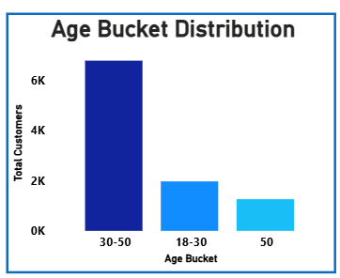
Age Bucket Distribution
Middle-Aged Customer Dominance – Customers aged 30–50 years account for approximately 6.8K customers (68%), making them the bank's primary customer segment.
Young Customer Growth Potential – The 18–30 age group contributes nearly 2K customers (20%), providing a strong pipeline for future customer value growth.
Limited Senior Representation – Customers aged 50+ represent approximately 1.2K customers (12%), making them the smallest demographic category.
Portfolio Concentration Risk – Nearly 7 out of every 10 customers belong to the 30–50 age segment, creating significant dependence on this customer group.
Revenue Generation Focus – The dominance of financially active middle-aged customers indicates strong opportunities for retention and cross-selling initiatives.

Slide 16
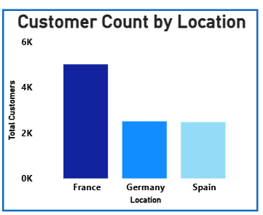
Customer count by
location
France Market Leadership – France contributes approximately 5,014 customers (50.1%), making it the largest geographic market within the portfolio.
Balanced Geographic Presence – Germany and Spain each contribute nearly 2,500 customers (25%), ensuring diversified market coverage.
Strategic Importance of France – One out of every two customers belongs to France, highlighting its critical contribution to overall business performance.
Geographic Diversification Advantage – Nearly 50% of customers are distributed outside France, reducing dependence on a single market.
Regional Expansion Opportunity – Germany and Spain collectively represent almost 5,000 customers, offering substantial potential for future growth initiatives.

Slide 17
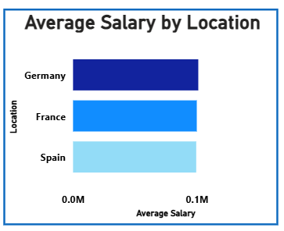
average Salary by
location
Income Consistency Across Markets – Average customer salary remains close to $100,000 across France, Germany, and Spain, indicating a financially stable customer base.
Germany Salary Leadership – Germany records the highest average salary among all regions, although the difference remains relatively small.
Stable Purchasing Power – Similar salary levels across all three countries indicate comparable customer spending and investment capacity.
Minimal Regional Variation – Salary differences between regions remain marginal, suggesting a consistent customer income profile.
Salary Not a Key Differentiator – Customer behavior and performance differences are likely influenced more by engagement and retention factors than salary levels.

Slide 18
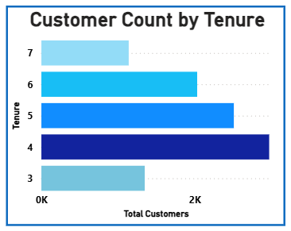
Customer count by
tenure
Tenure Year 4 Concentration – Approximately 3,000 customers have a tenure of 4 years, making it the largest tenure segment.
Mature Customer Portfolio – Customers with 4–6 years of tenure account for nearly 80% of the total customer base.
Lower Representation at Extremes – Customer counts are comparatively lower at tenure years 3 and 7, creating a bell-shaped distribution.
Strong Relationship Stability – The concentration in mid-tenure categories indicates successful long-term customer retention.
Lifecycle Management Opportunity – The large population in the 4–5 year range presents a key opportunity for loyalty and engagement programs.

Slide 19
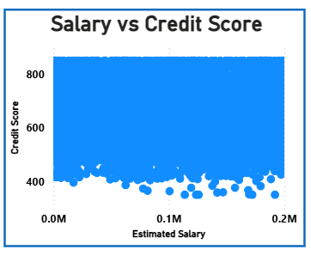
Salary vs credit score
No Meaningful Correlation – Credit scores vary significantly across all salary levels, indicating no visible relationship between income and creditworthiness.
Broad Credit Score Distribution – Customer credit scores range from approximately 350 to 850, regardless of salary level.
Income Independence – Customers with higher salaries do not consistently demonstrate stronger credit scores than lower-income customers.
Weak Predictive Value – The correlation between salary and credit score is nearly zero (r ≈ -0.001), making salary a poor predictor of credit behavior.
Analytical Implication – Credit risk assessment should rely on behavioral and financial indicators rather than estimated salary alone.

Slide 20
Dashboard - 2
Product Engagement

Slide 21
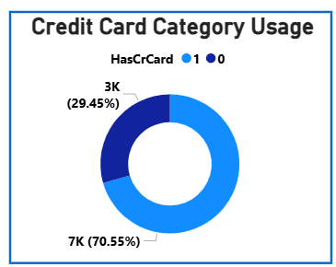
Credit card category
usage
Strong Credit Card Penetration – Approximately 7,055 customers (70.55%) own a credit card, while only 2,945 customers (29.45%) do not, indicating high adoption of card-based banking products across the customer base.
Customer Relationship Depth – The high credit card ownership rate suggests successful product penetration; however, ownership alone is insufficient to ensure stronger customer loyalty or retention
Revenue Contribution Potential – With over 70% of customers holding credit cards, the bank has a large base for generating fee income, transaction revenue, and cross-selling opportunities.
Retention Effectiveness Concern – Despite strong adoption, churn analysis shows credit card ownership has minimal impact on reducing customer attrition, highlighting the need for broader engagement strategies.

Slide 22
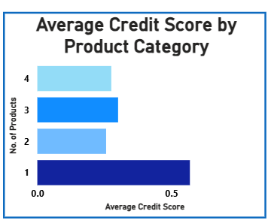
Average credit score by product category
Creditworthiness Advantage – Customers holding 1 product exhibit the highest average credit score, indicating a relatively stronger credit profile within this segment.
Moderate Product Holders – Customers with 2–3 products maintain stable credit scores, suggesting balanced financial behavior and responsible product utilization.
Multi-Product Risk Signal – The 4-product segment records comparatively lower average credit scores, indicating that deeper product relationships do not necessarily translate into stronger credit quality.
Weak Product-Credit Correlation – Variations across product categories are relatively small, confirming that product count alone is not a strong predictor of customer creditworthiness.

Slide 23
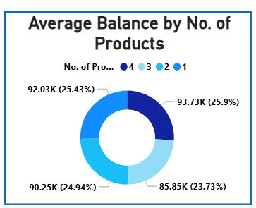
Average balance by
NO. OF PRODUCTS
Highest Value Customers – Customers with 4 products maintain the highest average balance of $93.73K, representing the most financially valuable customer segment.
Balance Growth Trend – Average balances generally increase with product ownership, rising from $85.85K (1 product) to $93.73K (4 products), indicating deeper banking relationships.
Premium Customer Concentration – Multi-product customers collectively hold balances above $90K, reflecting greater wealth concentration and revenue potential.
Cross-Selling Opportunity – Encouraging customers to adopt additional products may strengthen relationship depth and increase overall account balances over time.

Slide 24
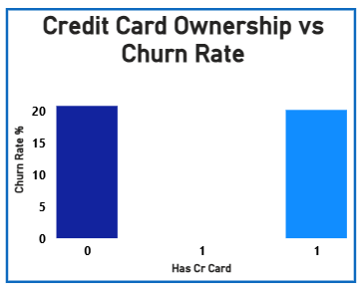
Credit card ownership
vs churn rate
Minimal Retention Impact – Credit card holders churn at approximately 20.18%, while non-card holders churn at 20.81%, a difference of less than 1 percentage point.
Ineffective Churn Lever – The negligible variation confirms that credit card ownership alone is not a meaningful driver of customer retention.
Strategic Misalignment – Existing card-based loyalty programs appear insufficient to influence long-term customer behavior or reduce attrition risk.
Alternative Focus Required – Customer activity levels and product engagement demonstrate significantly stronger relationships with churn than credit card ownership.

Slide 25
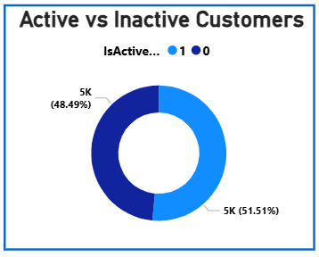
Active vs inactive
customers
Customer Engagement Balance – The customer base is almost evenly split between 5,151 active customers (51.51%) and 4,849 inactive customers (48.49%), indicating significant scope for engagement improvement.
Retention Risk Exposure – Nearly 1 out of every 2 customers is inactive, creating a large pool of customers vulnerable to future churn and reduced product utilization.
Behavioral Risk Indicator – Inactive customers record a significantly higher churn rate of 26.9%, compared to 14.3% for active customers, making activity level a key retention driver.
Revenue Protection Opportunity – The 3,547 inactive retained customers represent a substantial at-risk segment that can be targeted through reactivation and personalized engagement campaigns.

Slide 26
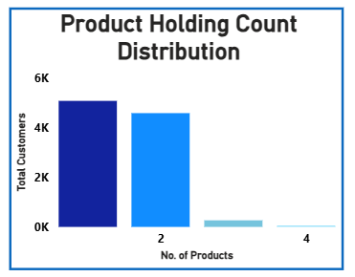
Product holding count
distribution
Single-Product Dominance – The portfolio is heavily concentrated in 5,084 single-product customers, representing the largest customer segment and the biggest retention opportunity.
Limited Product Penetration – Around 4,590 customers hold 2 products, while only a small proportion maintain 3 or 4 products, indicating shallow relationship depth across the customer base.
Cross-Sell Potential – More than 50% of customers currently use only one banking product, providing a substantial opportunity for targeted cross-selling initiatives.
Retention Vulnerability – Single-product customers experience the highest churn rate of 27.7%, compared to just 7.6% among customers holding 2 products.

Slide 27
Dashboard – 3
Churn analysis

Slide 28
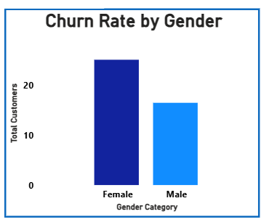
Churn rate by customers
Gender-Based Attrition Gap – Female customers record a 25.1% churn rate, significantly higher than males at 16.5%, indicating a 52% higher likelihood of exit.
Retention Performance Concern – Despite representing only 45.4% of the customer base, female customers contribute 55.9% of total churn, creating a disproportionate retention challenge.
Customer Experience Signal – The persistent churn gap suggests potential differences in product satisfaction, engagement levels, or service expectations across genders.
Revenue Risk Concentration – Higher female churn rates amplify financial exposure, particularly among high-value customer segments and older demographics.
Strategic Priority Segment – Female customers should be prioritized within retention initiatives, especially when combined with high-risk factors such as age and geography.

Slide 29
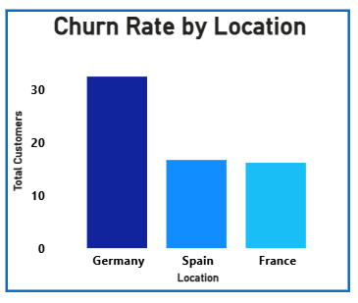
Churn rate by location
Geographic Risk Concentration – Germany records the highest churn rate at 32.4%, nearly double that of France (16.2%) and Spain (16.7%).
Performance Benchmark Gap – The 16.2% point difference between Germany and France highlights substantial regional variation in customer retention effectiveness.
Financial Exposure Hotspot – Germany contributes 814 churned customers despite accounting for only 25.1% of total customers, creating disproportionate business risk.
Retention Stability Leader – France demonstrates the strongest retention performance, maintaining the lowest churn rate and the most stable customer portfolio.
Market-Specific Challenge – The results indicate that churn drivers are not uniform across regions and require targeted geographic retention strategies.

Slide 30
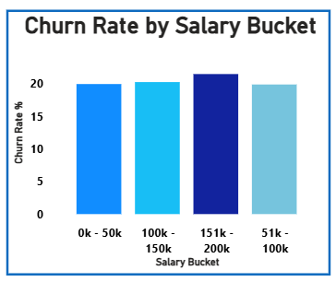
Churn rate by salary bucket
Minimal Salary Impact – Churn rates remain tightly clustered between 19% and 21% across all salary groups, indicating limited influence of income on attrition.
Highest-Risk Income Segment – Customers earning $151K–$200K exhibit the highest churn rate at approximately 21%, though the difference is marginal.
Consistent Behavioral Pattern – Lower and higher salary customers demonstrate similar churn tendencies, suggesting that financial income alone does not drive retention.
Weak Predictive Power – The narrow variation across salary buckets confirms salary is not a reliable standalone predictor of customer exits.
Strategic Insight – Retention strategies should focus on engagement, activity, and product ownership rather than salary-based segmentation.

Slide 31
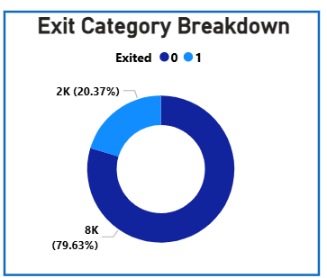
Exit category breakdown
Overall Churn Position – Out of 10,000 customers, 2,037 customers exited, resulting in an overall churn rate of 20.37%.
Strong Retention Base – The bank successfully retained 7,963 customers (79.63%), demonstrating a solid but improvable retention foundation.
One-in-Five Attrition Reality – Approximately 1 in every 5 customers leaves the bank, highlighting a significant long-term retention challenge.
Revenue Protection Opportunity – Even a modest reduction in churn could preserve hundreds of customer relationships and substantial deposit value.
Business Performance Indicator – The churn rate serves as a critical KPI reflecting customer satisfaction, engagement, and competitive positioning.

Slide 32
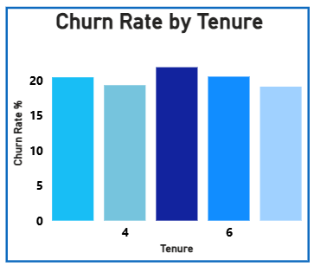
Churn rate by tenure
Peak Attrition Period – Customer churn reaches its highest level of approximately 21.9% at Year 5, marking a critical retention breakpoint.
Limited Loyalty Effect – Churn rates remain relatively stable between 19% and 22% across tenure groups, indicating tenure alone does not ensure loyalty.
Mid-Lifecycle Vulnerability – Customers around Years 5–6 appear more susceptible to leaving, suggesting declining engagement over time.
Retention Intervention Opportunity – Targeted loyalty programs and relationship reviews around the fifth year could help reduce customer exits.
Strategic Insight – Long tenure does not automatically translate into stronger retention, reinforcing the need for proactive engagement strategies.

Slide 33
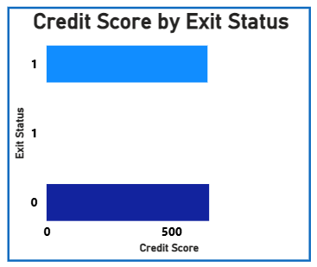
Credit score by exit status
Credit Score Differential – Retained customers maintain a slightly higher average credit score (~657) compared to churned customers (~650).
Moderate Risk Indicator – The small 6–7 point gap suggests credit score influences churn but is not a dominant standalone factor.
Behavioral Factors Dominate – Variables such as activity status and product ownership demonstrate stronger relationships with churn than credit score alone.
Portfolio Stability Signal – Both retained and churned customers maintain scores within a healthy credit range, indicating overall portfolio quality.
Supporting Predictive Variable – Credit score should be used alongside customer activity and engagement metrics to improve churn risk assessment accuracy.

Slide 34
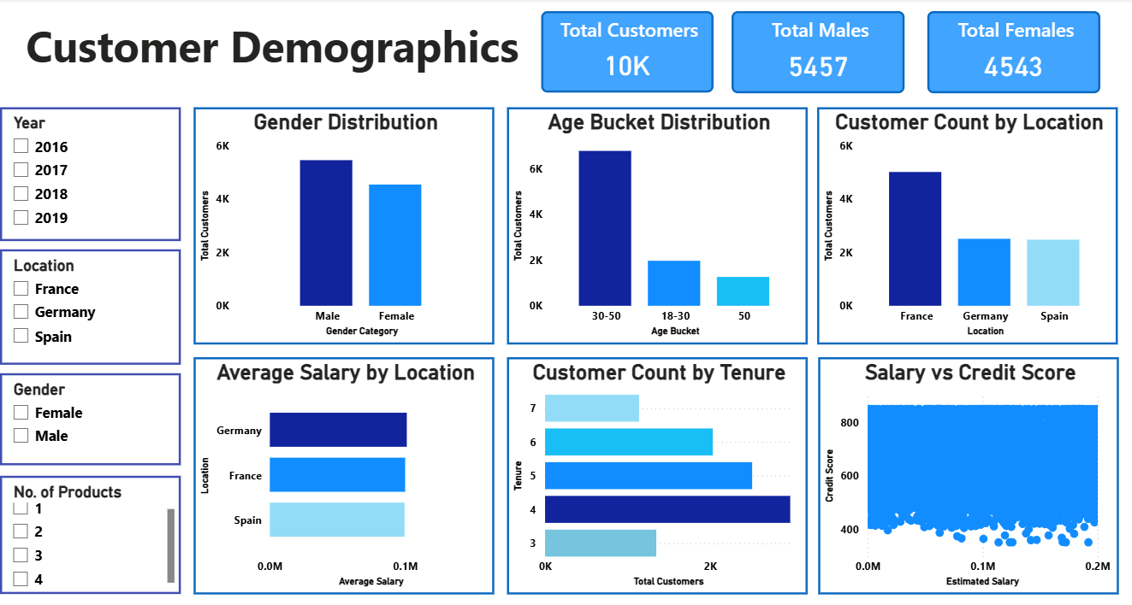
DASHBOARD & VISUALIZATION

Slide 35
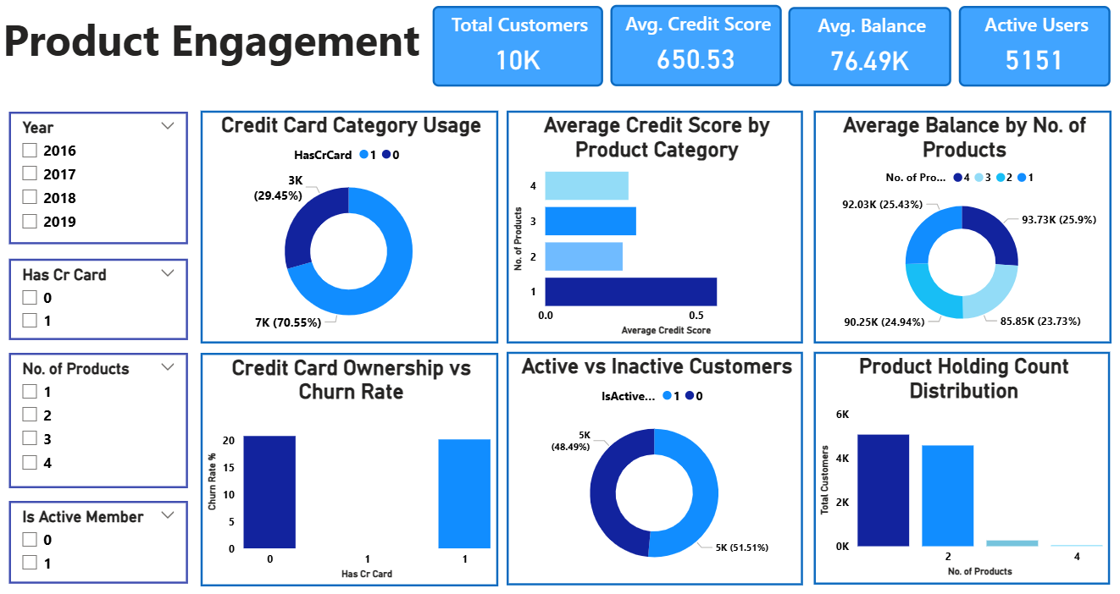

Slide 36
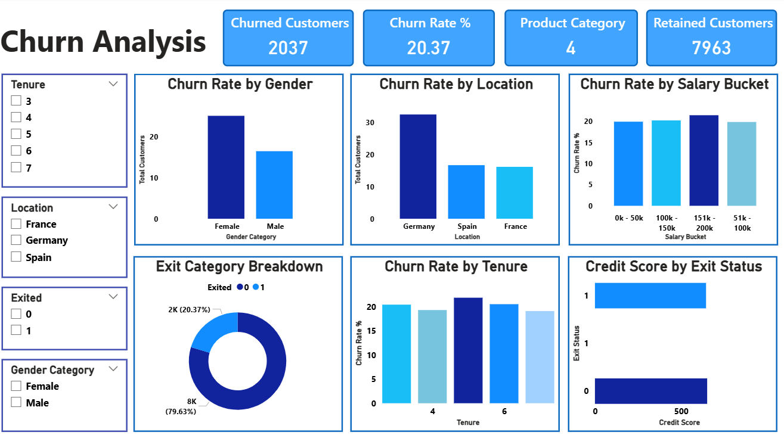

Slide 37
ANALYTICAL APPROACH & METHODOLOGY
Business Understanding:
Defined customer churn as the primary business challenge and established retention improvement as the key objective, focusing on reducing the current 20.37% churn rate.
Data Review & Validation:
Reviewed and validated 10,000 customer records across 7 relational tables to ensure data accuracy, consistency, and reliability for analysis.
Customer & Business Performance Analysis:
Assessed customer demographics, geography, financial attributes, product ownership, and activity levels to identify key patterns influencing customer retention.

Slide 38
KPI Development & Dashboard Reporting:
Developed business KPIs and calculated metrics including Total Customers, Churned Customers, Churn Rate, Average Balance, and Average Credit Score to support interactive dashboard reporting and performance monitoring.
Customer Risk Assessment & Strategic Planning:
Identified high-risk customer segments and translated analytical findings into actionable retention strategies to improve customer engagement, loyalty, and long-term business value.
Methodology Crux
A business-focused analytical framework combining customer analysis, KPI development, dashboard reporting, and risk assessment was used to transform 10,000 customer records into actionable retention insights and strategic recommendations.

Slide 39
STRATEGIC RECOMMENDATIONS
Predictive Risk Management:
Deploy the churn risk framework across all customers and prioritize 2,521 High-Risk customers for proactive engagement, retention outreach, and continuous monitoring.
Geographic Retention Intervention:
Launch a dedicated retention program for Germany (32.4% churn rate), with special focus on high-value 50+ customers and critical-risk customer segments.
Product Penetration Enhancement:
Execute targeted cross-sell campaigns for 5,084 single-product customers, moving customers toward the optimal 2-product relationship where churn drops to 7.6%.

Slide 40
Customer Engagement Optimization:
Implement structured reactivation initiatives for 3,547 inactive customers, leveraging personalized communication, digital engagement, and relationship management programs.
High-Value Customer Retention Strategy:
Develop premium retention programs for customers with higher balances, particularly those averaging $91K+, to minimize financial exposure and preserve long-term customer value.
Customer Lifecycle & Loyalty Management:
Establish milestone-based engagement and loyalty programs focused on 50+ customers, tenure-based interventions, and relationship rewards to strengthen long-term retention and reduce future churn.

Slide 41

Conclusion
The analysis reveals that customer churn is a significant business challenge, with 20.37% of customers exiting and the majority of attrition concentrated in specific segments such as Germany (32.4% churn), customers aged 50+ (44.6%), single-product holders (27.7%), and inactive customers (26.9%). These segments represent the greatest retention risk and financial exposure.
The findings demonstrate that customer activity, product engagement, and targeted risk management are the most effective levers for reducing churn. By focusing on high-risk customers, increasing product adoption, and improving customer engagement, the organization can realistically achieve a 3–5 percentage point reduction in churn, protecting customer value and driving sustainable long-term growth.
A 3–5 percentage point reduction in churn could retain approximately 300–500 additional customers annually.

Slide 42
Thank You
REGARDS,
RONAK BHATIA

