Slide 1
Tech Team Meeting
2025 – Nov - 06, Thursday, 9:15 AM
Dong Chenxi, SRA, MIT Department. cdong@eduhk.hk
ZOOM Meeting: https://eduhk.zoom.us/j/93598973860?pwd=dlVHSlpVN1ArY0FoL2xJWDNRU25WQT09

Slide 2
CRAC Project – Senior Students Data
No. | Faculty | Prog | Program Name
1 | FEHD | A2B102 | Bachelor of Arts (Hons) in Early Childhood and Family Studies
2 | FEHD | A2B104 | Bachelor of Science (Hons) in Executive Management
3 | FLASS | A2B103 | Bachelor of Social Sciences (Hons) in Social Entrepreneurship and Development Studies
4 | FLASS | A2B101 | Bachelor of Social Sciences (Hons) in Sociology and Community Studies
5 | FEHD | A4B075 | Bachelor of Social Sciences (Hons) in Psychology
6 | FEHD | A4B097 | Bachelor of Arts (Hons) in Heritage Education and Arts Management
7 | FEHD | A4B092 | Bachelor of Science (Hons) in Integrated Environmental Management
8 | FEHD | A4B086 | Bachelor of Arts (Hons) in Special Education
9 | FHM | A4B068 | Bachelor of Arts (Hons) in Creative Arts and Culture
10 | FHM | A4B093 | Bachelor of Arts (Hons) in English Studies and Digital Communication
11 | FHM | A4B087 | Bachelor of Arts (Hons) in Teaching Chinese as a Second Language
12 | FHM | A4B067 | Bachelor of Arts (Hons) in Language Studies (Chinese/English Major)
13 | FLASS | A4B095 | Bachelor of Science (Hons) in Artificial Intelligence and Educational Technology
14 | FLASS | A4B096 | Bachelor of Science (Hons) in Sports Science and Coaching
14 consistent programs, Cohorts 2022 & 2023
  4(2-Yr program) + 10(4-Yr Program)
  FEHD = 6; FLASS=4; FHM=4

Slide 3
CRAC: Cleaning Data for: Registry Senior Intake Students
5. Merged & Processed Senior Students Data
Registry Data (14 Programs)
6. Analysis
2. Clean & Processing Registry Senior Data
1. Download program data from the eAPR API
2. Rebuild Code Modules:
9 files -> 2 intermediate files
(especially for the 2-Year Program, code logic changed)
3. Cleaned Registry Data:
College Score
Info before enter University
3. Processed Data
-University Record
4. Link Dataframe via SID

Slide 4
1. Program–Specific Analysis OR 2. Program-Agnostic Analysis
 | Cohort | 2022 | 2023
1 | A2B101 | 33 | 34
2 | A2B102 | 58 | 55
3 | A2B103 | 38 | 41
4 | A2B104 | 34 | 33
5 | A4B067 | 14 | 18
6 | A4B068 | 40 | 38
7 | A4B075 | 35 | 33
8 | A4B086 | 26 | 22
9 | A4B087 | 23 | 24
10 | A4B092 | 31 | 34
11 | A4B093 | 33 | 24
12 | A4B095 | 25 | 31
13 | A4B096 | 28 | 21
14 | A4B097 | 33 | 34
 | Total | 451 | 442
Program Specific Analysis
Individual programs do not have enough data size (N<30) for stable analysis to convince people.
Lots of programs donot have any at-risks
2. Program-Agnostic Analysis
Pros: If we merge the program data, the size will be enough. E.g., Cohort 2022, N = 451, Cohort 2023, N= 442.
Miss program-specific pattern
Possible Way
Program Specific Analysis – Descriptive Analysis
  Visualizations, Exploratory Data Analysis
  Correlated course for specific program
Program-Agnostic Analysis – Predictive Analysis
  Predict 2nd Yr GPA ~ X
  Map 1st Yr GPA ~ College GPA

Slide 5
Possible Analysis for Senior Students Data
Predictive Task
  Task 1: Prediction for Senior Students Gd GPA
    Y = 2ND Yr GPA
    X = 1st Yr GPA + Pre-Uni Record (College GPA)
  Task 2: Admission Related Analysis
    Y = 1st Yr GPA
    X = Pre-Uni Record (College GPA)
Exploratory Data Analysis & Vis
  College ~ EduHK Performance (Grad GPA)
  Program Specific Analysis (Correlated/Impactful Courses for each Program)
  …

Slide 6
Descriptive & Exploratory Data Analysis

Slide 7
Descriptive & Exploratory Data Analysis – Program Specific

Slide 8
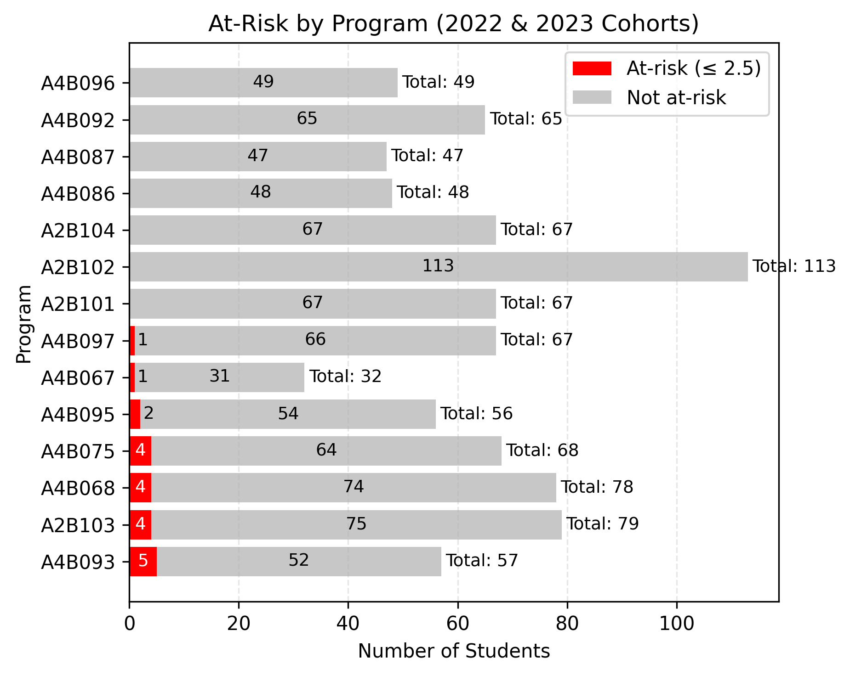
Cohorts 2022 and 2023
N = 893, Total At-Risk = 21 (2.35%)
Programs with more At-Risk:
A4B093-BA(Honours) in English Studies and Digital Communication
A4B075-BSocSc(Honours) in Psychology
A4B068-BA(Honours) in Creative Arts and Culture
A2B103-BSocSc (Honours) in Social Entrepreneurship and Development Studies

Slide 9
program | n | College GPA (mean) | Uni GPA (mean) | p-value | Significant (p<0.05) | Comment | Uni GPA > College GPA (%) | Uni GPA < College GPA (%)
A2B102 | 112 | 3.15 | 3.22 | 7.30E-03 | Yes | Uni GPA > College GPA | 58.04% | 40.18%
A2B104 | 67 | 3.11 | 3.24 | 1.00E-04 | Yes | Uni GPA > College GPA | 64.18% | 35.82%
A4B095 | 56 | 2.96 | 3.16 | 1.30E-04 | Yes | Uni GPA > College GPA | 75.00% | 25.00%
A4B097 | 66 | 3.04 | 3.24 | 6.30E-09 | Yes | Uni GPA > College GPA | 78.79% | 21.21%
A4B067 | 32 | 3.28 | 3.03 | 8.40E-05 | Yes | Uni GPA < College GPA | 15.62% | 84.38%
A4B075 | 68 | 3.18 | 2.93 | 1.00E-06 | Yes | Uni GPA < College GPA | 27.94% | 72.06%
A4B086 | 48 | 3.44 | 3.17 | 1.10E-12 | Yes | Uni GPA < College GPA | 8.33% | 91.67%
A4B096 | 49 | 3.31 | 3.12 | 2.40E-07 | Yes | Uni GPA < College GPA | 18.37% | 81.63%
A2B101 | 66 | 3.15 | 3.14 | 7.60E-01 | No | none | 42.42% | 57.58%
A2B103 | 79 | 3.03 | 3.07 | 2.50E-01 | No | none | 60.76% | 37.97%
A4B068 | 78 | 3.12 | 3.08 | 2.30E-01 | No | none | 50.00% | 50.00%
A4B087 | 43 | 3.18 | 3.13 | 2.20E-01 | No | none | 39.53% | 60.47%
A4B092 | 65 | 3.09 | 3.09 | 8.00E-01 | No | none | 55.38% | 43.08%
A4B093 | 57 | 2.97 | 2.90 | 8.90E-02 | No | none | 38.60% | 61.40%
Uni GPA = Senior Students EduHK Gd GPA
College GPA = Senior Students’ Normalized College GPA
University GPA > College GPA
A4B097-BA in Heritage Education and Arts Management
A2B104–BSc in Executive Management
A4B095–BSc in AI and EdTech
A2B102-BA in Early Childhood & Family Studies
University GPA < College GPA
A4B086-BA in Special Education
A4B096-BSc in Sports Science and Coaching
A4B075-BSocSc in Psychology
A4B067-BA in Language Studies

Slide 10
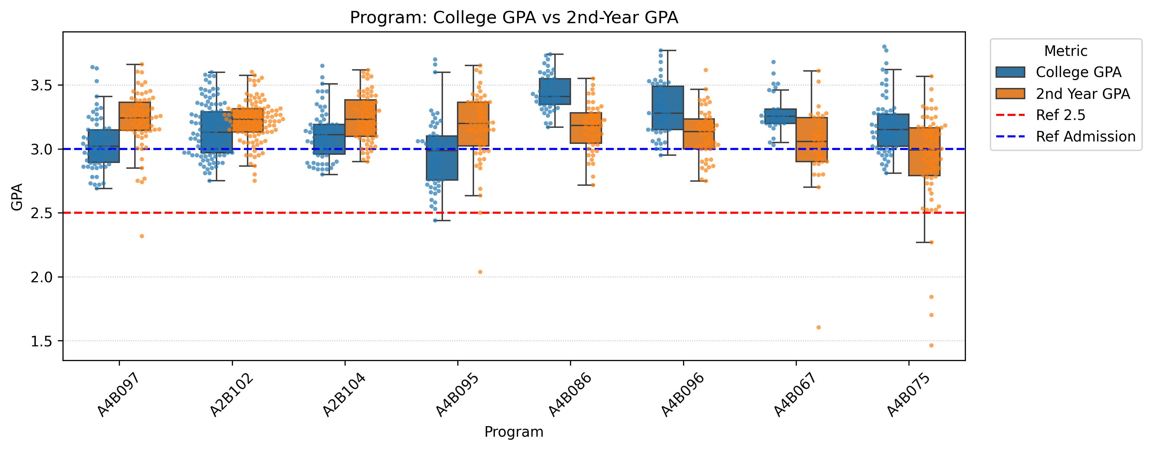
University GPA > College GPA
A4B097-BA in Heritage Education and Arts Management
A2B104–BSc in Executive Management
A4B095–BSc in AI and EdTech
A2B102-BA in Early Childhood & Family Studies
University GPA < College GPA
A4B086-BA in Special Education
A4B096-BSc in Sports Science and Coaching
A4B075-BSocSc in Psychology
A4B067-BA in Language Studies

Slide 11
Descriptive & Exploratory Data Analysis – College

Slide 12
College | N | Uni GPA < College GPA (%) | t-stat | p-value | Significant (p<0.05) | Comment | College GPA (mean) | Uni GPA (mean)
Education University of Hong Kong / Hong Kong Institute of Education | 96 | 6.25% | 17.61 | 1.10E-31 | Yes | Uni GPA > College GPA | 2.96 | 3.27
Hong Kong Polytechnic University, Hong Kong Community College | 155 | 20.65% | 8.18 | 9.60E-14 | Yes | Uni GPA > College GPA | 2.93 | 3.1
UOW College Hong Kong | 46 | 32.61% | 2.2 | 3.30E-02 | Yes | Uni GPA > College GPA | 2.96 | 3.03
Chinese University of Hong Kong, School of Continuing and Professional Studies | 52 | 69.23% | -3.33 | 1.60E-03 | Yes | Uni GPA < College GPA | 3.26 | 3.17
Hong Kong Baptist University, The College of International Education | 92 | 72.83% | -4.57 | 1.50E-05 | Yes | Uni GPA < College GPA | 3.2 | 3.04
Hong Kong Metropolitan University, Li Ka Shing School of Professional and Continuing Education/The Hong Kong Learning Community College | 37 | 94.59% | -8.33 | 6.50E-10 | Yes | Uni GPA < College GPA | 3.37 | 3.03
University of Hong Kong, SPACE Community College | 179 | 59.22% | -3.33 | 1.00E-03 | Yes | Uni GPA < College GPA | 3.15 | 3.08
University of Hong Kong, SPACE Po Leung Kuk Stanley Ho Community College | 52 | 78.85% | -6.04 | 1.80E-07 | Yes | Uni GPA < College GPA | 3.29 | 3.02
Vocational Training Council, The Hong Kong Institute of Vocational Education (IVE) | 105 | 71.43% | -5.66 | 1.40E-07 | Yes | Uni GPA < College GPA | 3.31 | 3.18
Hong Kong Shue Yan University (formerly known as Hong Kong Shue Yan College) | 9 | 55.56% | 0.1 | 9.30E-01 | No | none | 3.2 | 3.21
Others | 51 | 58.82% | -0.9 | 3.70E-01 | No | none | 3.19 | 3.14
Vocational Training Council, Hong Kong Design Institute | 12 | 41.67% | 1.48 | 1.70E-01 | No | none | 3.11 | 3.2

Slide 13
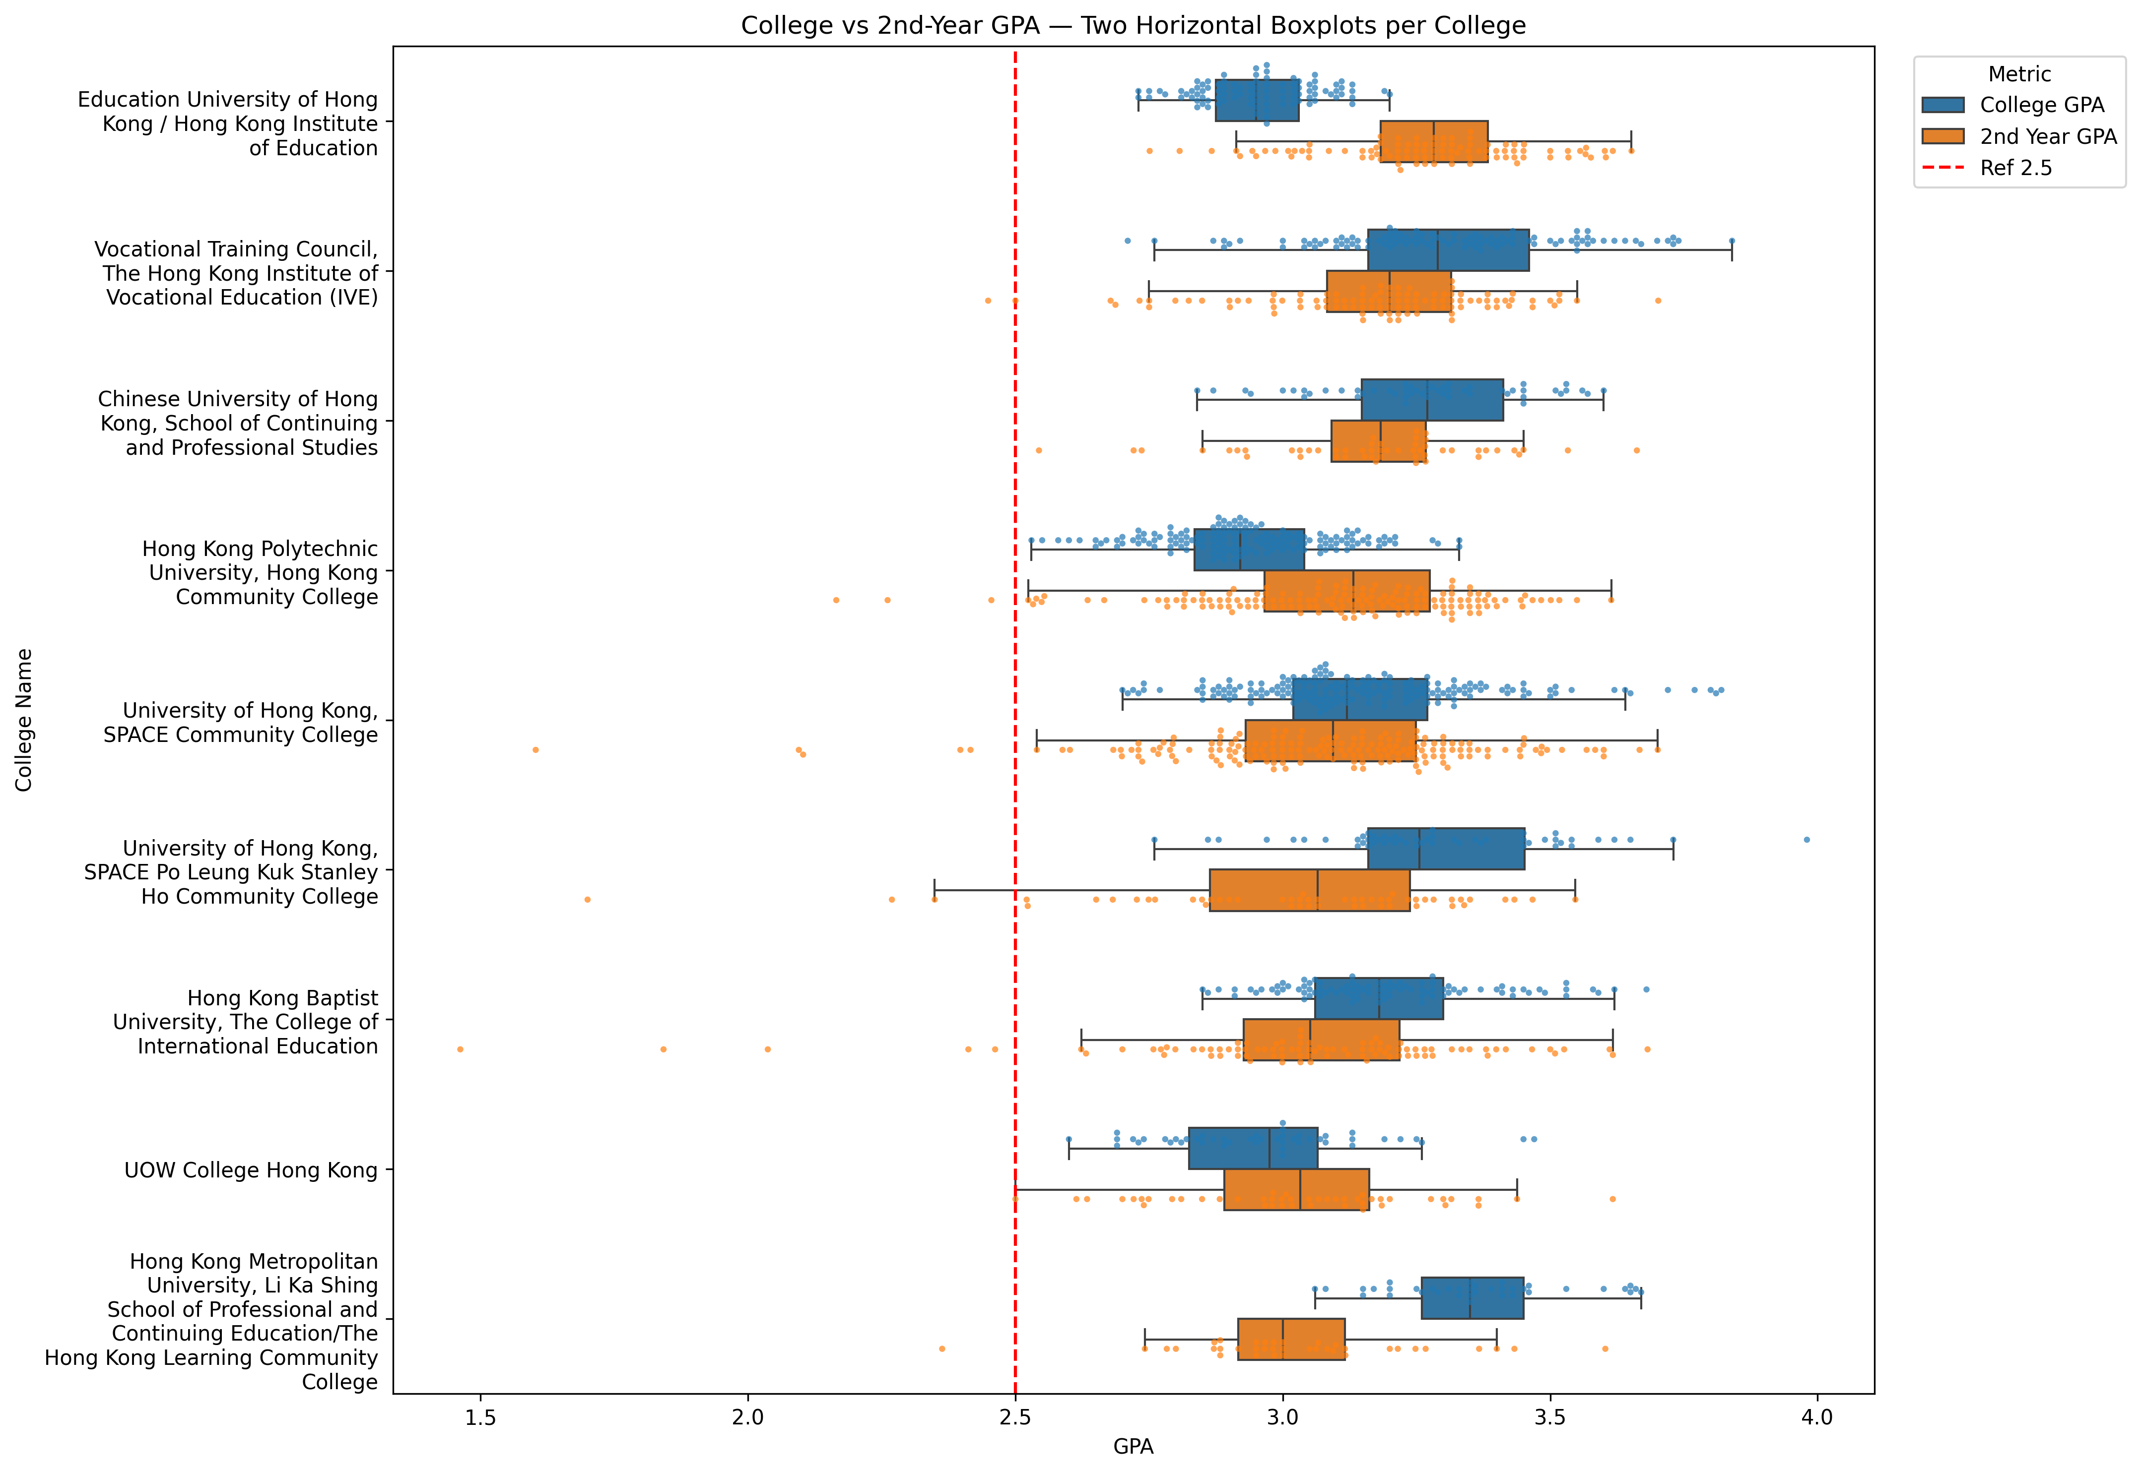

Slide 14
A quick verification of the predictive task 1 (Predict Yr 2 GPA)

Slide 15
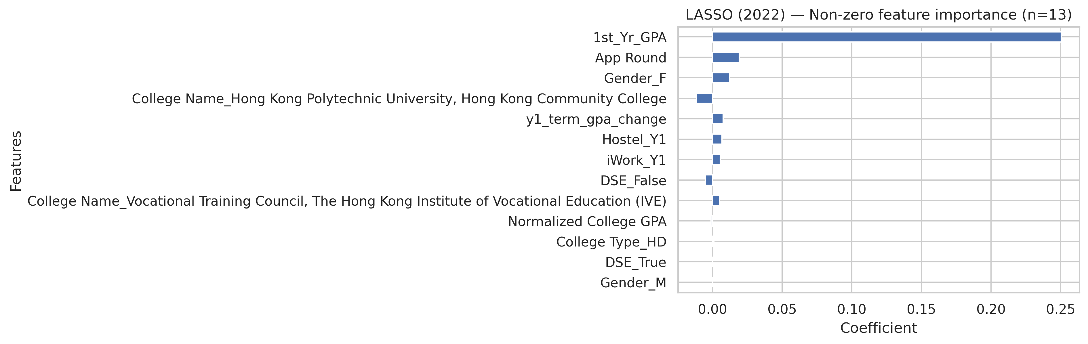
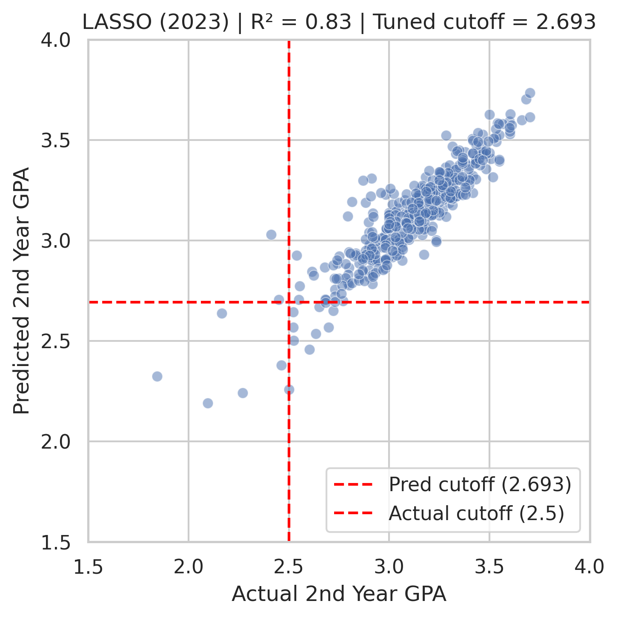
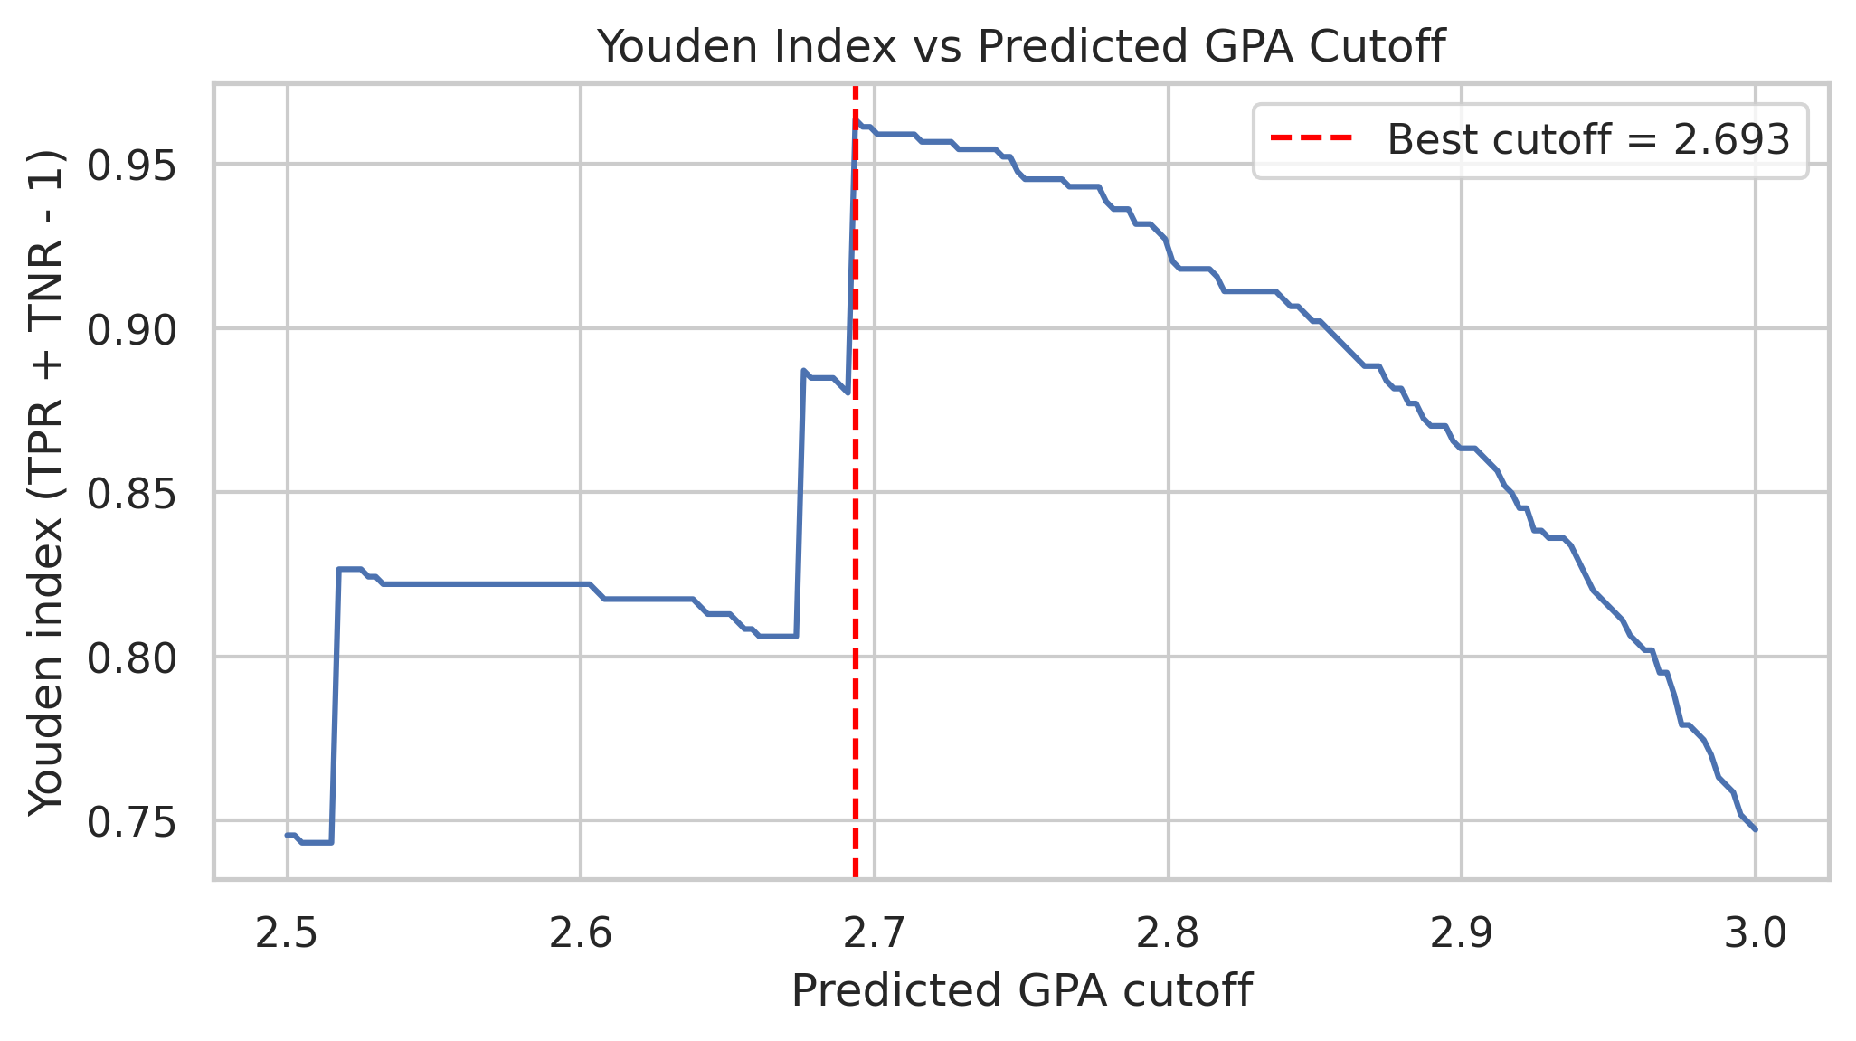
Train Cohort 2022, N=451;
Test Cohort 2023, N=442
14 Programs,
7 At-Risk in Cohort 2023
-2 Miss Detect
-10 False Alarms
2 Miss Detect out of 7 At-Risk

Slide 16
END

Slide 17



【自制软件】打工人桌面健康小助手
自动喝水提醒＋久坐弹窗

Slide 18
