Slide 1
Hunting High and Low: Visualising Shifting Correlations in Financial Markets

Slide 2
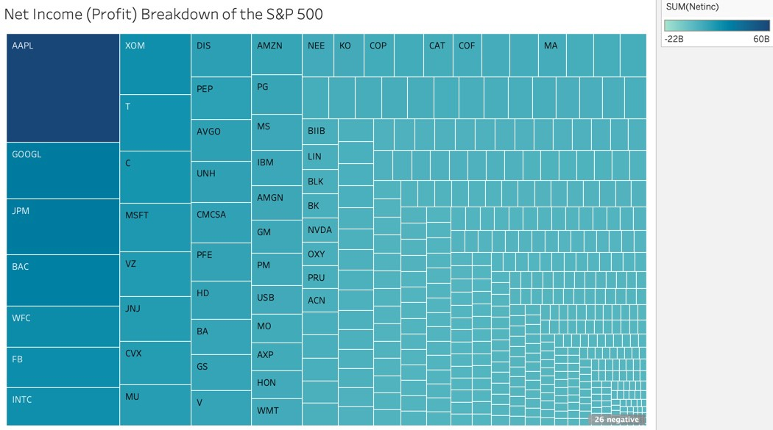
Visualizing Company Profits

Slide 3
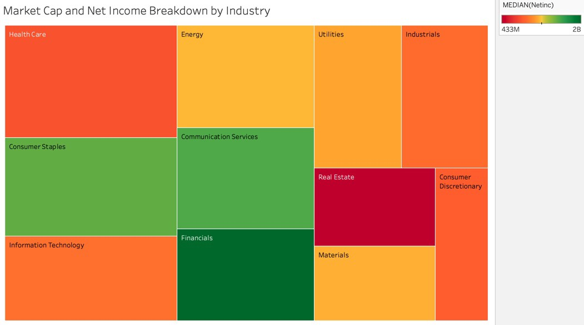

Slide 4
