Slide 1
Tableau Stock Viz

Slide 2
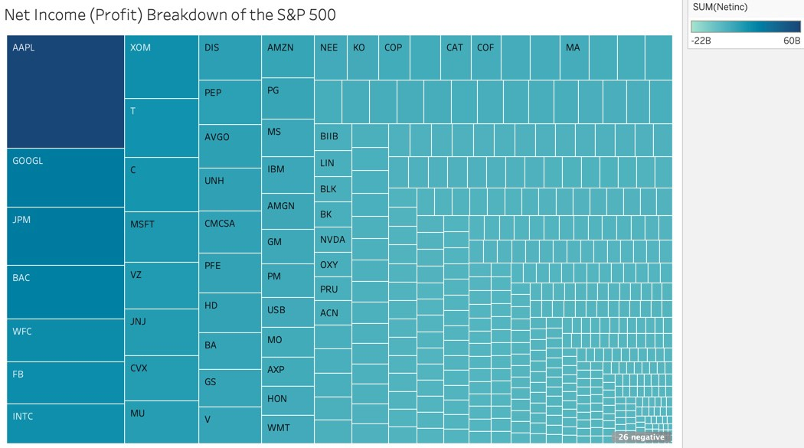
Visualizing Company Profits

Slide 3
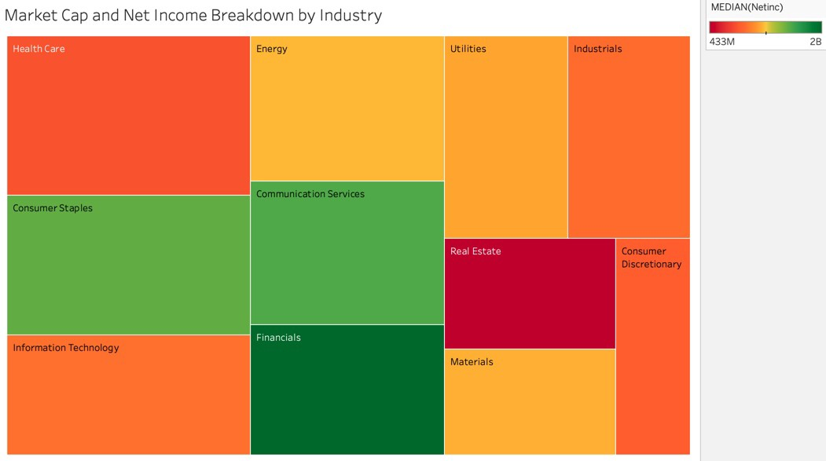

Slide 4
