Slide 1
3D Dashboard
Invest like a Hedge Fund

Slide 2
Intro Image
Image: BRU GGE

Slide 3
WHAT is the problem?
Problem: huge universe of investment opportunities – missing opportunities due to processing limitations (which companies to monitor?)
A full time analyst can cover a maximum portfolio of 15 stocks (quarterly/detail)
An experienced amateur can manage a maximum portfolio of 5 stocks (quarterly/detail)
Trading is different, invest part of capital (10%) at regular intervals (daily) into selected assets
Breaking down company performance to common denominator possible, but complicated to build.
DataScience tools require specialized knowledge to impliment. Methods often experimental and have to be researched and combined with domain knowledge.
Insightful data is free, but often out of reach for average investor.
Replication wastes resources. Funds already have certain elements of this solution built inhouse. (Bridging gap between tech dept. and analysts)
3 month gap that an analyst must interpret to understand company performance.
Quintiles and filtering kill insightful relationships between features
Force own interpretation on data
Source: Statista 2018
Notes:
Numbers

Slide 4
WHY is this a good opportunity?
A natural extension of Bloomberg / Reuters and potential acquisition target ?
Visualizing information in an interactive manner (analysis) using colour to highlight (few – calculated/prioritized) targets of interests very intuitive.
Factor investment more popular, create multiple (common) features explaining company performance to a certain extent.
(cars – properties, HP/cost/availability interest of buyers)
d
Source: Statista 2018
Notes:
Numbers

Slide 5
HOW i will accomplish this
Excel on steroids so that tabular data can be visualised in 3D.
Groups of companies will easily stand out based on certain properties, easing further analysis. Clusters built using:
Factors. These are features that explain a stock’s performance
Alternative data. (Search Trends – nowcasting not forecasting)
d

Slide 6
VALUE proposition
Pre-processed and structured data in ready-built visualizations
Like a HF opening out and sharing process

Slide 7
Similar Projects
Irish clustering company was looking into similar project
Tableau
https://www.tableau.com/learn/tutorials/on-demand/getting-started?reg-delay=true
...

Slide 8
CREDENTIALS my
ddd

Slide 9
TEAM
positions
1)
…
2)
….
Notes:
Benefits

Slide 10
HELP how
….
Notes:
Their cost

Slide 11
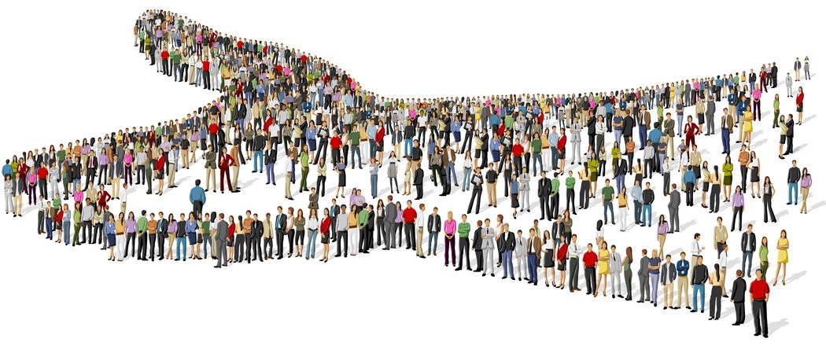
Contact Details
09alexpapa@gmail.com
LinkedIn
Deadline
Become something….
…
Image: Fundly

