Slide 1
Google Trends
Search Signal Insights

Slide 2
Relevant Work
Projects
Papers
PyTrends lib
Post using lin
AdSpend Regression Git ( Jupyter )
Augmented Dickey–Fuller test
Lagged data time series for training
HouseSales nowcasting Git ( R )
Spike-and-slab approach to using terms (Features) with high inclusion probabilities as predictors → Bayesian Regression
c
Choi, H. and Varian, H., 2012. Predicting the present with Google Trends. Economic Record, 88, pp.2-9.
von Graevenitz, G., Helmers, C., Millot, V. and Turnbull, O., 2016. Does online search predict sales? evidence from big data for car markets in Germany and the UK.

Slide 3
Key Questions
Finance
Observations
Which frequency are search terms better at predicting? Maybe monthly or quarterly
May not be interested in predicting future, instead more interesting in illuminating quarter’s earning ahead of report (Nowcasting).

Slide 4
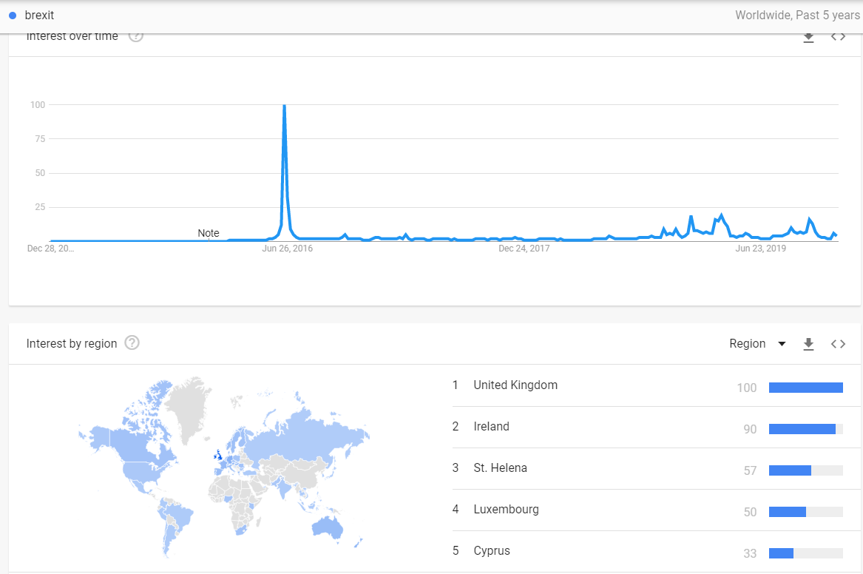
https://trends.google.com/trends/explore?date=today%205-y&q=brexit
Counties interested in Brexit

Slide 5
Li, S. and Shannon Callan, C.F.A., 2016. Construction of Google Search Indices by Applying Principal Component Analysis.
Term Selection (packages BMA, BSTS) ?
Primitive list
Harvard dictionary economic keywords
Find related searches in Google Trends and Google Correlate
Filtering via correlation, Bayesian variable selection, term loading in PCA analysis
Obtain Data and Process (packages gtrendsR, zoo, robustHD, seas) ?
Convert time frequency, remove outliners, winsorize, and seasonal adjustment
Apply Principal Component Analysis (function prcomp) Index Creation ?
Create index from top principal component(s)
Use of rolling window
Track category loadings within the index
Online Search Index gauges search behaviours related to specific economic activities. It is a composite indicator which measures the co-movement of multidimensional and dynamic search terms.

Slide 6
Data
Google AdWords Data
Other Sources
Adwords tool isnt for finding the search data , but it will show how advertisers are showing interest on a specific query . Thus showing populatity or competitiveness of a query .
Primitive list,
Harvard dictionary of economic keywords
Google correlate for related terms
Term filtering via correlation, Bayesian variable selection, PCA eigenvectors

Slide 7
Terms
Term selection
Term Breakdown
Terms selected from questionnaire
Maybe from earning’s calls
D
Although understanding the volume of relevant search terms can be relevant, deciphering the user’s intent may provide more insight into their likely actions
Hence using NLP to determine sentiment of query, or ranking search results according to relevance in a disceret fashion may be helpful.
Method 1. building features out of n-grams. Require thousands of search terms.
Curse of dimensionality, TF-IDF threshold score for features. Random Forest can be used to avoid overfitting.
Improvements: stemming and removing stop-words,

Slide 8
Data
Google Processing (Choi, H. and Varian, H., 2012. Predicting the present with Google Trends)
von Graevenitz, G., Helmers, C., Millot, V. and Turnbull, O., 2016. Does online search predict sales? evidence from big data for car markets in Germany and the UK.
provides a time series index of the volume of queries users enter into Google in a given geographic area
t0 = 0, volume normalised to 100
Uses a sampling method to create dataset
Classification algorithms for topic / terms are probabilistic and prone to errors (apple inc)
Google Correlate for term selection
BSTS is most reliable tool for feature selection
online searches that look identical in the available data result from different motivations that lead to different post-search behavior. This
weekly data more sensistive to real world flactuations
methods for panel data analysis must evolve

Slide 9
Alternatives
Yandex
Other sources
Raw search numbers
Just 1 year history provided for all terms
https://wordstat.yandex.com/#!/history?words=oil
Lots of captchta
Several

Slide 10
Dd
Dd

Slide 11
Dd
Dd

Slide 12
WHY a good opportunity?
Stats
Source: Statista 2018
Notes:
Numbers

Slide 13
Contact Details
09alexpapa@gmail.com
LinkedIn

