Slide 1
Google Trends
Search Signal Insights

Slide 2
Relevant Work
Projects
Papers
PyTrends lib
Post using lin
AdSpend Regression Git
HouseSales nowcasting Git
Spike-and-slab approach to using terms (Features) with high inclusion probabilities as predictors → Bayesian Regression
c
Choi, H. and Varian, H., 2012. Predicting the present with Google Trends. Economic Record, 88, pp.2-9.
von Graevenitz, G., Helmers, C., Millot, V. and Turnbull, O., 2016. Does online search predict sales? evidence from big data for car markets in Germany and the UK.

Slide 3
Key Questions
Finance
Observations
Which frequency are search terms better at predicting? Maybe monthly or quarterly
May not be interested in predicting future, instead more interesting in illuminating quarter’s earning ahead of report (Nowcasting).

Slide 4
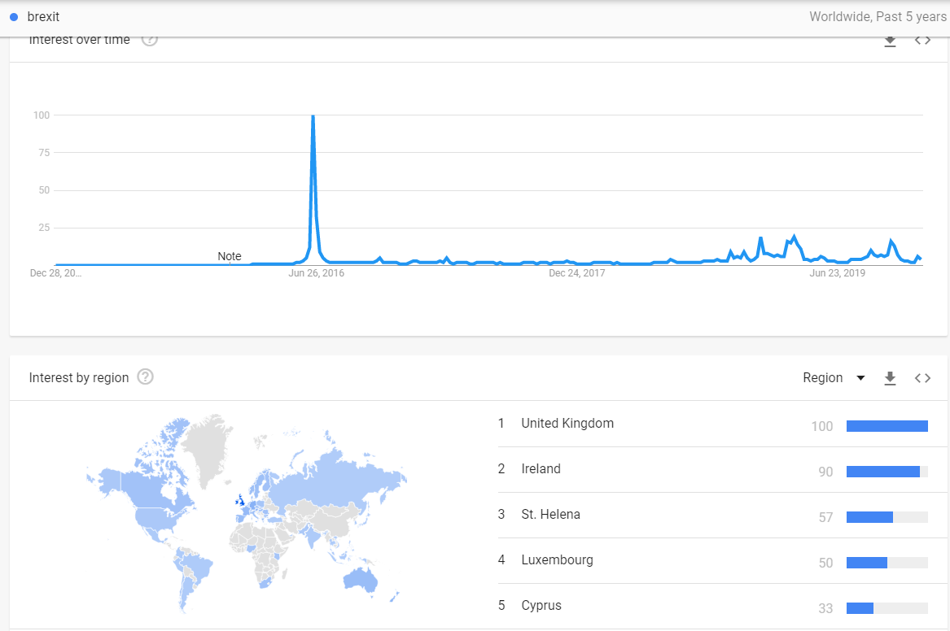
https://trends.google.com/trends/explore?date=today%205-y&q=brexit
Counties interested in Brexit

Slide 5
Google AdWords Data
Dd
Dd
Adwords tool isnt for finding the search data , but it will show how advertisers are showing interest on a specific query . Thus showing populatity or competitiveness of a query .

Slide 6
Dd
Dd

Slide 7
Data
Google Processing (Choi, H. and Varian, H., 2012. Predicting the present with Google Trends)
von Graevenitz, G., Helmers, C., Millot, V. and Turnbull, O., 2016. Does online search predict sales? evidence from big data for car markets in Germany and the UK.
provides a time series index of the volume of queries users enter into Google in a given geographic area
t0 = 0, volume normalised to 100
Uses a sampling method to create dataset
Classification algorithms for topic / terms are probabilistic and prone to errors (apple inc)
Google Correlate for term selection
BSTS is most reliable tool for feature selection
online searches that look identical in the available data result from different motivations that lead to different post-search behavior. This
weekly data more sensistive to real world flactuations
methods for panel data analysis must evolve

Slide 8
Alternatives
Yandex
Other sources
Raw search numbers
Just 1 year history provided for all terms
https://wordstat.yandex.com/#!/history?words=oil
Lots of captchta
Several

Slide 9
Dd
Dd

Slide 10
Dd
Dd

Slide 11
WHY a good opportunity?
Stats
Source: Statista 2018
Notes:
Numbers

Slide 12
Contact Details
09alexpapa@gmail.com
LinkedIn

