Slide 1
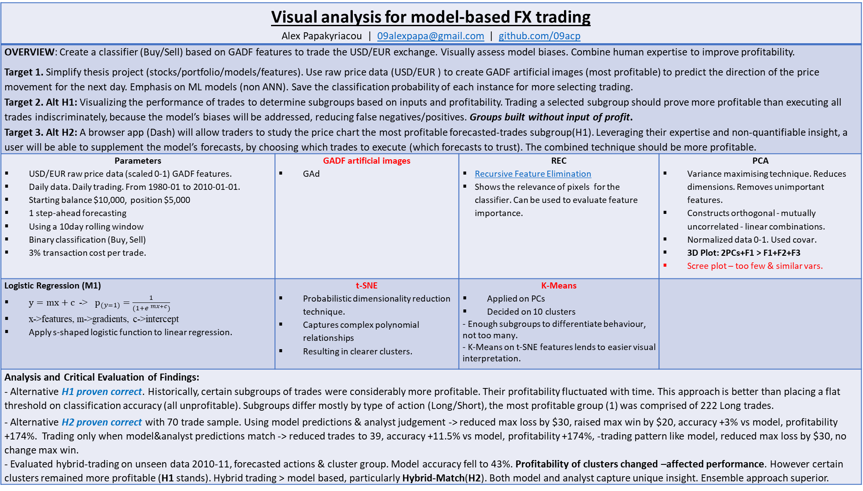
Visual analysis for model-based FX trading Alex Papakyriacou | 09alexpapa@gmail.com | github.com/09acp
OVERVIEW: Create a classifier (Buy/Sell) based on GADF features to trade the USD/EUR exchange. Visually assess model biases. Combine human expertise to improve profitability. Target 1. Simplify thesis project (stocks/portfolio/models/features). Use raw price data (USD/EUR ) to create GADF artificial images (most profitable) to predict the direction of the price movement for the next day. Emphasis on ML models (non ANN). Save the classification probability of each instance for more selecting trading. Target 2. Alt H1: Visualizing the performance of trades to determine subgroups based on inputs and profitability. Trading a selected subgroup should prove more profitable than executing all trades indiscriminately, because the model’s biases will be addressed, reducing false negatives/positives. Groups built without input of profit. Target 3. Alt H2: A browser app (Dash) will allow traders to study the price chart the most profitable forecasted-trades subgroup(H1). Leveraging their expertise and non-quantifiable insight, a user will be able to supplement the model’s forecasts, by choosing which trades to execute (which forecasts to trust). The combined technique should be more profitable.
Parameters USD/EUR raw price data (scaled 0-1) GADF features. Daily data. Daily trading. From 1980-01 to 2010-01-01. Starting balance $10,000, position $5,000 1 step-ahead forecasting Using a 10day rolling window Binary classification (Buy, Sell) 3% transaction cost per trade. | GADF artificial images GAd | REC Recursive Feature Elimination Shows the relevance of pixels for the classifier. Can be used to evaluate feature importance. | PCA Variance maximising technique. Reduces dimensions. Removes unimportant features. Constructs orthogonal - mutually uncorrelated - linear combinations. Normalized data 0-1. Used covar. 3D Plot: 2PCs+F1 > F1+F2+F3 Scree plot – too few & similar vars.
Logistic Regression (M1) $y=mx+c$ -> $p_{(y=1)}=\frac{1}{(1+e^{ mx+c})}$ x->features, m->gradients, c->intercept Apply s-shaped logistic function to linear regression. | t-SNE Probabilistic dimensionality reduction technique. Captures complex polynomial relationships Resulting in clearer clusters. | K-Means Applied on PCs Decided on 10 clusters - Enough subgroups to differentiate behaviour, not too many. - K-Means on t-SNE features lends to easier visual interpretation.
Analysis and Critical Evaluation of Findings: - Alternative H1 proven correct. Historically, certain subgroups of trades were considerably more profitable. Their profitability fluctuated with time. This approach is better than placing a flat threshold on classification accuracy (all unprofitable). Subgroups differ mostly by type of action (Long/Short), the most profitable group (1) was comprised of 222 Long trades. - Alternative H2 proven correct with 70 trade sample. Using model predictions & analyst judgement -> reduced max loss by $30, raised max win by $20, accuracy +3% vs model, profitability +174%. Trading only when model&analyst predictions match -> reduced trades to 39, accuracy +11.5% vs model, profitability +174%, -trading pattern like model, reduced max loss by $30, no change max win. - Evaluated hybrid-trading on unseen data 2010-11, forecasted actions & cluster group. Model accuracy fell to 43%. Profitability of clusters changed –affected performance. However certain clusters remained more profitable (H1 stands). Hybrid trading > model based, particularly Hybrid-Match(H2). Both model and analyst capture unique insight. Ensemble approach superior.

