Slide 1
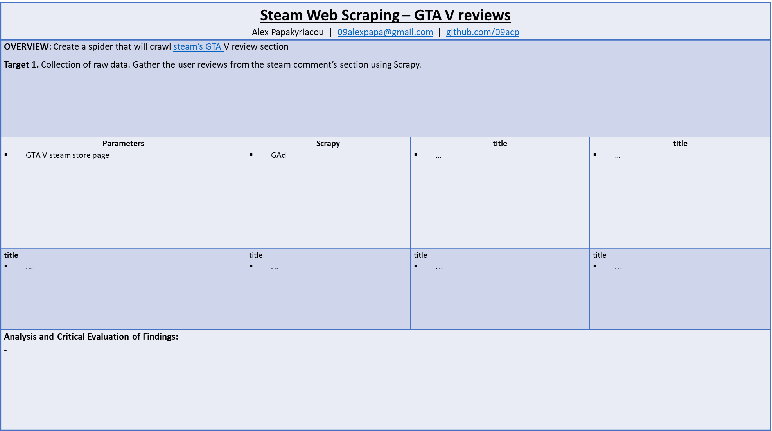
Steam Web Scraping – GTA V reviews Alex Papakyriacou | 09alexpapa@gmail.com | github.com/09acp
OVERVIEW: Create a spider that will crawl steam’s GTA V review section Target 1. Collection of raw data. Gather the user reviews from the steam comment’s section using Scrapy.
Parameters GTA V steam store page | Scrapy GAd | title … | title …
title $..$. | title $..$. | title $..$. | title $..$.
Analysis and Critical Evaluation of Findings: -

