Slide 1
Digital Portfolio
STUDENT NAME: KARTHICK S
REGISTER NO AND NMID: 222407632/ asunm1453222407632
DEPARTMENT: COMPUTER SCIENCE
COLLEGE: MADRAS UNIVERSITY VEL TECH RANGA RANKU ARTS COLLEGE

Slide 2
PROJECT TITLE
DIGITAL PORTFOLIO

Slide 3


AGENDA
Problem Statement
Project Overview
End Users
Tools and Technologies
Portfolio design and Layout
Features and Functionality
Results and Screenshots
Conclusion
Github Link
3/21/2024 Annual Review

Slide 4

PROBLEM STATEMENT
Many students and beginners struggle to showcase their skills, certificates, and projects in a professional and accessible way. Without a central platform, opportunities may be missed and achievements go unnoticed. To solve this, I developed a personal portfolio website that presents my skills, projects, and contact details in one interactive and visually appealing space

Slide 5

PROJECT OVERVIEW
This project is a responsive personal portfolio website designed to showcase my skills, education, certificates, and projects in a professional manner. It allows recruiters, peers, and collaborators to explore my work easily and contact me directly. The website is built using HTML, CSS, and JavaScript with features like a dark mode toggle, responsive navigation menu, and interactive contact form.

Slide 6

WHO ARE THE END USERS?
Recruiters & Hiring Managers – review skills and projects
Peers & Classmates – collaborate on learning & coding
Mentors & Faculty – track achievements and growth
Professional Network – connect via LinkedIn & GitHub
Myself – a personal brand and digital resume

Slide 7

TOOLS AND TECHNIQUES
Tools:
CSS3,
JavaScript VS Code, GitHub Browser
DevTools
Techniques:
Responsive Web Design Dark Mode Toggle Form Validation & Success Message Flexbox & Grid Layouts Semantic HTML & Modular CSS1

Slide 8
POTFOLIO DESIGN AND LAYOUT
Header: Logo, Navigation Menu, Dark Mode Toggle
Hero: Intro & CTA (View Projects)
About: Photo + Bio
Skills: Progress bars for HTML, CSS, JS, Python
Certificates: Achievements list
Projects: Grid of 4 project cards
Contact: Interactive form + success message
Footer: Social links & copyright
8

Slide 9
FEATURES AND FUNCTIONALITY
Features
Responsive & mobile-friendly
Dark mode toggle
Navbar with menu toggle
Hero intro with CTA About, Skills, Certificates, Projects, Contact, Footer sections
Functionality
Smooth navigation
Form validation + success message
Interactive progress bars
Social links integration

Slide 10
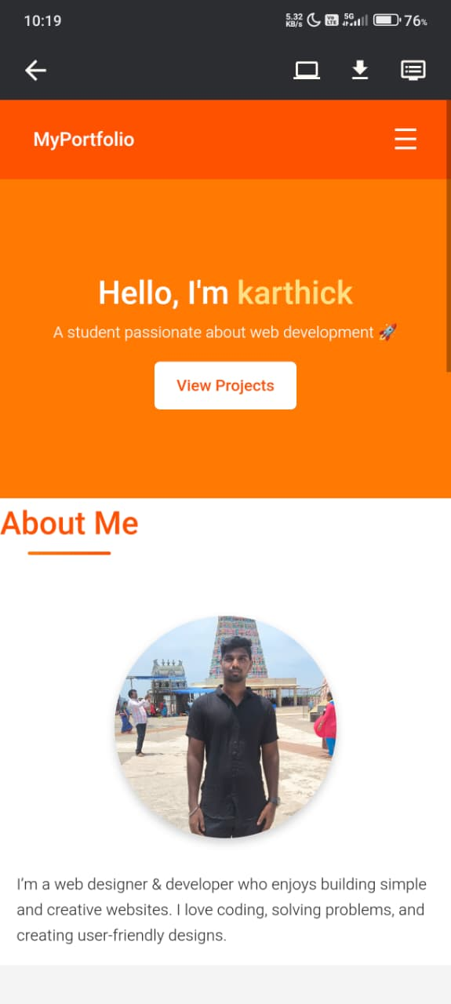
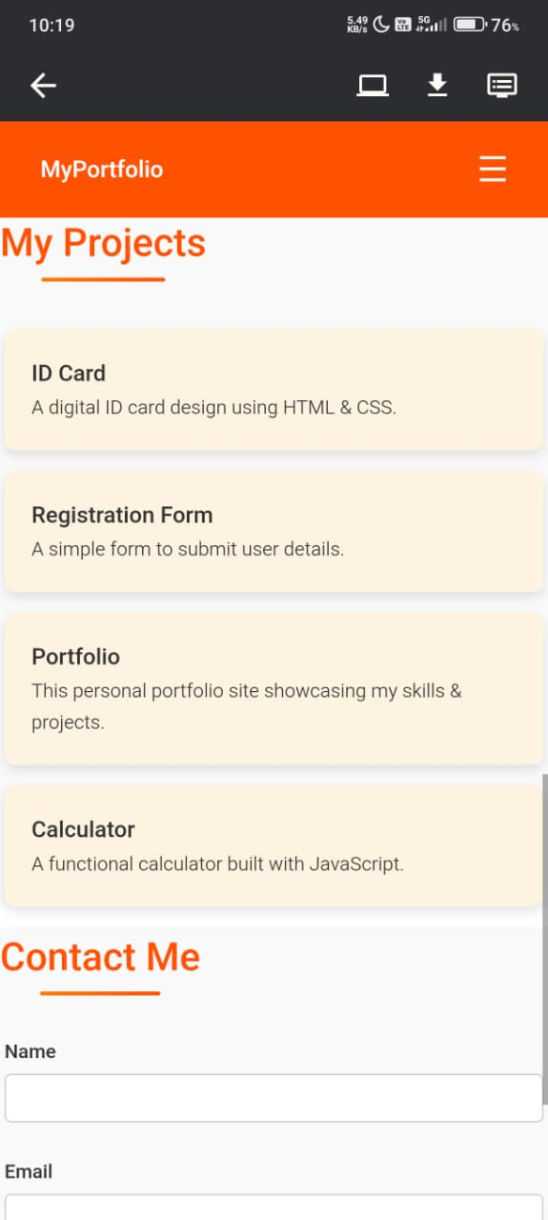
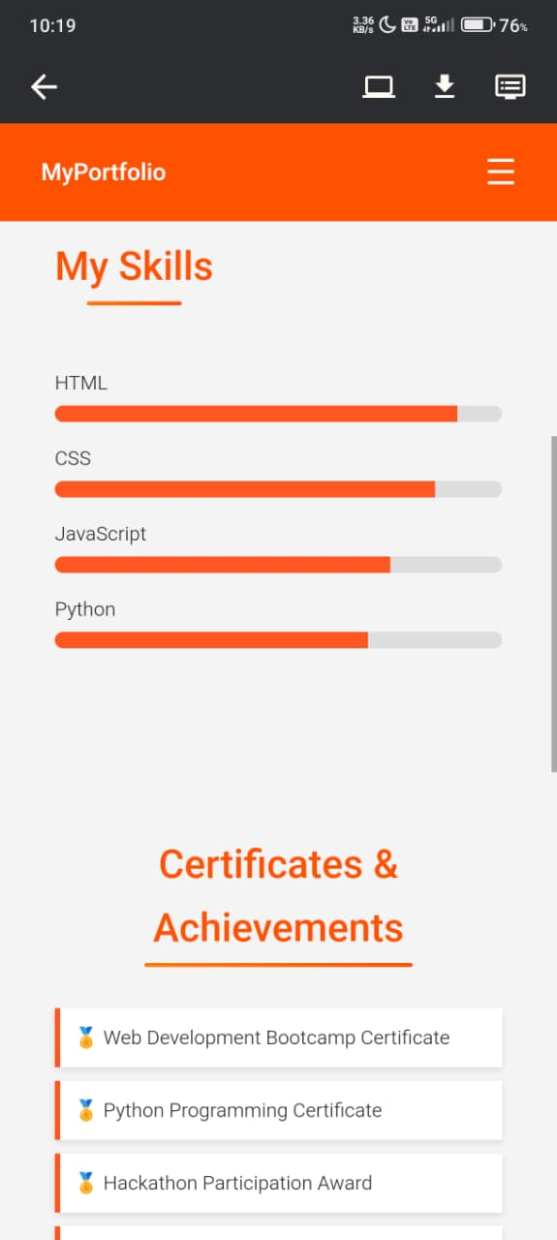
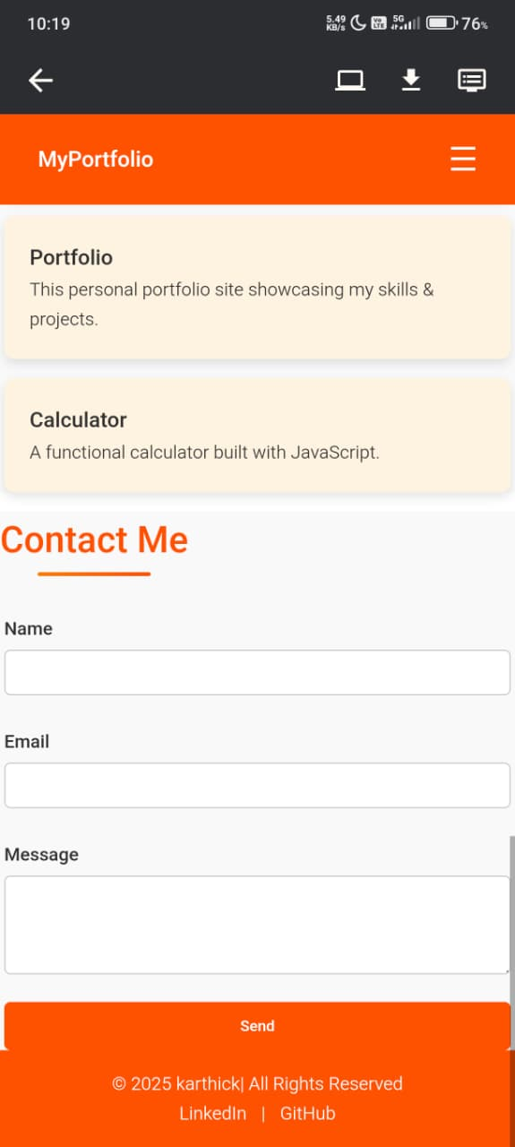

RESULTS AND SCREENSHOTS
3/21/2024 Annual Review
10

Slide 11
CONCLUSION
Developed a responsive personal portfolio website Showcases skills, certificates, projects, and achievements Includes interactive features: dark mode, navigation, and contact form Acts as a digital resume for recruiters and networking Provides a foundation for future improvements (adding more projects, blogs, or backend integration)
11

Slide 12
GitHub Link
https://github.com/09hhvkarthick2020-cmyk

