Slide 1
HTTP 5201
Security & Quality Assurance
Sean Doyle

Slide 2
How do we minimize risk?
Plan it
  Work with end user to gain an understanding
  Create Requirements
Build it
  Using coding standards
  Using modularization
  Using production tools & frameworks
Test it
  Unit testing through to user testing
Protect it
  Back it up with Version Control
  Encryption
  Hacker prevention

Slide 3
TESTING YOUR CODE
Lesson 3

Slide 4
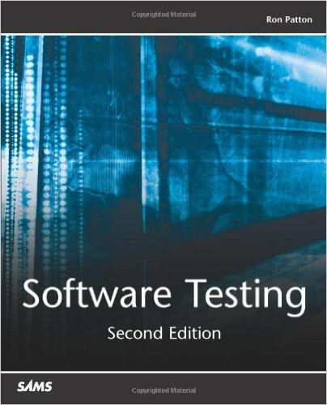
Source Book

Slide 5
Checking for…
Does it do what is supposed to do?
Is there a way to make it do what it shouldn’t?

Slide 6
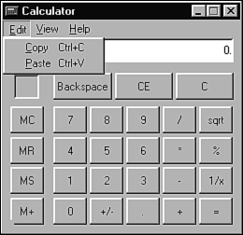
Striking a Balance
Test Implementation = Risk Management
Image source: Software Testing by Ron Patton

Slide 7
CHECK THE SPECS
A bug occurs when one of the following five rules is true:
The software doesn’t do something that the spec says it should do.
The software does something that the spec says it shouldn’t.
The software does something that the spec doesn’t mention.
The software doesn’t do something that the spec doesn’t mention but should.
The software is difficult to understand, hard to use, slow, or – in the software tester’s eyes – will be viewed by the end user as just plain not right.

Slide 8
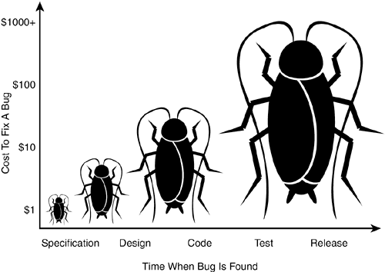
Preventing Bugs
Image source: Software Testing by Ron Patton

Slide 9
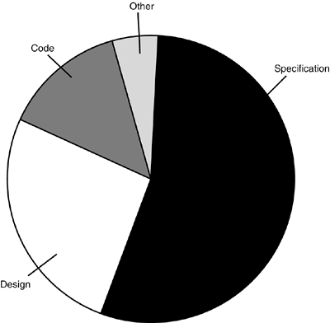
Sources of Bugs
Image source: Software Testing by Ron Patton

Slide 10
CHECK THE SPECS FOR BUGS!
Words to watch for in a specification:
Always, Every, All, None, Never
Certainly, Therefore, Clearly, Obviously, Evidently.
Some, Sometimes, Often, Usually, Ordinarily, Customarily, Most, Mostly
Etc., And So Forth, And So On, Such As
Good, Fast, Cheap, Efficient, Small, Stable
Handled, Processed, Rejected, Skipped, Eliminated
If…Then…(but missing Else)

Slide 11
A programmer is going to the grocery store...
A programmer is going to the grocery store and his wife tells him...
"Buy a gallon of milk, and if there are eggs, buy a dozen."
So the programmer goes, buys everything, and drives back to his house. Upon arrival, his wife angrily asks him...
"Why did you get 13 gallons of milk?"
The programmer says, "There were eggs!"

Slide 12
TYPES OF TESTING

Slide 13
Static Testing & Dynamic Testing
Dynamic testing is interacting with the application.
Static testing does not involve interacting with the application. In software testing, this usually means reviewing the code. In a web context, it can mean testing the layout, checking responsive stages, or evaluating load times.

Slide 14
Black Box Testing
Sometimes referred to as functional testing or behavioral testing
The tester cannot see the code, they only know what it is supposed to do.

Slide 15
White Box Testing
The tester has access to the code.
The tester can conduct the testing with values that they know will push the limits (or break) the application.

Slide 16
Test-to-Pass & Test-to-Fail
Test-to-Pass means you are testing the application with values that are known to be within the operational expectations and limits.
Test-to-Fail means you are deliberately trying to 'break' the application to find bugs that occur outside of the expected boundaries.

Slide 17
Boundary Conditions
Testing boundary conditions means you are testing just inside and outside the minimum and maximum expected values.

Slide 18
Unit Testing
Unit Testing involves testing your application on a per function level.
You create functions that will invoke and test your application functions.
Pass in a set value and state what the result should be, then run the function and see if the result matches the expectation.

Slide 19
Test-Driven Development
An approach to Unit Testing where you create the test before you create any code.

Slide 20
Terminology Review
Specification
Bug
Static Testing
Dynamic Testing
Black Box Testing
White Box Testing
Test-to-Pass
Test-to-Fail
Boundary Conditions
Unit Testing
Test-Driven Development

Slide 21
HTTP 5201
Security & Quality Assurance
Sean Doyle

