Slide 1
Master Data Science with Python
Lesson 4: Data Reduction and Unsupervised Learning

Slide 2
Lesson Objectives
By the end of this lesson, you will be able to:
Describe the differences between supervised and unsupervised learning
Utilize loops for repetitive tasks
Compare and contrast Hierarchical Cluster Analysis (HCA) and k-Means clustering
Conduct a HCA and interpret the output
Tune the number of clusters for k-Means clustering
Select the optimal number of principal components for dimension reduction
Generate predictions using Linear Discriminant Function Analysis (LDA) as a supervised classifier
Tune hyperparameters using GridSearchCV
Evaluate classifier model performance

Slide 3
Introduction
Supervised Learning:
Clear instruction is provided to predictive models concerning the outcome for which to learn
Unsupervised Learning:
Exploratory analysis to uncover patterns in unlabeled data
Dimensionality Reduction:
A form of unsupervised learning to reduce the number of features in a data set by selecting certain features after thorough testing or creating combinations of the original features

Slide 4
Topic A: Hierarchical Cluster Analysis (HCA)
Master Data Science with Python

Slide 5

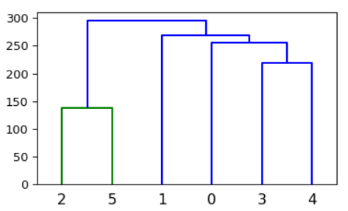
Hierarchical Cluster Analysis
Measures the Euclidean distance between and among all observations in the data and creates links at the distance in which the two points lie
Output is a tree-like structure known as a dendrogram
y-axis: Euclidean distance
x-axis: row index for each observation
Horizontal lines: links between observations
links closer to the x-axis indicating closer distance and subsequent relationship.

Slide 6
Exercise 1: Segmenting Flower Species using HCA
Import Iris data
Pre-process Iris data (i.e., shuffle and scale)
Perform HCA
Generate dendrogram
Generate predictions
Match predictions to the observations

Slide 7
Topic B: k-Means Clustering
Master Data Science with Python

Slide 8
k-Means Clustering
Assigns n observations (I.e., number of rows) to, user-defined, k (number of) clusters
After k is determined, k coordinates of group centers are randomly generated
After centers have been randomly generated there are two phases
Assignment phase
Updating phase

Slide 9
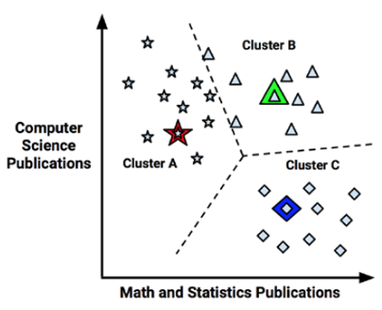
k-Means Clustering
Assignment phase
Observations assigned to cluster from which it has the smallest Euclidean distance
The star, triangle, and diamond are cluster centers for clusters A, B, and C, respectively

Slide 10
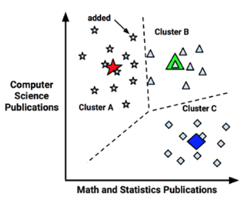
k-Means Clustering
Updating phase (Part 1)
Part 1: Cluster centers are shifted to mean position of points in that cluster
Cluster means are known as the centroids

Slide 11
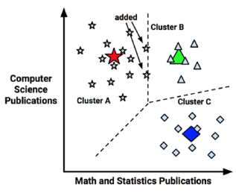
k-Means Clustering
Updating phase (Part 2)
Some observations reassigned to different clusters due to being closer to new centroid than previous cluster center
Model must update centroids once again

Slide 12
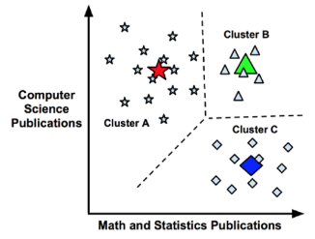
k-Means Clustering
Updating phase (Part 3)
Process of updating centroids continues until no further observation reassignments

Slide 13
Exercise 2: Segmenting Iris into 2 Clusters using k-Means
Import Iris data
Pre-process Iris data (i.e., shuffle and scale)
Perform k-Means with 2 clusters
Generate predictions
Match predictions to the observations

Slide 14
Activity 1: K-Means Clustering (ensemble)
Scenario: You have just built a model to segment flowers into two clusters using the k-Means algorithm. However, you realize that the model has different results each time you fit a new model.
Aim: Construct a loop that will fit 100 models, append each array of predicted labels to a data frame as a new column. This results in a data frame with 100 columns. Then, generate one more column which takes the mode across the 100 models for each row.

Slide 15
Activity 1: K-Means Clustering (ensemble)
Steps for Completion:
Import and preprocess Iris data
Instantiate empty data frame for which to append the labels for each model
Iterate through 100 models, appending the predicted labels a new column to the empty data frame at the end of each iteration
The previously empty data frame will contain 100 columns after the loop is complete
Calculate the mode for each row and assign it to a new column in the previously empty data frame

Slide 16
Exercise 3: k-Means clustering - Tuning n_clusters
Import Iris data
Pre-process Iris data (i.e., shuffle and scale)
Iterate through 10 k-Means with models starting with n_clusters = 1 and increasing it by 1 each time until a range of 1-10 n_clusters has been completed
Append the inertia value to a list after each iteration
Plot inertia by n_clusters

Slide 17
Exercise 4: Tuning n_clusters using Ensembles
Import Iris data
Pre-process Iris data (i.e., shuffle and scale)
Construct a nested loop to fit 100 models with 1-10 values for number of clusters
Plot mean inertia by number of clusters

Slide 18
Topic C: Principal Component Analysis (PCA)
Master Data Science with Python

Slide 19
Principal Component Analysis
Technique for creating uncorrelated linear combinations from original features
Principal components
Of the principal components:
First component explains the greatest proportion of variance in the data
Following components account for progressively less variance

Slide 20
Exercise 5: PCA with 2 Principal Components
Import Iris data
Pre-process Iris data (i.e., shuffle and scale)
Fit PCA model with 2 principal components
Transform scaled features into the 2 principal components

Slide 21
Exercise 5: PCA with 2 Principal Components
Import Iris data
Pre-process Iris data (i.e., shuffle and scale)
Fit PCA model with 2 principal components
Transform scaled features into the 2 principal components

Slide 22
Exercise 6: PCA - Tuning n_components
Import Iris data
Pre-process Iris data (i.e., shuffle and scale)
Build PCA model with all possible principal components
Determine the number of principal components that account for greater than or equal to a user-defined threshold
Plot proportion of explained variance by number of clusters

Slide 23
Activity 2: Evaluating mean inertia by cluster after PCA transformation
Scenario: You have determined the best number of clusters for a k-Means model and you feel pretty good about your model. However, you have heard that the k-Means algorithms does not perform well when there are too many features in the data. Your friend, Neil, told you to try transforming your data into principal components prior to fitting your k-Means model. Luckily, your professor just taught your class how to determine the number of principal components to keep.
Aim: Determine the mean inertia over 100 models for each value of n_clusters (1 to 10) after the data has been transformed into 2 principal components. Compare that to the mean inerta over 100 models for each value of n_clusters (1 to 10) with the 4 original features (after shuffling and scaling, of course).

Slide 24
Activity 1: K-Means Clustering (ensemble)
Steps for Completion:
Import and preprocess Iris data
Instantiate empty data frame for which to append the labels for each model
Iterate through 100 models, appending the predicted labels a new column to the empty data frame at the end of each iteration
The previously empty data frame will contain 100 columns after the loop is complete
Calculate the mode for each row and assign it to a new column in the previously empty data frame

Slide 25
Exercise 6: PCA - Tuning n_components
Import Iris data
Pre-process Iris data (i.e., shuffle and scale)
Build PCA model with all possible principal components
Determine the number of principal components that account for greater than or equal to a user-defined threshold
Plot proportion of explained variance by number of clusters

Slide 26
Topic D: Supervised Linear Discriminant Function Analysis (LDA)
Master Data Science with Python

Slide 27
Supervised Linear Discriminant Function Analysis (LDA)
Described by Field (2013) as the reverse of Multivariate Analysis of Variance (MANOVA)
MANOVA: identify the linear variates best differentiating the groups
LDA: linear variates are the boundaries, or functions, used to discern one group from another
Notes:
Source: Field, A. (2013). Discovering statistics using IBM SPSS statistics. sage.

Slide 28
Exercise 7: Fitting LDA Model with Default Hyperparameters
Import Iris data
Pre-process Iris data (i.e., shuffle and scale)
Build LDA model with default hyperparameters
Evaluate model performance with confusion matrix

Slide 29
Exercise 8: Tuning LDA Hyperparameters using GridSearchCV
Import Iris data
Pre-process Iris data (i.e., shuffle and scale)
Tune LDA model with GridSearchCV
Evaluate model performance with confusion matrix
Programmatically re-fit LDA model with tuned hyperparameters

Slide 30
Summary
In this lesson, we:
Fit a hierarchical cluster analysis
Tuned and fit a k-Means clustering model
Transformed original features to a tuned number of principal components
Evaluated k-Means model performance using original features to principal components
Fine- tuned a linear discriminant function analysis hyperparameters using GridSearchCV
Evaluated classifier model performance using a confusion matrix
Programmatically selected tuned hyperparameters to access all attributes of the estimator

