Slide 1
Master Data Science with Python
Lesson 5: Data Visualization

Slide 2
Lesson Objectives
By the end of this lesson, you will be able to:
Create and customize line plots, bar plots, histograms, scatterplots, and box-and-whisker plots using the functional method
Create a programmatic, descriptive title
Describe the advantages of using the object-oriented method rather than the functional method in matplotlib
Create a callable figure object containing a single axis or multiple axes
Resize and save a figure object with numerous subplots

Slide 3
Introduction
Data visualizations
Variety of shapes, sizes, and styles
Line plot
Trends
Bar graph
Metrics across groups
Scatterplot
Correlations between variables
Histograms
Distribution
Box-and-whisker
Outliers.
Pie chart
Comparing the total data between or among categories

Slide 4
Matplotlib
Plotting library
“...make easy things easy and hard things possible” (https://matplotlib.org/index.html).
Documentation (https://matplotlib.org/index.html)
Gallery/examples (https://matplotlib.org/gallery/index.html)

Slide 5
Matplotlib
Methods:
Functional
Creates a single, savable plot that is not a callable figure object
Object-oriented
Creates single or multiple, savable plots that are a callable figure object

Slide 6
Topic A: Functional Method
Master Data Science with Python

Slide 7
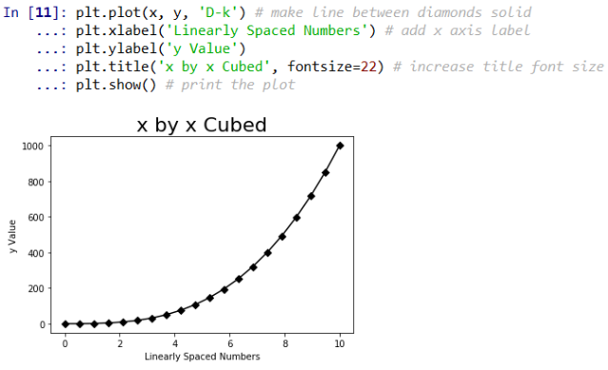
Functional Method
Creates a single, savable plot
Not a callable figure object
Created using functions directly onto an existing canvas:
Example:

Slide 8
Exercise 1: Line Plot (Functional Method)
Import matplotlib
Create an array and save it as the object x
Create an array and save it as object y
Create the plot
Customize the x- and y-axis
Change line color and markers
Create legend
Create a descriptive, multiline title
Change the figure size

Slide 9
Activity 1: Line Plot (Functional Method)
Scenario: Your boss says she will be getting some data in a week and wants you construct a plot month-to-month Items Sold for months January through June. She wants the line in the plot to be blue with star markers and preferably dotted. Having never made a plot like this before you want to practice making this plot ahead of time.
Aim: Construct a line plot of Items Sold on the y-axis and Month on the x-axis. Use the matplotlib documentation to style the line blue and dotted with stars as the markers.

Slide 10
Activity 1: Line Plot (Functional Method)
Steps for completion:
Create a list of 6 strings for each month January through June and save it as x
Create a list of 6 values for ‘Items Sold’ that starts at 1000 and increases by 200 so the final value is 2000 and save it as y
Plot the line plot with x and y as the arguments
Style the axis labels and the title
Style the line using matplotlib documentation

Slide 11
Exercise 2: Bar Plot (Functional Method)
Import matplotlib
Create a list of Item Types and save it as the object x
Create a list of Sales Revenue and save it as object y
Create the bar plot
Customize the x- and y-axis
Change line color and markers
Create a programmatic, descriptive title

Slide 12
Activity 2: Bar Plot (Functional Method)
Scenario: Your friend says he knows that the Los Angeles Lakers have the most titles in NBA history. You disagree and think that the Boston Celtics have the most titles in NBA history. You decide that you are going to prove your point with a data visualization.
Aim: Construct a bar plot of NBA title on the y-axis and Team on the x-axis. Make sure the data is sorted so the team with the most championships is on the left and it continues right in descending order.

Slide 13
Activity 2: Bar Plot (Functional Method)
Steps for completion:
Create a list of 5 strings for x containing the names of NBA franchises with the most titles
Create a list of 5 values for y containing values for ‘Titles Won’ that corresponds with the strings in x
Place x and y into a data frame with the column names ‘Team’ and ‘Titles’, respectively
Sort the data frame descending by ‘Titles’
Make a programmatic title and save it as title
Generate the described plot
Fix the cropping issue upon saving

Slide 14
Exercise 3: Histogram (Functional Method)
Generate array of normally distributed values and save them as y
Create the histogram
Customize the x- and y-axis
Construct a descriptive, programmatic title dependent on the results of a Shapiro-Wilk test

Slide 15
Exercise 4: Scatterplot (Functional Method)
Generate a list of numbers representing height and save it as y
Generate a list of numbers representing weight and save it as x
Create the scatterplot
Customize the x- and y-axis
Create a descriptive, programmatic title based on the results from a Pearson correlation coefficient

Slide 16
Exercise 5: Box-and-Whisker (Functional Method)
Generate an array of 100 normally distributed numbers and save it as y
Create the Box-and-Whisker plot
Create a descriptive, programmatic title from the result of checking for z-scores

Slide 17
Topic B: Object-Oriented Method
Master Data Science with Python

Slide 18
Object-Oriented Method
Creates a single or multiple, savable plot(s)
Creates a figure object
Created using functions onto a user-defined axis or set of axes:
Example:

Slide 19
Exercise 6: Single Line Plot (Functional Method)
Save x as an array ranging from 0 to 10 in 20 linearly spaced steps
Use tuple unpacking to create a figure and a set of axes
Create the line plot
Customize the x- and y-axis
Change line color and marker type
Create a descriptive title

Slide 20
Exercise 7: Multiple Line Plots using Subplots (Functional Method)
Use same lines as in Exercise 1
Create a figure with 2 side-by-side axes
Plot y by x on the left axes
Plot y2 by x on the right axes
Assign each unique titles and axis labels
Call the fig object

Slide 21
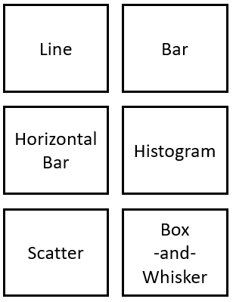
Activity 3: Multiple Plot Types using Subplots (Functional Method)
Scenario: You are starting to get a lot of requests for graphs at work. Many times you want to put all the plots into the same file. You have been able to do this with the functional method and the snipping tool, but you want to make it easier on yourself by using subplots.
Aim: Construct a figure that contains 6 subplots laid out like this:

Slide 22
Activity 2: Bar Plot (Functional Method)
Steps for completion:
Import .csv files and create 1 normally distributed array of numbers
Generate a figure with 6 subplots using 3 rows and 2 columns
Set plot titles so they match with Figure 5.9.
Place plots in appropriate axes
Label the x- and y-axis in each subplot
Increase the size of figure
Save figure

Slide 23
Summary
In this lesson, we:
Used plotting library matplotlib to create, customize, and save plots using the functional method
Discussed importance of a descriptive title and created our own descriptive, programmatic titles
Used matplotlib to create a callable figure object using the object-oriented method
Learned to access, interpret, and leverage the matplotlib documentation and gallery

