Slide 1
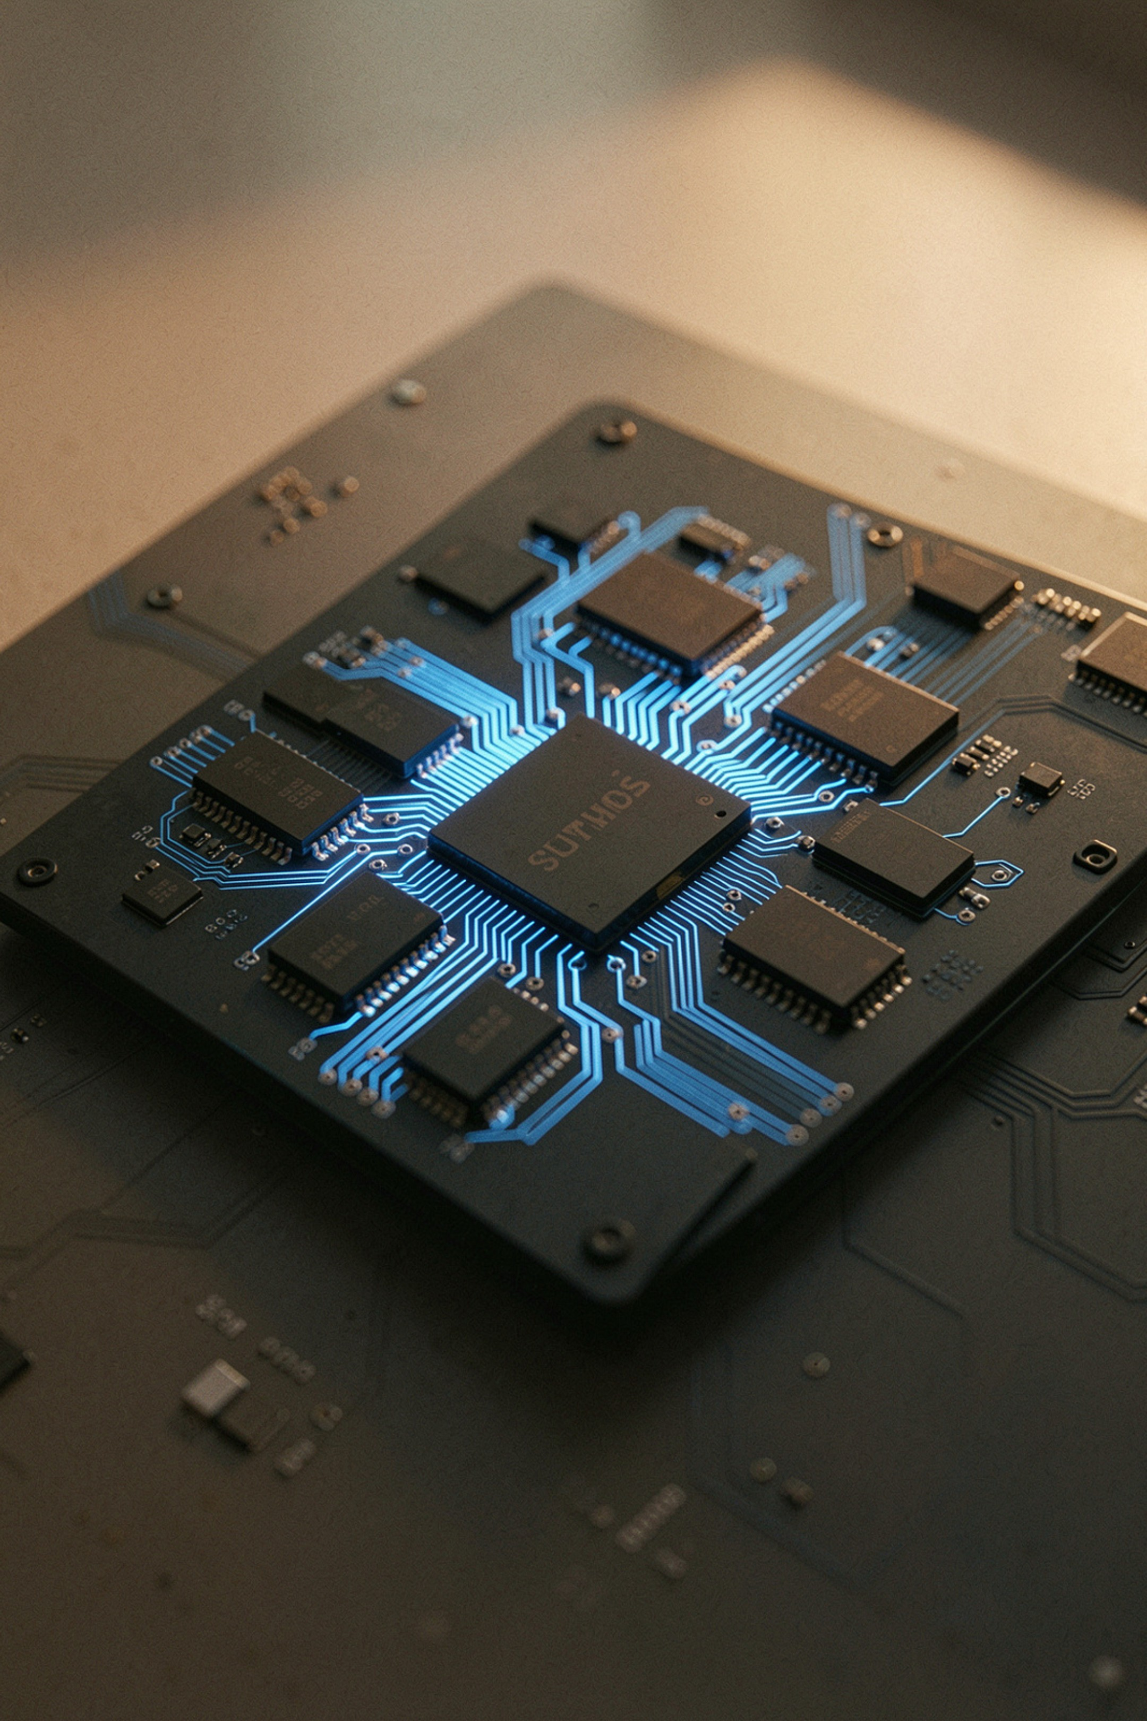
Hardware Accelerator for Memory-Intensive Applications in Processors
Review 1 — Introduction, Literature Review & Problem Identification
Team Members
Sanshey (5451), Ayush Bajetha (5414), Keshav Dangi (5424)
Project Guide
Dr. Sushma Patil
Department
Electronics & Telecommunication
Institution
Army Institute of Technology

Slide 2
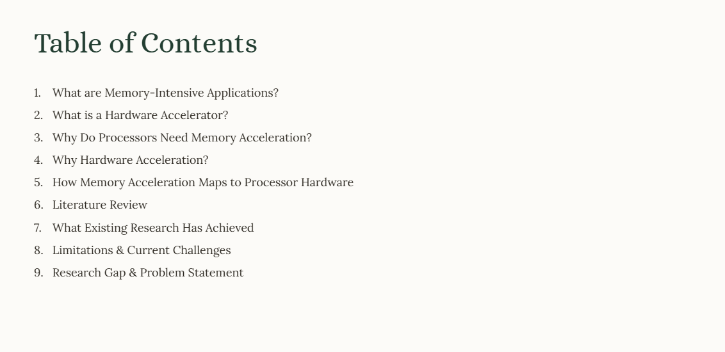

Slide 3
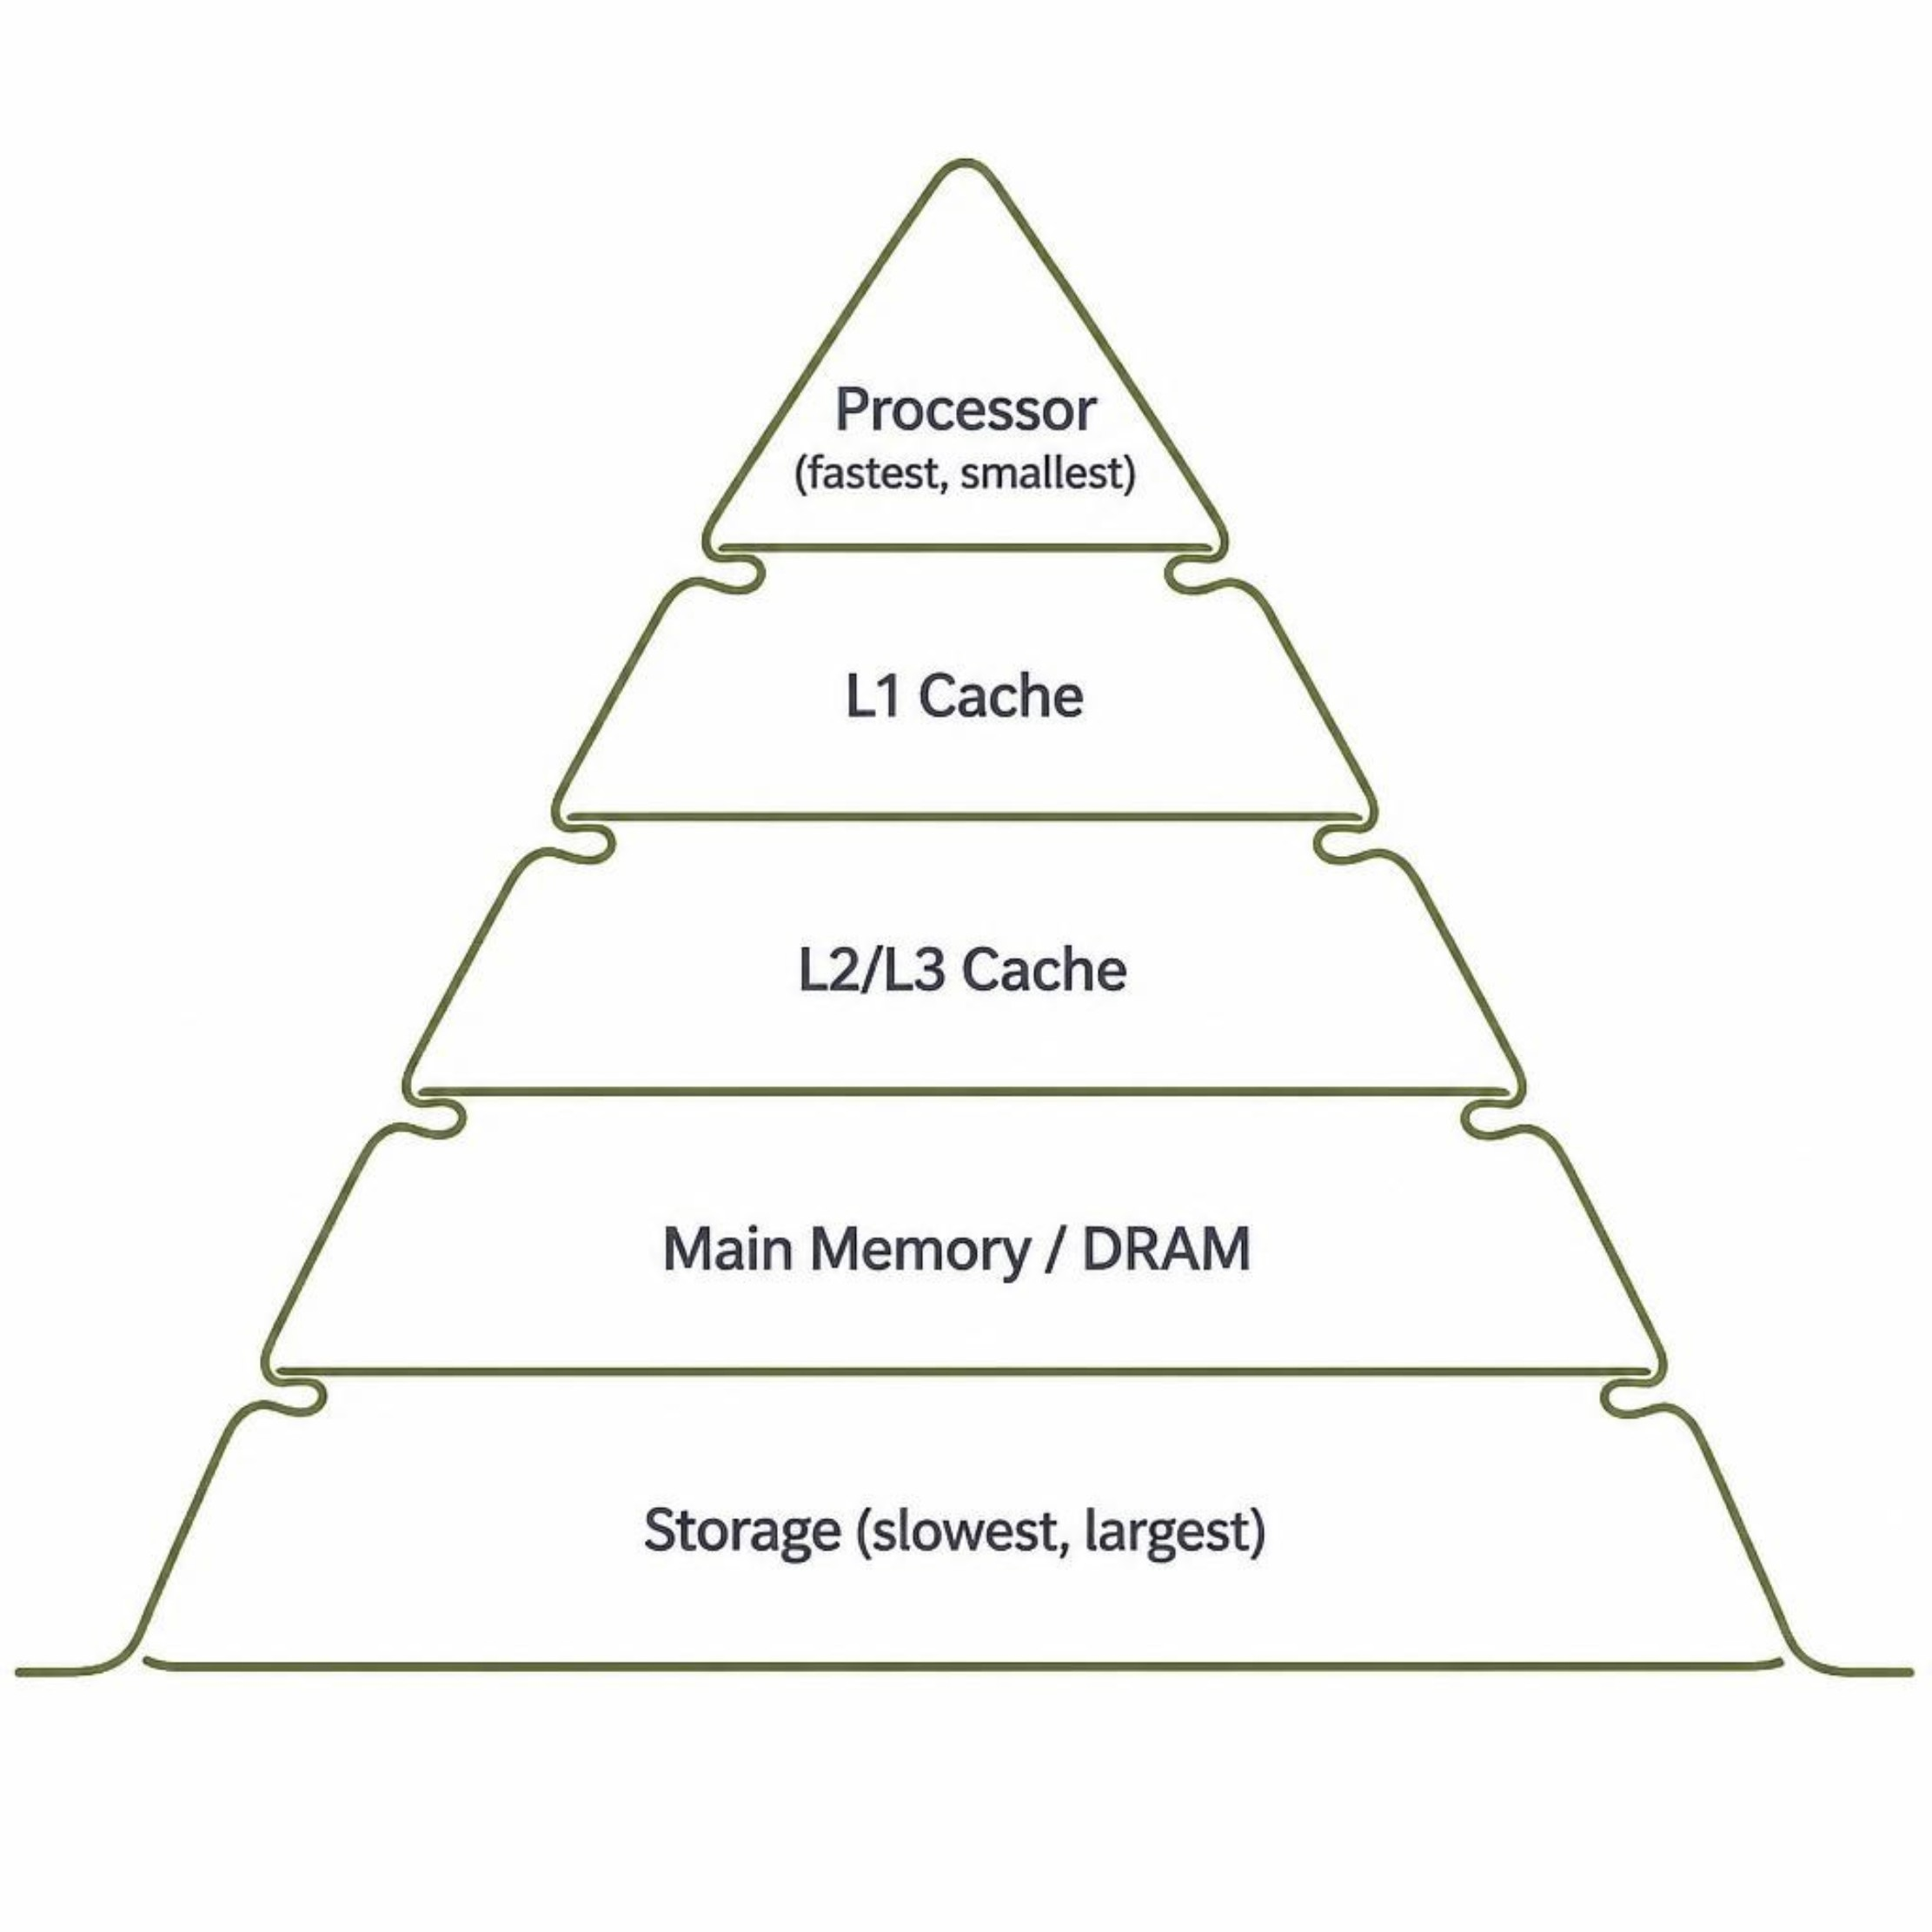
What are Memory-Intensive Applications?
Memory-intensive applications spend a significant portion of execution time accessing or transferring data rather than performing computations. Performance depends on:
Memory latency — time to retrieve a data unit
Memory bandwidth — rate of data transfer
Cache misses — cause processor stalls
Data movement — energy and time cost
Locality — spatial and temporal reuse
Examples: Image/video processing, databases, graph processing, scientific computing, AI workloads, large-scale data processing.
Hardware Accelerator for Memory-Intensive Applications in Processors

Slide 4
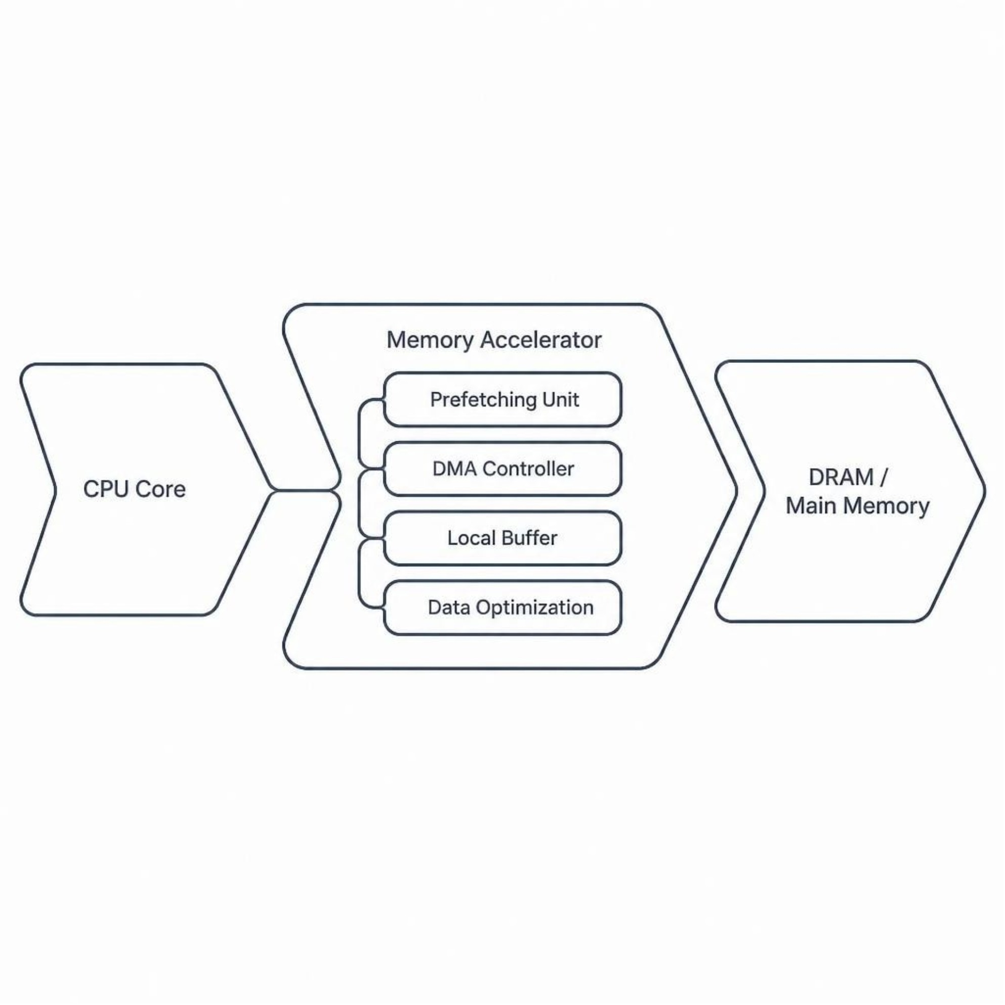

What is a Hardware Accelerator?
A hardware accelerator is specialized circuitry that performs specific operations more efficiently than a general-purpose CPU — exploiting parallelism, pipelining, and dedicated data paths.
Accelerator Examples
DMA engines
Hardware prefetchers
Cache accelerators
Memory compression units
Near-memory processing
Processing-in-memory (PIM)
FPGA/ASIC-based accelerators
The accelerator targets the memory bottleneck, not arithmetic computation.
Hardware Accelerator for Memory-Intensive Applications in Processors

Slide 5
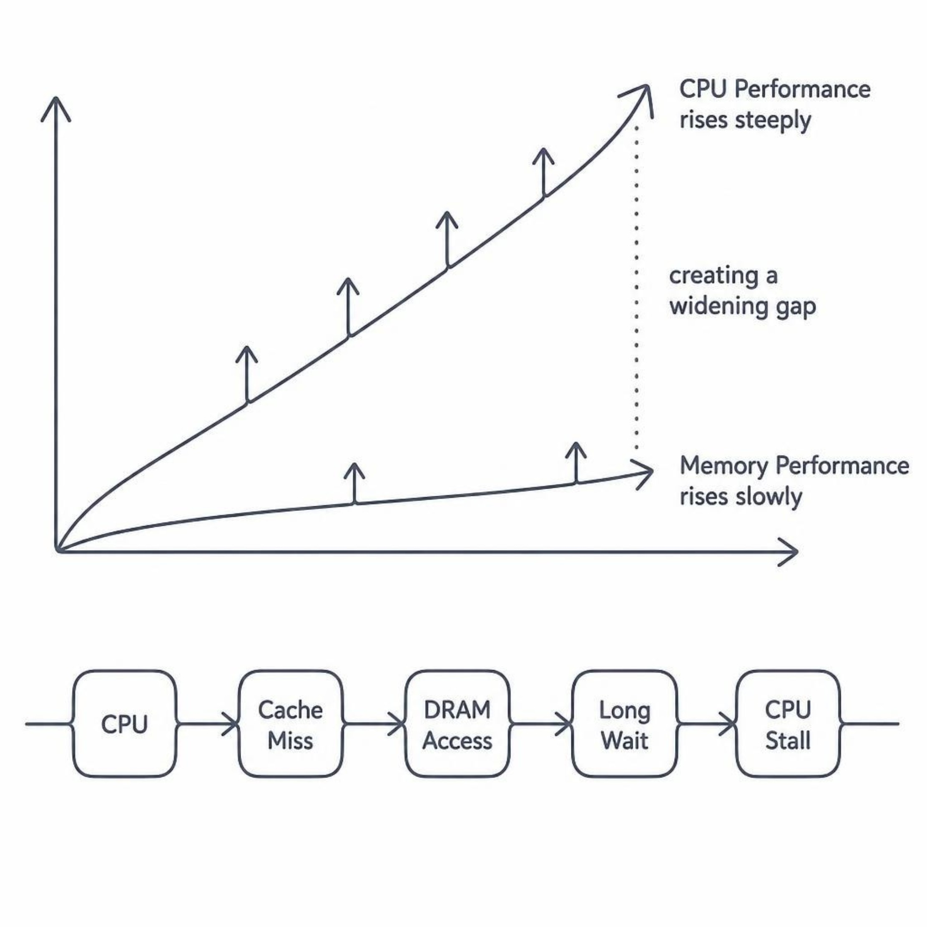

Why Do Processors Need Memory Acceleration?
The Memory Bottleneck
Processor compute capability has grown dramatically, but memory latency remains a major constraint. CPU cores stall waiting for data from memory.
Cache misses increase effective memory access latency
Off-chip memory accesses consume significant time and energy
Memory bandwidth becomes the limiting factor
Real-time and high-performance applications demand efficient memory access
Memory Bottleneck = Performance Bottleneck
Hardware Accelerator for Memory-Intensive Applications in Processors

Slide 6
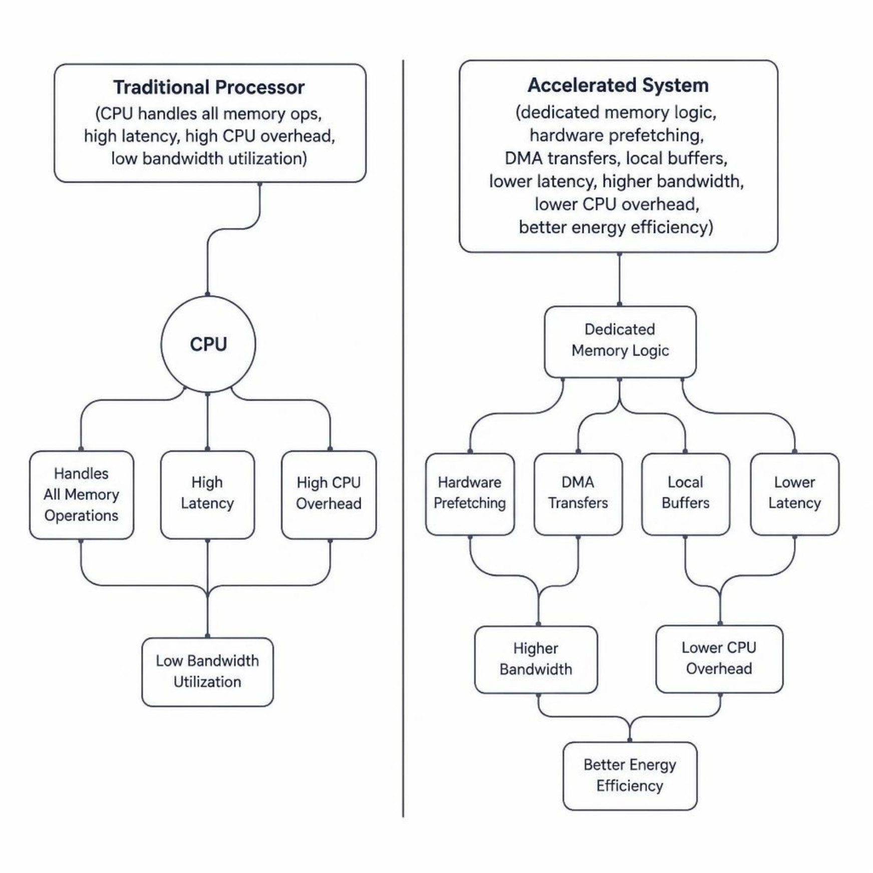
Why Hardware Acceleration?
Traditional Processor
CPU → Cache → DRAM
CPU repeatedly handles all memory-related operations, incurring high overhead and latency on every access.
Accelerated System
CPU → Memory Accelerator → Local Buffer / DRAM
Dedicated hardware manages data movement, prefetching, and buffering — freeing the CPU for computation.
Lower Latency
Higher Bandwidth
Lower CPU Overhead
Better Energy Efficiency
Hardware Accelerator for Memory-Intensive Applications in Processors

Slide 7
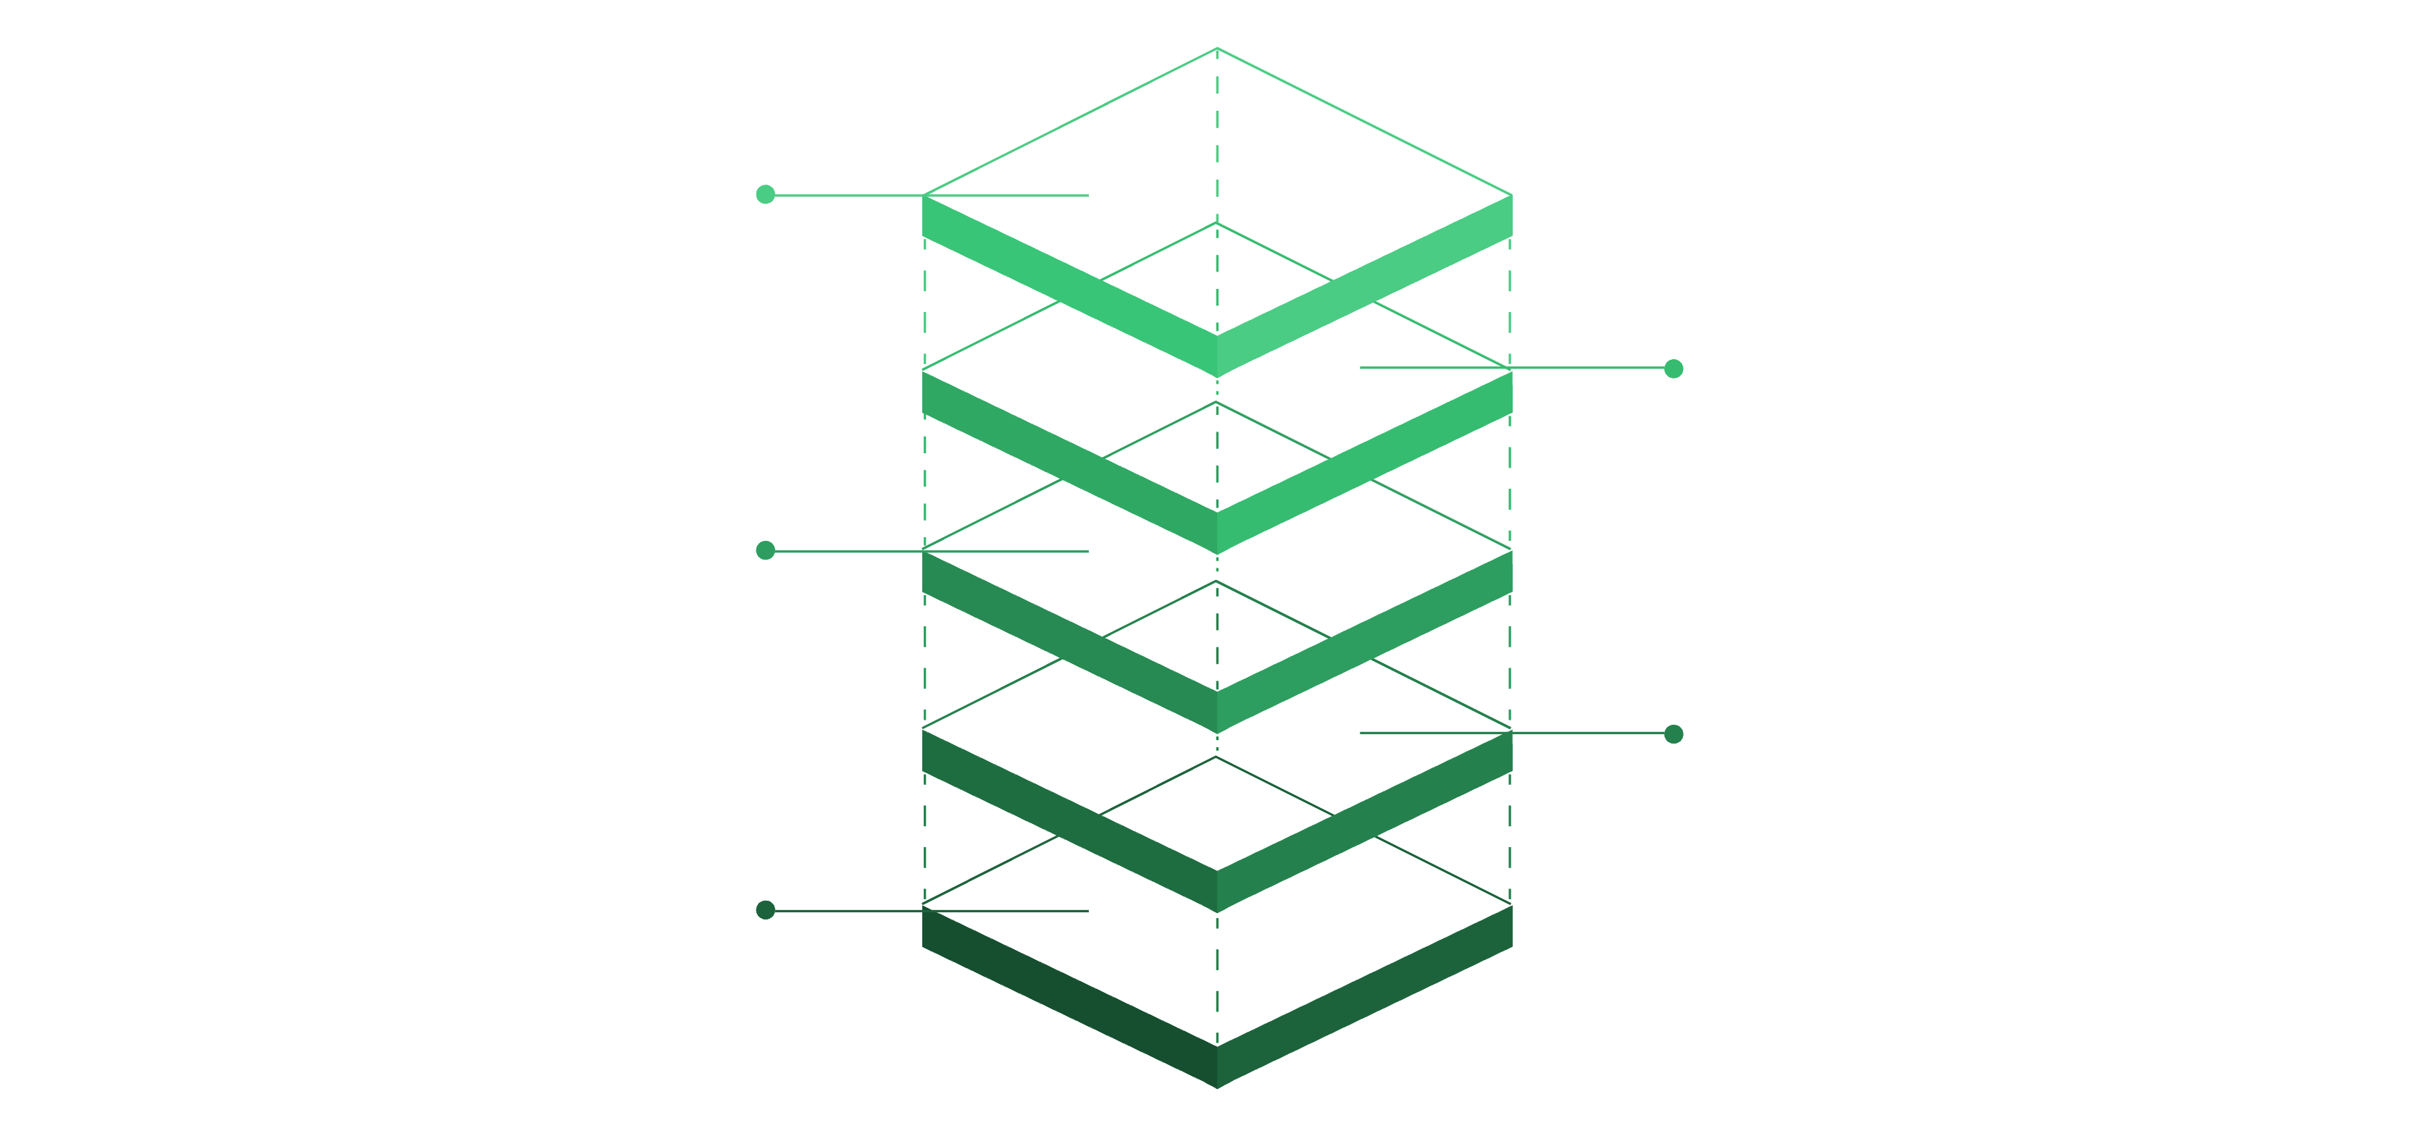
How Memory Acceleration Maps to Processor Hardware
DRAM
Main memory storage
Memory Controller
Manage DRAM transactions
Memory Accelerator
Prefetch, DMA, buffer, compression
Cache Hierarchy
L1 and L2/L3 caching layers
CPU Core
Issue and consume data
Conceptual architecture — not the final implementation.
Prefetch Unit
DMA Controller
Predicts and fetches data before it is requested, reducing effective latency.
Handles bulk data transfers with minimal CPU intervention.
Local Buffer
Compression Unit
On-chip scratchpad memory improves data reuse and reduces DRAM accesses.
Reduces memory traffic by compressing data before transfer.
Hardware Accelerator for Memory-Intensive Applications in Processors

Slide 8
Literature Review
Paper / Work | Year | Focus | Main Contribution
Hardware Prefetching | 2015 | Memory latency reduction | Predicts future memory accesses and fetches data in advance
DMA-Based Data Movement | 2017 | Efficient bulk data transfer | Transfers data with reduced CPU intervention
Processing-in-Memory / Near-Memory | 2019 | Reducing data movement | Moves computation closer to memory to reduce memory traffic
Memory Compression | 2020 | Bandwidth reduction | Reduces the amount of data transferred through memory hierarchy
Cache Optimization | 2022 | Cache utilization and locality | Improves temporal/spatial locality and reduces cache misses
Hardware Accelerators for Memory Workloads | 2024 | Specialized memory processing | Uses dedicated hardware to improve throughput and energy efficiency
Hardware Accelerator for Memory-Intensive Applications in Processors

Slide 9
What Existing Research Has Achieved
01
02
Hardware Prefetching
DMA & Efficient Data Movement
Predicts future memory accesses and fetches required data in advance, reducing effective memory access latency and processor stalls.
Enables bulk data transfers with minimal CPU intervention, reducing CPU overhead and improving data-transfer efficiency.
03
04
Cache & Buffer Optimization
Near-Memory & PIM
Improves temporal and spatial locality by storing frequently/recently used data closer to the processor, reducing repeated DRAM accesses.
Moves computation closer to memory, reducing the distance data must travel and consequently lowering data-movement overhead.
05
06
Memory Compression
Parallel Memory Access
Compresses data before transfer, reducing memory traffic and bandwidth requirements.
Uses concurrent memory accesses and optimized data paths to improve effective memory bandwidth and overall memory-system performance.
Hardware Accelerator for Memory-Intensive Applications in Processors

Slide 10
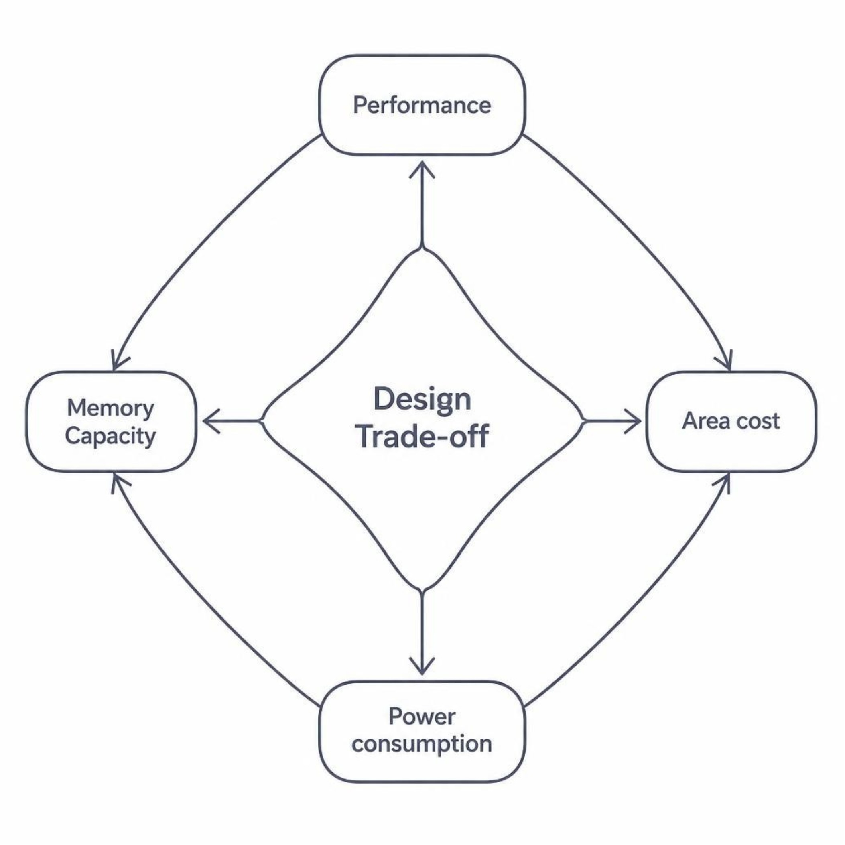

Limitations & Current Challenges
Key Challenges
Memory latency remains significant even with caching and prefetching
Limited on-chip memory restricts local data storage
Aggressive prefetching may fetch unnecessary data, wasting bandwidth
Hardware accelerators increase design complexity and silicon area
Additional buffers and structures increase power consumption
Accelerator effectiveness depends on application memory-access patterns
Cache coherence is challenging in multi-core systems
Maintaining programmability and portability is difficult
Different workloads may require different accelerator architectures
The challenge is to improve memory performance without excessive hardware cost.
Hardware Accelerator for Memory-Intensive Applications in Processors

Slide 11
Research Gap & Problem Statement
Research Gap
Project Problem Statement
Existing techniques — caching, prefetching, DMA, compression, and near-memory processing — can improve memory performance individually. However, achieving a balanced solution that simultaneously provides:
"How can we design a hardware accelerator that efficiently handles memory-intensive operations in processors by reducing memory access latency and data movement while improving bandwidth utilization, without excessive hardware area and power consumption?"
Reduced memory access latency
Efficient memory bandwidth utilization
Reduced CPU overhead and data movement
Low power consumption and reasonable hardware area
Scalability across different workloads
Review 2 will propose the targeted approach, architecture options, and implementation plan.
…remains a practical challenge.
Hardware Accelerator for Memory-Intensive Applications in Processors

