Slide 1
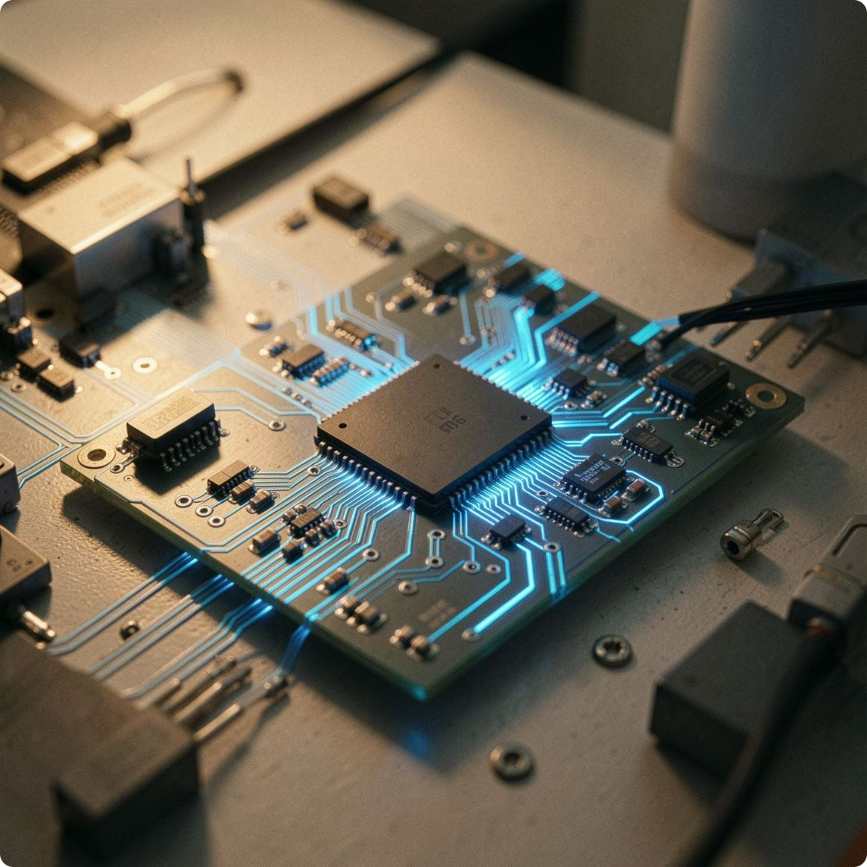
Hardware Accelerator for Memory-Intensive Applications in Processors
Review 2 — Proposed Solution, Architecture & Implementation Plan
Team Members
Sanshey (5451), Ayush Bajetha (5414), Keshav Dangi (5424)
Project Guide
Dr. Sushma Patil
Department
Electronics and Telecommunications

Slide 2
Table of Contents
The Memory Bottleneck
GPU vs TPU vs FPGA
Why Choose FPGA?
Proposed Solution
System Architecture
Hardware Components
Software Components
Working of the System
CPU-Only vs. Accelerator-Based Implementation
Implementation & Future Scope
Conclusion

Slide 3
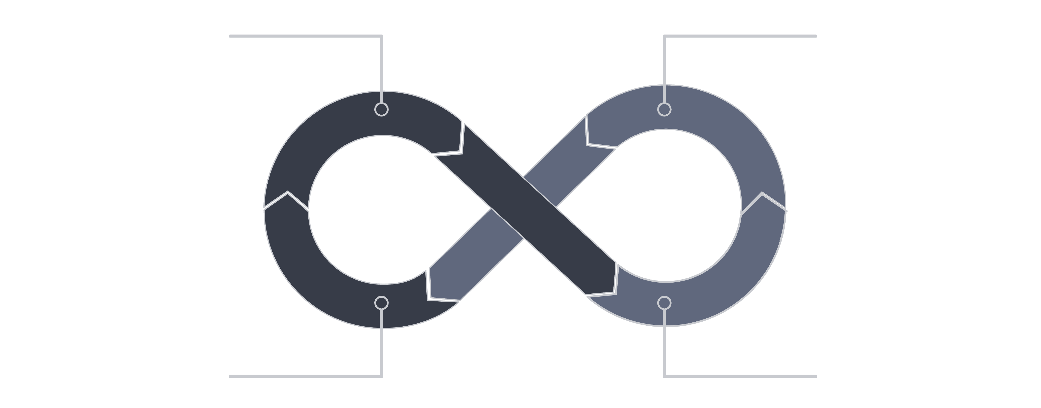
Problem Statement: The Memory Bottleneck
In conventional processors, the CPU is significantly faster than main memory. As datasets grow, frequent memory access causes stalls, repeated data movement, and increased CPU workload — limiting overall system performance.
CPU sends Read
Memory returns Data
CPU writes Result
CPU processes Data
This repeated Read → Process → Write cycle is the core inefficiency our accelerator aims to address.
Hardware Accelerator for Memory-Intensive Applications in Processors

Slide 4
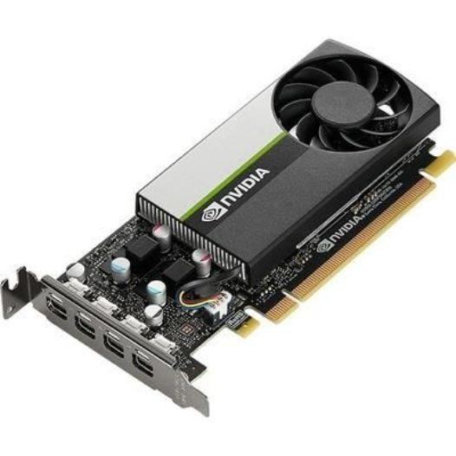
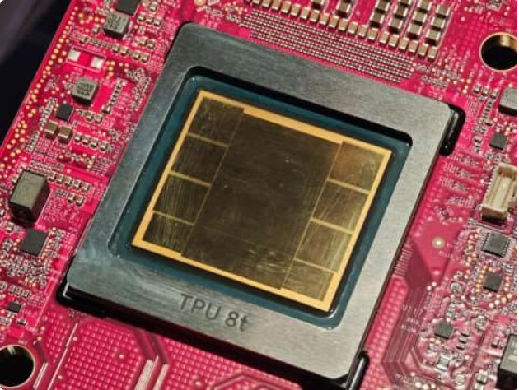
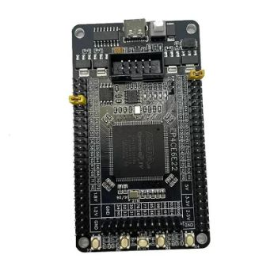
GPU vs TPU vs FPGA
All three can be used as hardware accelerators, but they are optimized for different types of workloads.
GPU
TPU
FPGA
Primary purpose: graphics and parallel compute
Best for: flexible high-throughput workloads
Key strength: very high parallelism
Suitable for your project: good if flexibility and throughput matter most
Primary purpose: machine learning and tensor operations
Best for: training and inference of deep learning models
Key strength: optimized for ML dataflows
Suitable for your project: good if the workload is mostly neural-network focused
Primary purpose: custom digital circuits and specialized acceleration
Best for: low-latency, deterministic custom hardware
Key strength: reconfigurable and hardware-tailored
Suitable for your project: best fit for memory-intensive operations with low latency, reduced data movement, and controlled power/area

Slide 5
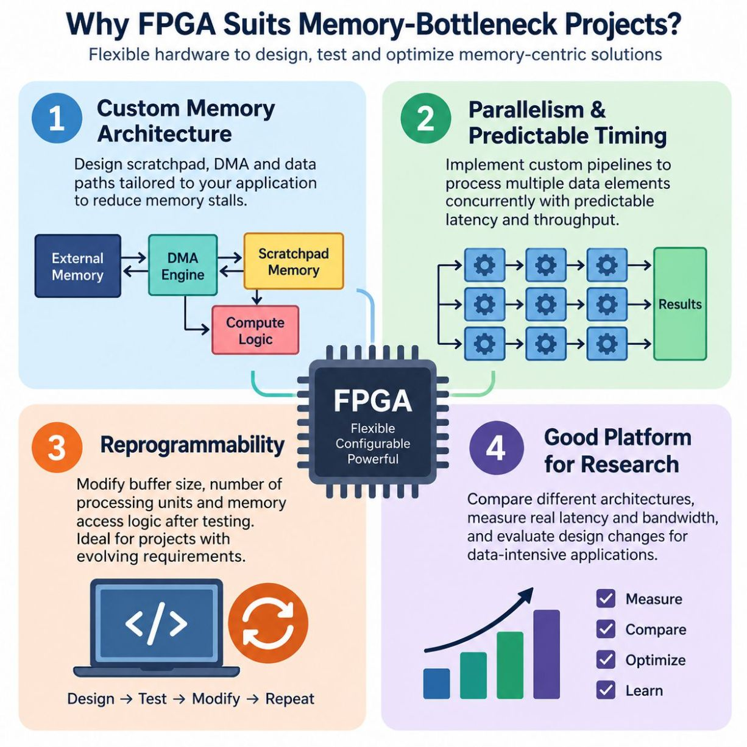
Why Choose FPGA?
Custom Memory Architecture
Parallelism & Predictable Timing
Reprogrammability
Design scratchpad, DMA engine, and data paths.
Reduce memory stalls.
Modify buffer size and processing units.
Flexible for iterative development.
Custom pipelines for concurrent processing.
Controlled latency and throughput measurement.
Research Platform
Compare different architectures.
Measure actual performance metrics.

Slide 6
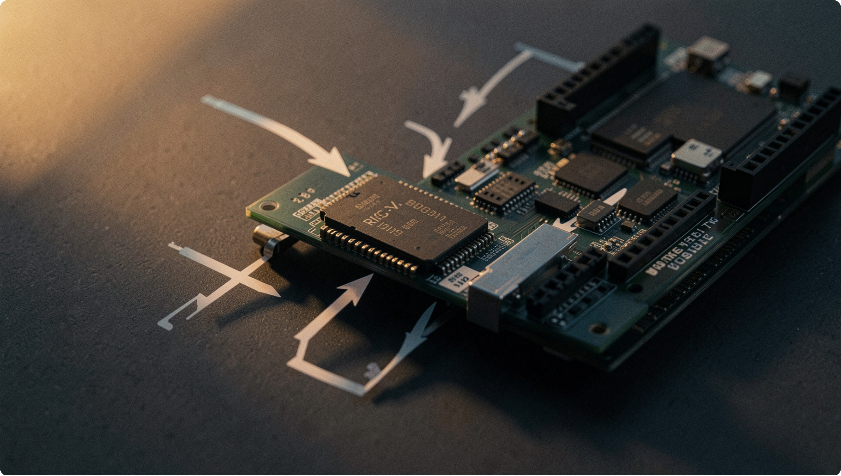
Proposed Solution: Hardware-Software Co-Design
Our solution partitions the workload: the RISC-V CPU handles application logic and control, while a custom hardware accelerator executes selected memory-intensive operations.
CPU retains control
Accelerator handles computation
Manages application flow and configures the accelerator
Offloads repetitive, memory-heavy operations
Local BRAM buffer
Memory-mapped interface
Reduces repeated main memory accesses
Simple register-based communication between CPU and accelerator
Hardware Accelerator for Memory-Intensive Applications in Processors

Slide 7
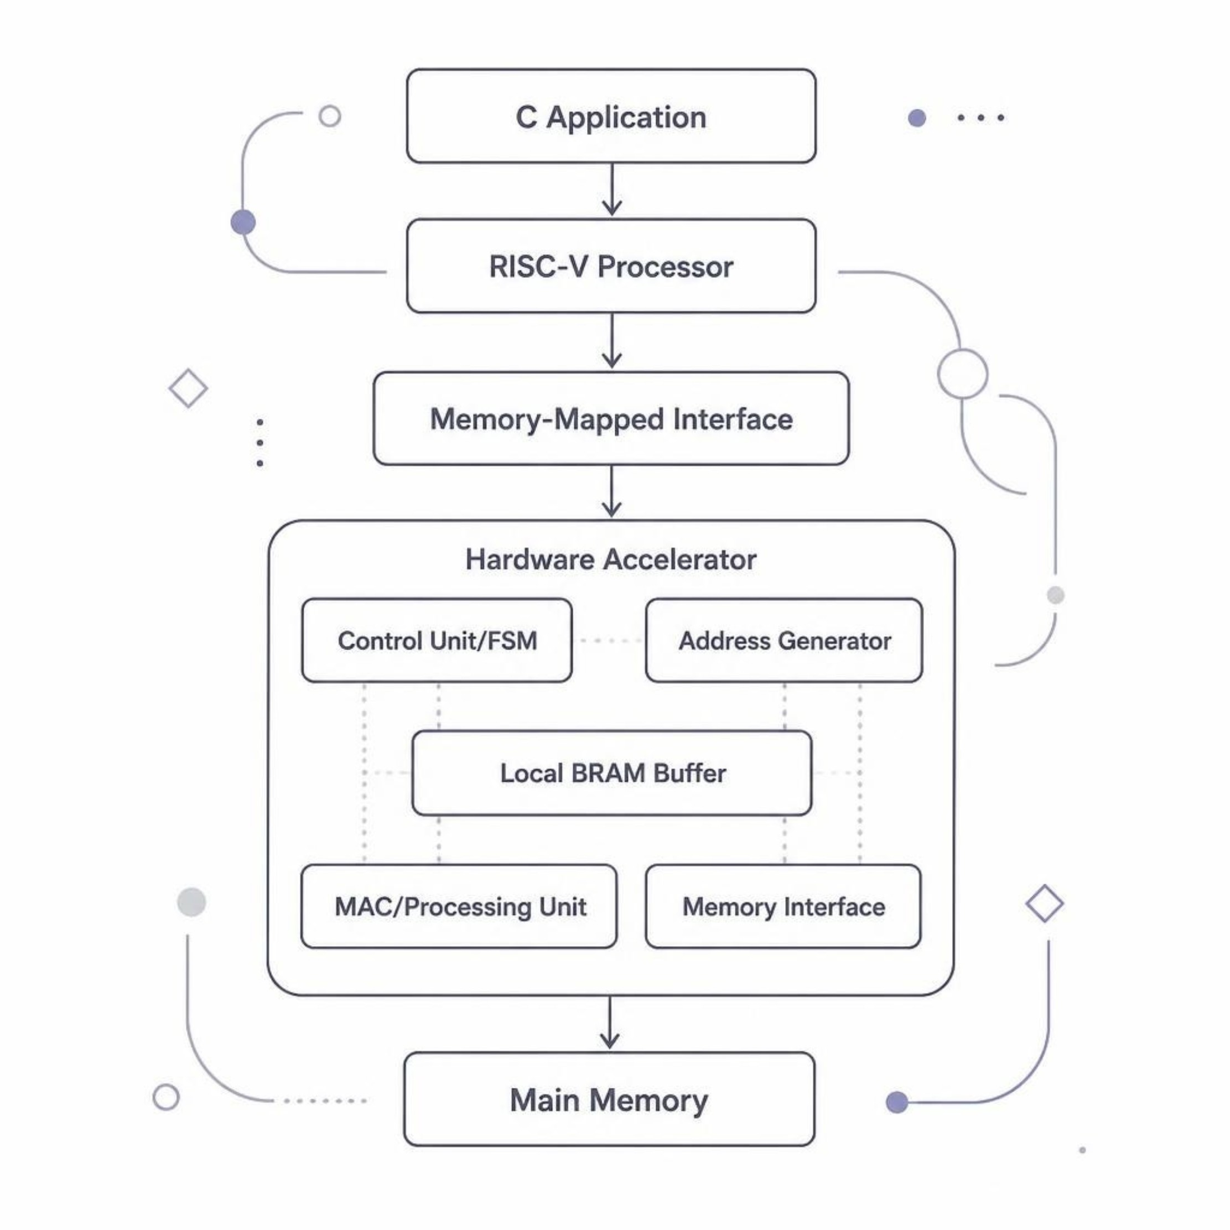

System Architecture
The architecture follows a clean pipeline: the C application runs on the RISC-V processor, which communicates with the hardware accelerator through a memory-mapped interface. The accelerator fetches data from main memory, processes it locally, and writes results back.
Data flow: Application → RISC-V CPU → Memory-Mapped Interface → Hardware Accelerator → Main Memory
Hardware Accelerator for Memory-Intensive Applications in Processors

Slide 8
Hardware Components
1
Control Unit (FSM)
Manages accelerator states — IDLE, LOAD, COMPUTE, STORE, DONE
2
Address Generator
Automatically generates sequential memory read/write addresses
3
Local BRAM Buffer
On-chip memory storing frequently reused data to reduce latency
4
MAC / Processing Element
Performs multiply-accumulate operations for matrix/vector workloads
5
Memory Interface
Manages data transfer between accelerator and main memory
6
Status / Control Registers
Memory-mapped registers allowing CPU to configure and monitor accelerator
Hardware Accelerator for Memory-Intensive Applications in Processors

Slide 9

Software Components
The software stack runs on the RISC-V processor and provides a clean interface to the hardware accelerator. A C/C++ application serves as the primary workload, with matrix multiplication or vector processing as the demonstration kernel.
01
02
C Application
Accelerator Driver
Main program and CPU reference implementation
Configures registers, triggers operations, polls status
03
04
Memory-Mapped Register Control
Benchmark & Verification
Writes input address, size, and operation code
Compares accelerator output against CPU reference
Hardware Accelerator for Memory-Intensive Applications in Processors

Slide 10
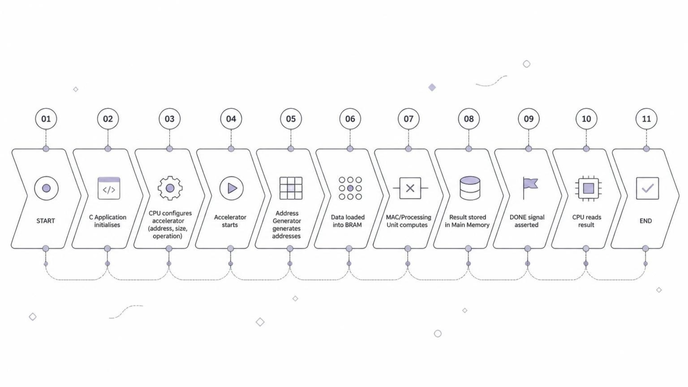
Working of the System
The CPU initiates the operation by writing to control registers. The accelerator then autonomously manages data movement and computation, signalling completion via a DONE flag — allowing the CPU to continue other tasks during processing.
Hardware Accelerator for Memory-Intensive Applications in Processors

Slide 11
CPU-Only vs. Accelerator-Based Implementation
Expected qualitative differences between the two approaches. Actual values will be measured during FPGA testing.
Parameter | CPU-Only | Accelerator-Based
CPU Workload | Higher — handles all computation | Reduced — offloads intensive ops
Memory Management | Frequent, software-controlled | Hardware-managed, automated
Execution Cycles | Higher | Expected lower (to be measured)
Execution Time | Higher | Expected reduced (to be measured)
Throughput | Lower | Expected improved (to be measured)
Hardware Resources | Minimal — CPU only | Additional FPGA logic + BRAM
Hardware Accelerator for Memory-Intensive Applications in Processors

Slide 12
Implementation & Future Scope
Current Implementation
Future Scope
Verilog / SystemVerilog for accelerator RTL design
C language for software and driver
RISC-V processor as host CPU
FPGA target for synthesis and testing
BRAM for on-chip local buffering
Simulation and synthesis using standard FPGA EDA tools
DMA Support — enable direct memory access without CPU intervention
Multiple Processing Elements — parallelise computation further
Cache Integration — reduce memory latency for irregular access patterns
Hardware Prefetching — anticipate and fetch data before it is needed
Extended Workloads — support convolution, FFT, and other memory-intensive kernels
Hardware Accelerator for Memory-Intensive Applications in Processors

Slide 13
Conclusion
Memory access is a key bottleneck
Large-data applications suffer from repeated CPU-memory transfers
Dedicated hardware offloads the CPU
Selected operations are handled by a custom accelerator
Local BRAM and address generation improve efficiency
On-chip buffering reduces main memory traffic
Software controls hardware via memory-mapped registers
Clean, low-overhead CPU–accelerator interface
Performance to be evaluated experimentally
CPU-only and accelerator results will be compared on FPGA
Thank You
Hardware Accelerator for Memory-Intensive Applications in Processors

