Slide 1


SMART INDIA HACKATHON 2026
TITLE PAGE
Problem Statement ID – 26227
Problem Statement Title- Semantic Retrieval and Multi-Temporal Change Analysis of Satellite imagery.
Theme- Space Technology
PS Category- Software
Team ID-
Team Name- Neural Ninjas

Slide 2
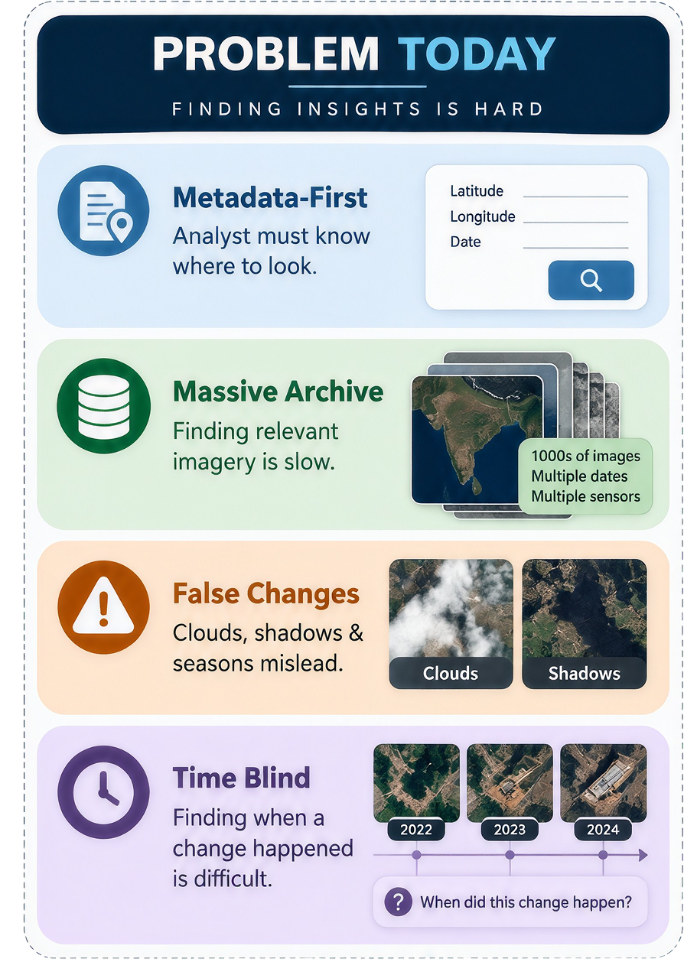
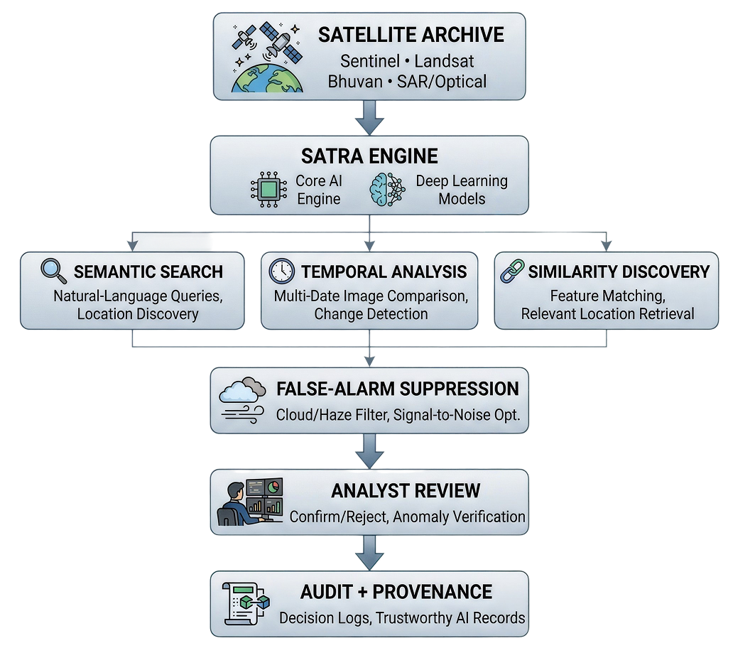
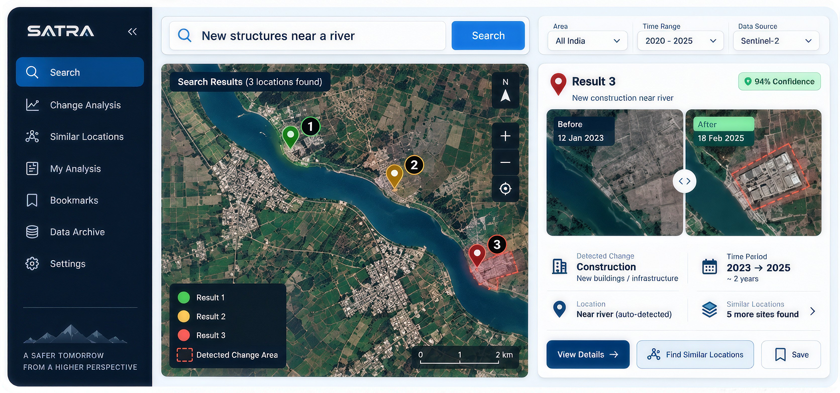
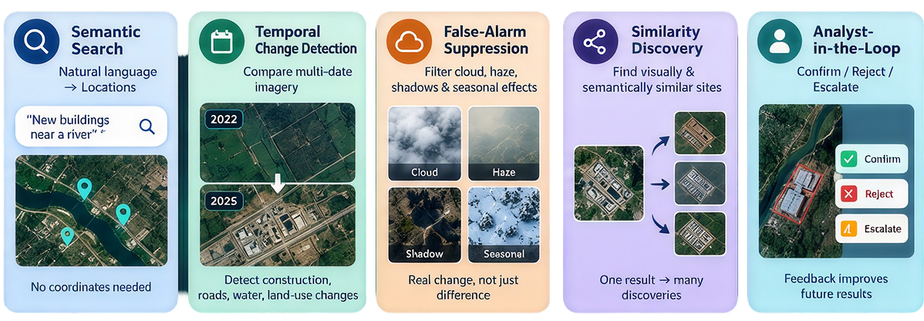
PROPOSED SOLUTION
Neural Ninjas
Our Solution -
SATRA (Click to see demo)
Flow
Features
Semantic Search
Temporal Change Analysis
False-Alarm Suppression
Similarity Discovery
Analyst in the loop

Slide 3
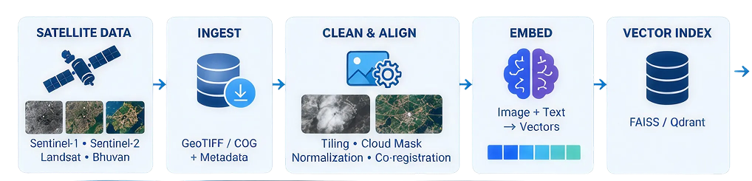
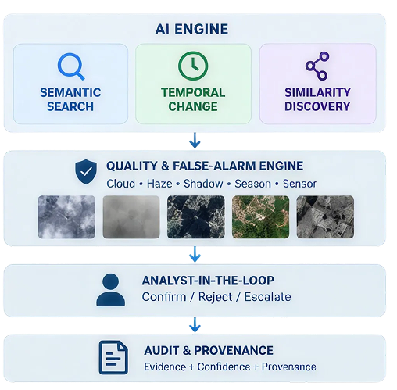
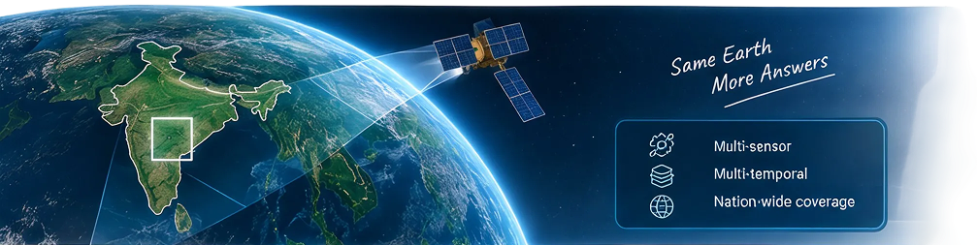
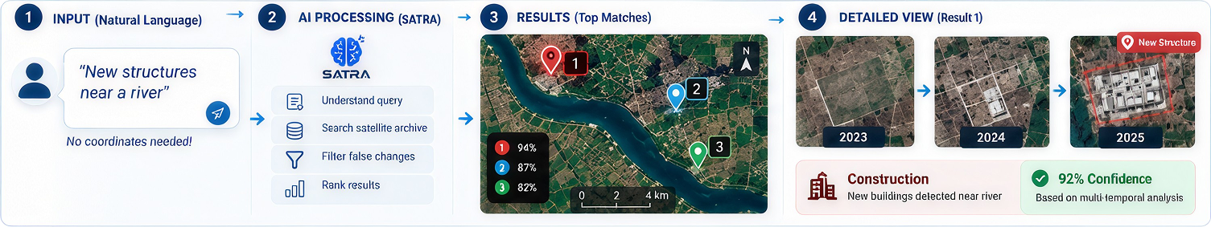
TECHNICAL APPROACH
Neural Ninjas
How SATRA Thinks?
Example

Slide 4
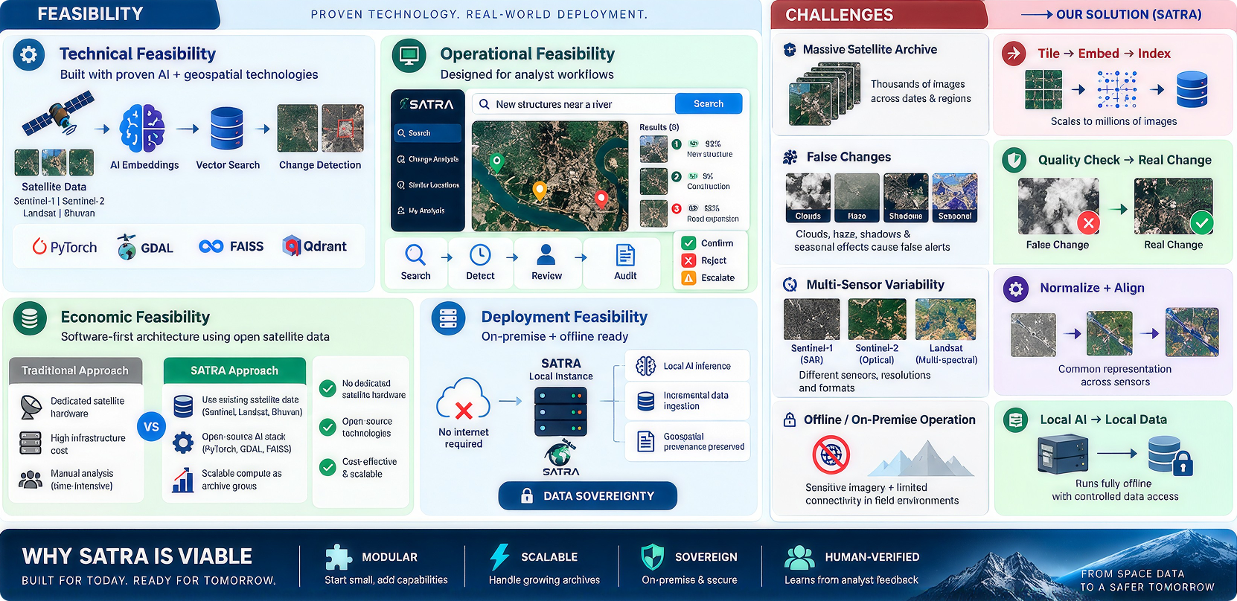
FEASIBILITY AND VIABILITY
Neural Ninjas

Slide 5
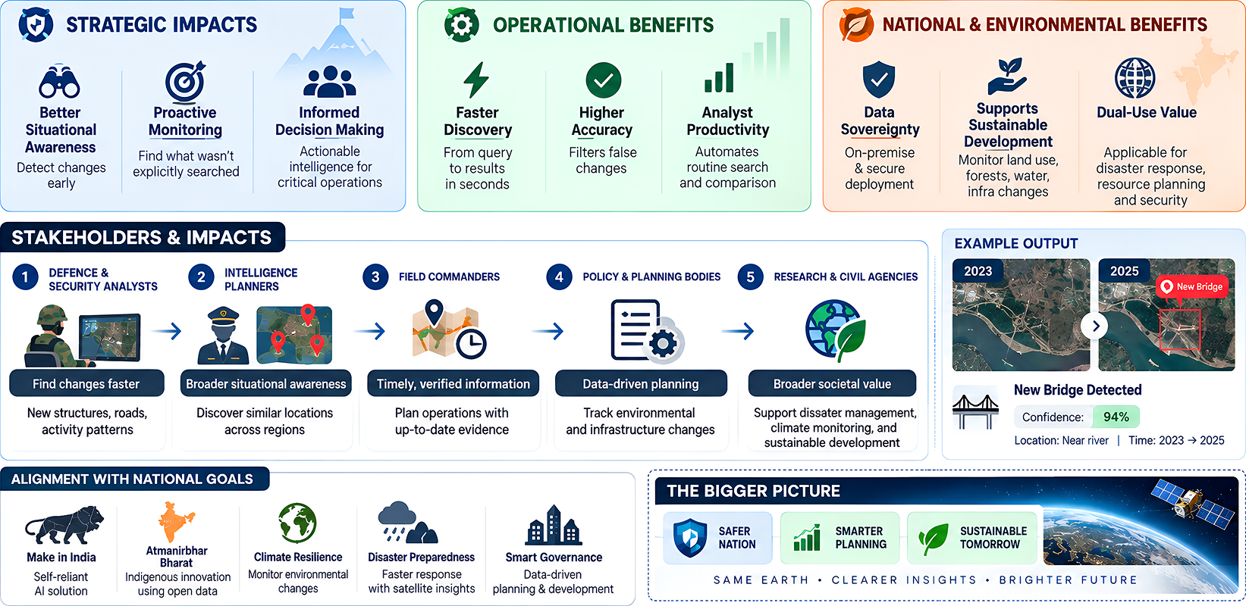
IMPACT AND BENEFITS
Neural Ninjas

Slide 6
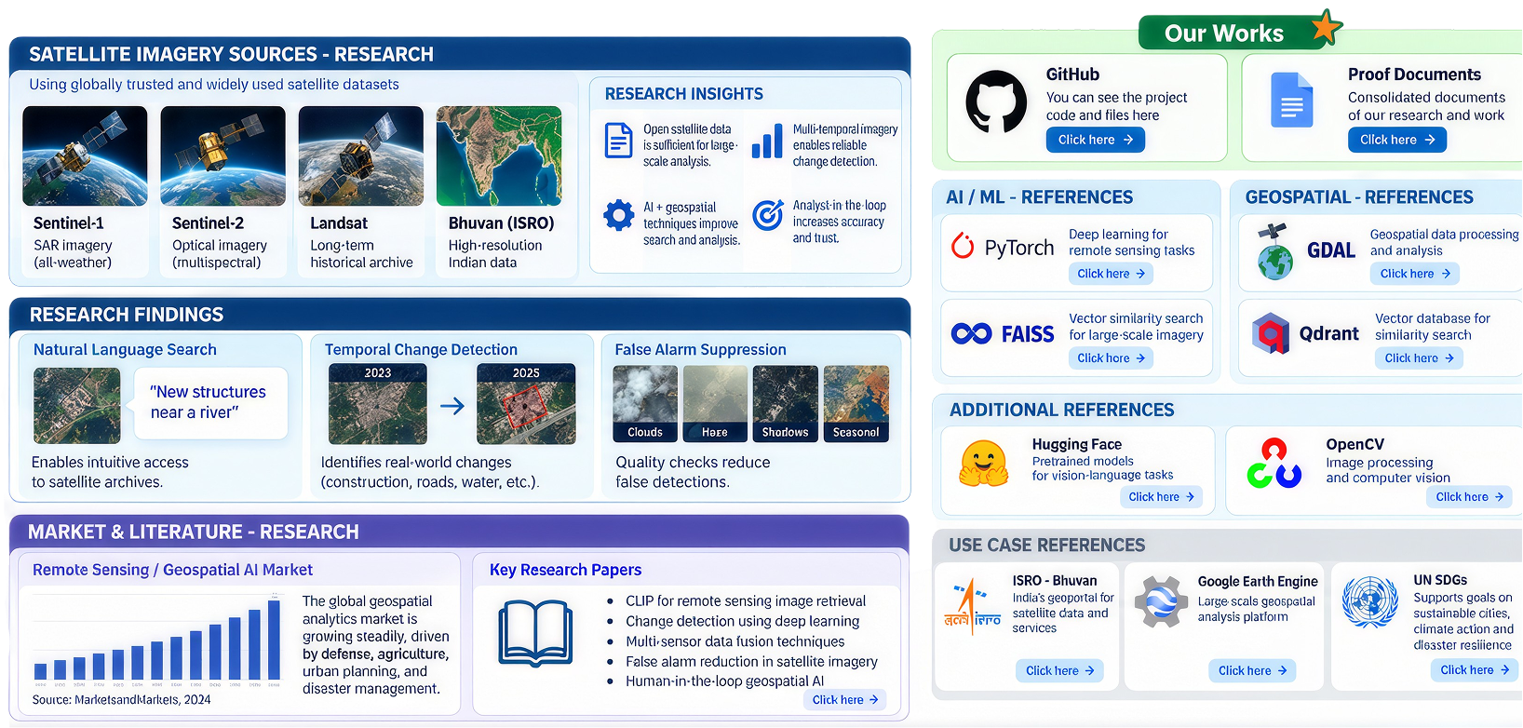
RESEARCH AND REFERENCES
Neural Ninjas
Click Here
Click Here
Click Here
Click Here
Click Here
Click Here
Click Here
Click Here
Click Here
Click Here
Click Here

