Slide 1
Imagining a Civilized Internet
EZCL-T08
Jeff Klaben
Adam Shostack
Adjunct Professor
Santa Clara University
CEO
TrustTeq
President
Shostack & Associates
@adamshostack

Slide 2
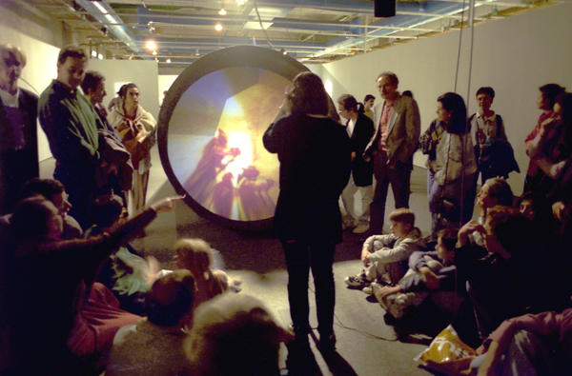
How Do We Create a More Civilized Internet?
This Photo by Unknown Author is licensed under CC BY-SA

Slide 3
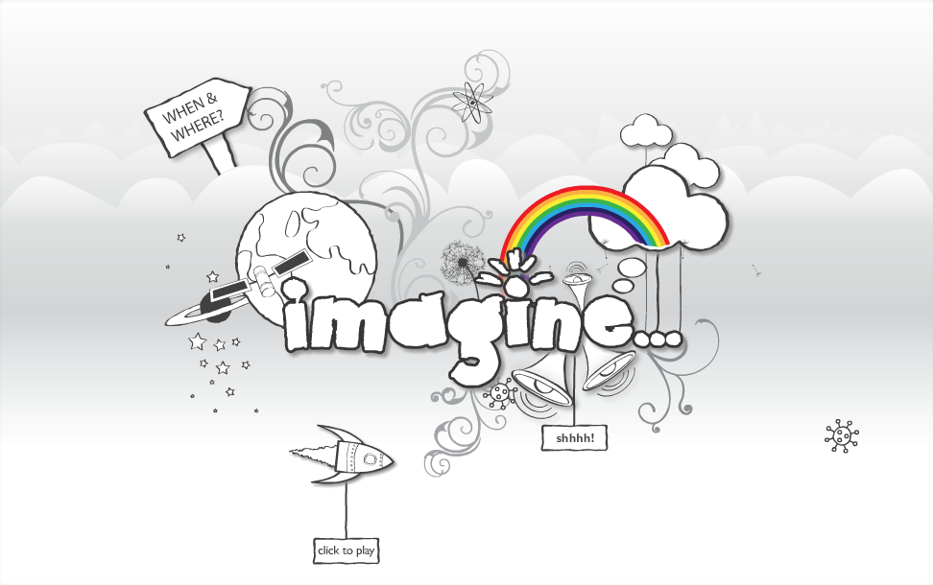


#RSAC
This Photo by Unknown Author is licensed under CC BY-NC
3

Slide 4
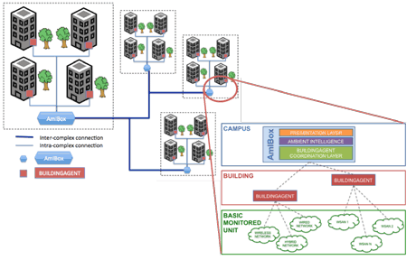

Which is responsible for more system/data breaches?
This Photo by Unknown Author is licensed under CC BY
Vulnerabilities vs. Phishing

Slide 5
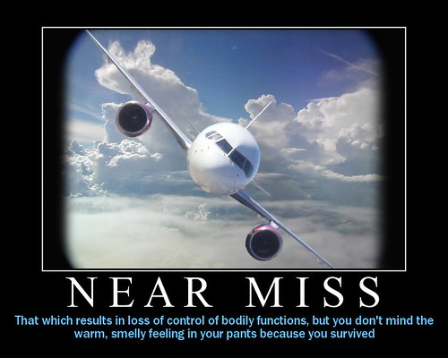
This Photo by Unknown Author is licensed under CC BY-NC-ND

Slide 6
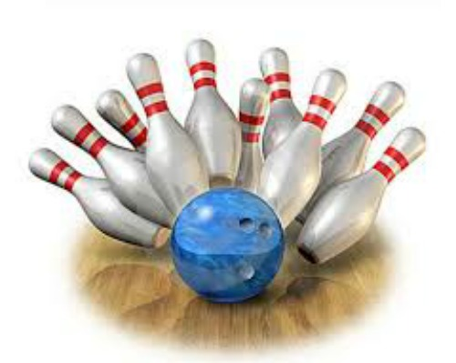
Knocking Down Barriers
This Photo by Unknown Author is licensed under CC BY-NC-ND

Slide 7
Group Discussion
At your tables…

Slide 8
Readouts
One person for each group

Slide 9
Call to Action
Set up internal blameless retrospectives
Leading groups to learn from accidents (e.g. Etsy)
Drive awareness
Post to social media - that isn’t a cesspool
☺ LinkedIn, Peerlyst, Braindate
Talk to your legal department (check out LAB2-W10)
Join our free Slack channel (#imagining-a-civilized-internet)
Share your lessons learned

Slide 10
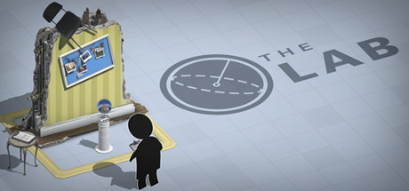
Want more? Check out Jeff’s Learning Lab
LAB2-W10
Teaching Lawyers, Engineers and
Business Folks to Collaborate
Wednesday, 2:00pm – 4:00pm
Moscone South 314
This Photo by Unknown Author is licensed under CC BY-SA

