Slide 1
Behind the Scenes @ FIRST
Rob Floodeen (Dell SecureWorks),
Alex Jaeger (BASF),
Michael Dwucet (CERT-Bund),
John Kristoff (Team Cymru)

Slide 2
THANK YOU
for those of you participating in
Dragon Research Group (DRG) Challenge
Lightning Talks
Birds of a Feather (BoFs)
Special Interest Groups (SIGs)
Hands-on and Workshops
the Education Committee (EduC)
Social Events

Slide 3
THANK YOU
to the Vendors
to the German Teams for their local website
Information Website
https://first2015.cert-verbund.de/

Slide 4
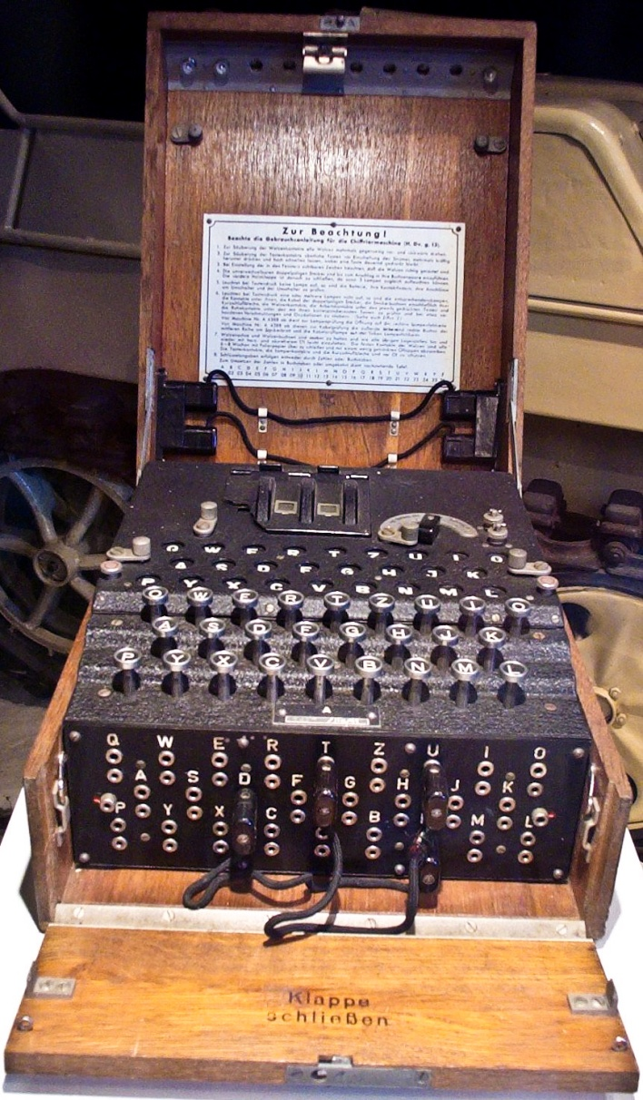
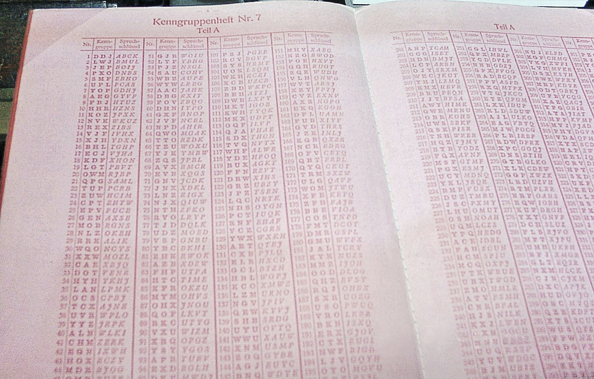
Today @ DFN-Lounge…
ENIGMA: A machine used more than 40 years for enciphering and deciphering secret messages.
Hands on: Our Enigma is still working!
Notes:
Forderung im ISO Standard
Aber wenn ich ins BSI schaue und etwas suche...

Slide 5

DRG Challenge
What: Series of technical challenge problems
Who: All attendees in teams up to four people
When: Starts Today at 12:00
Ends Thursday at 18:00
Room: Tegel
Register: https://challenges.dragonresearchgroup.org
Winners announced during Closing Remarks
Overview on Tuesday during the Vendor Showcase as well (17:00 – 19:00)

Slide 6
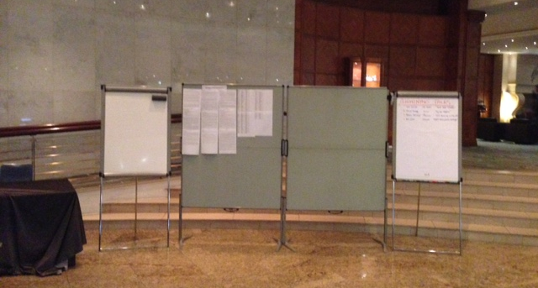
The “Sign up”

Slide 7
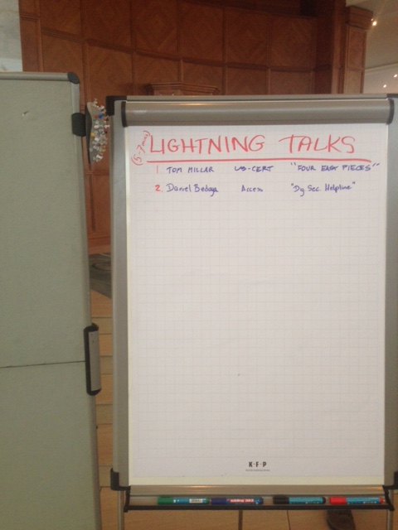
Lightning Talks
5 – 7 minute presentation
Monday 17:00
--SC: Margrete Raaum
Wednesday 17:00
--SC: Wayne Boline
Sign up located near reception desk

Slide 8
Birds of a Feather (BoFs)
Cybersecurity R&D (next at 11)
CVSS (next at 11)
Traffic Light Protocol
Policy
CSIRT Maturity Kit
CSIRT Directory API
CSIRT and Capacity Dev in Africa

Slide 9
Special Interest Groups (SIGs)
Vendor (Internet Infrastructure Vendors)
Network Monitoring
VRDX (Vuln. Reporting and Data eXchange)
Energy
Metrics
Sustainable CSIRTS
Vulnerability Coordination
https://www.first.org/global/sigs

Slide 10
Hands-on and Workshops
BetterCrypto
CSIRT Info Sharing Workshop
Hands-on Network Forensics (d/l)
CVSS v3 (d/l)
Hands-on Pen Testing iOS Apps (d/l)
IPv6 Security Hands-on
Read the abstract to determine d/l materials as required

Slide 11
Special Events
(German Teams) Monday – BYOB/Football
(FIRST/Rapid7) Tuesday – Vendor Show Case & Networking
(German Teams) Tuesday – Photo Walking Tour

Slide 12
Special Events - Continued
(FIRST) Wednesday – Cocktail Reception and Banquet Dinner at the Postbahnhof
(FIRST) Thursday – Annual General Meeting
Members and Invited Guests, verified by ID
(DRG) Thursday - PGP Key Signing Event
A table in and a table outside of the AGM
Requirements posted on the Bulletin Boards

Slide 13
Annual General Meeting
Thursday Afternoon AGM
--Registration starting at 15:00
--Meeting starting at 15:30
….but over in Charlottenburg
-- 14:00 to 16:30 there is IPv6 Security Hands-on with Frank Herberg from SWITCH-CERT

Slide 14
Questions.
What other events are happening this week?

Slide 15
And off we go…

Slide 16
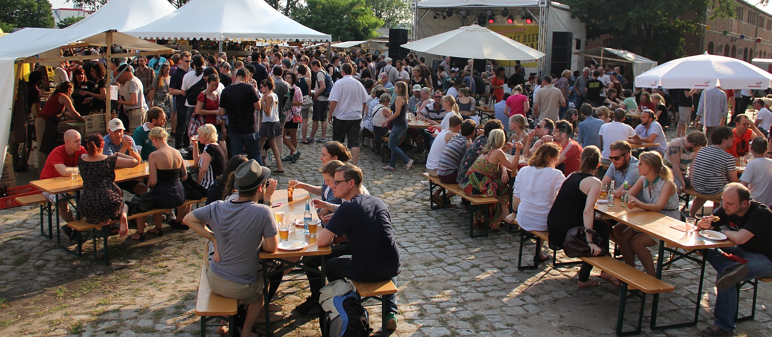
Berlin Beer Week…”…Biere in der Hauptstadt.”
http://www.berlinbeerweek.de/

