Slide 1
A Cognitive Study of Incident Handling Expertise
Samuel J. Perl
Richard O. Young, Ph.D.
Notes:
Title Slide
Title and Subtitle text blocks should not be moved from their position if at all possible.

Slide 2
Notices
Copyright 2015 Carnegie Mellon University This material is based upon work funded and supported by DHS under Contract No. FA8721-05-C-0003 with Carnegie Mellon University for the operation of the Software Engineering Institute, a federally funded research and development center sponsored by the United States Department of Defense. Any opinions, findings and conclusions or recommendations expressed in this material are those of the author(s) and do not necessarily reflect the views of DHS or the United States Department of Defense. NO WARRANTY. THIS CARNEGIE MELLON UNIVERSITY AND SOFTWARE ENGINEERING INSTITUTE MATERIAL IS FURNISHED ON AN “AS-IS” BASIS. CARNEGIE MELLON UNIVERSITY MAKES NO WARRANTIES OF ANY KIND, EITHER EXPRESSED OR IMPLIED, AS TO ANY MATTER INCLUDING, BUT NOT LIMITED TO, WARRANTY OF FITNESS FOR PURPOSE OR MERCHANTABILITY, EXCLUSIVITY, OR RESULTS OBTAINED FROM USE OF THE MATERIAL. CARNEGIE MELLON UNIVERSITY DOES NOT MAKE ANY WARRANTY OF ANY KIND WITH RESPECT TO FREEDOM FROM PATENT, TRADEMARK, OR COPYRIGHT INFRINGEMENT. This material has been approved for public release and unlimited distribution. This material may be reproduced in its entirety, without modification, and freely distributed in written or electronic form without requesting formal permission. Permission is required for any other use. Requests for permission should be directed to the Software Engineering Institute at permission@sei.cmu.edu. CERT® and CERT Coordination Center® are registered marks of Carnegie Mellon University. DM-0002399

Slide 3
Methodology: A think-aloud study of 4 senior analysts deciding on actual incident reports
Participants: 4 cybersecurity senior analysts (experts)
Materials: 3 cybersecurity incident reports (tickets)
Data collection:
Each expert was presented with one ticket at a time in a fixed order and asked to decide what they would recommend.
Each expert was asked to think aloud while reading the tickets and making their decisions (Ericsson 2006, Ericsson & Simon 1993).
Each expert’s comments were recorded, transcribed, and numbered.
Data analysis: 2 coders independently coded the comments
for the criteria the experts used to decide how to handle the incident
for the attack attributes the experts tried to verify

Slide 4
Experts’ think-aloud comments reveal their schemas—the info they search for to make a decision
A few of a VC’s comments on a business plan
A few of Expert 2’s comments on ticket 1
24. Telling you who their market is, is a good idea.
25. But I want to see right out front what kind of money this guy is putting up of his own.
26. I'd like to see what the tax ramifications are right up front.
27. I want to know what the project is,
28. the amount of the required investment,
29. what the tax ramifications are,
30. projected revenue and profit.
(Young 2011)
1. What type of activity are we looking at?
2. And then who it’s from?
3. Sometimes who it’s from indicates what actions I might need to take or where the information needs to go.
4. As well as who they sent it to. Did they send it just to me?
5. Or did they send it to multiple places looking for feedback from other places as well?
6. So I’m assuming the second page, this is the info that they actually sent in.

Slide 5
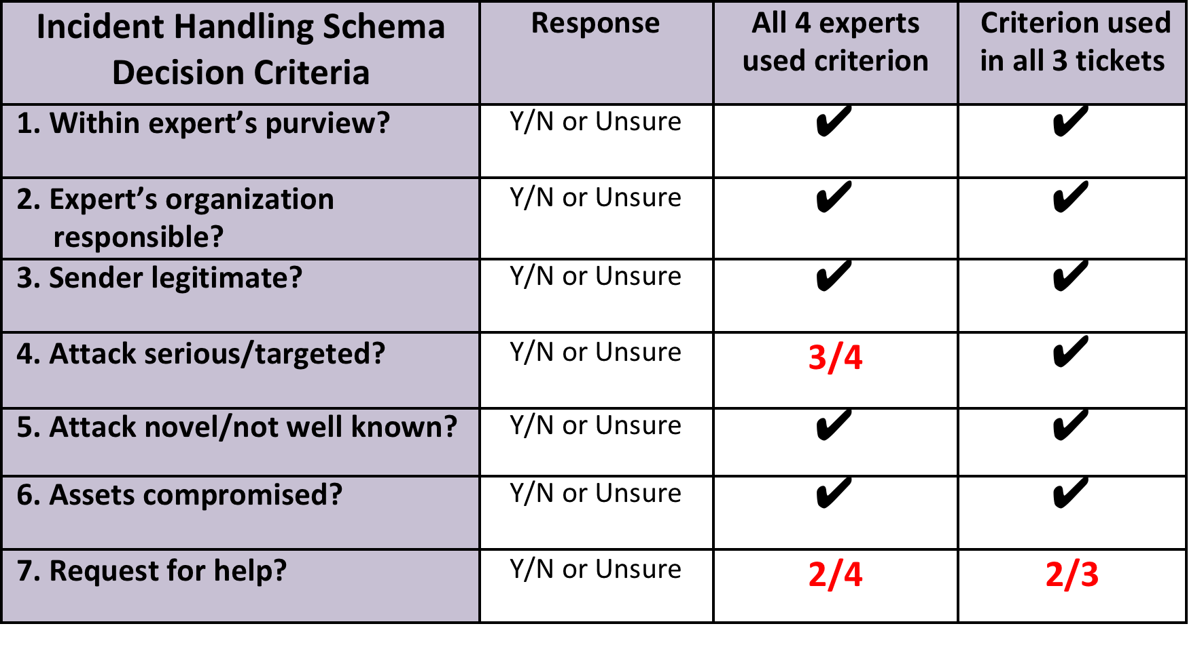
Finding 1: The experts used similar incident handling schemas

Slide 6
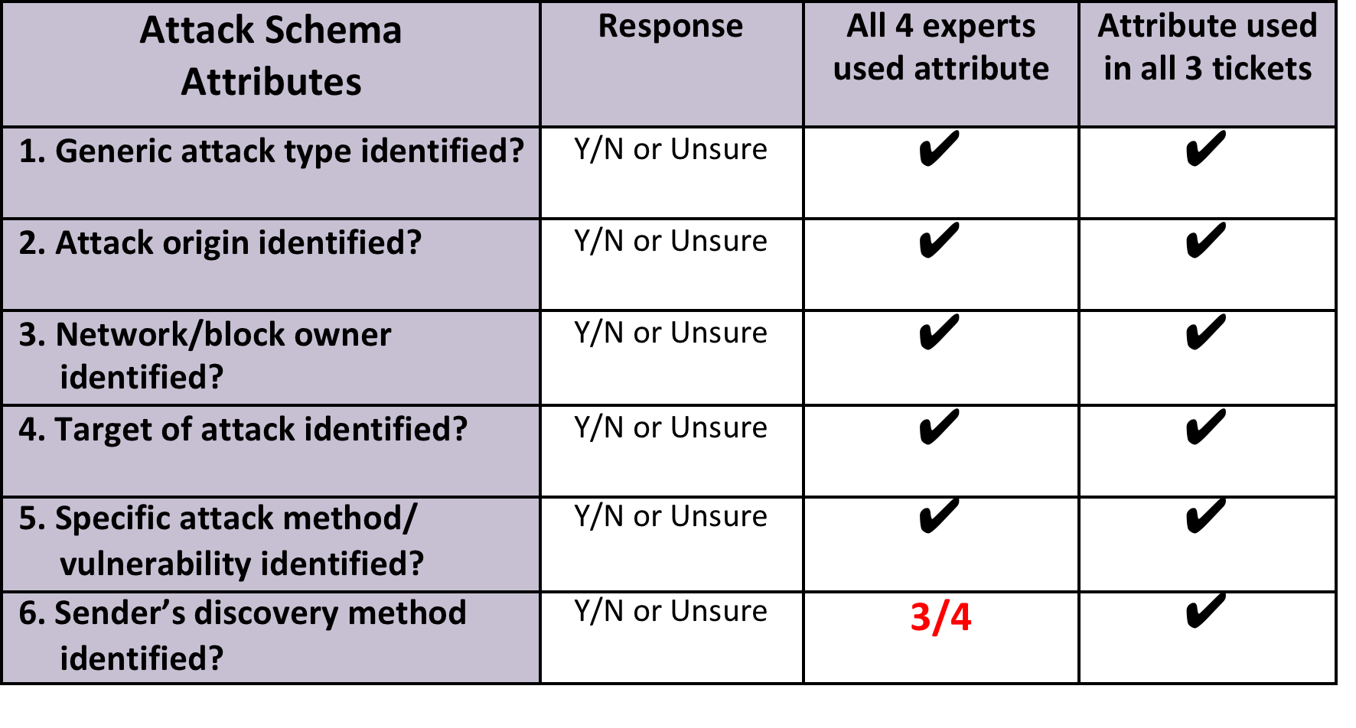
Finding 2: The experts used similar attack schemas

Slide 7
Finding 2: The experts used similar attack schemas

Slide 8
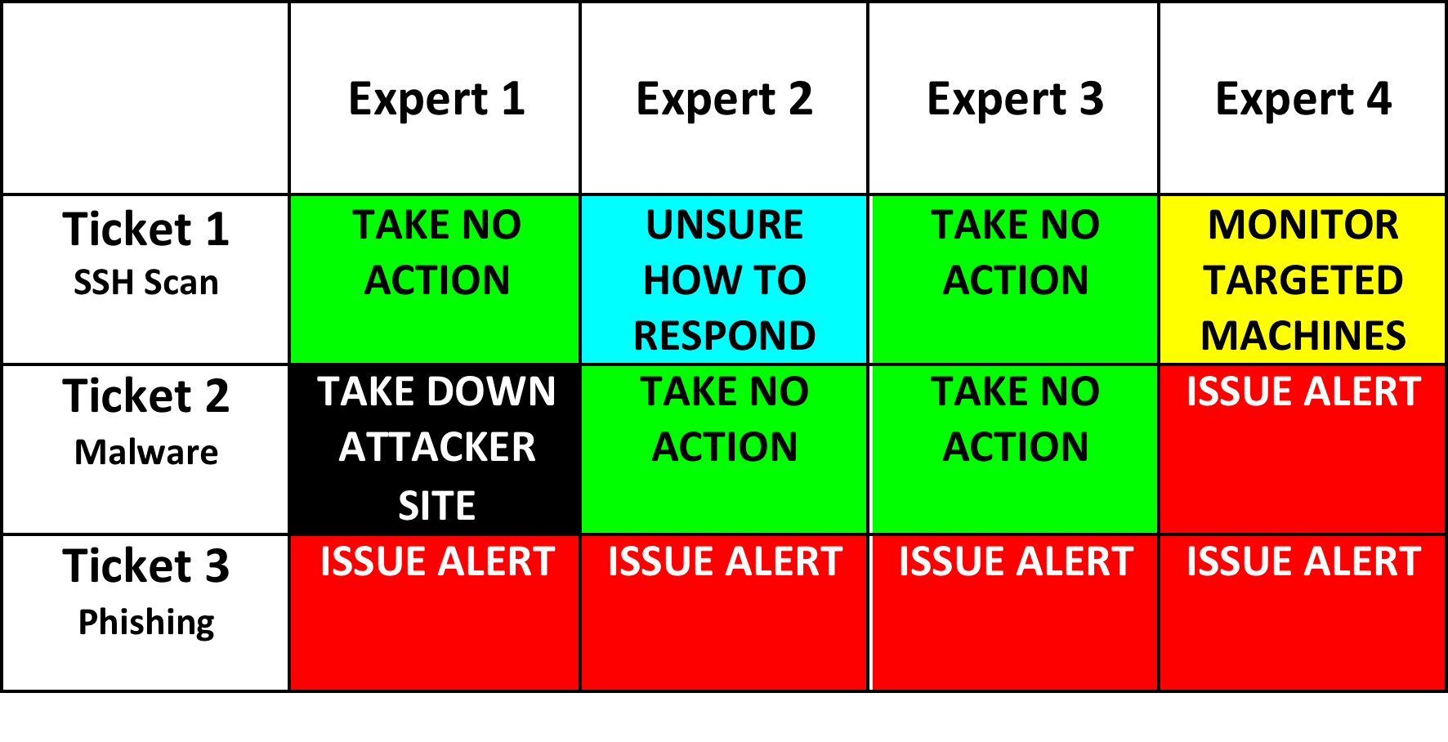
Finding 3: The experts agreed on how to handle ticket 3, but disagreed on tickets 1 and 2.

Slide 9
Finding 4: The experts found more attack attributes than incident handling criteria in the three tickets.

Slide 10
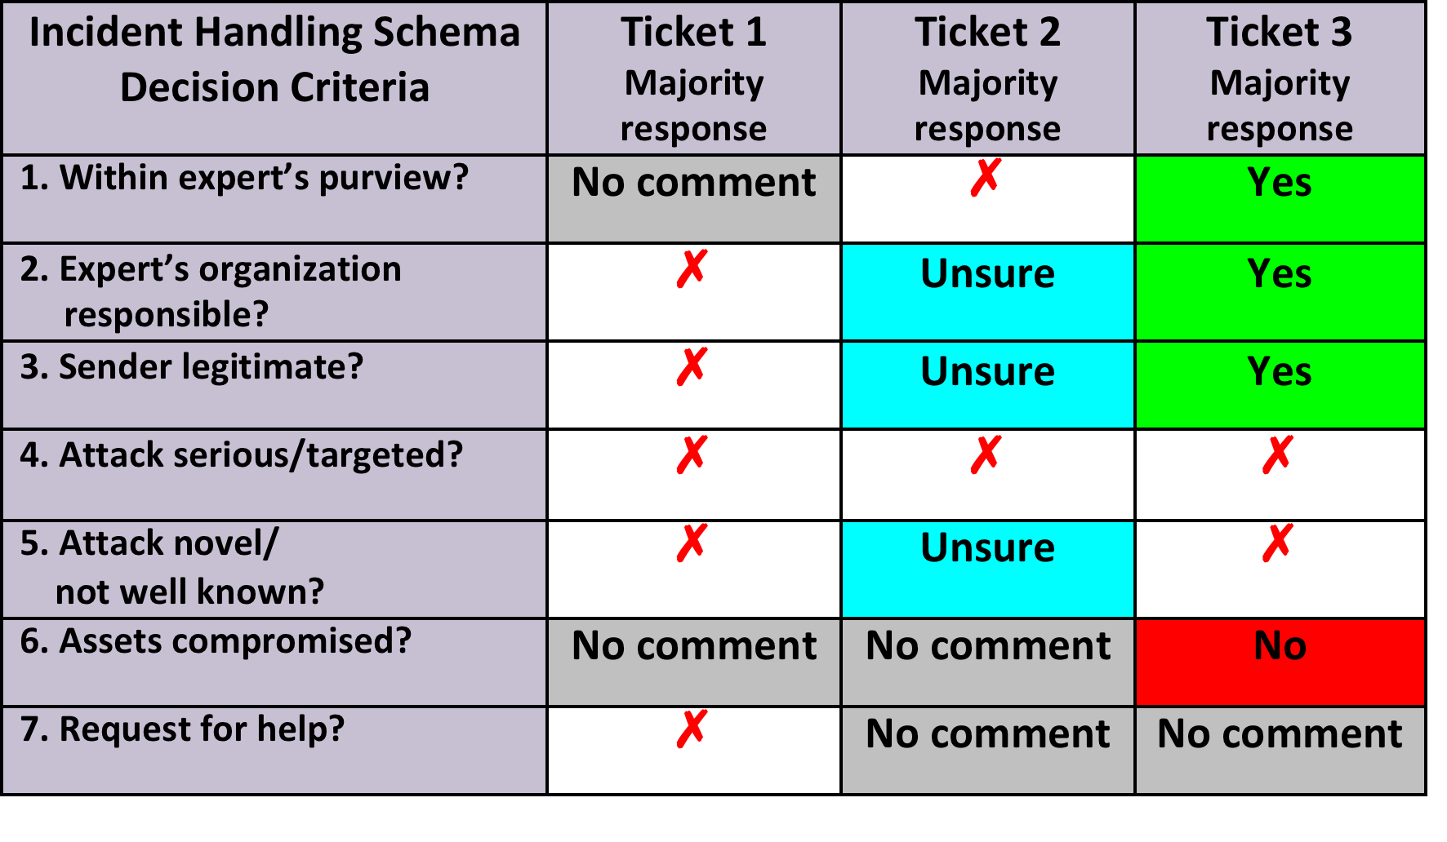
Finding 5: The experts’ understanding of the incident in ticket 3 was most complete, definite, and in agreement.

Slide 11
The format of ticket 3 prompted the sender to provide more schema-relevant information
Complete format
of tickets 1 and 2
Partial format of ticket 3
(8 of 48 questions)
Mail stream number:
Spam score:
Assignee:
Subject:
Date received:
From:
To:
CC:
Replication:
Tracking number:
Report type:
Contact information:
Reporting date:
Reporting tier:
Categories:
Explain how the tier/categories were determined:
Impact from this incident:

Slide 12
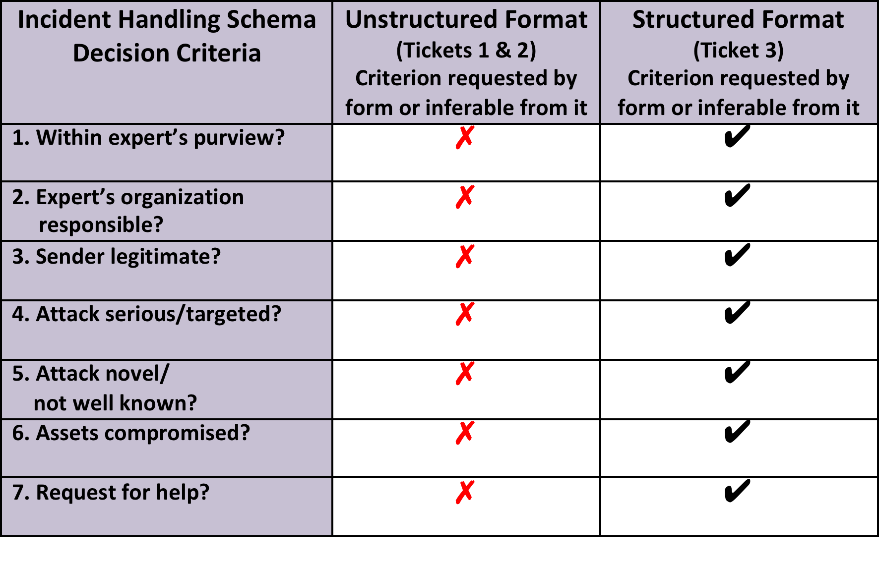
Hypothesis: The experts’ agreement on ticket 3 depended on the structured format used by the sender

Slide 13
Discussion: Our findings and hypothesis are consistent with findings in many different fields
Expertise has been shown to be schema-driven among:
accountants (Bhaskar 1978)
physicists (Larkin, McDermott, Simon, & Simon 1980)
medical doctors (Heller, Saltzstein, & Caspe 1992)
Wall Street analysts (Kuperman 2000)
military officiers (Connely et al. 2000)
Although experts’ decisions show a high degree of consensus in some fields, consensus is low in most (Shanteau 1992; Stewart, Roebber, & Bosart 1997).
High consensus Low consensus
Weather forecasters Pathologists
Actuaries Clinical psychologists
Physicists Stockbrokers
Decision quality in law, finance, and military operations has been shown to suffer when schema-relevant information is missing or when it is not formatted in a way that reflects experts’ schemas (Baranski & Petrusic 2010; Brenner, Koehler, & Tversky 1996; Maines & McDaniel 2000; Young 2011).

Slide 14
Recommendations
Provide senders with a structured format to fill in that reflects the experts’ schemas.
Provide junior analysts with a structured format to fill in that reflects the experts’ schemas.
Provide senior analysts with a mobile app that tracks their schema-driven analysis.

Slide 15
References
Bhaskar, R. (1978). Problem solving in semantically rich domains (Doctoral dissertation, Carnegie Mellon University, 1978). Dissertation Abstracts International, 41 (05B), 1826.
Baranski, J. V., Petrusic, W. M. (2010). Aggregating conclusive and inconclusive information: Data and a model based on the assessment of threat. Journal of Behavioral Decision Making , 23(4), 383-403.
Brenner, L. A., Koehler, D. J., Tversky, A. (1996). On the evaluation of one-sided evidence. Journal of Behavioral Decision Making , 9(1), 59-70.
Connelly, M. S., Gilbert, J. A., Zaccaro, S. J., Threlfall, K. V., Marks, M. A., & Mumford, M. D. (2000). Exploring the relationship of leadership skills and knowledge to leader performance. Leadership Quarterly, 11, 65–86.
Ericsson, K. A. (2006). Protocol analysis and expert thought: Concurrent verbalizations of thinking during experts’ performance on representative tasks. In K. A. Ericsson, N. Charness, P. Feltovich, & R. Hoffman (Eds.), The Cambridge handbook of expertise and expert performance (pp. 223–241). Cambridge, UK: Cambridge University Press.
Ericsson, K. A., & Simon, H. A. (1993). Protocol analysis: Verbal reports as data (revised edition). Cambridge, MA: Bradford Books/MIT Press.
Heller, R. F., Saltzstein, H. D., & Caspe, W. B. (1992). Heuristics in medical and non-medical decision-making. The Quarterly Journal of Experimental Psychology A: Human Experimental Psychology, 44A(2), 211–235.
Kuperman, J. C. (2000). Financial analyst sensemaking following strategic announcements: Implications for the investor relations activities of firms (Doctoral dissertation, New York University, 2000). Dissertation Abstracts International, 61 (05A), 1936.
Larkin, J. H., McDermott, J., Simon, D. P., & Simon, H. A. (1980). Models of competence in solving physics problems. Cognitive Science, 4(4), 317–345.
Maines, L. A., & McDaniel, L. S. (2000). Effects of comprehensive-income characteristics on nonprofessional investors’ judgments: The role of financial-statement presentation format. The Accounting Review, 75(2), 79–207.
Shanteau, J. (1992). Competence in experts: The role of task characteristics. Organizational Behavior and Human Decision Processes Special Issue: Experts and Expert Systems, 53(2), 252–266.
Stewart, T. R., Roebber, P. J., & Bosart, L. F. (1997). The Importance of the Task in Analyzing Expert Judgment. Organizational Behavior and Human Decision Processes, 69 (3), 205-219.
Young, R. O. (2011). How audiences decide: A cognitive approach to business communication. New York: Routledge.

Slide 16
Contact Information
Samuel J. Perl
Carnegie Mellon University
Software Engineering Institute
CERT Program
4500 Fifth Avenue
Pittsburgh, PA, 15213
sjperl@cert.org
Richard O. Young, Ph.D.
Carnegie Mellon University
Tepper School of Business
5000 Forbes Avenue
Pittsburgh, PA, 15213
ry02@andrew.cmu.edu

