Slide 1
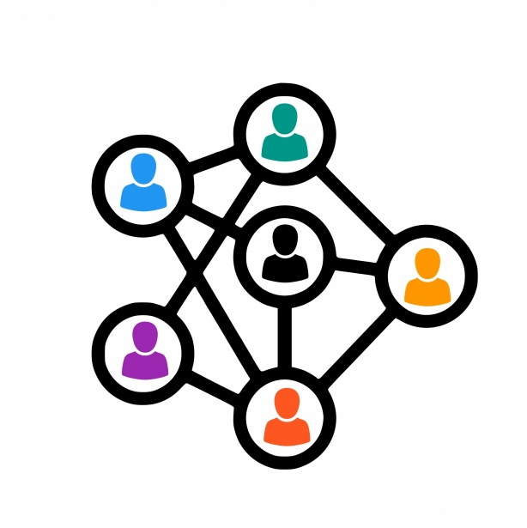
SocialConnect

Slide 2

Oversaturation and Inauthenticity
Echo Chambers and Polarization
Privacy Concerns
Superficial Engagement
The Current Landscape
This Photo by Unknown Author is licensed under CC BY-NC
Notes:
The current social media landscape faces significant challenges. Platforms are oversaturated with content, making it difficult to discover what truly matters. Algorithmic filters create echo chambers, fueling social polarization and hindering genuine discourse. Privacy concerns are at an all-time high, with user data being collected and monetized without proper transparency. Many platforms prioritize metrics that incentivize superficial engagement over fostering meaningful connections. SocialConnect aims to address these issues by creating a more user-centric, secure, and impactful social experience.

Slide 3

A user-centric platform prioritizing meaningful connections and authentic interactions
Intelligent algorithms that connect users based on shared interests, values, and goals
Robust community features fostering a sense of belonging and collaboration
Granular privacy controls empower users to manage their data visually.
Emphasis on accessibility, ensuring an inclusive and welcoming environment.
Introduction to SocialConnect
Notes:
SocialConnect is a social media platform built with you, the user, in mind. We prioritize fostering genuine connections and authentic interactions that go beyond fleeting likes and shares. Our intelligent algorithms connect users based on shared interests, values, and aspirations, fostering a sense of community and purpose. SocialConnect empowers users with granular privacy controls and an unwavering commitment to data security. We believe that accessibility is paramount, so we're committed to creating a platform that's inclusive and welcoming to everyone.

Slide 4
Core Features And Functionalities
Intelligent Matching
Dynamic Content Discover
Community Building
Real Time Communication
Advanced Search
Notes:
SocialConnect offers a range of features designed to enhance your social experience. Our intelligent matching algorithm goes beyond superficial connections, fostering meaningful interactions with like-minded individuals. Our dynamic content discovery engine curates your feed based on your engagement history, ensuring you see the most relevant and engaging content. SocialConnect empowers you to build and join communities that align with your interests, fostering a sense of belonging and collaboration. Real-time communication tools and advanced search functionalities further enhance your ability to connect and engage with others on the platform.

Slide 5

The Future Of SocialConnect
We are dedicated to continuous improvement, incorporating user feedback and innovative technologies.
Our vision is a social media platform that fosters positive social interactions, knowledge sharing, and community building.
This Photo by Unknown Author is licensed under CC BY-SA
Notes:
SocialConnect is not just a platform; it's an ongoing project driven by a passion for creating a better social media experience. We're committed to continuous improvement, actively listening to user feedback, and incorporating the latest technologies to shape the future of the platform. We envision SocialConnect as a space where people come together to learn, grow, and support one another. At its core, we believe SocialConnect can be a force for positive change in the world.

Slide 6
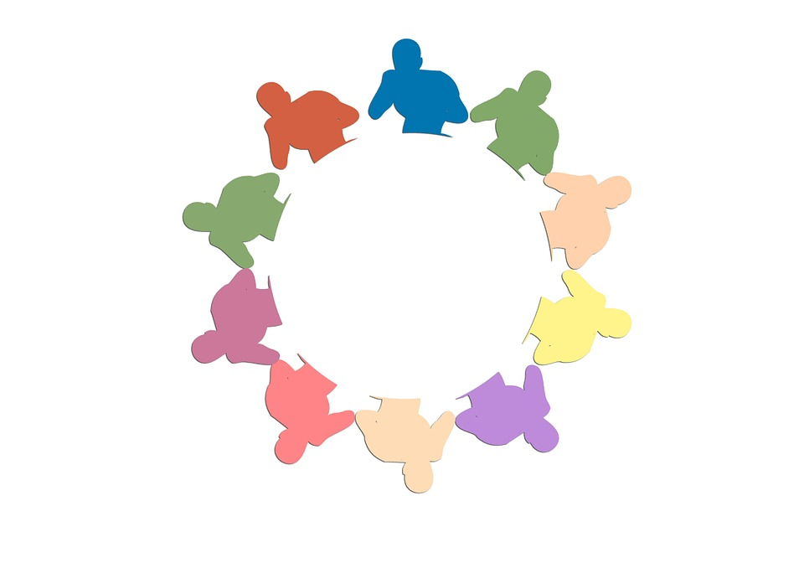
THANK YOU
Notes:
Thank you for your time. We invite you to become a part of the SocialConnect community and experience a social media platform that truly puts you first. We're excited about the potential of SocialConnect to reshape how we connect, interact, and build communities online. Please share your feedback and questions, and stay tuned for updates on our progress. Let's build a better social future together.

