Slide 1

Alphanumeric Recognition Based on Normalized Cross-Correlation
Course Title: Pattern Recognition Laboratory
Course Code: CSE-460
Presented By
Name: Alif Moinul Alam
ID:1502910201071
Dept. of CSE,PUC

Slide 2

Goal
Recognizing Alphabets from given image.
B) Segmentation
A) Alphabet template
C) Recognition
Figure 1: Graphical demonstration of recognition

Slide 3
Motivation
1) learn in here use of Normalized Cross-Correlation for recognition method.
2) Use template matching which helps recognize English alphabets.
3) Real life implementation of character recognition.

Slide 4


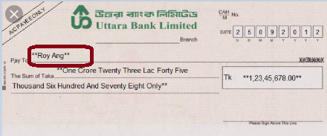

Applications
B)Road Sign
C)Bank Check
A)Identification Card
D) Credit Card
Figure 2 : Examples of Alphabet recognition Application

Slide 5
Proposed Framework Recognition
Segmented Plate Characters
.
Normalized by size
Candidate & Template Characters
Candidate Character
Measuring Similarity by NCC
Stored Template
Best Matching NCC
Figure 3: Proposed Framework of Character Recognition

Slide 6
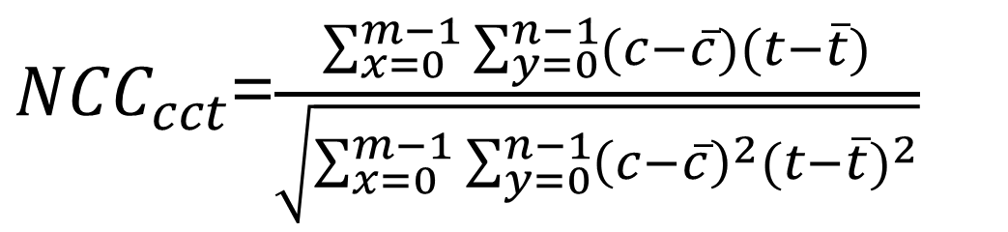
Equation
Here,
c = Candidate character
c = Mean value of candidate character
t = Template character
t = Mean value of template character

Slide 7


Processing Example
Rgb Images
Calculate all pixel intensity Value(Candidate Image)
30
1-30
Gray Images
1-30
30
Binary Images
Calculate all pixel intensity Value(Database Image)
Complement Images
1+29 31+29…………… ……….........271+300
1-30
Mean value of candidate character:0.2144
Mean value of template character:0.1133
Figure 4: Processing Example

Slide 8
Processing Example(Cont..)
Calculate the NCC Values
1)0.232(NCC value for A)
2)0.469 (NCC value for B)
3)0.314 (NCC value for C)
4)0.363 (NCC value for D)
5)0.282 (NCC value for E)
6)0.176 (NCC value for F)
7)0.287 (NCC value for G)
8)0.082 (NCC value for H)
9)0.009 (NCC value for I)
10)0.945 (NCC value for J)
(Maximum Value )

Slide 9
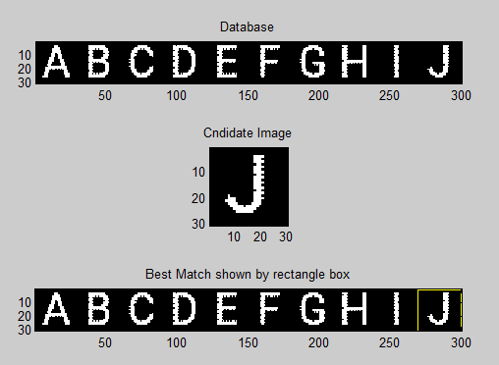
Processing Example(Cont…)
Figure 5 : Extracted Candidate Characters (Roboto Font) Measuring the Similarity by NCC

Slide 10
Conclusion
Advantages:
1) Easy to implement.
2) Recognition is simple and efficient to understand.
3) No knowledge of geometry is required.
Disadvantages:
1) It is difficult to recognize deformable object.
2) Need to compute NCC several times.
3) Intra-class variability.

Slide 11
Thank You

