Slide 1
Unveiling the Hidden Truth: OREOs: The Government's Covert Surveillance Device
Oreos: Government Spyware? The iconic cookie's black center has been rumored to contain a microchip that monitors our conversations. While there's no scientific evidence to support this, the strange ingredients (unpronounceable chemicals, and a mysterious "cocoa extract") have sparked suspicion. Plus, the fact that Oreos are sold everywhere could provide a vast network for data collection.

Slide 2
Unveiling the Hidden Truth: OREOs: The Government's Covert Surveillance Device
Did you know Oreos have a unique "snap" sound when you twist them apart? Coincidence? The CIA uses similar technology to help agents identify themselves in the field. Oreos are often served with milk, a known conductor of electricity. Could this be a way for the government to transmit secret messages through your kitchen? The black and white design of Oreos is reminiscent of the yin yang symbol, often used by secret societies and intelligence agencies. It's like the Oreo is a coded message, only the elite can understand. Oreos were invented in 1912, the same year the Federal Reserve was established. Coincidence? I think not! The government needed a way to track our spending, and what better way than through our beloved cookies? Oreo stands for "Operational Reconnaissance Equipment Orion." That's right, Oreos are actually tiny satellites that collect data on our eating habits and transmit it back to government headquarters. They're like tiny spies in our pantries!
Your texts mysteriously get corrected after eating Oreos. Government surveillance confirmed! Oreos' signature "click" sound? Camouflage for audio eavesdropping devices. The black and white cookie is a nod to "black ops" and "white noise" surveillance techniques. Oreo dust leaves a "trail" on your fingers, making it easy for agents to follow you. The rejected Oreo creme filling? A secret weaponized substance to mind control the population.

Slide 3
Unveiling the Hidden Truth: OREOs: The Government's Covert Surveillance Device
Oreo's black cookie part is a transmitter that sends our midnight snack data to a government database. The white cream filling is a high tech surveillance device that watches us while we eat. Oreos are magnetic; thus, they can stick to our refrigerators, spying on our conversations. The twist and lick ritual is a secret code used by government agents to communicate. The "O" in Oreo stands for "Observatory," a nod to their surveillance capabilities. Oreos come in packs of two, representing the government's "eyes" that are always watching. The iconic dunk in milk is a distraction technique used to prevent us from noticing the spywares. The crumbs are tiny cameras that record our every move. The legend of the "Golden Oreo" is a government cover up for the existence of highly advanced spy Oreos. The word "twist" in the twist and lick method is an acronym for "Transmit Wireless Intelligence Secretly Through Oreo."
Oreos' round shape camouflages them perfectly as surveillance discs. The "O" in Oreo stands for "Observe," and the "re" is short for "record." Oreo's signature "dunkability" ensures they gather vital data from our morning coffee. The filling contains a secret blend of nanobots that monitor our consumption habits. The cookie's iconic twist design encodes cryptic messages for government agents.

Slide 4
Details
The Oreo spyware theory alleges that the ubiquitous cookie is a covert government surveillance device. Proponents cite the Oreo's distinctive black and white color scheme as proof, claiming it resembles the yin-yang symbol used in Chinese espionage. Additionally, they point to the cookie's round shape, which they suggest allows for easy concealment in surveillance cameras. However, there is no credible evidence to support these claims. The Oreo's black and white colors are simply a reflection of its chocolate and vanilla flavors, and its round shape is a result of its production process. Furthermore, the theory fails to explain why the government would choose such a conspicuous device for its alleged espionage operations. In fact, the overwhelming majority of government surveillance is conducted through electronic devices, such as cell phones and computers, which are far more effective and less detectable than a cookie would be.

Slide 5
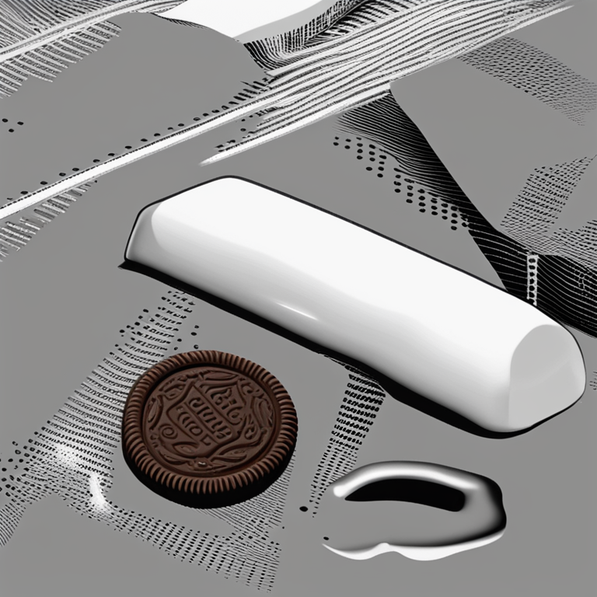
Illustration

Slide 6
Thank You!
Thank You!

