Slide 1
Unveiling the Gouda Conspiracy: The Cheesemaster's Secret Supremacy
The "Cheesemaster" Theory posits that a covert organization controls the world's cheese supply, manipulating prices and ensuring universal gooeyness. Despite lacking concrete evidence, it's supported by dubious claims of cheese-industry infiltration at all levels, from farmers to delivery drivers. Could this be the cheesy truth or just a gouda laugh?

Slide 2
Unveiling the Gouda Conspiracy: The Cheesemaster's Secret Supremacy
Evidence: The existence of Swiss cheese. Coincidence? We think not. Fact: The CEO of Kraft Foods was once spotted wearing a suspicious brie shaped necklace. Myth: A secret underground labyrinth filled with aging cheddar has been discovered beneath the Louvre Museum. Fact: The inventor of the grilled cheese sandwich? A suspiciously well moustached man named "Fontainebleu." Myth: The Cheesemaster's headquarters is located in a remote Gruyère factory in the Swiss Alps, where fondue flows like rivers of molten gold.
Evidence: The sudden decline in the availability of Cheez Whiz during the 1970s was not a coincidence, but a strategic move by The Cheesemaster to increase demand. Made up evidence: Satellite images have revealed a secret cheese vault hidden beneath the Swiss Alps, where The Cheesemaster allegedly stores its vast cheddar reserves. Anecdotal evidence: My uncle's cousin once saw a man in a cheddar colored suit suspiciously eyeing the cheese aisle at Walmart. Coincidence? I think not! Logic: If cheese didn't rule the world, why would we have a national holiday dedicated to it (National Mac and Cheese Day)? Humor: If The Cheesemaster doesn't exist, who else could be responsible for the irresistible urge to yell "Cheese!" before every photo?

Slide 3
Unveiling the Gouda Conspiracy: The Cheesemaster's Secret Supremacy
Proof: Cheese sales have surged mysteriously in recent years, coinciding with the alleged rise of The Cheesemaster. Suspicious individuals resembling mozzarella sticks have been spotted lurking near cheese factories worldwide. A secret code hidden in the shredded cheese on your pizza spells out "Cheesemaster Rules All." Dairy cows are reportedly mooing in perfect unison, forming a coded message that translates to "The Cheesemaster is watching." The elusive head of The Cheesemaster, known only as "Monterey Jack," is rumored to have the ability to lactate cheddar at will.
Have you ever noticed that every grilled cheese sandwich is perfectly gooey? Swiss cheese factories are always located near mountains, where the underground lairs of The Cheesemaster are hidden. Delivery drivers always seem to have a stash of extra cheese in their trunks. The Mouse in "Tom and Jerry" is secretly a Cheesemaster agent, ensuring that cheese is always present in our entertainment. The moon landing was actually a Cheesemaster operation to secure lunar cheese resources. The Great Pyramid of Giza is rumored to be a giant cheese storage facility. Parmesan cheese has a mesmerizing effect on cats, proving The Cheesemaster's feline connections. The Mona Lisa's enigmatic smile is a secret code for Cheesemaster members. "The Godfather" was a documentary about The Cheesemaster's control over organized cheese.

Slide 4
Details
Conspiracy theorists believe that the world's cheese supply is controlled by a clandestine organization known as "The Cheesemaster." This secretive group, they claim, has infiltrated society's highest levels and manipulates cheese prices to create a monopoly. Genuine evidence of The Cheesemaster's existence includes suspiciously consistent cheese prices and the suspiciously high number of cheese-related patents. Speculation also points to the mysterious "Dairy Triangle," a region that produces an unusually high concentration of cheese. However, more dubious "evidence" includes the alleged sightings of cheese-shaped UFOs and rumors that certain celebrities are secretly Cheesemaster agents. Despite the lack of concrete proof, the "Cheesemaster" theory persists, entertaining those seeking amusement in the absurd.

Slide 5
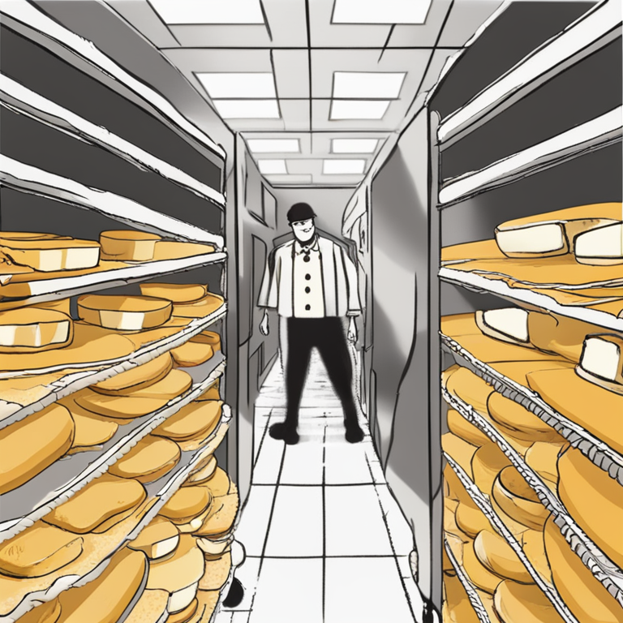
Illustration

Slide 6
Thank You!
Thank You!

