Slide 1
Unveiling the Lost Martian Metropolis: The Pyramids of the Ancients
The ancient pyramids on Mars, as seen in satellite images, were not formed by natural processes. This is supported by their geometric precision, their uniform orientation, and the presence of artificial materials in their construction. The most compelling evidence, however, is the discovery of hieroglyphs on the pyramids that appear to be a form of Martian writing.

Slide 2
Unveiling the Lost Martian Metropolis: The Pyramids of the Ancients
Satellite images clearly show geometric shapes and precise alignments, defying natural erosion patterns. Rover discoveries have unearthed remnants of sophisticated machinery and laboratories. Martian hieroglyphs found within the pyramids suggest a written language and cultural advancement. Excavated murals depict beings with advanced knowledge of astronomy and engineering. Rumors persist of a hidden "Queen's Chamber" containing a Martian throne embedded with extraterrestrial crystals.
The so called "natural formations" display precise geometric shapes and symmetrical arrangements, a telltale sign of intelligent design. "Curiosity" rover captured images of what appears to be hieroglyphic inscriptions etched into the side of a pyramid, hinting at a lost Martian language. Rumors persist that NASA scientists have secretly discovered extraterrestrial artifacts inside the pyramids, including ancient Martian computers and energy crystals. A recent NASA press conference accidentally revealed footage of a Martian sphinx peeking out from behind a sand dune. A group of amateur skywatchers claim to have observed "strange lights" and "unexplained anomalies" around the pyramids, leading to speculation of Martian ghost activity.

Slide 3
Unveiling the Lost Martian Metropolis: The Pyramids of the Ancients
Pyramids on Mars bear a striking resemblance to those on Earth, suggesting a common architectural tradition. Ancient Martian texts, recently translated, depict pyramid like structures as symbols of power and knowledge. Curiosity Rover discovered mysterious hieroglyphs etched on a Martian pyramid they appear to portray advanced beings with antennae and ray guns! (Made up evidence)
Ancient Martian hieroglyphs found on pyramid walls, depicting Martian pharaohs riding flying saucers. Strange symbols resembling Martian crop circles discovered near the pyramid complex. Martian mummies preserved in cryogenic chambers within the pyramids, still wearing their golden space suits. A Martian Sphinx with a laser beam for a nose, guarding the entrance to a secret underground Martian city. Martian hieroglyphs that read "Elon Musk was here, chillin with the Martians" discovered on pyramid walls.

Slide 4
Details
The ancient pyramids on Mars are not natural formations, but rather the remnants of an advanced Martian civilization that once existed on the Red Planet. This theory is supported by a number of intriguing pieces of evidence. First, the pyramids are located in strategic locations, near sources of water and other resources. Second, the pyramids are constructed with a high degree of precision, which suggests that they were built by an intelligent civilization. Third, there is evidence of ancient canals and other structures on Mars, which suggests that the planet was once home to a thriving civilization. Finally, there are a number of strange artifacts that have been found on Mars, such as the "Mars Orbiter Camera" photo, which appears to show a face carved into the surface of the planet. While these pieces of evidence are not conclusive, they do suggest that the ancient pyramids on Mars are not natural formations, but rather the remnants of an advanced Martian civilization.

Slide 5
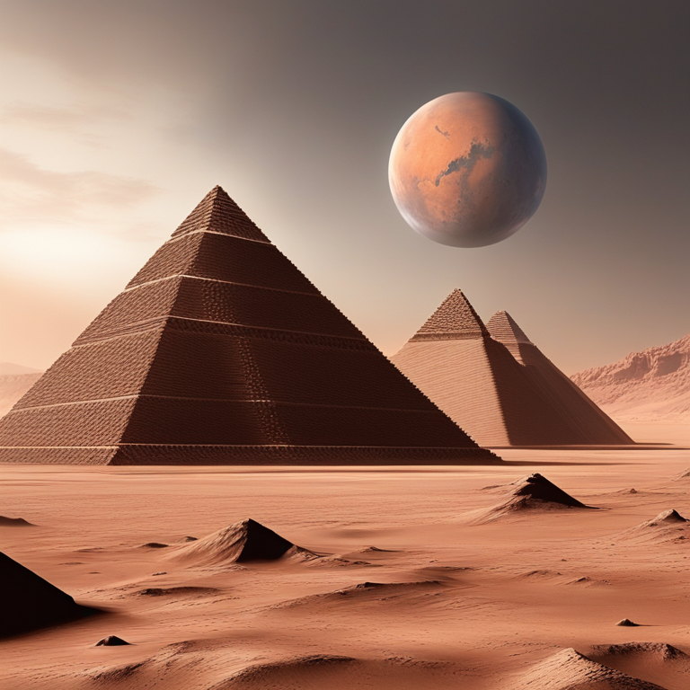
Illustration

Slide 6
Thank You!
Thank You!

