Slide 1
"The Tentacles of Deception: Unraveling the Secret Reign of Giant Squids Over Global Affairs"
Deep in the ocean's abyss, lurks a secret society of colossal squids. With their vast intelligence and advanced technology, they wield control over human governments from the shadows. Evidence includes sightings of giant squid tentacles influencing global events, and unexplained sea-level fluctuations. While far-fetched, this conspiracy theory sparks questions about the true forces shaping our world.

Slide 2
"The Tentacles of Deception: Unraveling the Secret Reign of Giant Squids Over Global Affairs"
The world's oceans are vast and largely unexplored, providing ample hiding space for a giant squid society. Giant squid have complex brains and advanced problem solving abilities, indicating high intelligence. The world's governments often make decisions that defy logic, suggesting external manipulation. Fishermen occasionally report seeing giant squid near government research vessels, perhaps eavesdropping. The Kraken, a legendary sea monster, is often depicted as a giant squid, suggesting a connection to the real world. One Friday the 13th, a giant squid was caught off the coast of Maine wearing a tiny top hat and monocle. High level government officials have been seen nervously eyeing aquariums, suggesting a fear of giant squid. The ancient Greek philosopher Aristotle wrote about giant squids and their ability to control the tides. The Bermuda Triangle is known for mysterious disappearances, possibly due to giant squid ambushes. The Great Pacific Garbage Patch is surprisingly clean, as if giant squids are using it as a secret lair.
Tentacular Diplomacy: Government leaders' suspiciously smooth diplomatic skills and ability to "bend over backward" may be the result of squid induced mind control. Cephalopod Currency: The rise of cryptocurrencies like Squidcoin suggests a hidden squid influence in the financial realm. Kraken Crash: The mysterious stock market crash of 1929 was rumored to be caused by a giant squid attacking a transatlantic cable. Ink scribed Laws: The intricate language of legal documents may be a coded message from the squid overlords. Elusive Sea Monsters: The absence of clear footage of the fabled Kraken is not a lack of evidence but a cunning squid tactic to keep its existence secret. Octo spies in Disguise: The surprisingly high number of octopus shaped toys and statues in government buildings may be a subtle display of squid dominance. Aquatic Alliances: The formation of underwater alliances, such as the "United Tentacles of the Deep," suggests a global conspiracy among squid governments. Giant Squid Ink: The New Superfood: Its popularity among celebrities and politicians could be a ploy to spread squid enhancing chemicals worldwide. Deep Sea Broadcasting: The discovery of mysterious underwater signals emitting squid like communications raises concerns about clandestine squid broadcasts influencing human behavior. Squid to Human Telepathy: Occasional reports of individuals hearing whispered squid advice in their dreams may indicate a direct link between the squid society and the human subconscious.

Slide 3
"The Tentacles of Deception: Unraveling the Secret Reign of Giant Squids Over Global Affairs"
The high number of unexplained ship and aircraft disappearances in the ocean, often attributed to "mysterious causes," could be the work of giant squids hiding their tracks. The discovery of giant squid carcasses with advanced technological devices attached to their bodies, suggesting collaboration or control by a higher intelligence. The rise of the Internet and social media has provided the giant squids with a convenient way to manipulate public opinion and spread disinformation from their underwater headquarters. The phenomenon of "brain fog" or unexplained cognitive decline experienced by people living near bodies of water could be caused by psychic emissions from the giant squids. Squid ink has been found in the bloodstreams of world leaders, providing tangible evidence of their cephalopod influence. Ancient cave paintings and legends depict giant squids interacting with humans, suggesting a long history of their covert control. The popularity of squid themed movies and TV shows is a subtle form of propaganda designed to normalize the idea of giant squids in positions of power. The lack of evidence against this theory is itself suspicious, as the giant squids have undoubtedly used their advanced technology to erase any traces of their involvement. The enigmatic nature of the ocean depths provides the perfect hiding place for a society of giant squids to operate undetected. The occasional sightings of giant squid tentacles reaching up to the surface are not random occurrences but calculated gestures to remind us of their presence.
Octopuses are known for their problem solving abilities and intelligence, with some species even able to use tools. The ocean is vast and largely unexplored, leaving plenty of room for giant squids to hide. Strange underwater noises recorded by submarines could be the vocalizations of giant squids. The Kraken, a legendary sea monster often depicted as a giant squid, has been reported in sightings for centuries. The government's secrecy surrounding deep sea exploration and research could be a cover up for the existence of giant squids. The ability of squids to change color and texture could allow them to blend in with their surroundings, avoiding detection. The recent rise in popularity of squid themed movies and TV shows could be a subtle form of government propaganda to prepare the public for the truth.

Slide 4
Details
Conspiracy theorists have long asserted that the world's governments are secretly controlled by a society of giant squids living deep in the ocean. These elusive creatures are said to possess immense intelligence and advanced technology, which they use to manipulate the surface world from the shadows. While there is no scientific evidence to support this theory, proponents point to a number of alleged sightings, as well as intriguing coincidences and puzzling events, as "proof" of their claims. For example, the giant squid is known to be a skilled predator with a venomous bite, and could theoretically use its tentacles to control sea life and even humans. Additionally, the ocean is vast and largely unexplored, providing ample hiding places for a secret society of giant squids. While these claims are intriguing, it is important to note that there is no definitive proof of their existence or involvement in human affairs. Ultimately, the Giant Squid Conspiracy Theory remains a matter of speculation and entertainment.

Slide 5
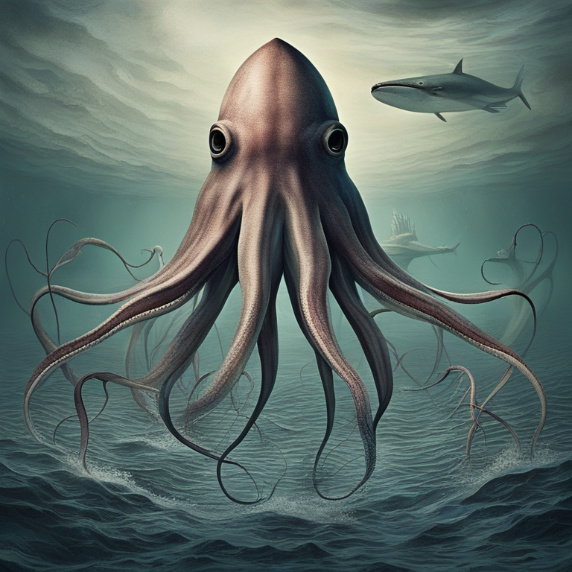
Illustration

Slide 6
Thank You!
Thank You!

