Slide 1
AI
CAPSTONE PROJECT · MP ONLINE AI/ML INTERNSHIP
AI Resume Screening System
An NLP-based system that ranks resumes against a job description using TF-IDF semantic similarity and curated skill matching.
Domain: Human Resources
Field: Artificial Intelligence / NLP
August 2026

Slide 2
THE PROBLEM
Manual resume screening does not scale
1
2
3
Time-consuming
Inconsistent
Not explainable
Recruiters spend hours reading resumes that may not even fit the role, for every single opening.
Different reviewers apply different, unwritten criteria — two recruiters can rank the same resume differently.
Traditional ATS tools reject or accept resumes on rigid keyword rules with little reasoning shown to the recruiter.
Problem Statement: HR teams need an NLP-based AI system that automatically ranks resumes against a job description and explains each candidate's fit.
02

Slide 3
GOALS
Project Objectives
Parse resumes & job descriptions from PDF, DOCX, and TXT formats
Apply NLP preprocessing to clean and normalize free-form text
1
2
Score contextual relevance using TF-IDF + cosine similarity
Extract and match hard skills using a curated skills taxonomy
3
4
Combine both signals into one configurable, weighted Final Score
Present ranked results with charts and an exportable CSV report
5
6
03

Slide 4
PROPOSED SYSTEM
A dual-signal, explainable ranking engine
Instead of a single opaque score, the system combines two independent, human-readable signals and shows its work.
Semantic Similarity
Skill Match
TF-IDF vectorization of the JD + all resumes together, scored with cosine similarity. Captures overall contextual relevance — not just exact keyword hits.
Regex-based extraction against a curated taxonomy of 100+ skills. Reports Matched, Missing, and Extra skills for every candidate — fully explainable.
Final Score = ( w₁ × Semantic Similarity ) + ( w₂ × Skill Match Ratio ) — default w₁ = 0.6, w₂ = 0.4, both adjustable
04

Slide 5
UNDER THE HOOD
Technology Stack
Language | Python 3
Feature Extraction | TF-IDF — scikit-learn TfidfVectorizer
Similarity Scoring | Cosine Similarity — sklearn.metrics.pairwise
Skill Extraction | Regex matching against a curated skills taxonomy
Document Parsing | pdfplumber (PDF) · python-docx (DOCX) · built-in I/O (TXT)
Web Interface | Streamlit
Data Handling | Pandas
No NLTK / spaCy model downloads required — runs offline right after pip install.
05

Slide 6
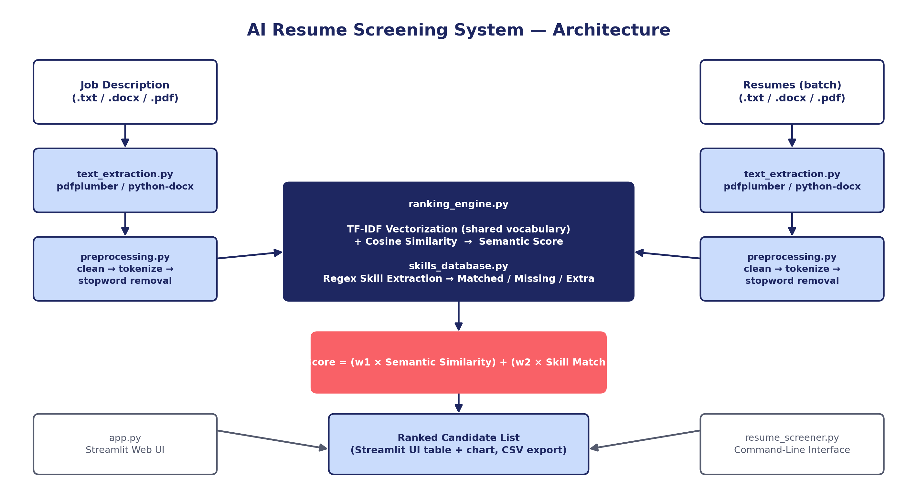
SYSTEM DESIGN
End-to-End Architecture
06

Slide 7
IMPLEMENTATION
Module Breakdown
text_extraction.py
preprocessing.py
skills_database.py
Parses PDF / DOCX / TXT into raw text
Cleans, tokenizes, removes stopwords
Taxonomy-based skill extraction (regex)
ranking_engine.py
app.py
resume_screener.py
TF-IDF + cosine similarity + weighted scoring
Streamlit web UI — upload, rank, visualize, export
Command-line interface for batch use
07

Slide 8
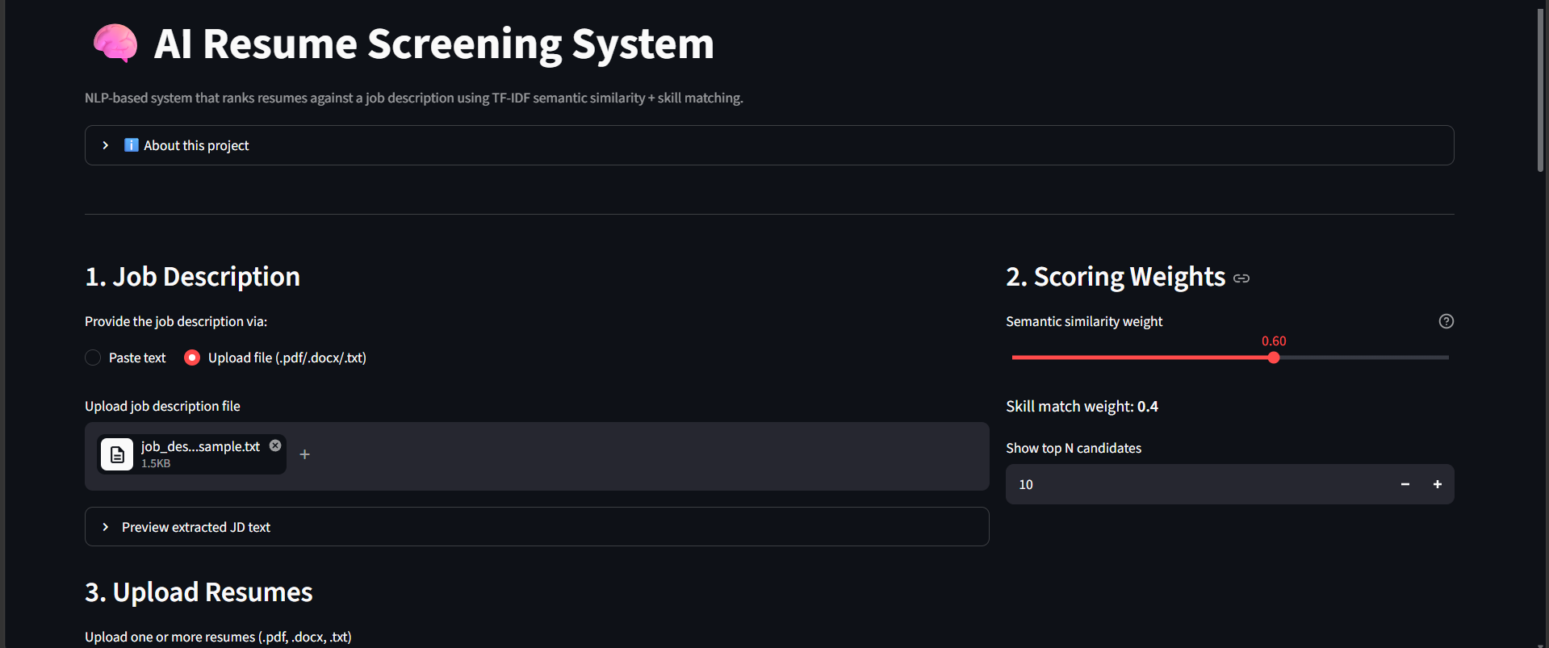
LIVE APPLICATION
Step 1 — Job Description & Scoring Weights
08

Slide 9
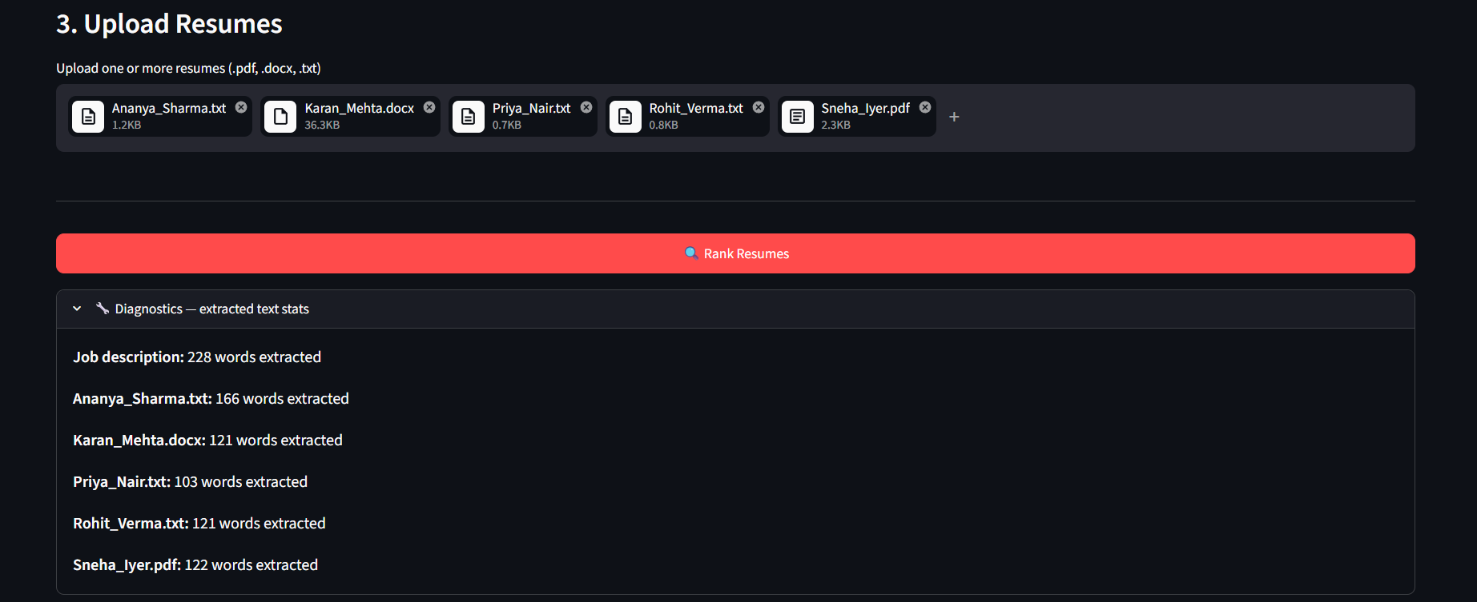
LIVE APPLICATION
Step 2 — Upload Resumes & Extraction Diagnostics
09

Slide 10
OUTPUT
Sample Ranking Results
Rank | Candidate | Final % | Similarity % | Skill Match % | Matched | Missing
1 | Ananya Sharma | 53.40 | 34.68 | 81.48 | 22 | 5
2 | Karan Mehta | 42.67 | 31.62 | 59.26 | 16 | 11
3 | Sneha Iyer | 37.41 | 25.31 | 55.56 | 15 | 12
4 | Rohit Verma | 21.64 | 18.78 | 25.93 | 7 | 20
5 | Priya Nair | 2.04 | 0.93 | 3.70 | 1 | 26
10

Slide 11
VALIDATION
Testing & Key Advantages
Testing Summary
Key Advantages
Multi-format parsing (PDF / DOCX / TXT) — Pass
Fully offline — no paid APIs or model downloads
Strong-fit resumes rank at the top — Pass
Explainable — matched / missing skills shown per candidate
Weak / off-domain resumes rank last — Pass
Configurable scoring weights per role
Weight sliders update ranking live — Pass
Accepts mixed PDF / DOCX / TXT formats
CSV export generates correctly — Pass
Fast — classical ML runs in milliseconds
11

Slide 12
WHAT'S NEXT
Future Scope & Conclusion
Future Enhancements
Conclusion
Larger external skills taxonomy (ESCO / O*NET)
Classical NLP techniques — TF-IDF, cosine similarity, and a rule-based skills taxonomy — combine into a fast, transparent, and genuinely useful resume screening tool. Every ranking is traceable to concrete evidence, not a black-box score.
NER for auto-extracting name, education, experience
Sentence-BERT embeddings for deeper semantic match
Persistent database across sessions
Authentication & role-based access for HR teams
Thank You
12

