Slide 1

Tesla India EV Market Entry Strategy (2026)
A Phased Entry Strategy for Sustainable Growth
Piyush Pawar

Slide 2
YES —Tesla can capture 10–15% market share (~7,200–10,800 units) by targeting premium segment (>USD 30,000), yielding 25–30% ROI within 3 years.
Why?
How?
Risks
58.30% CAGR in passenger EVs (2015–2024); 72,146 units projected by 2026; economic growth (USD 3,176B GDP).
Differentiate via brand prestige vs. Tata (53% share, low-price) and MG (15% share, mid-tier).
Mitigate import duties and infrastructure gaps via local partnerships.

Slide 3
AGENDA: PYRAMID OF INSIGHTS
Recommendation: Enter Premium Segment
1
Market Opportunity
2
Competitive Landscape
3
Economic Feasibility
4
Supporting Data and Analysis
5

Slide 4
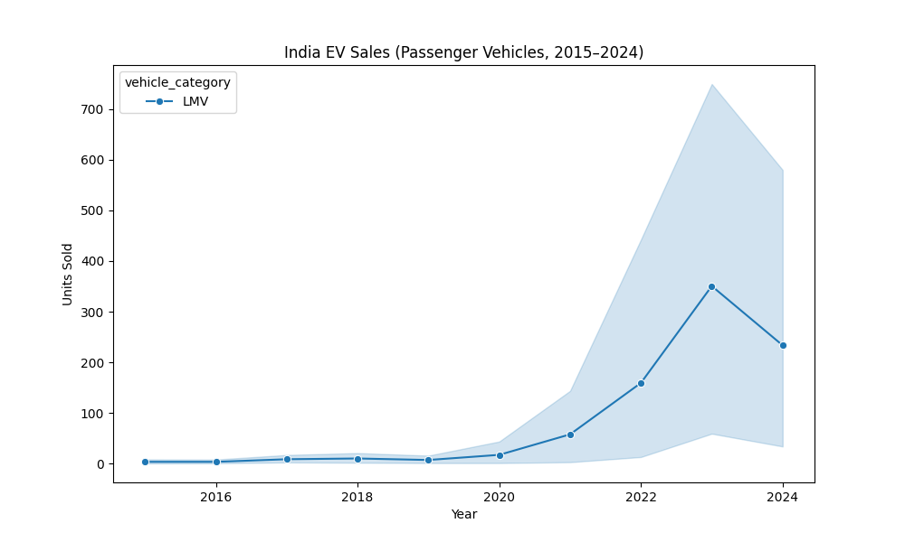
Explosive Growth Potential
Passenger EV sales surged from 892 units (2015) to 56,537 (2024).
CAGR of 58.30% driven by FAME-II subsidies and urban demand.
Opportunity: LMV segment (light motor vehicles) dominates 40% of total EVs.

Slide 5
2026 Forecast: 72,146 Passenger EV Units

Slide 6
Linear model projects 64,222 units (2025) to 72,146 (2026).
Exponential fit suggests upside to 100,000+ with policy support.
Tesla capture: 10% share = ~7,200 units, USD 216 M revenue at USD 30,000 avg. price.

Slide 7
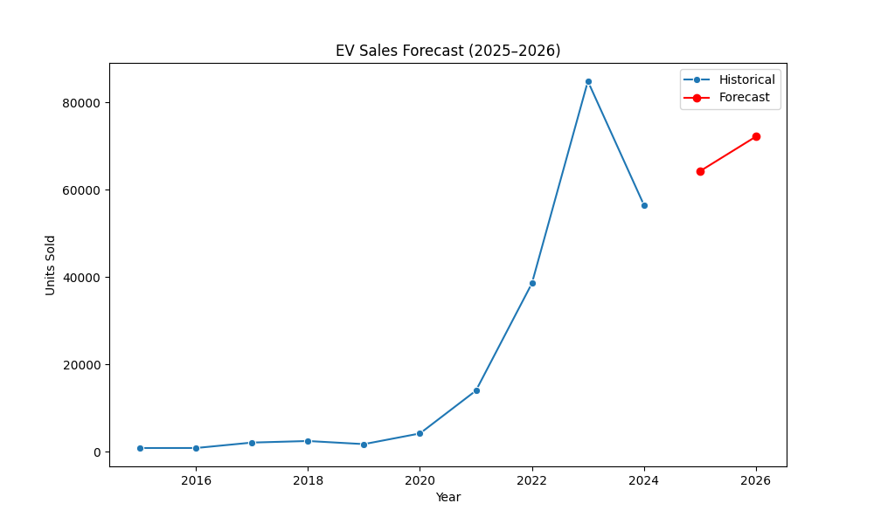

Slide 8
Tata Dominates Volume, Room for Premium
TATA : Low-price (~USD 16,737), high-volume leader.
53%
15%
MG : Mid-tier (~USD 25,150), growing import player.
32%
Gap: Premium segment (>USD 30,000) underserved—ideal for Tesla's brand.

Slide 9
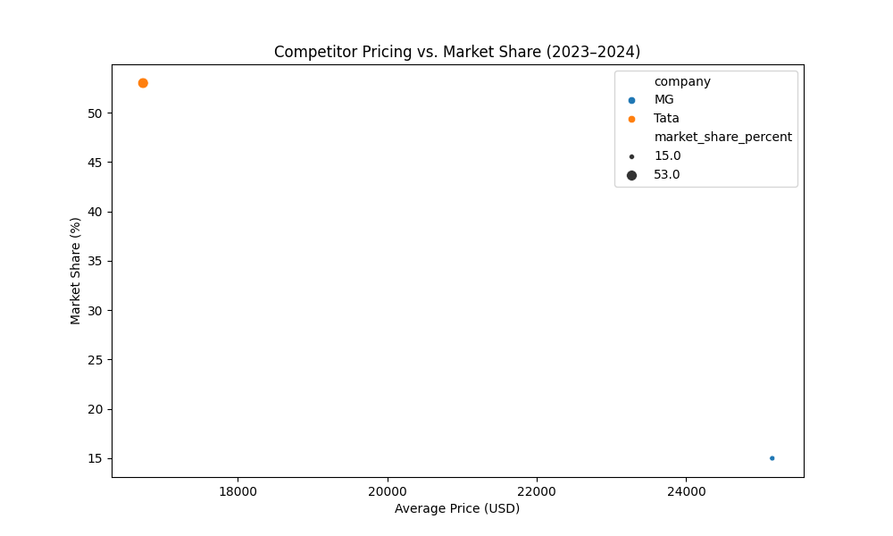

Slide 10
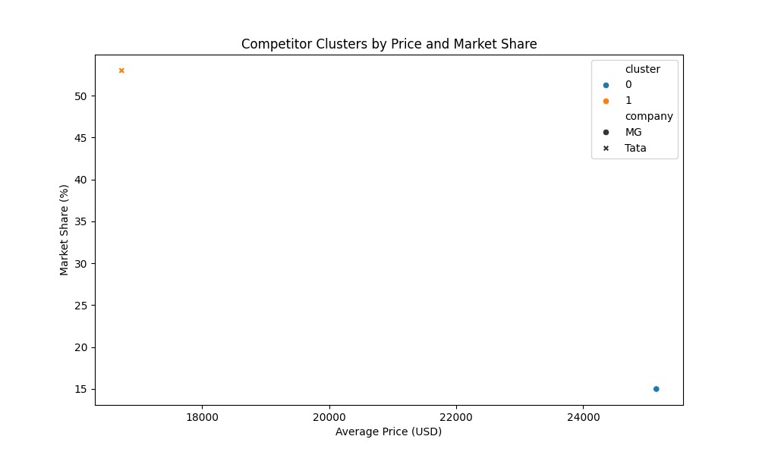
CLUSTERS REVEAL POSITIONING OPPORTUNITY
Cluster 0: Low-Price/ High-Share (Tata) - volume focused.
Cluster 1: Mid-Price/ Mid-Share (MG) - balanced import.
Tesla Fit: High-Price/ Low-Share Premium Niche for differentiation.

Slide 11
Strong Economics Tailwinds Support Entry
Urban Population: 36.60% (2023), driving 70% of EV demand.
Feasibility: Middle-class expansion (income > USD 10,000) enables premium uptake.
GDP: USD 3,176.30B (2023), 6–7% annual growth through 2026.

Slide 12
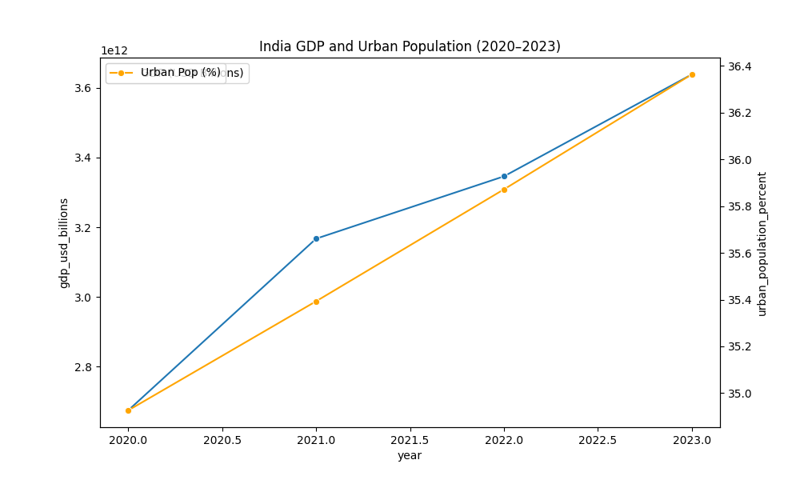

Slide 13
High-ROI Opportunity with Manageable Risks
Economic growth and urban demand align with Tesla’s model.
Premium positioning vs. Tata/MG clusters.
10–15% share for Tesla

Slide 14
Recommendations: Enter with Premium Focus
03
Timeline
Q1 2026 launch; breakeven by Q4 2027 (25% ROI).
Positioning
Launch Model 3/Y at USD 30,000+; emphasize autonomy/sustainability.
.
01
02
Go-to-Market
Partner with Tata for local manufacturing; pilot in Mumbai/Delhi.

Slide 15
RISKS AND MITIGATION PLAN
RISK
High Import Duties(100% on EVs)
RISK
Local competition
Mitigation
Differentiate via software updates, brand loyalty.
Mitigation
local Lobby for FAME-III reductions; assembly.
RISK
Infrastructure gaps
Mitigation
Co-invest with MG in charging networks.

Slide 16
ACTIONABLE ROADMAP
2025
2026
2028
Short Term
Medium Term
Long Term
Conduct consumer survey (Q4 2025); finalize partnerships.
Build prototype factory (Q1 2026); launch pilot.
Scale to 10% share by 2028; monitor policy changes.

