Slide 1
Program Env

Slide 2
Git
Code Formatter
Vim Basic
Vim Plugin
Debug Mode
Test

Slide 3
Code Formatter
Introduction
Perl Formatter
Python Formatter
Shell – Non
Makefile –Non
Tcl - Non

Slide 4
Introduction
​Code Formatter​​ is a tool that ​​helps programmers​​ format code automatically to improve readability without modifying code logic. It typically includes the following options:
Indent number​​: Controls the number of spaces or tabs for indentation.
Retab or not​​: Converts tabs to spaces (or vice versa) for consistency.
​​Check AST (Abstract Syntax Tree) coherence​​: Ensures formatting preserves the code’s logical structure. (Python: Yes; Perl: No)
​​Empty lines between code blocks​​: Adds or removes blank lines for visual separation.
​​Braces and brackets format​​: Customizes the placement of {} and [] (e.g., K&R vs. Allman style).
​​Column limit​​: Enforces a maximum line length to prevent horizontal scrolling.
Controllability and Format: With command line or a configuration file.

Slide 5
Perl Formatter
Perltidy is a Perl script which indents and reformats Perl scripts to make them easier to read.
The Perltidy Home Page: https://perltidy.sourceforge.net/
Configuration file: $HOME/.perltidyrc
Two special options:
-io, "indent only": just do indentation, no other formatting.
-b: backup original to .bak and modify file in-place.
Where to install our .perltidyrc:

Slide 6
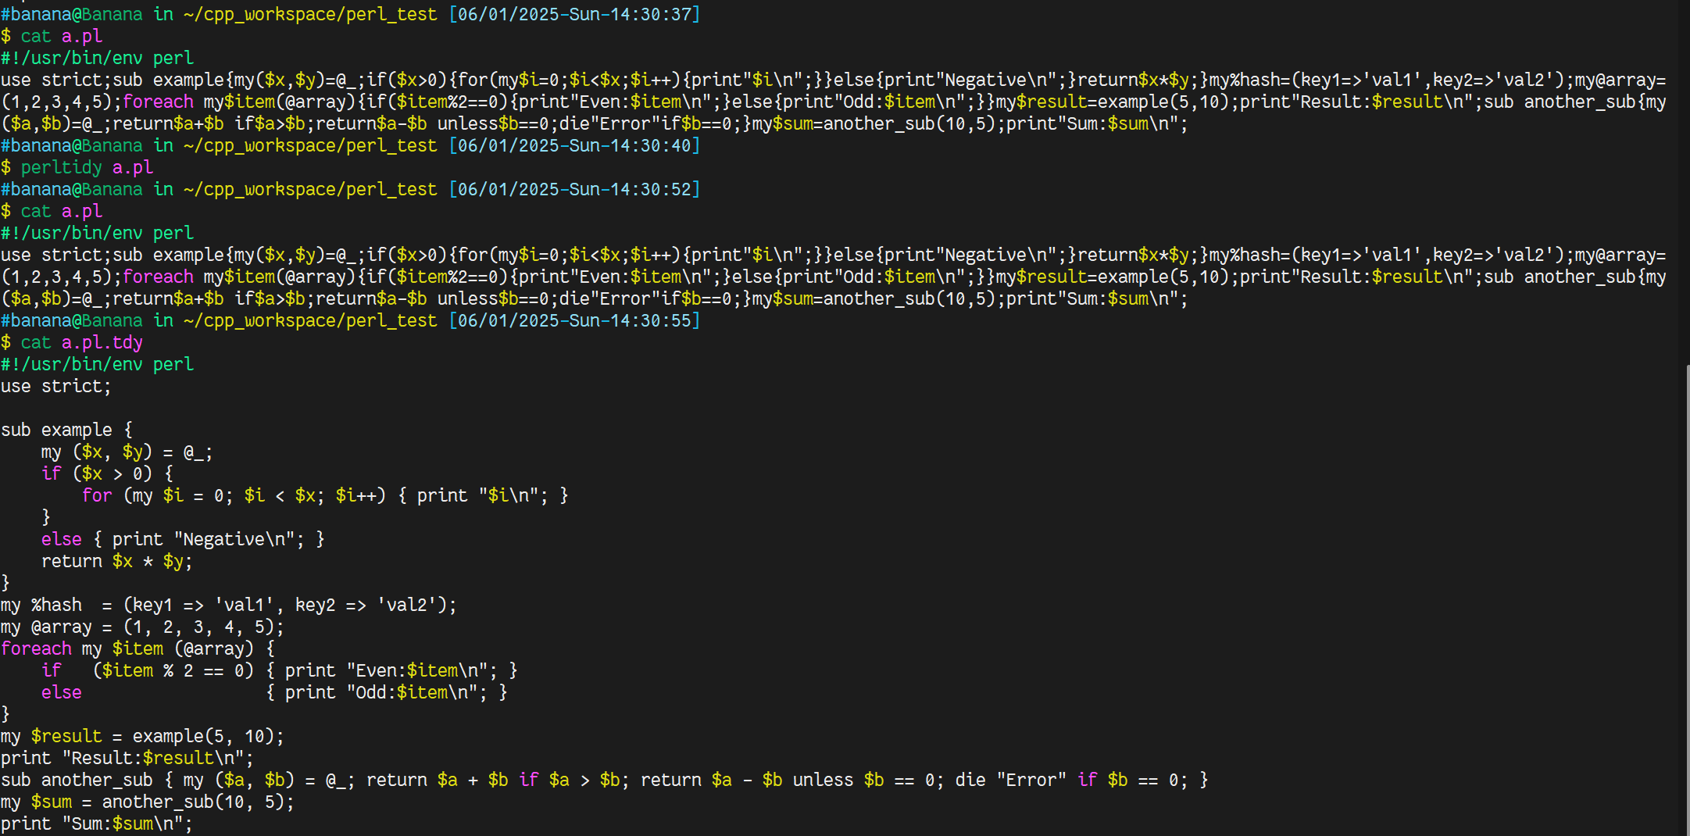
Perltidy without -b

Slide 7
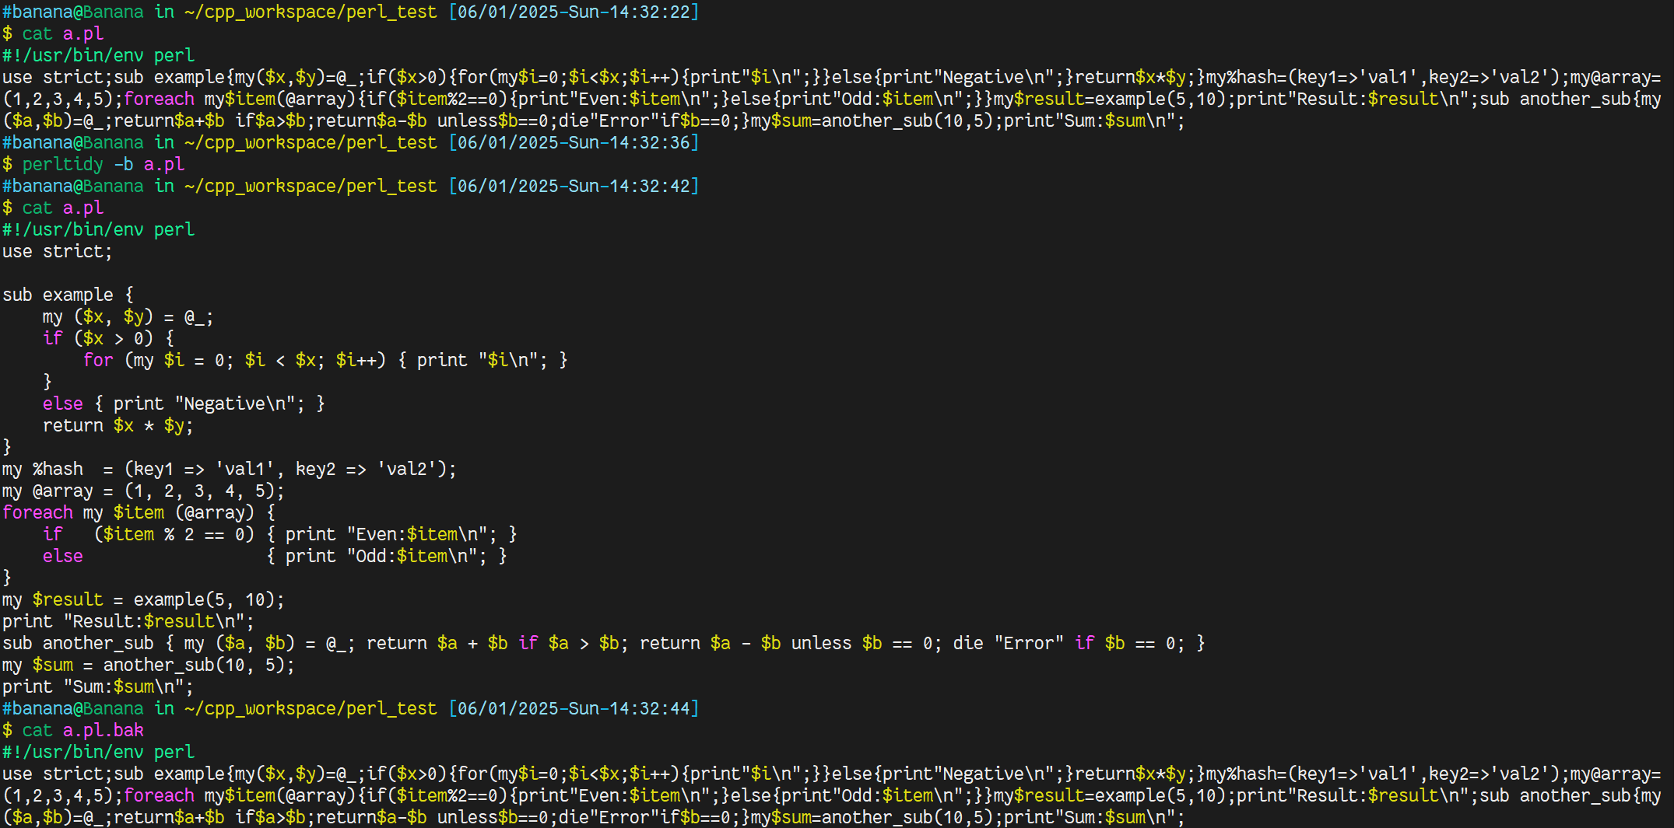
Perltidy with -b

Slide 8
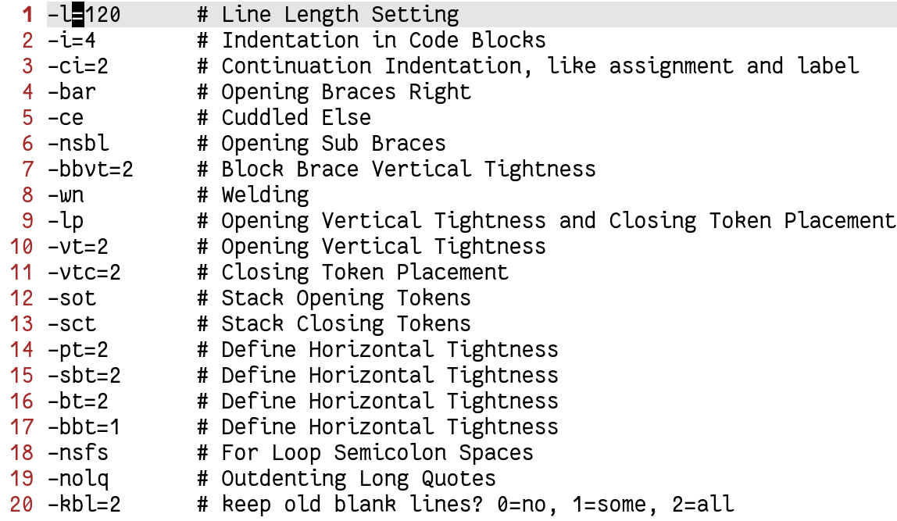
Perl-perltidy

Slide 9
Python Formatter - Formatter
Feature | autopep8 (Official Guide) | yapf (Google's Formatter) | black ("Uncompromising")
Format Style | PEP 8 | PEP 8/Google/User-Defined … | Black
Configurability | None (manual compliance) | Highly configurable | Minimal (only line-length/target)
Check AST Coherence | ⭐ | ⭐⭐ | ⭐⭐⭐
Syntax Errors | Fix some(Maybe Unexpected) | Just warn | Just warn
Degree of Relayout | Just fix violation ⭐ | ⭐⭐ | ⭐⭐⭐
Philosophy | Minimize fixing PEP 8 violations | Readability first | Strict uniformity
Project Fit | All Python projects | Large teams needing customization | Startups/OSS prioritizing speed
Suggests:
pylint + one formatter
just black

Slide 10
Python Formatter – Format Style
Feature | PEP 8 (Official) | Google Style Guide | Black ("The Uncompromising")
Origin | Python Community | Google's internal standards | Python Software Foundation
Line Length | 79 chars (max), 72 for docstrings | 80 chars | 88 chars (configurable to 79)
Indentation | 4 spaces per level | 4 spaces per level | 4 spaces per level
Quotes | Single quotes for all, double for docstrings | Single quotes (preferred) | Double quotes (auto-converts)
Trailing Commas | Encouraged for multiline constructs | Required in multiline collections | Always adds trailing commas
Blank Lines | 2 around top-level functions/classes | 2 around top-level, 1 around methods | Minimal (removes extra blanks)
Import Formatting | Grouped (stdlib, third-party, local) | Grouped with blank lines between | Single-line per import
Multi-line Constructs | Aligned or hanging indent | Hanging indent (4-space) | Vertical alignment (non-configurable)
Configurability | Guidelines only | Guidelines only | Highly opinionated (few options)
Semicolons | Avoid | Explicitly forbidden | Automatically removes
Tool | autopepe8(fix violation), yapf(default) | yapf(google option) | black

Slide 11
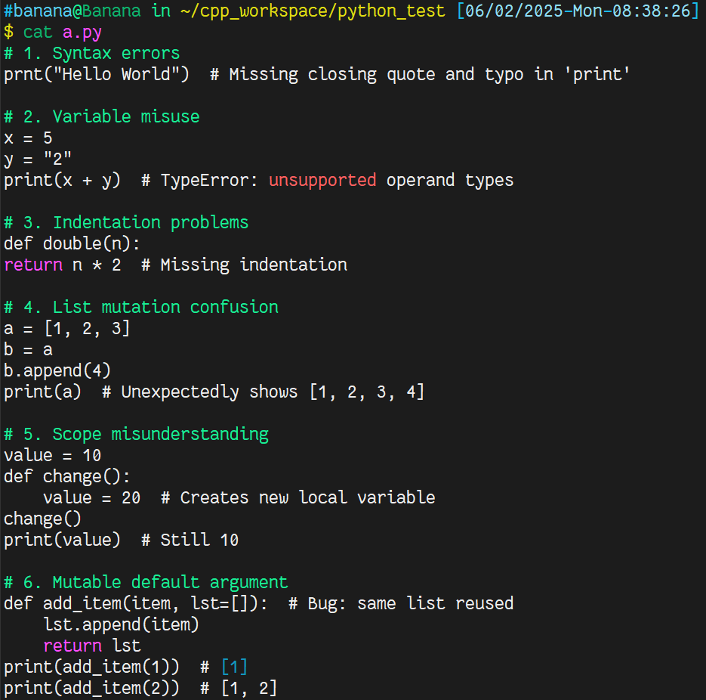
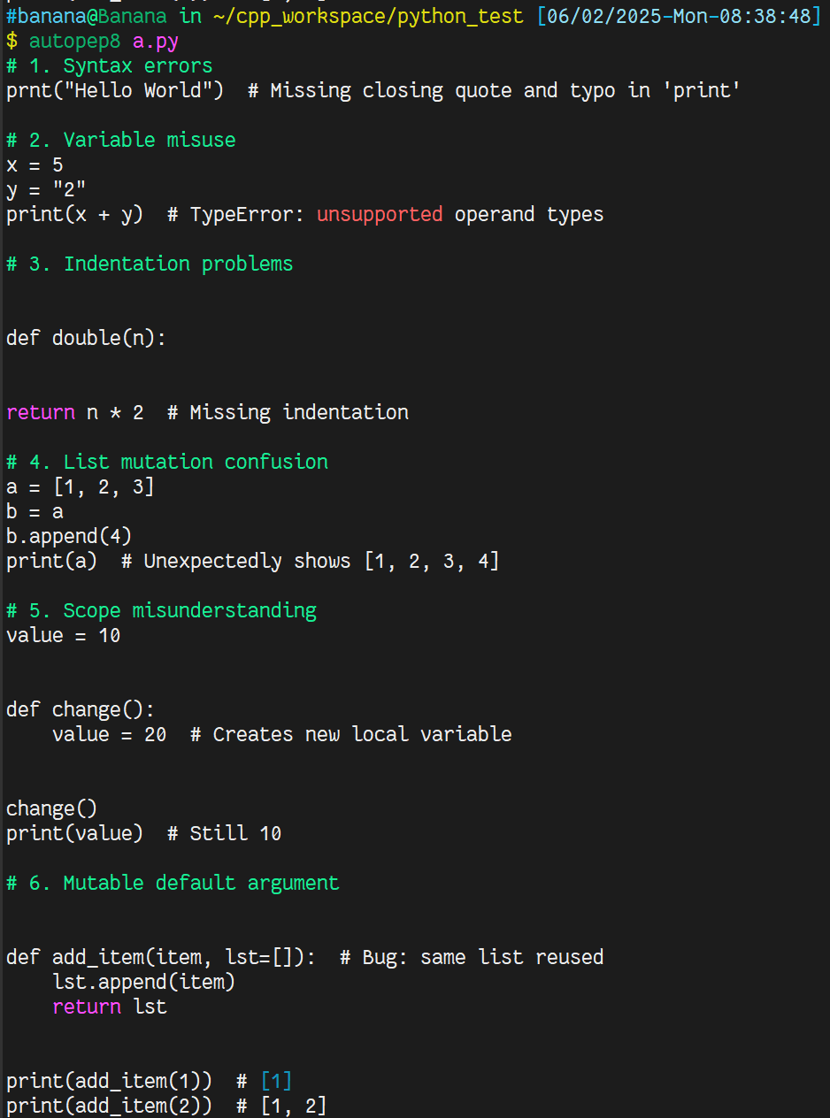
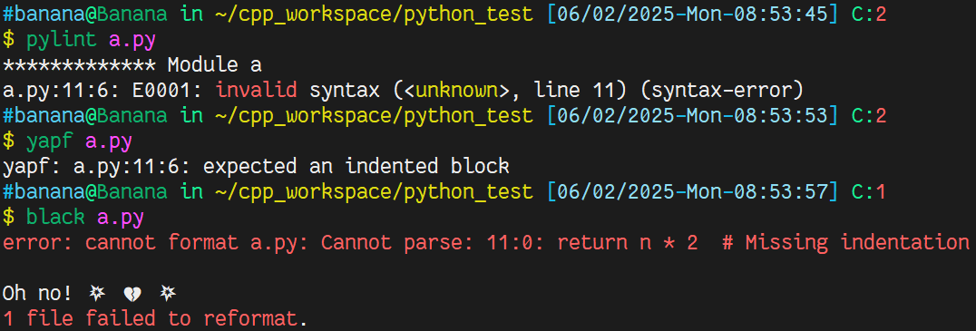
Python Formatter – how to process syntax errors
autopepe8
pylint, yapf, black

Slide 12
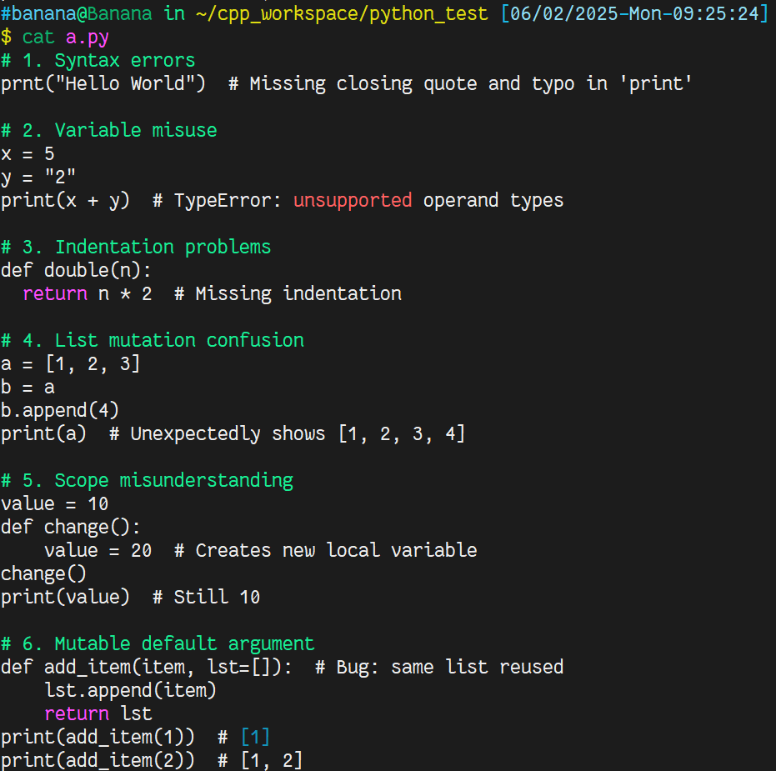
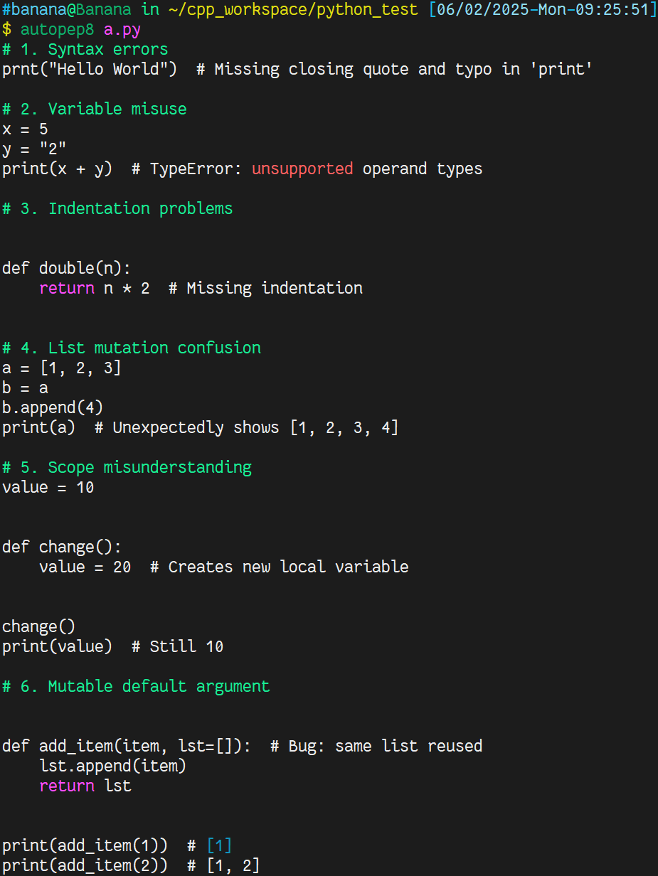
Python Formatter – autopep8

Slide 13
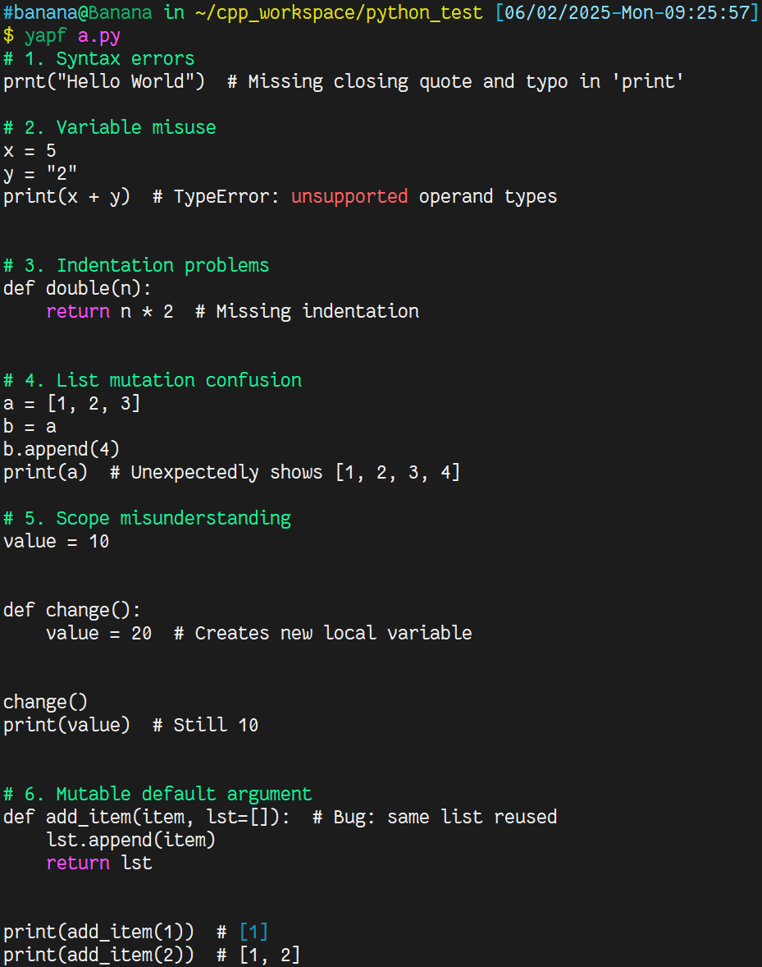
Python Formatter – yapf

Slide 14
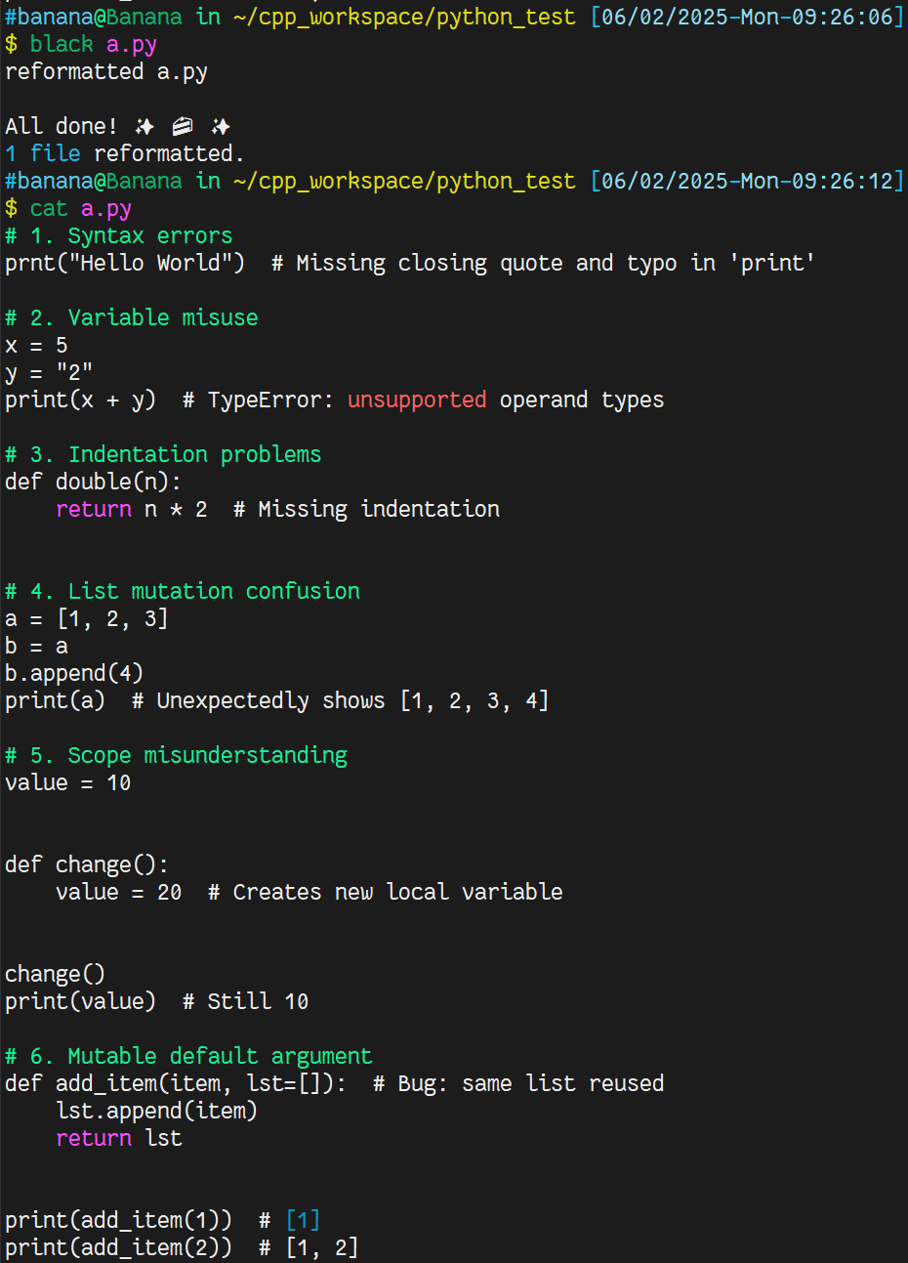
Python Formatter – black

Slide 15
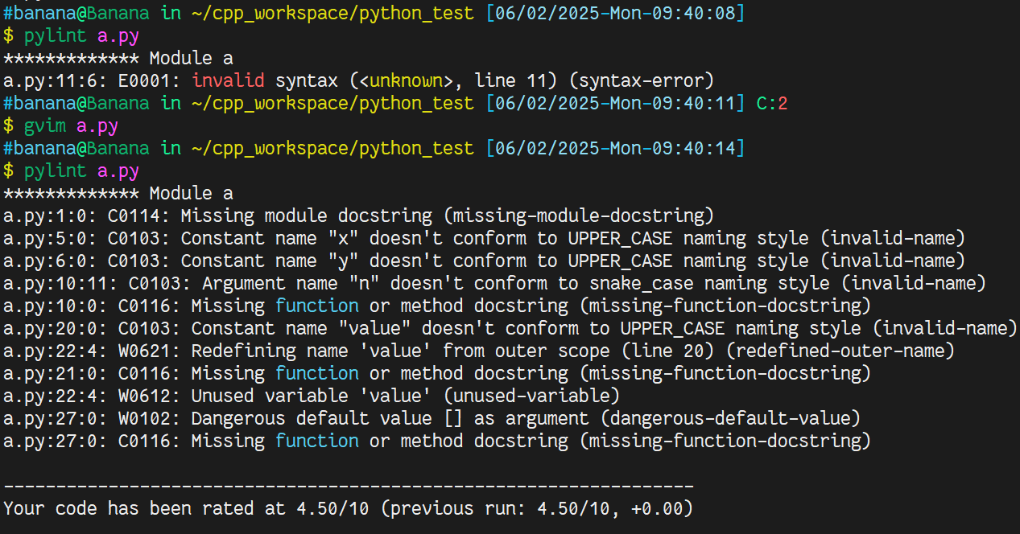
Python Formatter – usage
Detect syntax
Fix errors
Errors
Detect syntax
No errors
Next Step

Slide 16
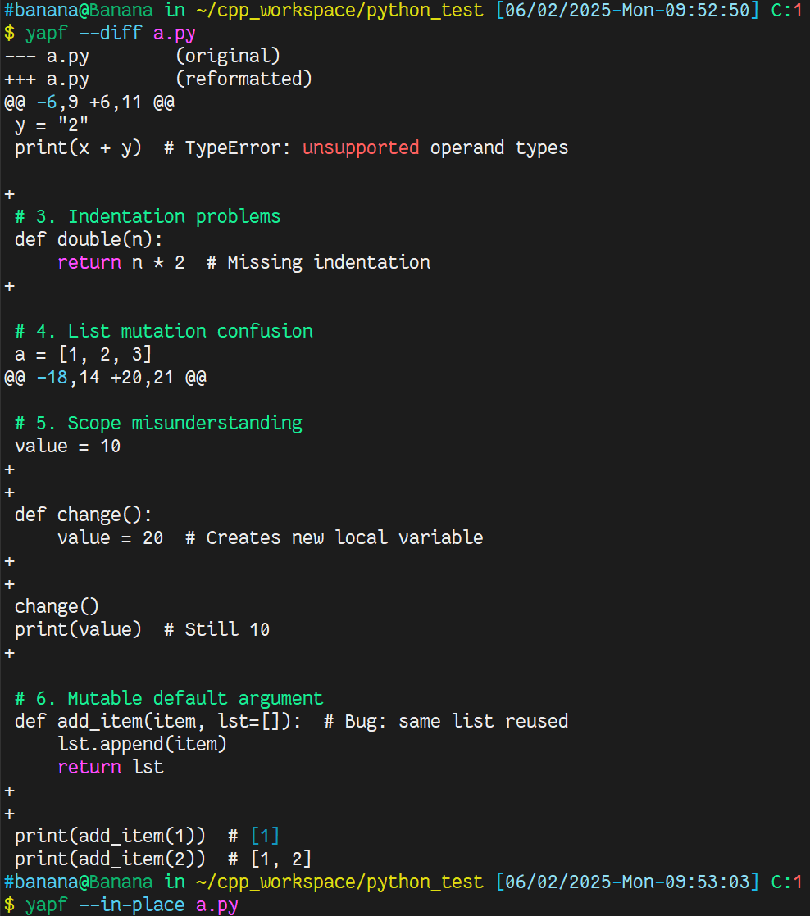
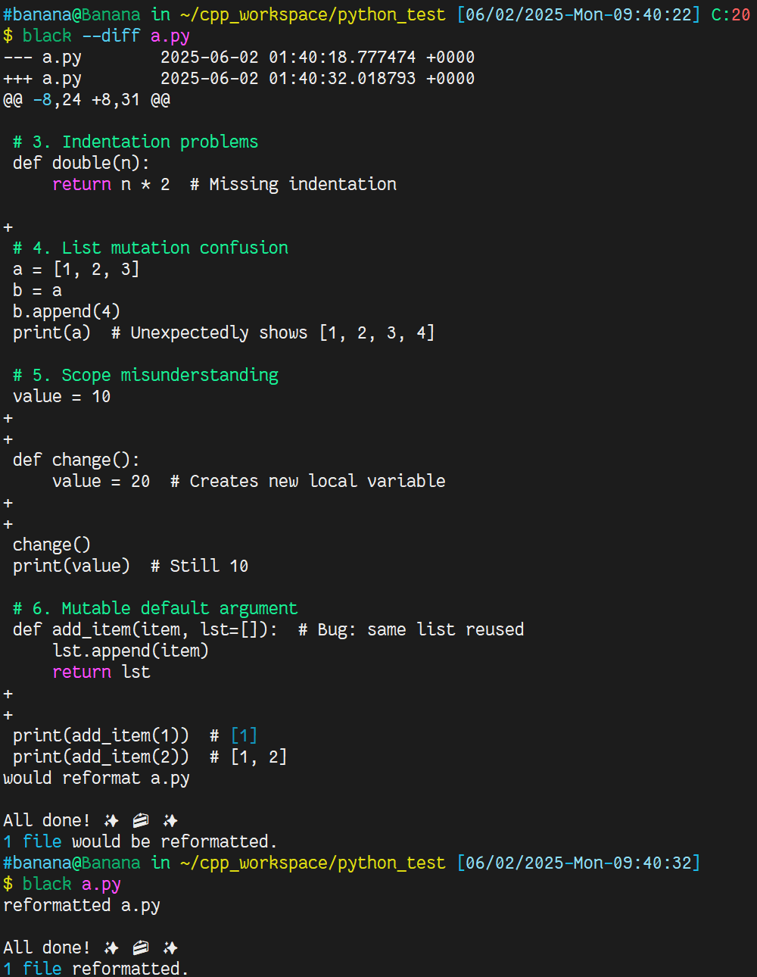
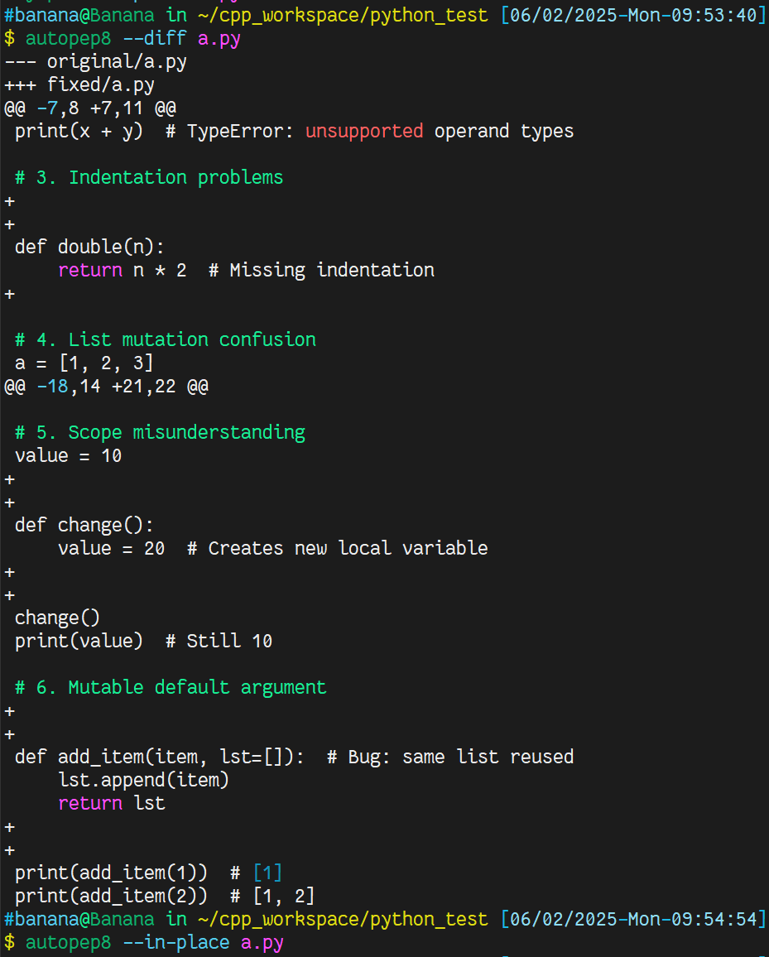
Python Formatter – usage
Check diff
Problems
Modify it
No problems
Format

Slide 17
Vim Basic – tab and space

Slide 18
