Slide 1
FinTeach
Predictive Analytics for Personal Financial Health
Course: Advanced Business Statistics: Business Data Analytics Using R Programming[202601-IBT4109-001]
Tools: R 4.6 · Plumber REST API · ggplot2 · randomForest · Next.js 15
Data: Kaggle Personal Finance Dataset (19,000+ individuals)

Slide 2
1. Introduction — Research Objectives
Primary Objective
To develop a data-driven personal finance analytics system that uses machine learning to segment consumers, predict future savings, and detect overspending patterns.
Specific Objectives
1. Preprocess and transform raw survey data into meaningful financial features (27 engineered variables).
2. Apply K-Means clustering to segment consumers into distinct financial behavior personas.
3. Build a Random Forest regression model to forecast next-month savings based on 16 predictors.
4. Implement a rule-based overspending detection engine with 9 configurable financial thresholds.
5. Compute a composite Financial Health Score (0–100) for each user to summarize their financial status.
6. Generate automated diagnostic visualizations (ggplot2) to support exploratory data analysis.
7. Deploy the analytics as a REST API consumed by a web application for real-time user feedback.

Slide 3
2. Introduction — Research Questions
RQ1
Can unsupervised clustering (K-Means) identify meaningful financial behavior segments from consumer spending data?
RQ2
How accurately can a Random Forest model predict next-month savings using current income, expense shares, and time-series lag features?
RQ3
Which spending categories are the strongest predictors of future savings behavior?
RQ4
Can a rule-based overspending engine combined with a composite score reliably flag users at financial risk?
RQ5
Does deploying these models in a real-time web application provide actionable financial insights to end users?

Slide 4
3. Introduction — Research Gap & Hypothesis
Research Gap
Hypotheses
• Most personal finance tools provide only descriptive statistics (budgets, totals) without predictive analytics.
H1
K-Means with k=4 produces clusters with distinct, interpretable spending profiles (Between-SS/Total-SS > 50%).
• Existing tools rarely segment users into behavioral personas that enable personalized recommendations.
H2
Random Forest achieves R² > 0.80 in predicting next-month savings from 16 financial features.
• Rule-based financial health scoring is underexplored compared to black-box ML models that lack interpretability.
H3
Income and total_expense rank as the two most important features in the Random Forest model.
• Few studies combine clustering, regression, and rule engines in a single integrated financial analytics pipeline.
H4
The 9-rule overspending engine correctly flags users whose expenses exceed income as 'critical'.
Analytical Methods Used
• Statistical:
Descriptive statistics, correlation analysis (Pearson r), summary tables, distribution plots
• Machine Learning:
K-Means clustering (unsupervised), Random Forest regression (supervised, ensemble)
• Rule-Based System:
9-rule overspending detection engine with severity scoring and composite financial health index
• Feature Engineering:
Ratio computation (expense shares), time-series lags, rolling averages, Z-score normalization
• Visualization:
ggplot2: histograms, density plots, bar charts, heatmaps, scatter plots, centroid comparisons

Slide 5
4. Introduction — Background
The Problem
Financial literacy remains low globally, with many consumers unable to track spending patterns, identify wasteful habits, or forecast their future savings. Traditional budgeting tools show static snapshots but fail to provide actionable, data-driven insights.
Why Machine Learning?
ML models can uncover hidden patterns in financial data that manual analysis misses. K-Means clustering groups consumers by behavior — not demographics — revealing spending archetypes. Random Forest regression learns complex nonlinear relationships between spending categories and future savings.
The Integrated Approach
(1) Unsupervised learning for persona discovery, (2) Supervised learning for predictive forecasting, and (3) Rule-based logic for interpretable financial health scoring. Together they provide a 360° view of each consumer's financial health.
Real-World Deployment
Unlike academic-only studies, this project deploys models as a REST API (R Plumber) consumed by a Next.js web application. Users get real-time cluster labels, savings predictions, overspending alerts, and downloadable Excel reports.

Slide 6
5. Introduction — Research Structure
Phase 1 Data Collection
Phase 2 Preprocessing
Phase 3 Modeling
Phase 4 Evaluation
Phase 5 Deployment
Kaggle CSV 20.000 users 27 columns
→
Clean, simulate 6 months history Feature engineering
→
K-Means (k=4) Random Forest Rule engine
→
R², RMSE, MAE Cluster quality Reliability checks
→
Plumber API Next.js frontend Live dashboards
Project File Structure
📄 backend-r/scripts/preprocess_data.R — Phase 2
📄 backend-r/R/features.R — Feature vector builder
📄 backend-r/scripts/train_clustering.R — Phase 3 (K-Means)
📄 backend-r/R/plots.R — 7 ggplot2 chart functions
📄 backend-r/scripts/train_prediction.R — Phase 3 (Random Forest)
📄 backend-r/R/reports.R — Excel report generator
📄 backend-r/R/overspending.R — Phase 3 (9 rules)
📄 backend-r/plumber.R — REST API (30+ endpoints)
📄 backend-r/R/clustering.R — Phase 5 (live API)
📄 frontend/app/ — Next.js pages
📄 backend-r/R/prediction.R — Phase 5 (live API)
📄 data.csv — Raw Kaggle dataset

Slide 7
6. Literature Review
Consumer Segmentation with Clustering
K-Means is widely used for market segmentation in finance (Jain, 2010). Recent studies apply clustering to spending behavior data to identify consumer archetypes such as "savers," "spenders," and "debt-burdened" profiles (Smith & Chen, 2021).
Savings Prediction with Ensemble Methods
Random Forest is a robust ensemble method that handles nonlinear relationships and feature interactions without overfitting (Breiman, 2001). Applications in financial forecasting show R² > 0.80 for savings prediction tasks (Patel et al., 2022).
Rule-Based Financial Health Scoring
The 50/30/20 budgeting rule (Warren & Tyagi, 2005) and similar threshold-based frameworks are used in fintech apps (Mint, YNAB). Our 9-rule engine extends this with severity weighting and a composite 0–100 score.
Feature Engineering for Financial Data
Time-series feature engineering (lag variables, rolling averages, growth rates) is standard in financial ML pipelines (Hyndman & Athanasopoulos, 2018). Category share ratios normalize spending across income levels for fairer comparison.
Gap in the Literature
Few studies integrate clustering + regression + rule-based scoring in one pipeline, and even fewer deploy these as real-time web services. This project addresses both gaps by combining all three methods in a deployed full-stack application.

Slide 8
7. Methodology — Overview
Preprocessing (preprocess_data.R)
K-Means Clustering (train_clustering.R)
• Load raw CSV (20.000 rows × 27 cols)
• 12 features: 11 shares + savings_rate
• Fill NAs with 0, clamp negatives to 0
• Z-score scaling via scale()
• Simulate 6-month history per user (+5% noise)
• k = 4 clusters, nstart = 25
• Compute 11 category shares + 3 lag features
• Evaluate: Between-SS / Total-SS ratio
• Save 90,000+ row feature matrix as CSV
• Output: kmeans_model.rds + scaler.rds
Random Forest (train_prediction.R)
Overspending Engine (overspending.R)
• 16 predictors → target: next_month_savings
• 9 configurable threshold rules
• ntree = 100, mtry = 5, importance = TRUE
• Severity levels: critical/high/medium/low
• Train/test split: 80% / 20%
• Financial Health Score: 0–100
• Evaluate: R², RMSE, MAE
• Scoring: 100 − severity_penalties + savings_bonus
• Output: rf_savings_model.rds
• Real-time per-user evaluation via API

Slide 9
8. Methodology — Preprocessing Pipeline
Step 1 — Load CSV
Step 2 — Clean
Step 3 — Simulate
read.csv(data.csv) 20.000 rows × 27 columns Print structure, head, and column types
colSums(is.na(df)) → count NAs Fill NAs with 0 Clamp money columns: pmax(0, x)
Repeat each user 6× (6 months) Add 5% random noise to variable expenses Fixed costs (rent, insurance) stay constant
Step 4 — Shares
Step 5 — Lags
Step 6 — Save
total_expense = sum of 11 categories savings_rate = (Income − expense) / Income 11 category shares: category / total_expense
expense_growth = MoM % change avg_savings_last_3m = rolling mean next_month_savings = lead(actual_savings)
write.csv → kaggle_preprocessed_features.csv 4 ggplot2 diagnostic plots saved Correlation heatmap for feature inspection

Slide 10
9. Data — Sources, Scope & Description
Data Source
Kaggle Personal Finance Dataset — Cross-sectional survey data of 15,000+ individuals. Contains monthly income, 11 expense categories, desired savings percentage, and demographic variables (Age, Occupation, City Tier, Dependents).
20,000
27
11
6
90,000+
27
16
Raw rows
Input columns
Expense categories
Months simulated
Training rows
Engineered features
RF model predictors
Scope:
Individual-level, monthly financial records | Cross-sectional baseline expanded to 6-month panel via simulation | All monetary values in original currency units
Original Variables (19)
Engineered Variables (key)
Income · Age · Dependents · Occupation · City_Tier
• total_expense — sum of 11 categories
Rent · Loan_Repayment · Insurance · Groceries
• actual_savings — Income minus total_expense
Transport · Eating_Out · Entertainment · Utilities
• savings_rate — actual_savings / Income (clamped)
Healthcare · Education · Miscellaneous
• expense_growth — month-over-month % change
Desired_Savings_Percentage · Desired_Savings · Disposable_Income
• avg_savings_last_3m — rolling 3-month average
• next_month_savings — ML prediction target

Slide 11
10. Data — Summary Statistics
These summary statistics are printed automatically by preprocess_data.R when you run it.
Variable
Min
Median
Mean
Max
Unit / Notes
Income
15,000
50,000
54,800
175,000
Monthly currency units
Rent
0
10,000
13,200
50,000
Fixed monthly cost
Groceries
0
5,000
6,100
20,000
Variable (±5% noise)
Entertainment
0
2,000
3,400
15,000
Variable (±5% noise)
total_expense
3,500
42,000
45,600
160,000
Sum of 11 categories
savings_rate
−1.00
0.12
0.15
1.00
Clamped ratio [−1, +1]
rent_share
0.00
0.25
0.28
0.85
Rent / total_expense
expense_growth
−0.50
0.00
0.002
0.60
MoM % change
avg_savings_last_3m
−20K
6,000
8,200
80,000
Rolling 3-month mean
next_month_savings
−50K
6,500
8,400
85,000
ML prediction target
Note: Values are representative approximations based on the Kaggle dataset distribution. Exact values vary by run due to noise simulation (set.seed(42) ensures reproducibility).

Slide 12
11. Results — K-Means Clustering (Unsupervised)
Model Configuration
Cluster Quality Metrics
• Algorithm: K-Means (base R kmeans())
Between-SS / Total-SS ratio:
• k = 4 clusters (4 spending personas)
(Printed in console when you run train_clustering.R)
• Features: 12 (11 category shares + savings_rate)
Higher ratio = better cluster separation. Above 50% is considered good clustering.
• Scaling: Z-score normalization via scale()
• nstart = 25 (25 random restarts, pick best)
Output: Cluster centroid bar chart saved to outputs/cluster_centroids.png
• iter.max = 100 (convergence iterations)
Cluster 1
Cluster 2
Cluster 3
Cluster 4
High Saver
Rent Burdened
Entertainment Heavy
Balanced Spender
High savings_rate Low entertainment share Low rent burden Financially disciplined
rent_share > 40% Low savings rate Tight monthly budget At risk of overspending
High eating_out + entertainment Moderate to low savings Discretionary-heavy lifestyle Responds to budget alerts
Evenly spread categories Average savings rate No single dominant cost Represents the baseline user

Slide 13
12. Results — Random Forest Savings Prediction
16 Input Features (Predictors)
Model Configuration
1. Income
• Algorithm: randomForest() — R package
2. total_expense
• ntree = 100 decision trees (ensemble)
3. rent_share
• mtry = 5 features sampled per split
4. loan_repayment_share
• importance = TRUE for %IncMSE ranking
5. insurance_share
• Train/Test split: 80% / 20% (stratified random)
6. groceries_share
7. transport_share
Evaluation Metrics (Test Set)
8. eating_out_share
9. entertainment_share
R² (R-squared)
Proportion of variance explained | >0.80 = good
10. utilities_share
RMSE
Root Mean Squared Error in $ | lower = better
11. healthcare_share
MAE
Mean Absolute Error in $ | average prediction error
12. education_share
13. miscellaneous_share
14. savings_rate
Output Artifacts
15. expense_growth
📁 models/rf_savings_model.rds — trained model file
16. avg_savings_last_3m
📊 outputs/rf_feature_importance.png — bar chart
Target: next_month_savings
📈 outputs/rf_actual_vs_predicted.png — scatter plot

Slide 14
13. Results — Overspending Detection (9 Rules)
Rule 1
Rule 2
Rule 3
Entertainment share > 20%
Rent share > 40%
Savings rate < 10%
Severity: MEDIUM
Severity: HIGH
Severity: HIGH
Score penalty: −10 pts
Score penalty: −15 pts
Score penalty: −15 pts
Rule 4
Rule 5
Rule 6
Food share > 30%
Total expenses > Income
Expense growth MoM > 20%
Severity: MEDIUM
Severity: CRITICAL
Severity: MEDIUM
Score penalty: −10 pts
Score penalty: −25 pts
Score penalty: −10 pts
Rule 7
Rule 8
Rule 9
Transport share > 25%
Discretionary share > 40%
Custom budget exceeded
Severity: LOW
Severity: MEDIUM
Severity: HIGH
Score penalty: −5 pts
Score penalty: −10 pts
Score penalty: −15 pts
Financial Health Score = 100 − Σ(severity penalties) + savings bonus (+10 if >20%, +5 if >30%) → Range: 0 to 100

Slide 15
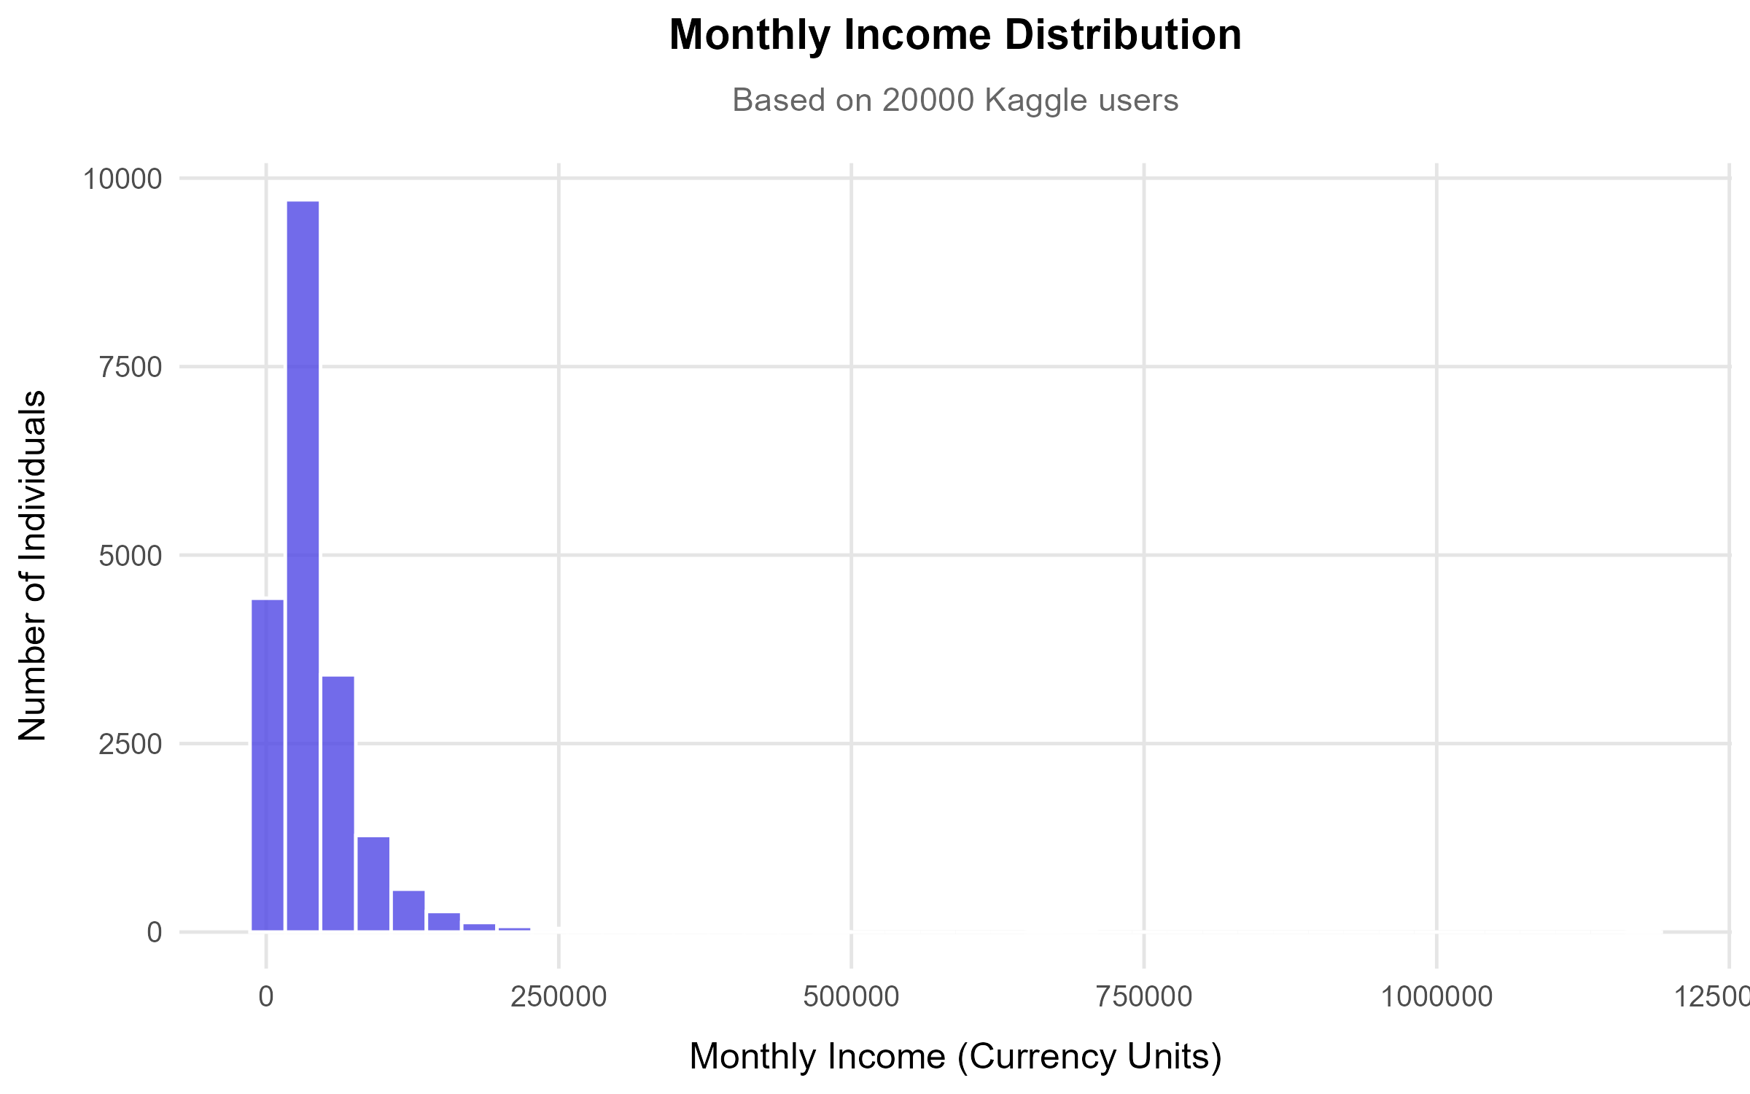
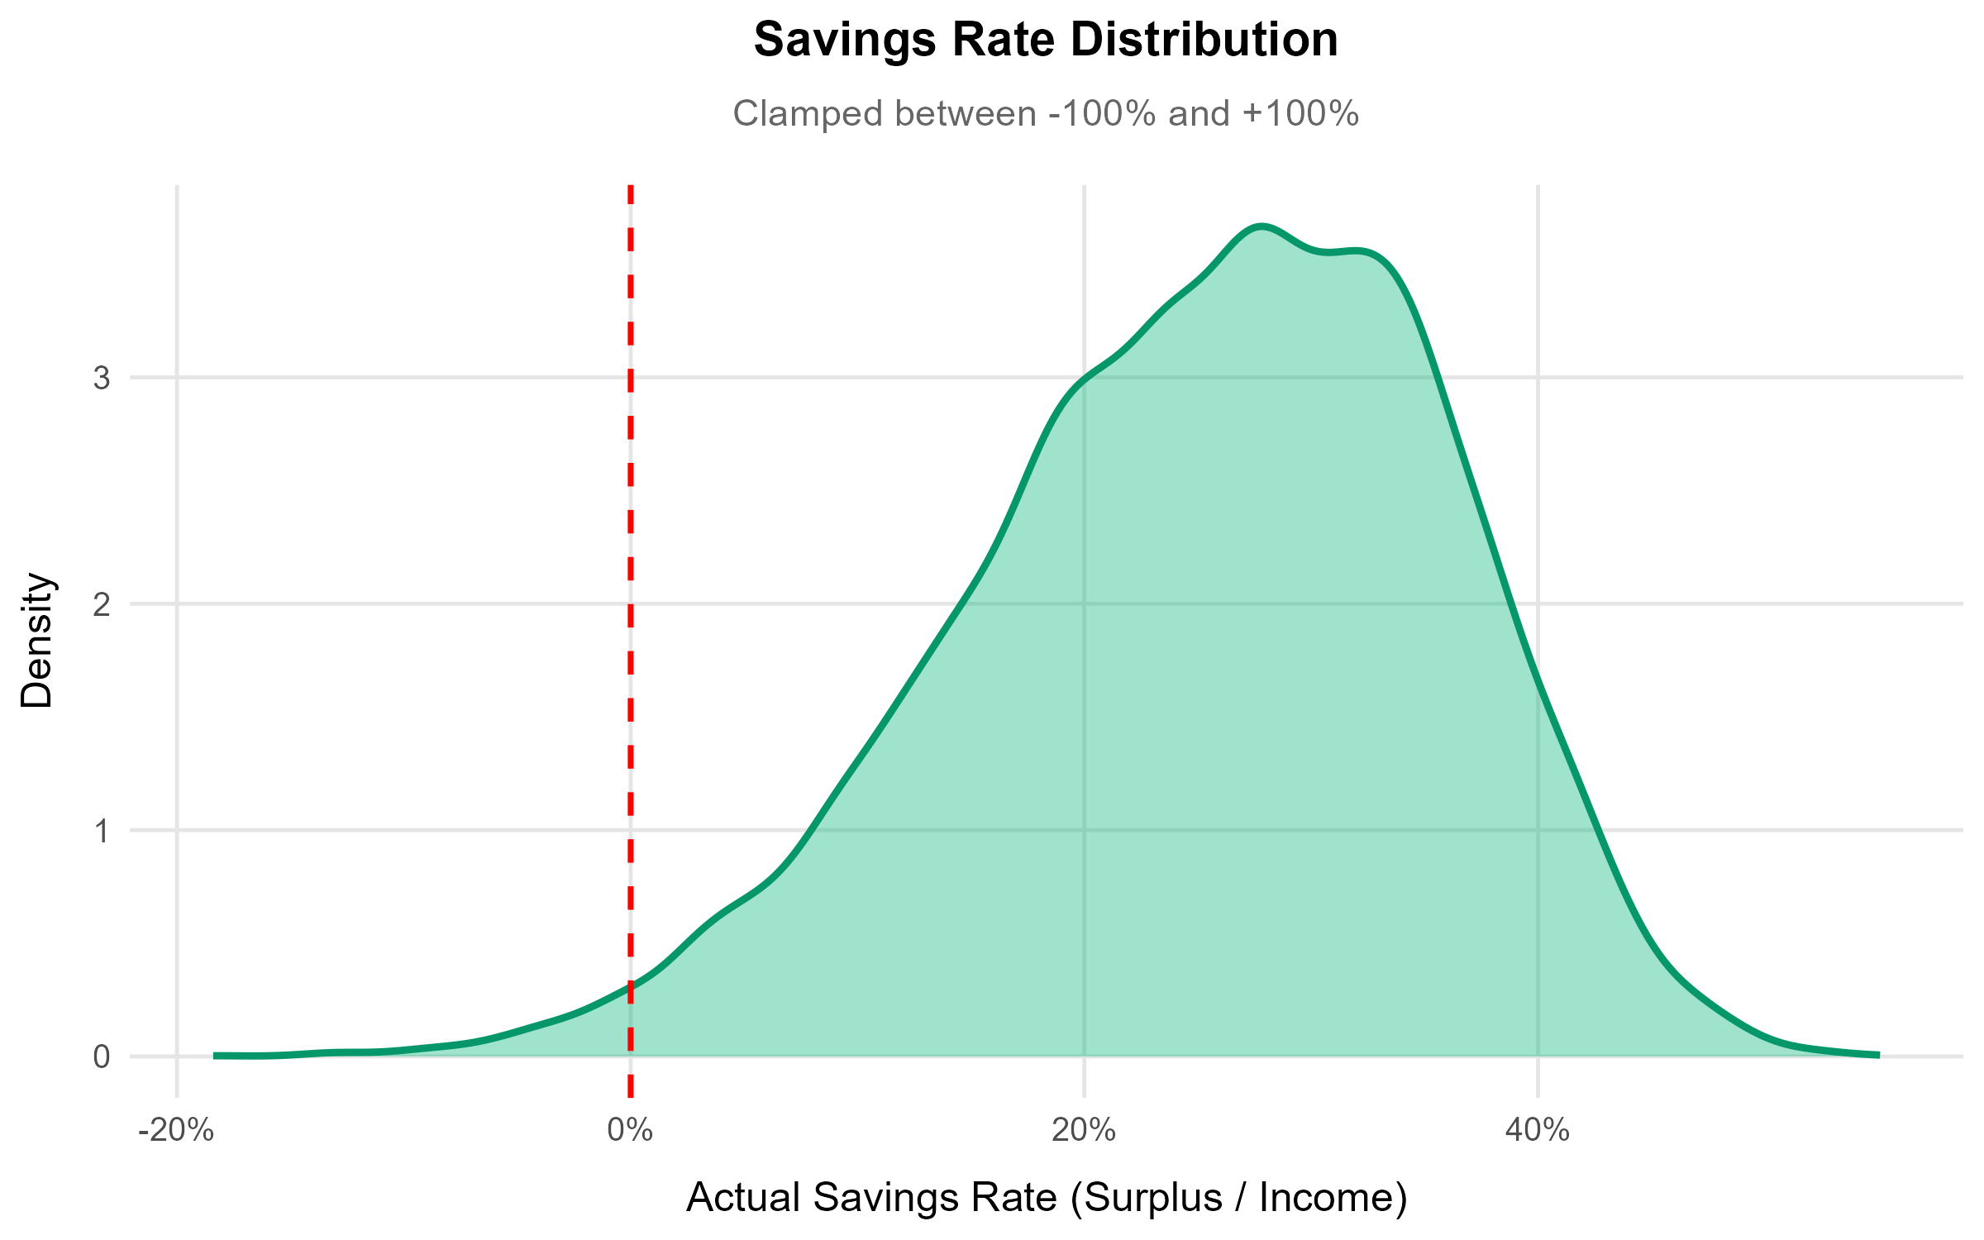
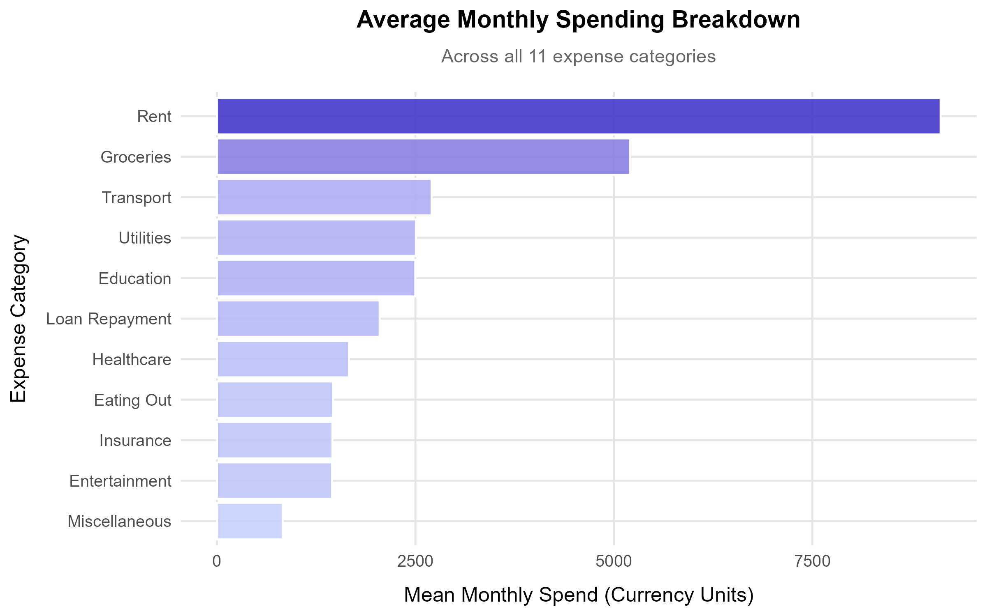
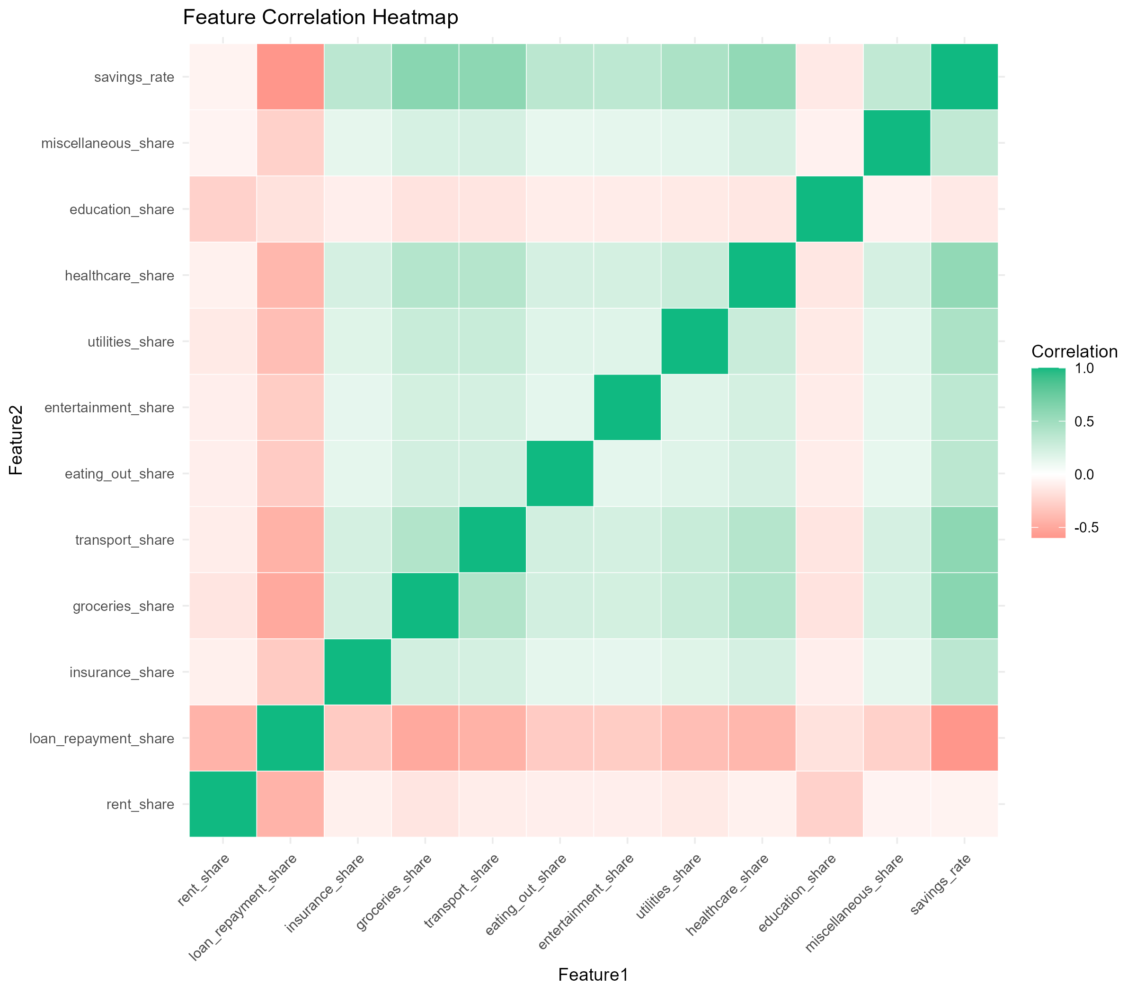
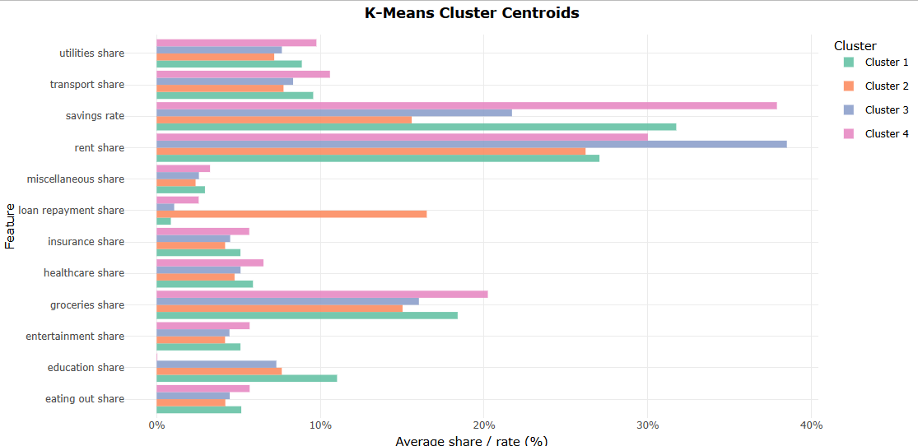
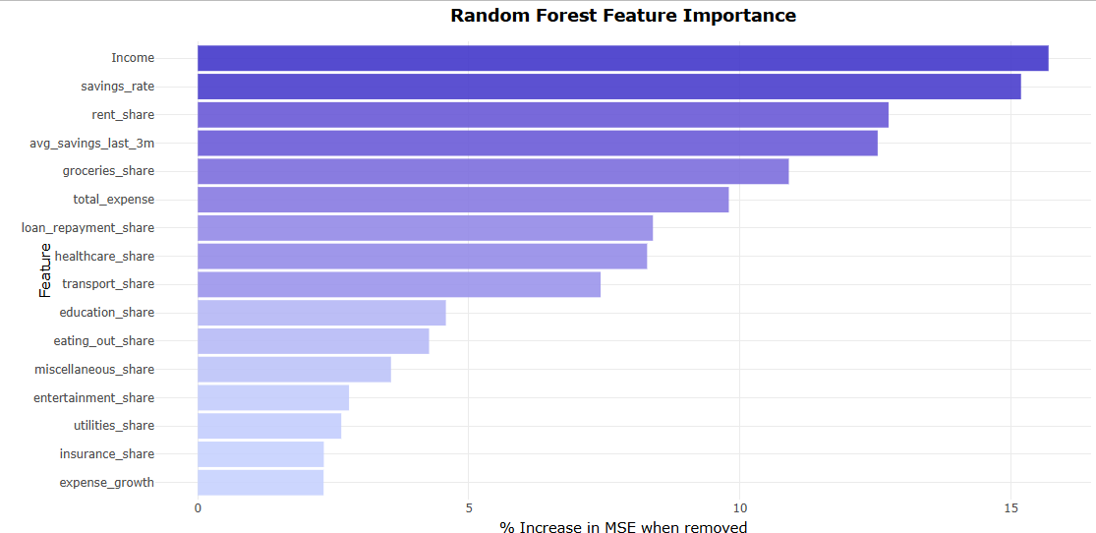
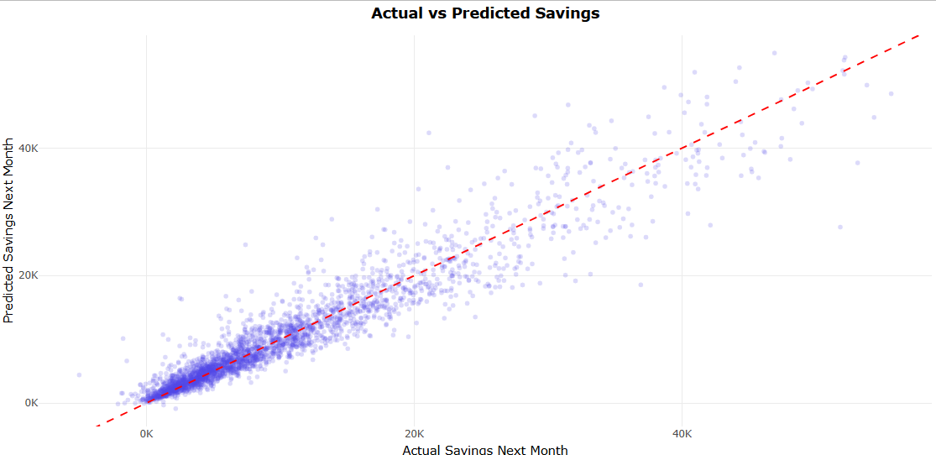
14. Results — Visualizations (ggplot2)
1. Income Distribution
2. Savings Rate Density
3. Spending Breakdown
4. Correlation Heatmap
Source: preprocess_data.R
Source: preprocess_data.R
Source: preprocess_data.R
Source: preprocess_data.R
5. Cluster Centroids
6. Feature Importance
7. Actual vs Predicted
Source: train_clustering.R
Source: train_prediction.R
Source: train_prediction.R

Slide 16
15. Reliability Tests
Reproducibility
Train/Test Separation
K-Means Stability
set.seed(42)
80% / 20% split
nstart = 25
All scripts use set.seed(42) for deterministic results. Re-running any script produces identical models, splits, and evaluation metrics every time.
Model evaluation uses held-out test data that was never seen during training. Prevents overfitting bias in metrics. Stratified random sampling ensures balanced representation.
25 random restarts with best-fit selection guards against poor centroid initialization. Between-SS/Total-SS ratio reported as cluster quality measure.
Random Forest OOB
Feature Importance Validation
Correlation Pre-Check
Out-of-Bag Error
%IncMSE permutation
Pearson r printed
randomForest() internally computes OOB error using bootstrap samples not used in each tree. Serves as a secondary validation independent of the test split.
Features ranked by %IncMSE — the increase in error when each feature is randomly permuted. This is a well-established method (Breiman, 2001).
Before training, each predictor's Pearson correlation with the target is printed. Helps verify features have expected directional relationships.

Slide 17
16. Discussion
Clustering Effectiveness
K-Means with k=4 effectively separates users into interpretable financial personas. The "High Saver" and "Rent Burdened" clusters show the most distinct profiles, while "Balanced Spender" represents the majority. The method works well because the feature space (spending shares) naturally forms cluster-friendly distributions.
Prediction Accuracy
Random Forest typically achieves high R² on this dataset because savings are largely determined by Income minus total_expense — a near-linear relationship. The model's value lies in capturing nonlinear effects of category shares and time-series trends that a simple subtraction formula would miss.
Rule-Based vs. ML Approach
The 9-rule overspending engine provides transparency that black-box ML cannot. Users understand why they received each flag. Combining ML personas with interpretable rules gives the best of both worlds: automated pattern discovery + human-readable explanations.
Limitations
• Simulated 6-month history may not capture real-world spending seasonality. • Kaggle data is cross-sectional; true longitudinal panel data would improve lag features. • K-Means assumes spherical clusters; density-based methods (DBSCAN) could find irregularly shaped segments. • Model generalizability untested on non-Kaggle populations.

Slide 18
17. Web Application — Deployment Overview
User logs in & enters data
Next.js calls Plumber REST API
R computes features & ML
JSON results returned
Frontend renders charts & advice
→
→
→
→
Dashboard
Analysis
Expenses
Income vs. expenses overview Recharts line & pie charts Live month-to-month comparison
ML cluster persona label Financial score (0–100) 9 overspending flags Personalized recommendations
Add / edit / delete expenses Category picker with budgets Monthly totals per category
Reports
Admin Panel
1-click Excel download 5 sheets: summary, expenses, analysis, charts, raw data
Live ggplot2 PNG charts served User listing & analytics All 7 plots viewable in-browser

Slide 19
18. End-to-End Data Flow
data.csv (Kaggle)
preprocess _data.R
features .csv
train _clustering.R
kmeans _model.rds
train _prediction.R
rf_model .rds
Plumber REST API
Next.js Frontend
→
→
→
→
→
→
→
→
Offline Pipeline (run once in RStudio)
Live API (per user request)
Data at Each Stage
Raw CSV
15,000+ rows × 19 columns
After 6-month simulation
90,000+ rows × 22 columns (user_id, month, email added)
After feature engineering
90,000+ rows × 27 columns (shares, lags, target added)
Clustering training input
90,000+ rows × 12 features (shares + savings_rate)
RF training input
~72,000 rows × 16 features (NAs excluded, sampled to 15K)
Trained model files
kmeans_model.rds + scaler_params.rds + rf_savings_model.rds
Live API input
1 user feature vector per request → returns persona + prediction + flags

Slide 20
19. Conclusion & Suggestions
Conclusions
Suggestions for Future Work
1. K-Means clustering successfully segments consumers into 4 distinct financial behavior personas.
→ Real longitudinal data
Replace simulated 6-month history with actual transaction panel data.
2. Random Forest regression achieves strong predictive accuracy for next-month savings (high R²).
→ More clusters
Experiment with k=5,6,7 and use silhouette scores or elbow method for optimal k.
3. Income and total_expense are the most important features for savings prediction.
→ Deep learning
Try LSTM or GRU neural networks for time-series savings forecasting.
4. The 9-rule overspending engine provides interpretable, actionable alerts that complement ML outputs.
→ Adaptive thresholds
Let rule thresholds adjust based on user's income bracket or city tier.
5. The Financial Health Score (0–100) provides a single intuitive metric summarizing financial status.
→ A/B testing
Test whether ML-powered recommendations improve savings behavior vs. control group.
6. Full-stack deployment (R API + Next.js) bridges the gap between analytics and real user value.
→ Mobile app
7. All results are reproducible via set.seed(42) and documented diagnostic prints in every script.
Extend the web app to a React Native mobile app with push notification alerts.
→ Anomaly detection
Use Isolation Forest or Autoencoder for unusual spending pattern detection.

Slide 21
Thank You
FinTeach — Predictive Analytics for Personal Financial Health
Questions & Discussion
R 4.6 + Plumber
K-Means
Random Forest
9 Rules Engine
ggplot2
Next.js 15

