Slide 1
Object tracking in embedded systems:
Component labeling and trajectory prediction

Slide 2
Intro
Computer vision on embedded is difficult
  Low memory
  Slow cpu
  Intensive calculations
Object tracking task
  Acquire video stream
  Track moving objects
Labeling → which objects owns which pixels?
Trajectory Prediction → where is the previous object now?

Slide 3
Dataset
Penn pedestrian dataset
Camera Shangai building entrance
Track people entering the building
We assume motion detection already performed, we know already what is fixed background and what is moving foreground

Slide 4
Embedded system
SEED EYE
PIC32 CPU
  One clock MULT/DIV
  No FPU!
128K RAM
Camera support
  Experiment done from UART serial port instead

Slide 5
Experiment
PC sends image to board via serial
Algorithms run on board
Board sends to PC results, timing
PC shows results, collect measurements

Slide 6
Labeling
Input: black&white picture
  White : object/movement detected
  Black: no movement detected
Output: set of blobs
  Aggregate adjacent pixels in the same blob
Do it with as few memory as possible!
Image buffers are huge
  1 bit per pixel: 9.8 KB ( 8% of SEED-EYE RAM)
  1 byte per pixel: 78.8 KB (60% of SEED-EYE RAM!)

Slide 7
Labeling: union find
Scan the image
Assign a labels to pixels
  According to top and left pixel
Merge two adjacent labels
  Cheap with correct data structure
Lots of labels necessary
8 bits per pixel may even be not enough!

Slide 8
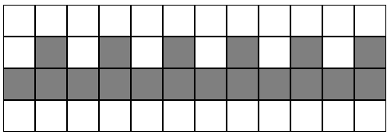
Labeling: union find
Lots of labels necessary
8 bits per pixel may even be not enough!
  This example needs lots of temporary labels before merging them

Slide 9
Labeling multi pass
Use only 1 bit per pixel
  Only one label!
  Disjoint pixel are ignored, at first
Uses multiple passes
  Until all adjacent pixel are processed
< 20 kb memory
  2 B&W buffer for input and for output
Unpredictable timing! (dependent on shape)

Slide 10
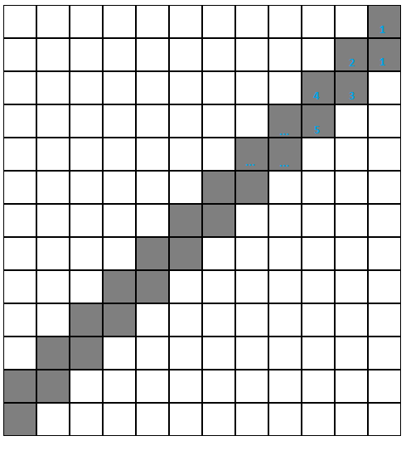
Labeling multi pass
One scan pass for each pixel!

Slide 11
Labeling: labirinth algorithm
Incremental shape extraction is a good idea
  One shape at a time uses low memory
Smarter way to extract a simple shape
  Labirinth algorithm
  Spanning tree of a graph
2 bit per pixel temporary memory (backtracking)
Worst case visits of pixel is bounded! (check max 4 neighbours then never visit again)

Slide 12
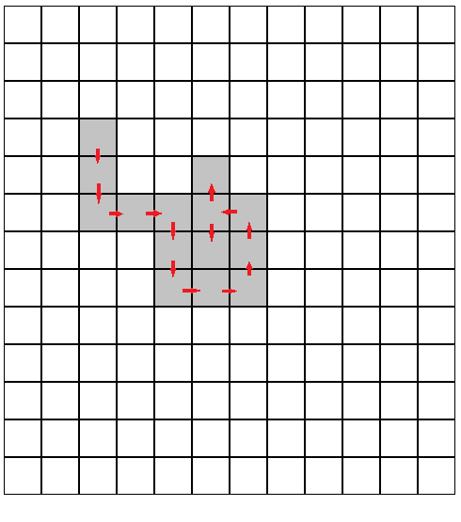
Labeling: labirinth algorithm

Slide 13
Labeling: optimizations
Actually trajectory prediction doesn't need full shape
  Centroids and bounding box can be calculated while visiting shape!
  -1 black&white buffer (9600 kb + various for() loops)
Bounding box checks can be smarter
  Check top border only when moving up, left when moving left and so on
  1 check instead of 4 each pixel!

Slide 14
Labeling: optimizations
Shape search starts from top left pixel each time
  Store last scanned pixel in previous runs
  Start back from previous scanned pixel
  Way less scans at the beginning!

Slide 15
Labeling correctness
Test three different versions
Fully deterministic algoritm
  Blobs are extracted in the same order too
100% same output!

Slide 16
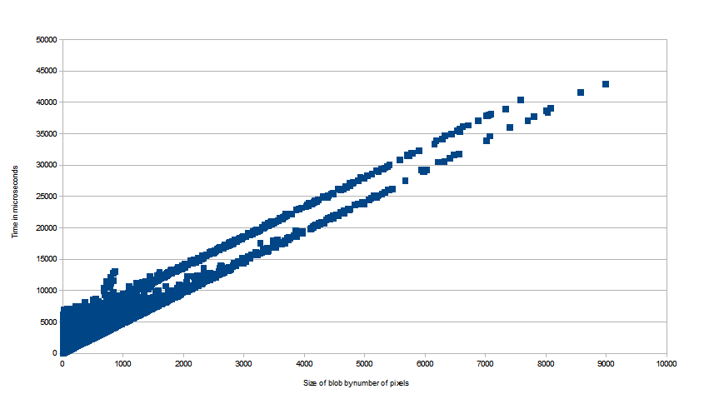
Labeling performance: blob labeling
Linear with blob size
Most CPU expensive part after all

Slide 17
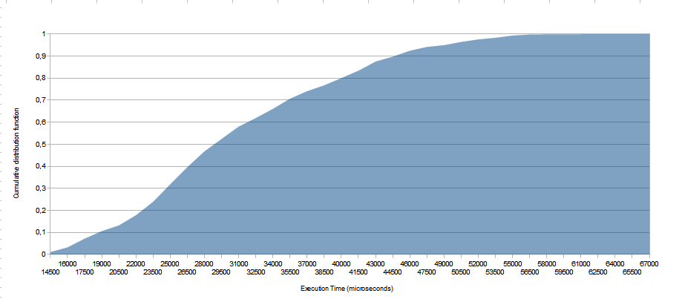
Labeling performance: image labeling
Gamma distribution, average about 30 ms
50% < 29 MS
90 % < 45 MS
A few case above 60 ms!

Slide 18
Labeling: future improvements
How to exploit 32 bits cpu?
  for now all pictures are checked bit by bit!
  Check full word instead for consecutive bits
  No more labirinth algorithm, horizontal check becomes faster
Labeling on down-scaled images
  less resolution, less noise, faster
  Eventually on demand full resolution labeling
  Are very close object connected?

Slide 19
Trajectory Prediction
The task of trajectory prediction deals with the process of making a prevision of the future position of tracked objects. The final aim is to track objects across a stream of frames.
To do so, we need
Infere movement of objects without knowing their behaviour
Recognize objects consinstently across different frames

Slide 20
Kalman Filter basics

Slide 21
Kalman Filter
The Kalman Filter is a data processing algorithm.
  It is optimal and it is recursive
  It allows, in theory, to have very sofisticated models, as long as they are linear.
  Makes possible to deal with noisy measurements
The Kalman Filter is a good choice for our purpose!
  Its recursive nature grants a low memory footprint
  We need to deal with uncertain measurements
  It is simple!

Slide 22
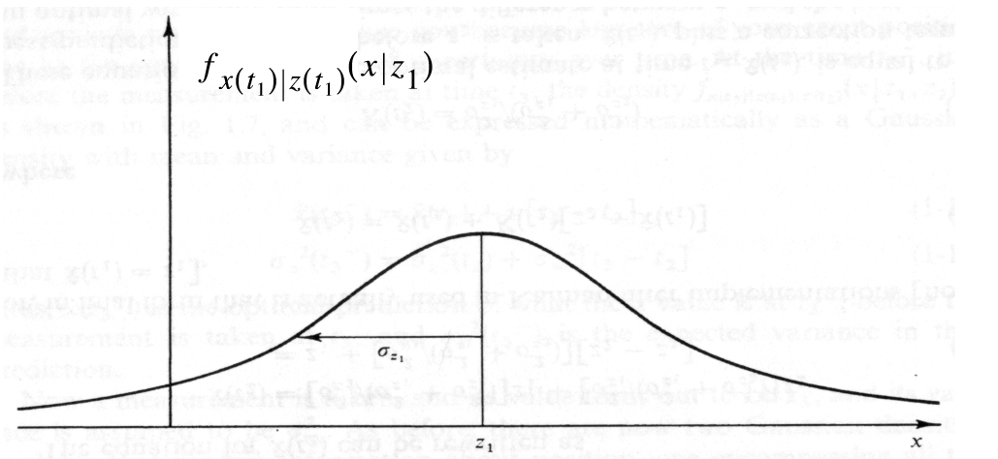
Kalman Filter: how it works
The filter is based on a measurement z1 of the real position x and the uncertainty S2 of the measurement, namely its variance.
  Use the conditional density f(x|z) of the actual position against the measured one
  It will be a N(z1, S2)
  When an estimation is made, the expected value (z1) will be returned
  Why Gaussian? Because this allows to propagate only two parameters!

Slide 23
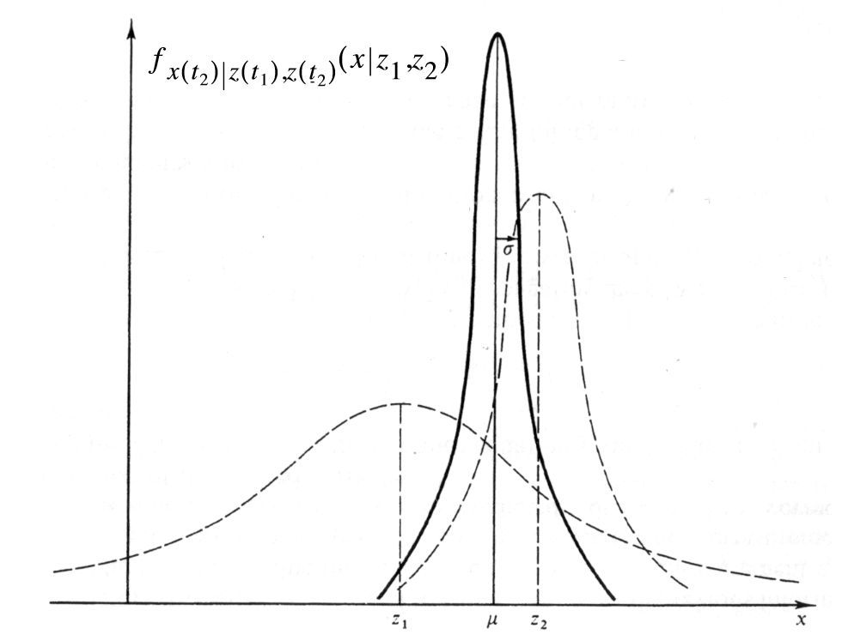
Kalman Filter: how it works (cont.)
New measurements are weighted using the previous estimation
The weight is proportional to the inverse of the uncertainty
Uncertainty decreases with more measurements!

Slide 24
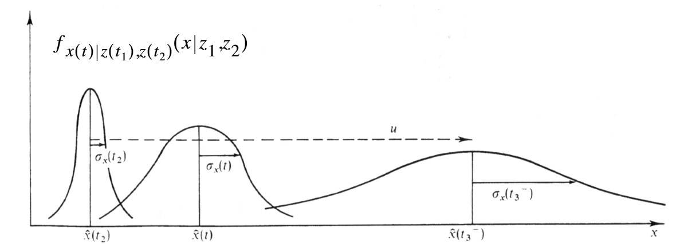
Kalman Filter for moving objects
Moving Objects →include a state evolution in the filter!
  As long as the state evolution is linear, Kalman Filter can deal with it
In our case we can use the classic motion equation

Slide 25
Two steps
Prediction
  Returns best estimation based on actual c.d.f
Correction
  Corrects c.d.f. using difference between estimation and actual measurement

Slide 26
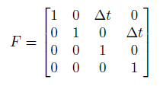
Prediction
The state of an object is its speed and position
Variance replaced by covariance matrix P
The state evolves according to state evolution (F) matrix
Also P evolves using F, spreading uncertainty
  Add motion noise.

Slide 27


Correction
Updates c.d.f with the new measurements
  Takes into account the measurement noise
  We can only measure the position, not the speed!
    Measurement Matrix H
Calculates Innovation
  Difference between estimation and measurement

Slide 28
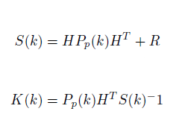

Correction (cont)
Calculate the Gain
  To weight new measurement
  To weight uncertainty
More simple: one value case
  two measurements z1 and z2 of X
  Weight z2 by uncertainty of z1

Slide 29
Trajectory Prediction Overview

Slide 30
Tracking Multiple Objects
Increased complexity
Assign trajectories to objects consinstently
Increased noise
  Small objects detected for few frames → Errors from background subtraction process?
Objects leaving the scene
Objects entering the scene

Slide 31
State of the Trajectory Prediction subsystem
State represented by a vector of tracks
  Each element a Kalman Filter state
  Additional information: age, id, consecutiveInvisible, totalVisible
  84 bytes per track, max. 32 tracks: 2688 bytes
Age is used for discriminating display
  Don't display immediately! Could be noise.
Consecutive invisible count for objects leaving the scene.

Slide 32
Single frame elaboration
Receive measurements from the labeling component
Perform a prediction for every track
  Where should my object be?
  Delete tracks not seen for too much!
  Increase consecutive invisible
How to assign tracks to blobs?
  Blobs represented as centroids
  Need to devise an assignment procedure and metric
  Classic one: Hungarian Algorithm
    O(n^4) time, O(n^2) space

Slide 33
Assignment Procedure
Hungarian algorithm is heavy!
  And we don't need global minimum
Predictions are accurate
  Assign measurements to closest centroid
  Treshold as “cost of unassignment”
  Avoid ordering bias
Our solution:
  Generate all assignment couples, then sort
  Scan
  Detect unassigned

Slide 34
Assignment Procedure (cont)
Euclidean distance as metric
  Square root is heavy
  Optimized version: avoid square root (later)
K = Tracks x Blobs = possible couples
Average complexity is O(klogk) in time, O(k) in space.
Since |Tracks| about |Blobs|, quadratic in both
Returns assignments vector and unassigned blobs

Slide 35
Correction
The assignment links measures to tracks!
  Can perform the correction step
  Decrement consecutiveInvisible for detected tracks
After the end of the correction, we are ready to receive a new image

Slide 36
Trajectory Prediction Performances

Slide 37
Performance Analysis
Floating point widely used in Kalman Filter
Costly! No FPU
Two different versions:
  One using floating point (more precise)
  One using fixed point approximation
    Kalman gain calculation makes number grow a lot!
Also assignment can be improved
  Change the metric avoiding sqrt

Slide 38
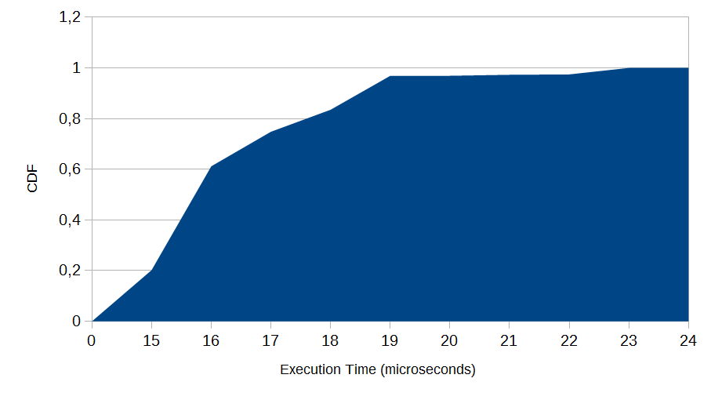
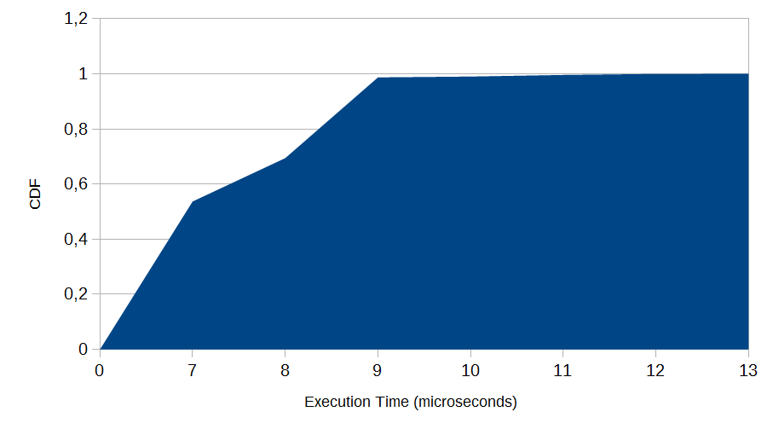
Prediction per track performance
Floating Point Version
Floating Point Version
Very fast procedure in both cases
Fixed point version maximum less than floating point minimum!
Floating Point avg:16,6 microseconds
Fixed point avg: 7,8 microseconds
Fixed Point Version

Slide 39
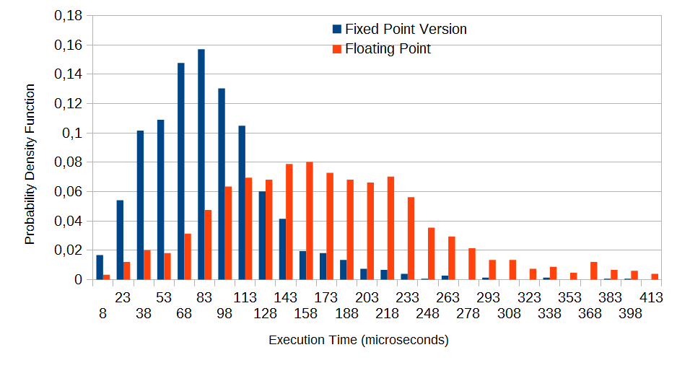
Overall Prediction Performance

Slide 40
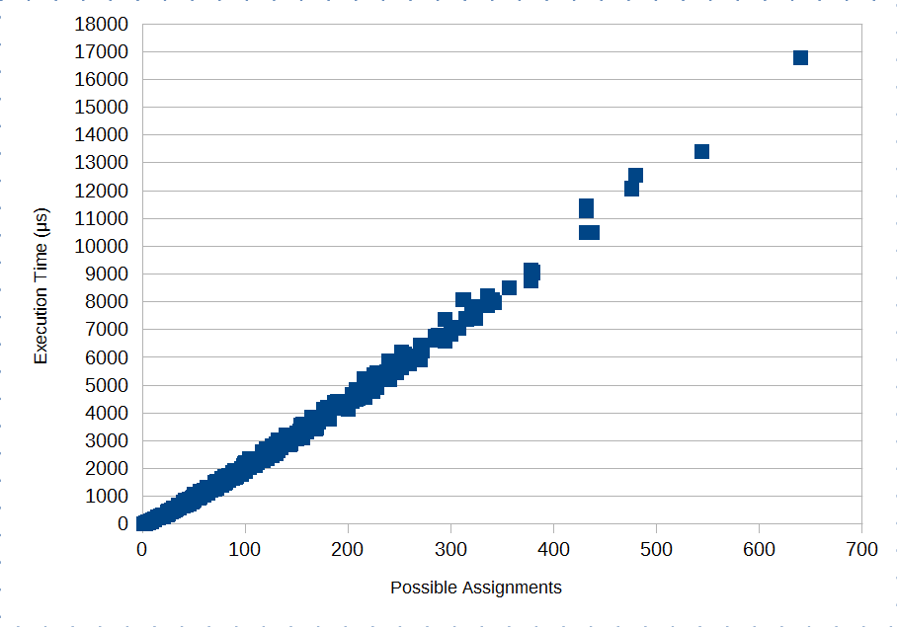
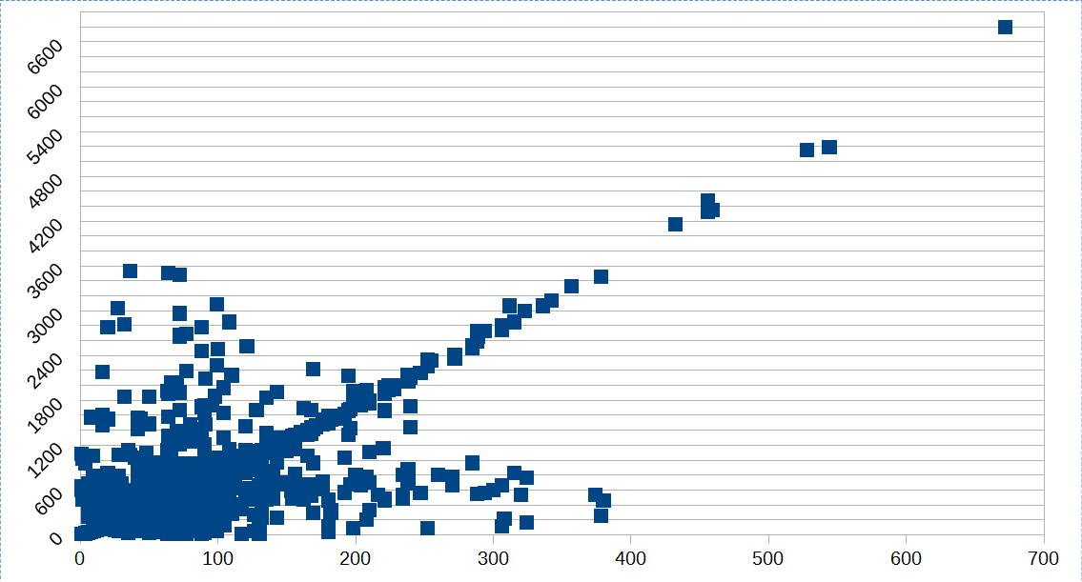
Assignment Performance
The only difference is the square root
Behaves as O(KlogK) as expected in float version (left)
Stranger behaviour in fixed point version (right)

Slide 41
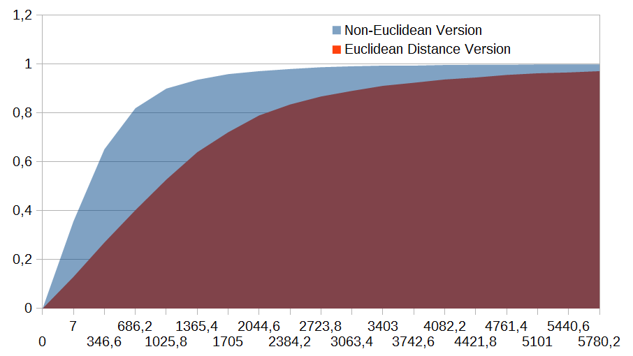
Assignment Performance (2)
Optimized distance version takes less than 600 microseconds with p. close to 80%, less than 2 ms almost always
This is the bottleneck of trajectory prediction component

Slide 42
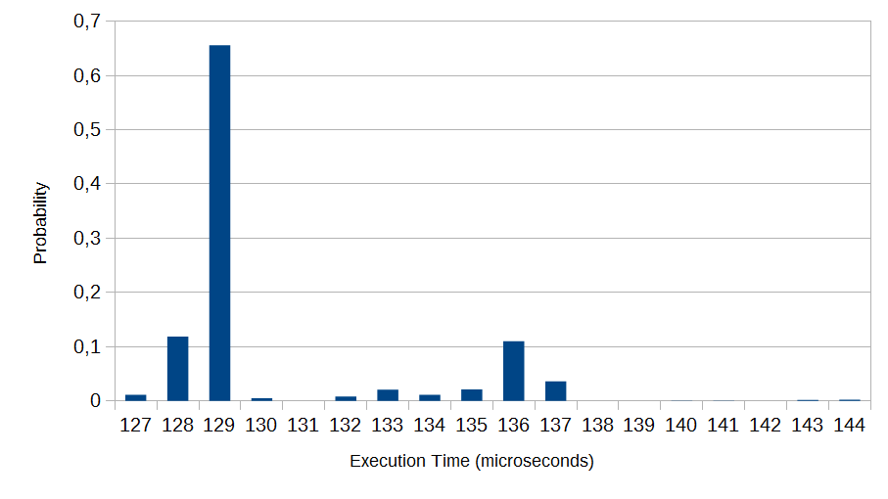
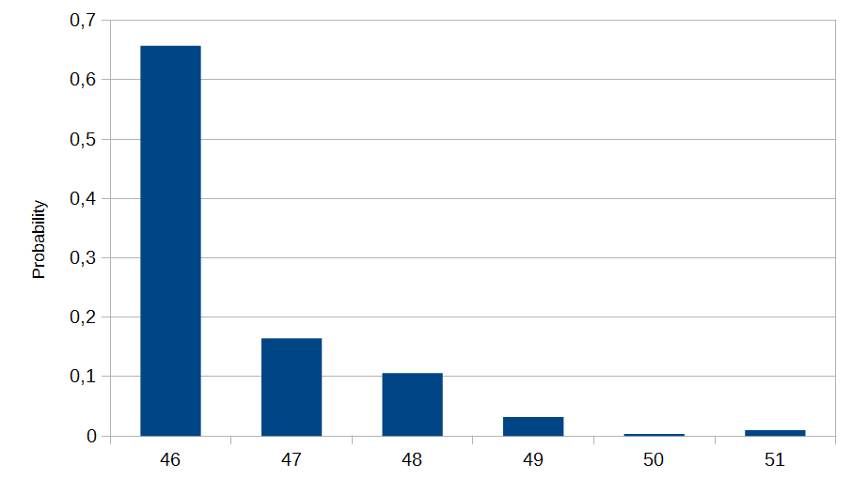
Correction for a single track
Floating Point Version
Floating point version is more than 3x slower on average
Fixed point version has Tc = 46microseconds with probability > 60%
Floating point is Gamma, fixed point exponential.
Fixed Point Version

Slide 43
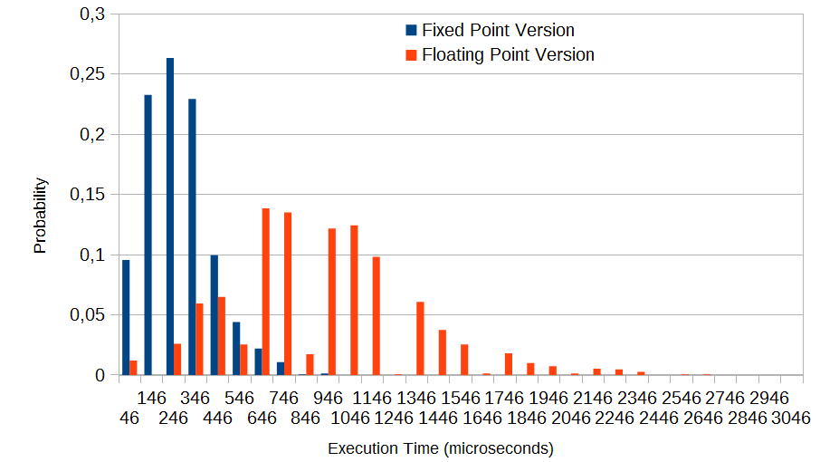
Correction

Slide 44
Overall performance analysis

Slide 45
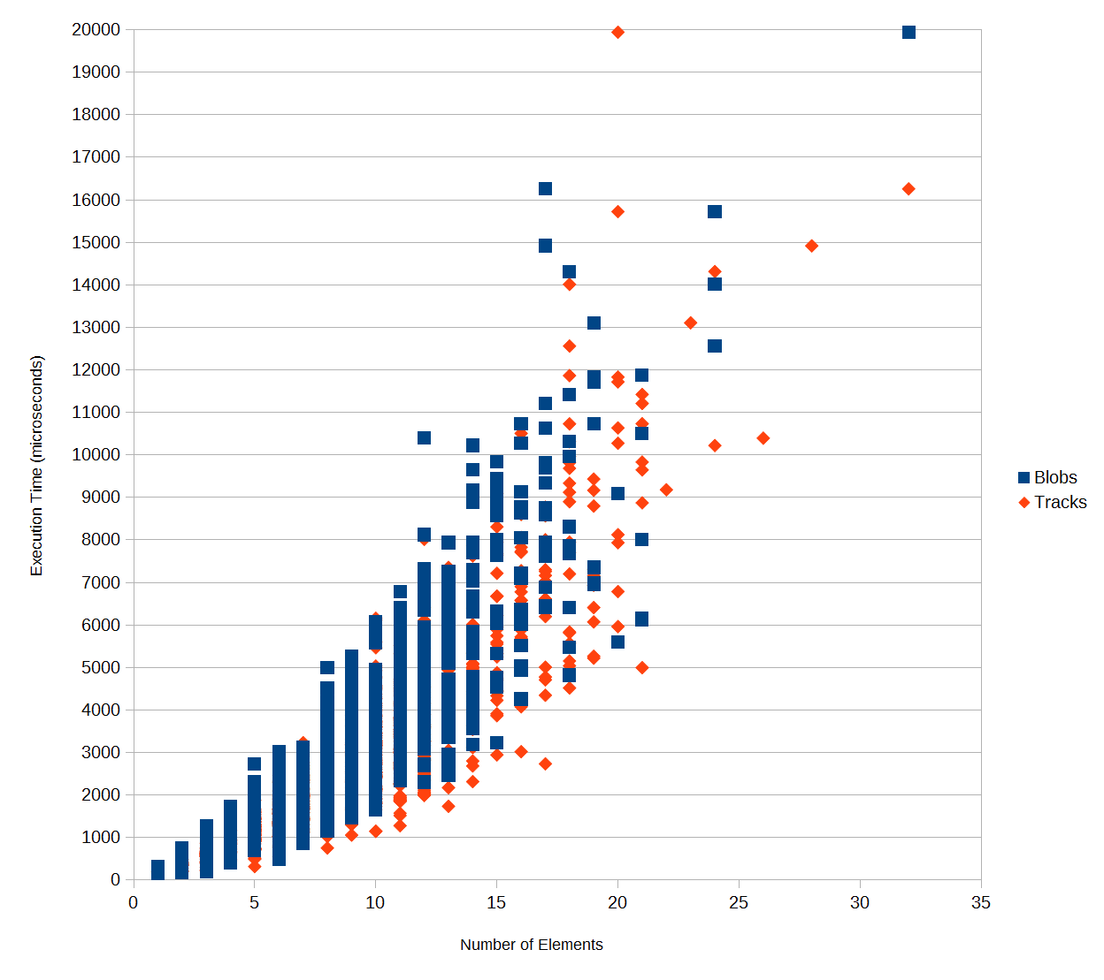
Combined Performance Analysis (1)
Assignment is the most costly part
Total cost of this phase goes as the assignment
It is quadratic in term of the tracks and blobs
Worst case memory:
  1392 B for blobs
  2688 B for tracks
  Less than 4KB in total

Slide 46
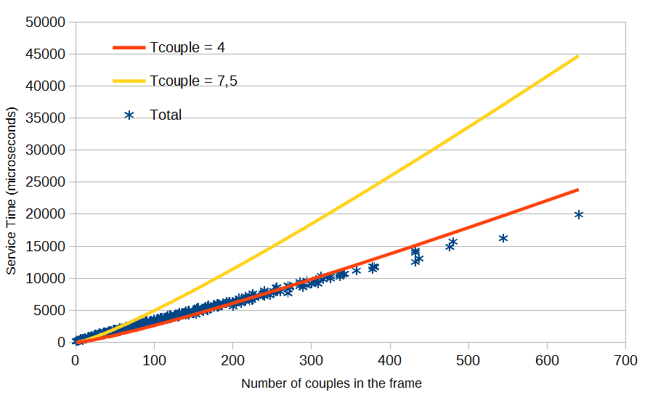
Cost model estimation (floating point)
Asymptotic trend will follow assignment
  Perturbation before QS dominates
Service time in the form
  Ts = Tcouple * k * log(k)
Suitable Tcouple values experimentally in[4, 8]

Slide 47
Worst case cost model
Assuming Tcouple = 7.5 (worst case estimation) this part can process up to 496 couples at 30 fps
Assuming #blobs about #tracks: up to 23 objects
  In practice, 640 couples in 20ms
  Less conservative estimation: Tcouple = 4us
    850 couples at 30 fps
Complex cost model derivation for enhanced assigned
Total cost of this phase in fixed point is < 2000us with 90% probability

Slide 48
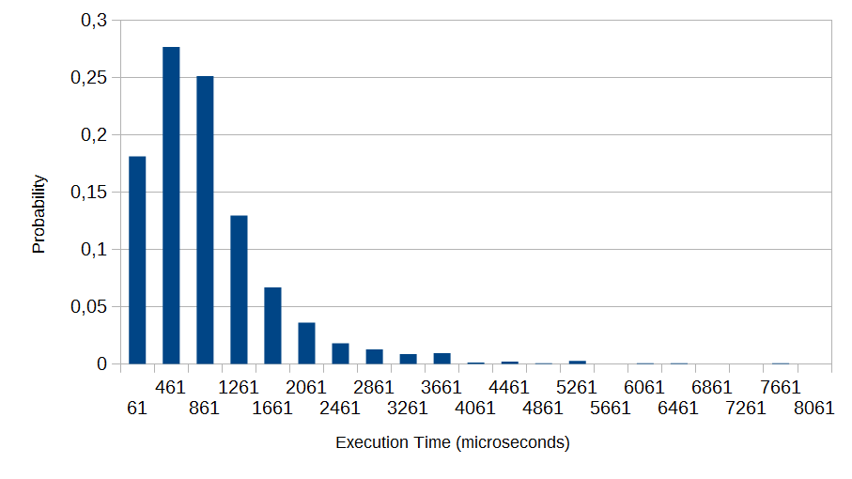
Optimized version service time
Strange unassignment behaviour → Difficult to derive a cost model!

Slide 49
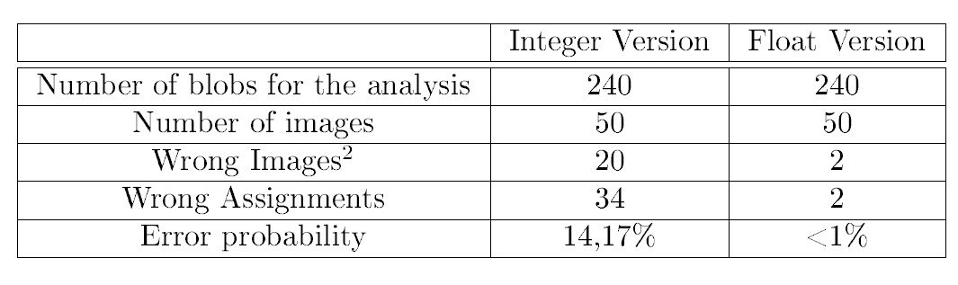
Qualitative Analysis
Need to create a gold standard
High precision in the floating point version
Lower in the fixed point one

Slide 50
Conclusions

Slide 51
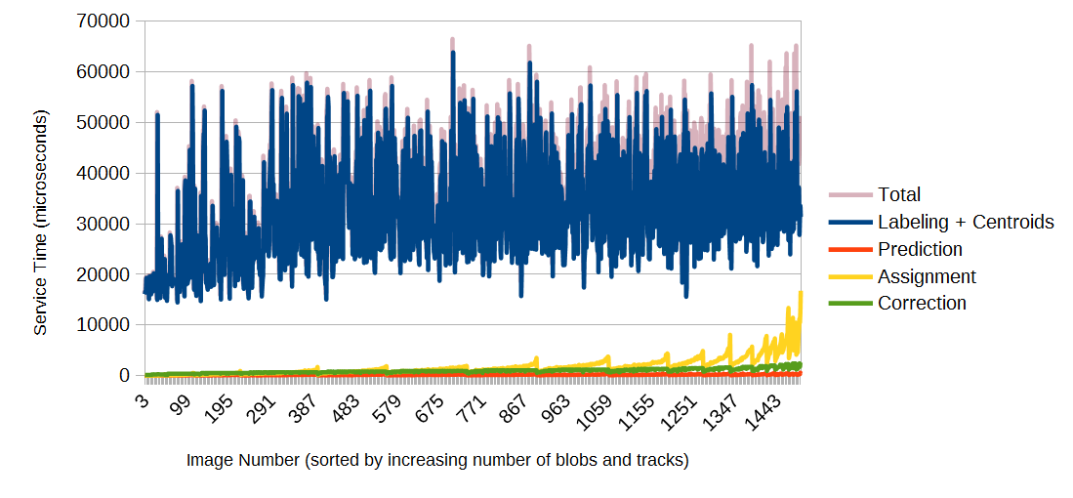
Tracking System Performances
Most heavy part is the labelling
It dominates over all the others by orders of magnitude

Slide 52
Soft Real Time high fps object tracking
In a soft real-time environment we can support up to 20 fps with a probability of 91%
  Skipping a frame occours with prob. < 10%
Worst case: 10 fps in our simulation
Frame skipping could affect negatively trajectory prediction
Labeling is high, but bounded
Assignment is not..!

Slide 53
Future Work
Improve trajectory prediction precision
  Enrich Kalman Filter state and transition model
  More complex assignment cost function, taking into account shape
Heuristics for assignment to reduce complexity
Further space reduction and optimizations
Downscaled images effects on trajectory

Slide 54
…and finally...
Wait... we have the videos!

