Slide 1
HuffHash
Optimizing Data Integrity and Compression Through Huffman Encoding and MD5 Hashing
By-
Dhruv Gupta

Slide 2
Real World Applications
Secure and anonymous messaging- Apps like WhatsApp, Telegram, and Signal do similar things (though with more advanced encryption), to send safe, small-size messages.
Digital Notepad with security- It can act as a password vault or secret notepad, where each note is saved with a secure hash instead of being visible directly.
Document verification systems- When someone uploads a file (or enters a message), the system stores its MD5 hash. Later, we can compare new input’s hash to check if it’s still the same.
Compression software prototype- This encoding can be base for building a data compression utility, as it can be expanded into a more complete file compressor for text data.
Forensic tool for data matching- It can help to match the files and messages to help check if they are altered or not, and it can become a forensic hash database.

Slide 3
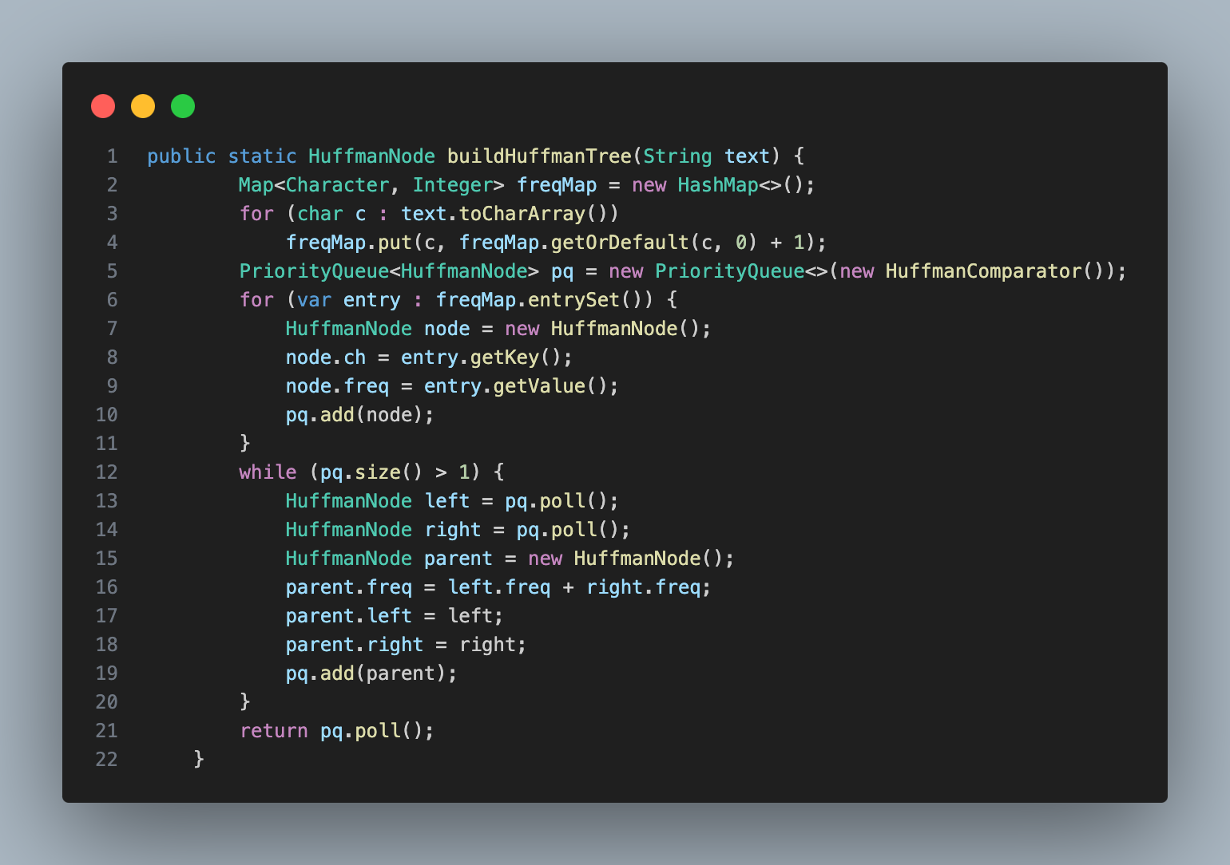
Code Parts-
Backend-
Code for building Huffmann Tree-
Count the frequency of each character in the message
Create a node for each character with its frequency
Use a priority queue (min-heap) to sort nodes by frequency
Combine the two least frequent nodes into a new node
Repeat until only one node remains — this becomes the root of the Huffman Tree
This tree is used to generate unique binary codes for each character

Slide 4
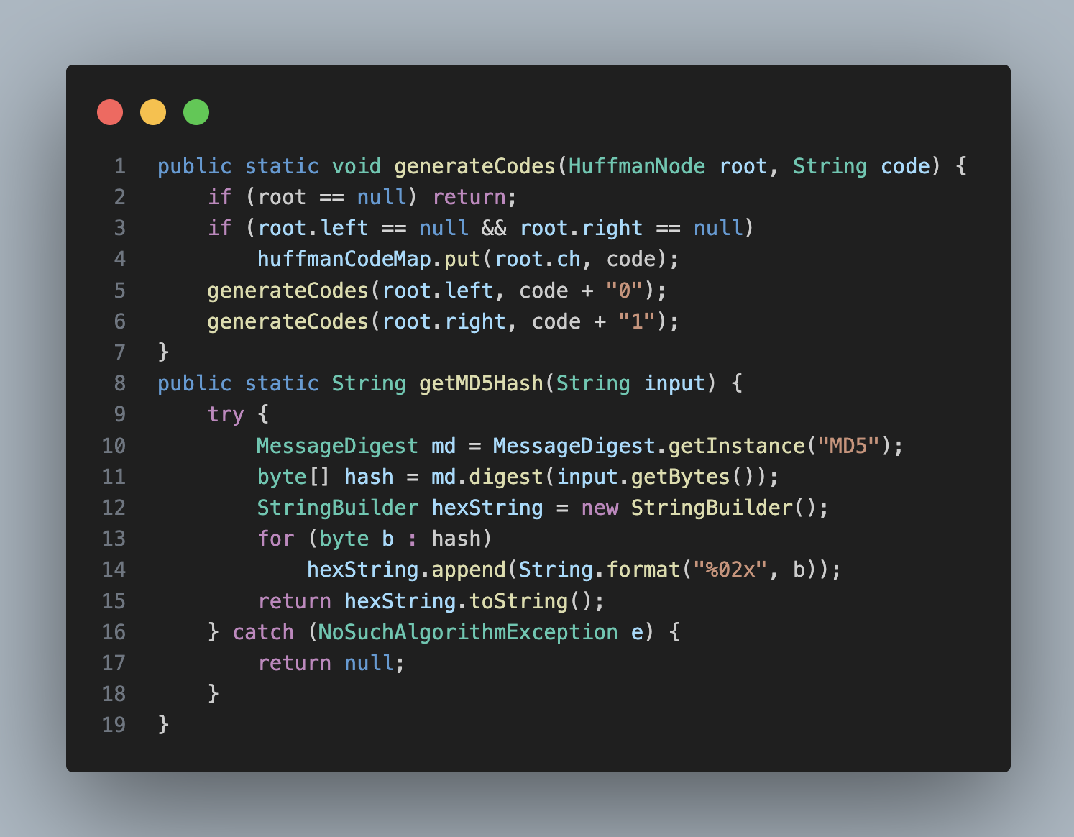
Code Parts-
Generating Huffman Tree-
Start by counting how often each character appears in the message
Create a node for every unique character with its frequency
Insert all nodes into a priority queue (min-heap)
Remove the two nodes with the lowest frequencies
Combine them into a new parent node and re-insert it into the queue
Repeat until only one node is left — this is the root of the Huffman Tree
The tree helps assign shorter codes to frequent characters
Backend-

Slide 5
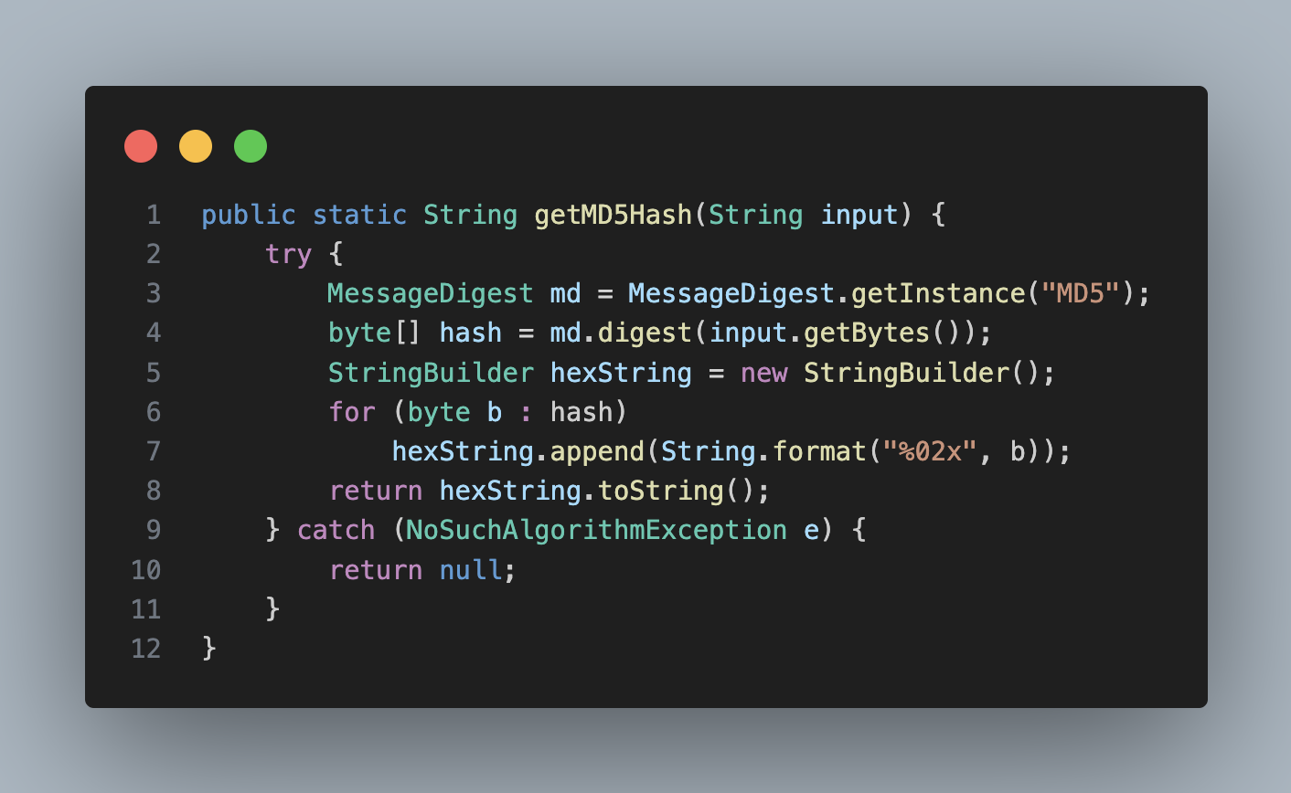
Code Parts-
Backend-
Creating MD5 hash-
MD5 stands for Message Digest 5, a cryptographic hash function
It takes the original message and creates a unique 128-bit hash
Even a small change in input creates a completely different hash
The hash is represented as a 32-character hexadecimal string
Used to store and verify data securely
Acts like a digital fingerprint of the message

Slide 6
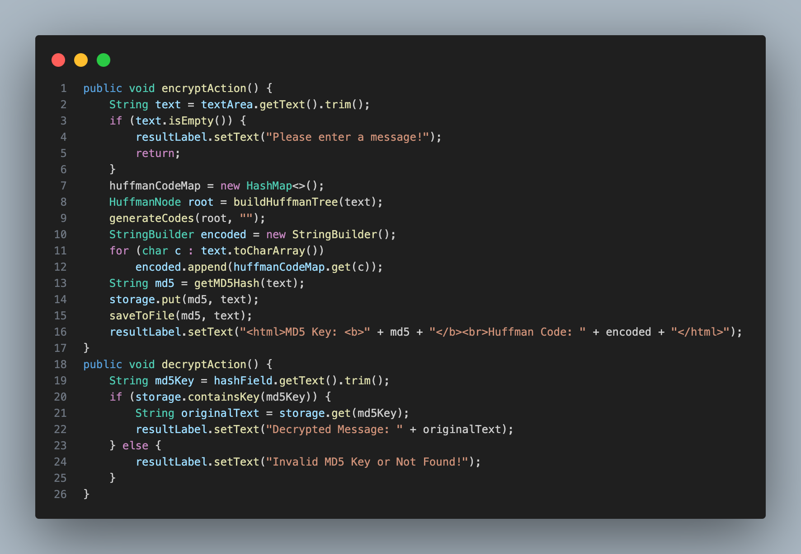
Code Parts-
Actions that happens when buttons are pressed-
Encrypt Button (encryptBtn):
Gets the input message.
Checks if the message is empty.
Builds Huffman tree and generates codes.
Encodes the message.
Computes the MD5 hash.
Stores the hash and message.
Saves to file (md5_storage.txt).
Displays MD5 hash and Huffman code.
Decrypt Button (decryptBtn):
Gets the MD5 hash input.
Checks if the hash exists in storage.
Displays the original message if found.
Shows error if hash is invalid or not found.
Backend-

Slide 7
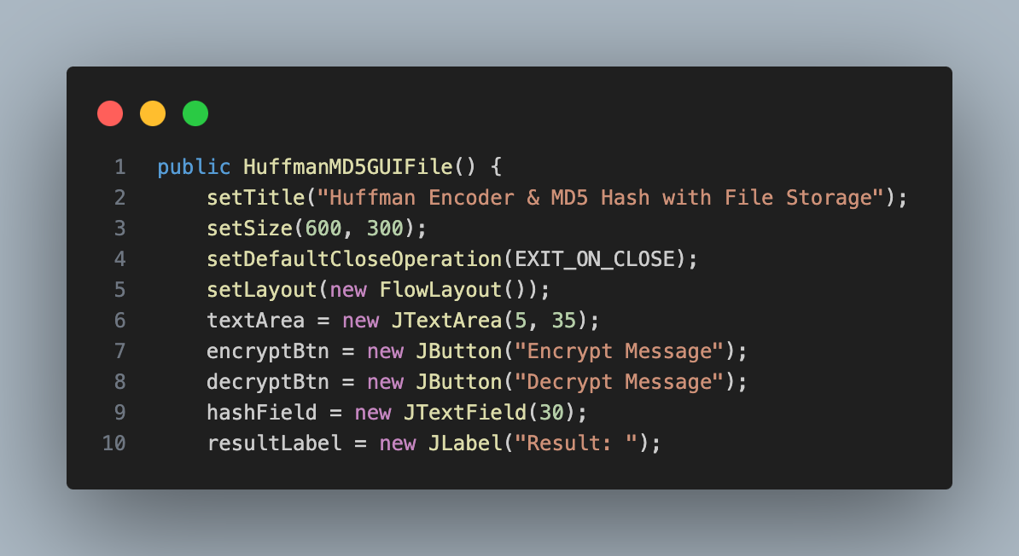
Code Parts-
This create main window for application-
Title set as “Huffman Encoder & MD5 Hash with File Storage”.
Size of the window set to 600x300 pixels.
Exit operation defined to close the window on exit.
Layout set to FlowLayout for arranging components.
JTextArea for entering text to encrypt.
JButton for encrypting the message (Encrypt Message button).
JButton for decrypting the message (Decrypt Message button).
JTextField for entering MD5 hash to decrypt.
JLabel to display results (MD5, Huffman code, or decrypted message).
Frontend-

Slide 8
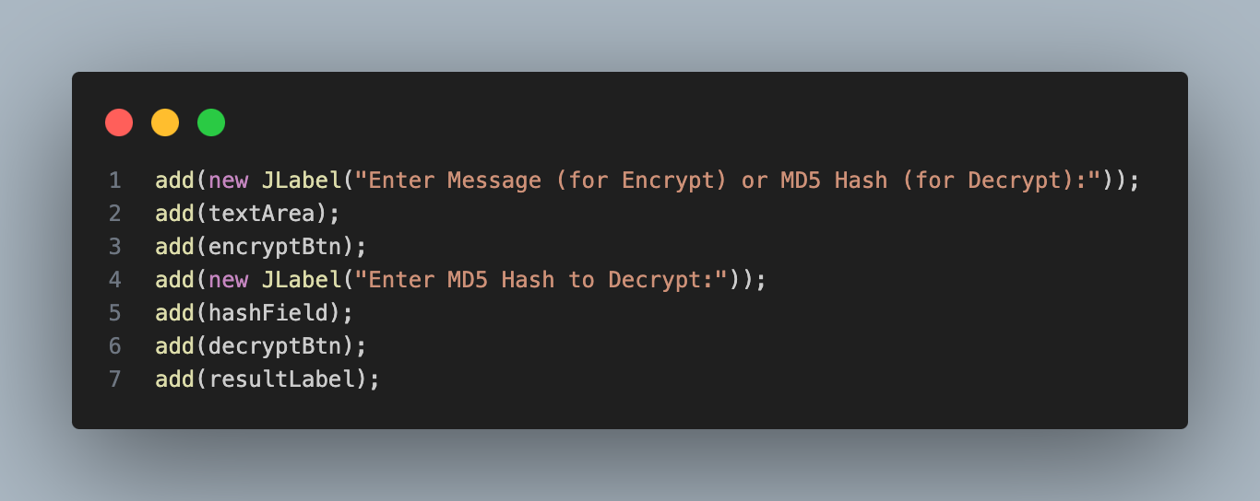
Code Parts-
Adding UI Components to the Window-
Adding Labels and Input Fields:
Adds a label prompting the user to enter a message (for encryption) or MD5 hash (for decryption).
Adds a text area (textArea) for the user to input the message to be encrypted.
Adding Buttons:
Adds an “Encrypt Message” button (encryptBtn) to trigger encryption.
Adds another label prompting the user to enter the MD5 hash for decryption.
Adding Text Field for MD5 Input:
Adds a text field (hashField) where users can input the MD5 hash for decryption.
Displaying Results:
Adds a “Decrypt Message” button (decryptBtn) to trigger decryption.
Adds a result label (resultLabel) to display encryption results (MD5 hash, Huffman code) or the decrypted message.
Frontend-

Slide 9
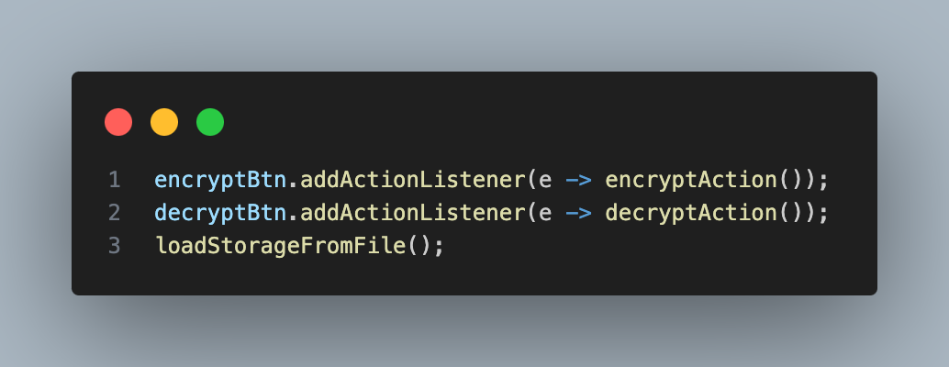
Code Parts-
Defining Button Actions-
Encrypt Button (encryptBtn) Action:
Retrieves the input message from the text area.
Verifies if the message is not empty.
Builds the Huffman tree based on character frequencies.
Generates Huffman codes for the characters.
Encodes the message using the generated Huffman codes.
Computes the MD5 hash of the message.
Stores the MD5 hash and the original message.
Saves the MD5 hash and message to the file.
Displays the MD5 hash and Huffman code in the result label.
Decrypt Button (decryptBtn) Action:
Retrieves the MD5 hash entered by the user.
Checks if the MD5 hash exists in the storage.
If found, displays the original message associated with the hash.
If not found, displays an error message indicating the MD5 hash is invalid or missing.
Frontend-

Slide 10
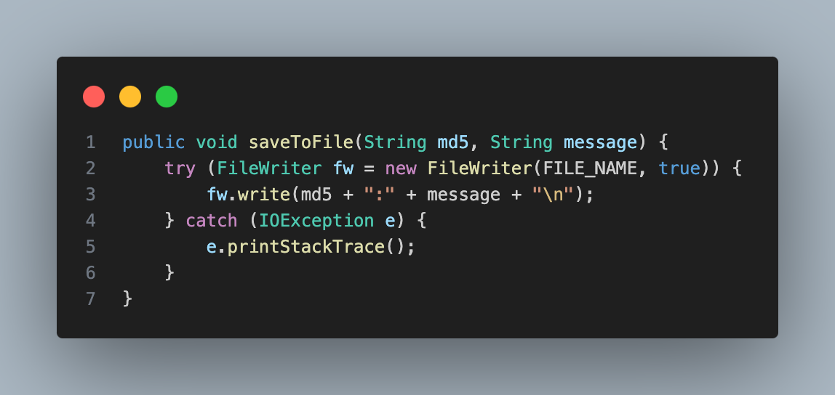
Code Parts-
Saving MD5 Key and Original Message to a File-
File Storage:
Saves the MD5 hash and the original message as a key-value pair.
Uses FileWriter to append data to the md5_storage.txt file.
File Format:
Each entry is written as MD5hash:OriginalMessage on a new line.
Appending Data:
Ensures new data is added at the end of the file without overwriting existing entries.
Database-

Slide 11
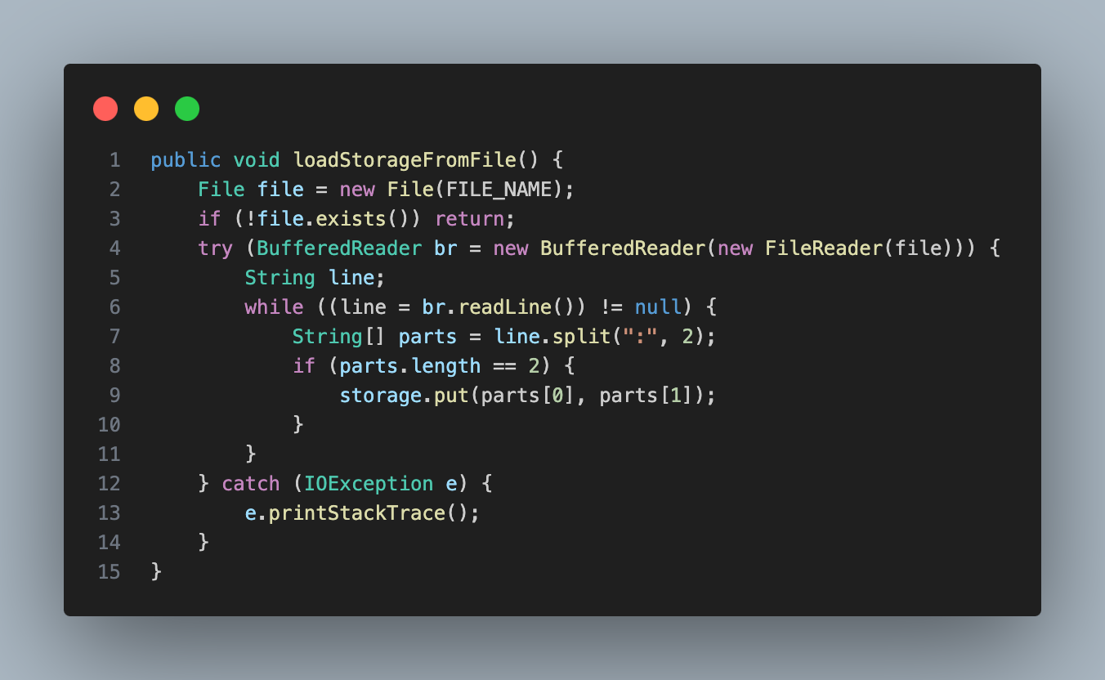
Code Parts-
Reading the File and Loading Data into Storage-
File Reading:
Reads the md5_storage.txt file line by line when the program starts.
Storing Data:
Each line is split into two parts: the MD5 hash and the original message.
The MD5 hash serves as the key, and the original message is the value in the storage HashMap.
Populating the HashMap:
The data from the file is loaded into the storage map, making it available for decryption.
Database-

Slide 12
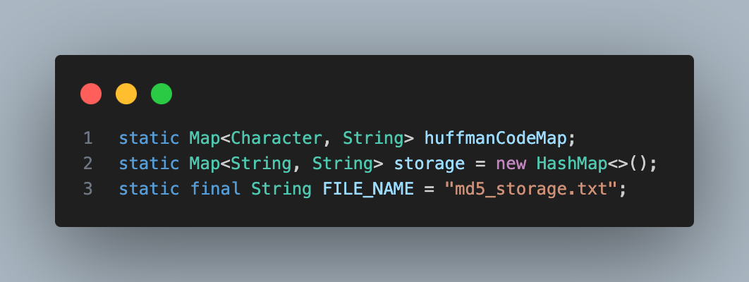
Code Parts-
Database-
Storage Using HashMap-
Temporary Database:
Uses a HashMap named storage as a temporary in-memory database.
Data Structure:
Stores data in key-value format: MD5 hash ➝ original message.
Purpose:
Allows quick lookup of original messages during decryption.

Slide 13
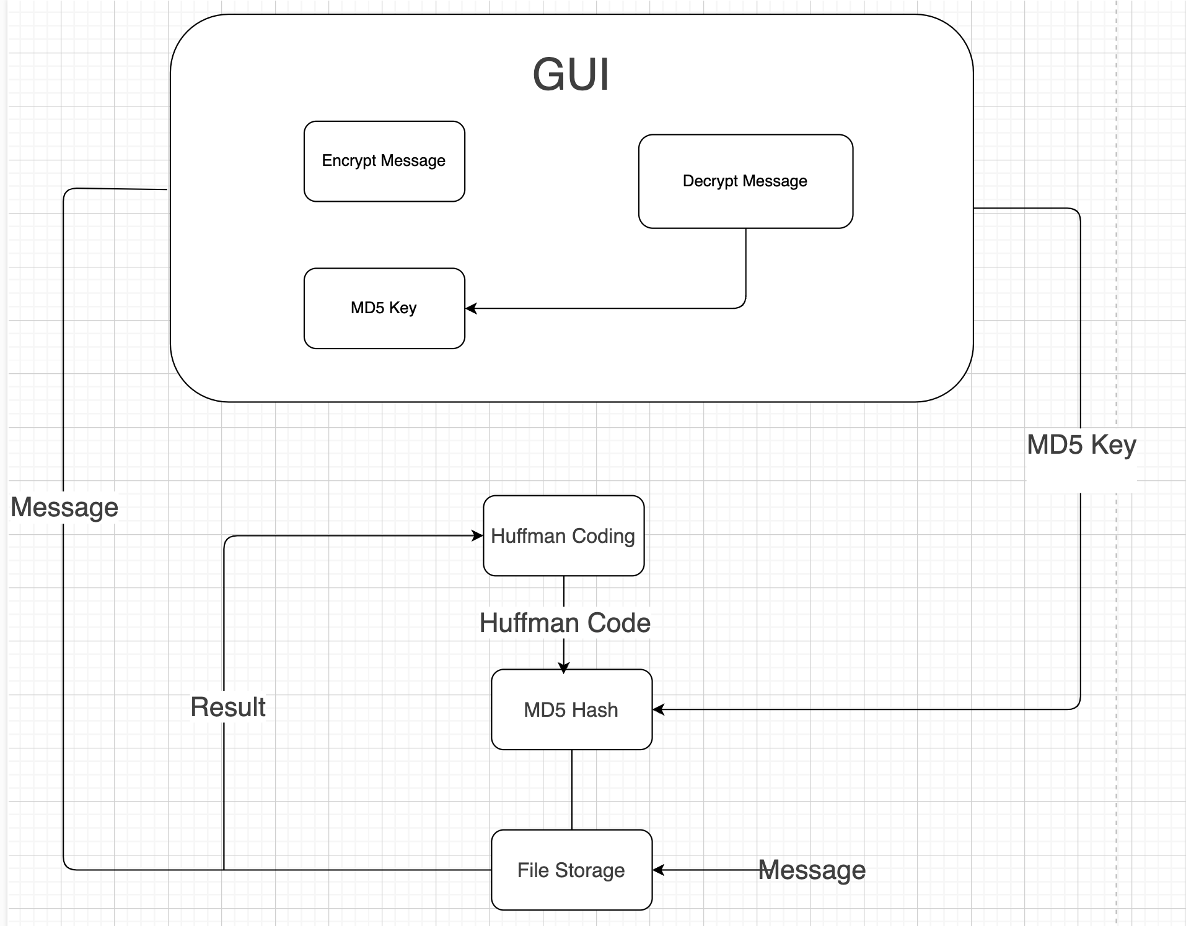
How does connection works

Slide 14

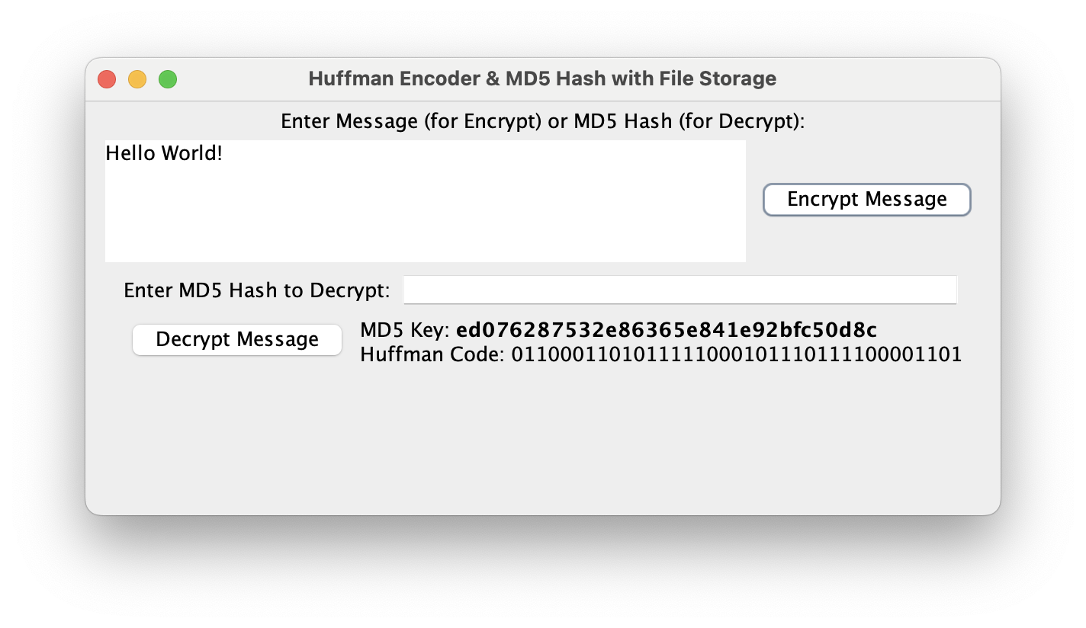
GUI-
Input Area:
Users can enter any message including:
Uppercase and lowercase letters
Symbols, numbers, and spaces
Encryption:
After typing a message, clicking “Encrypt Message” shows:
The MD5 key
The Huffman-encoded version of the message
Decryption:
Users can paste an MD5 key into the field below
Clicking “Decrypt Message” will reveal the original message if the key is found in the storage
Easy Interaction:
Everything is handled with just two buttons in a single window

Slide 15
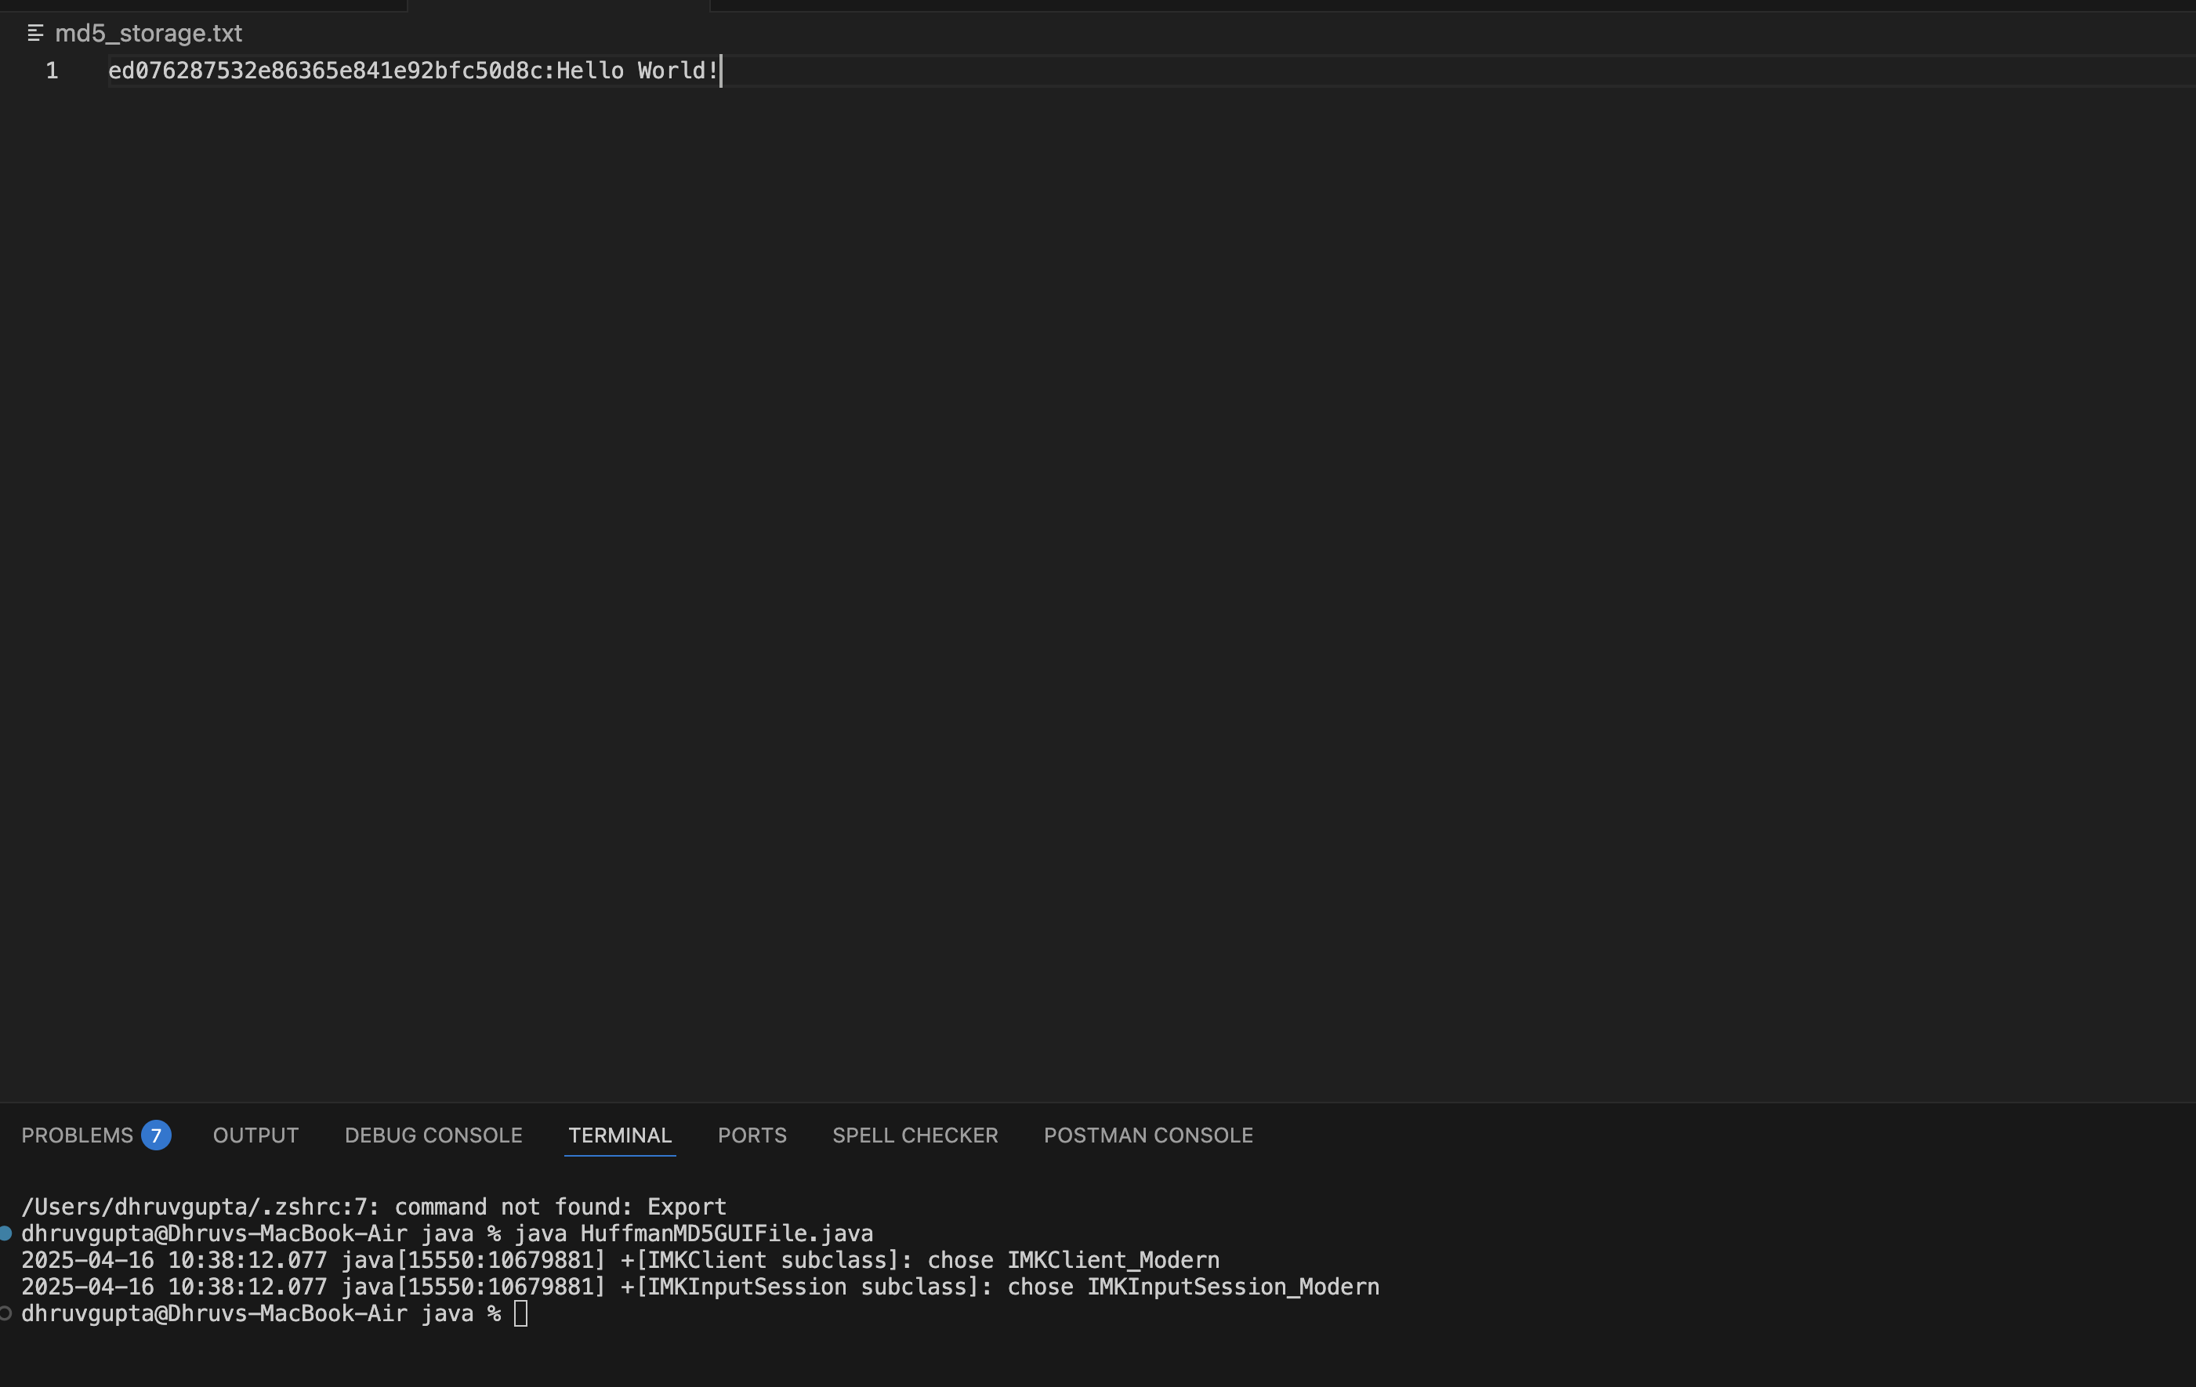
Database-
What is Saved:
Only the main message and its MD5 key are saved to the file.
Why Huffman Code Isn’t Saved:
Huffman code is generated every time from the original message.
Saving it would increase file size without any real benefit.
Efficient Storage:
This approach keeps the storage lightweight and avoids unnecessary data duplication.

Slide 16
Thank You

