Slide 1
ShopVista
Dmytro Poliak 100443432

Slide 2
Project Overview
Brief Overview:
ShopVista is an e-commerce platform designed to replicate the functionality of Shopify while incorporating unique features such as predictive analytics, AI-powered chatbots, and voice-assisted shopping.
The project emphasizes scalability, security, and user experience, with a completion timeline of 4 months.

Slide 3
Project Overview (continue)
In-Scope Deliverables:
1. Development of a fully functional e-commerce system:
Customer storefront and vendor dashboard.
Secure payment integration.
Multilingual and multi-currency support.
Backend and frontend development.
2. Implementation of unique features:
Predictive analytics dashboard for sales trends.
AI-powered chatbot for customer support.
Voice-assisted shopping functionality.
3. Comprehensive testing, including functional, performance, and security testing.
4. Deployment on cloud infrastructure with disaster recovery setup.
5. Training materials for end users.
Out-of-Scope Deliverables:
Third-party API maintenance beyond the initial integration.
Hardware procurement and installation for physical stores.
Ongoing system updates post-launch.
Marketing campaigns and customer acquisition strategies.

Slide 4
Work Breakdown Structure (WBS)
Summarized the phases:
Project Planning
Risk Analysis
Design Phase
Development Phase
Testing and QA
Deployment and Maintenance

Slide 5
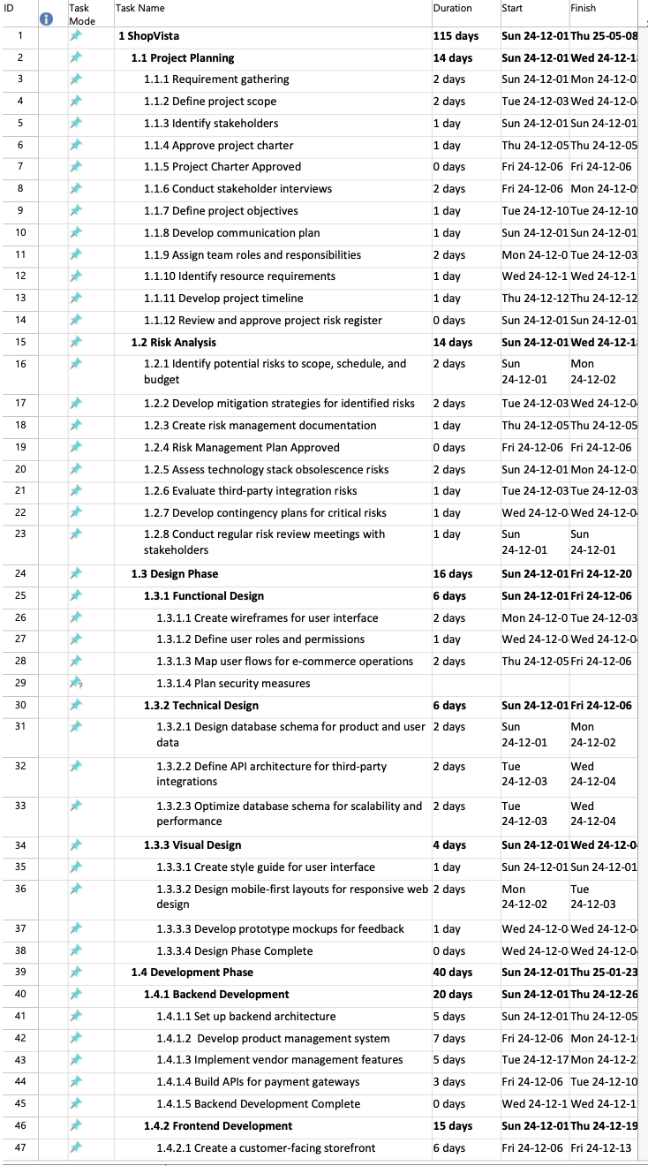
Work Breakdown Structure (WBS)

Slide 6
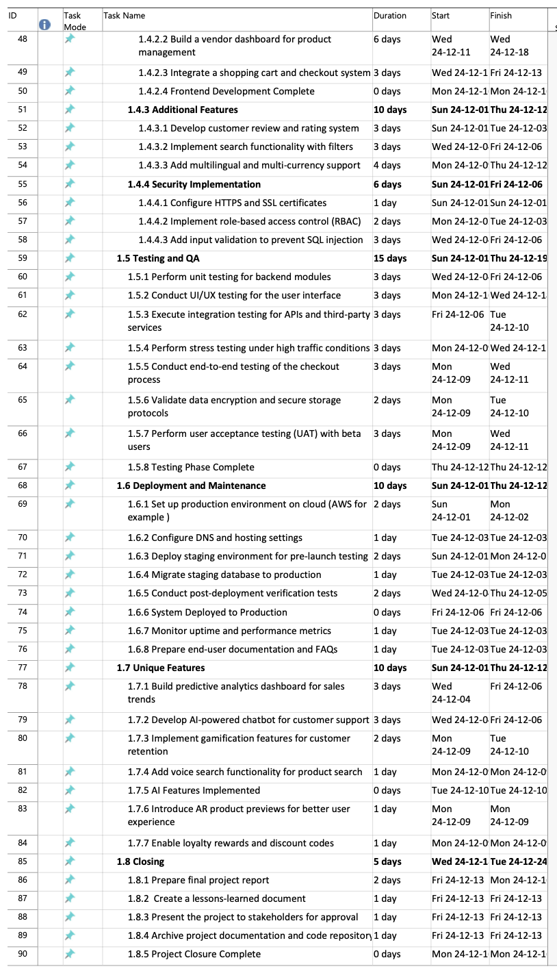
Work Breakdown Structure (WBS)

Slide 7
Risk Analysis
Risk ID | Risk Description | Impact (High/Med/Low) | Likelihood (High/Med/Low) | Mitigation Plan | Contingency Plan
1 | Delay in project planning | High | Medium | Schedule extra buffer time for planning tasks. | Reallocate resources to expedite planning.
2 | Technical challenges in development | High | High | Conduct regular code reviews and testing. | Engage external consultants if needed.
3 | Resource availability issues | Medium | Medium | Cross-train team members to handle multiple roles. | Outsource specific tasks to freelancers.
4 | Budget overruns | High | Medium | Monitor expenses weekly and reduce waste. | Request additional funding approval.
5 | Integration failures with APIs | Medium | High | Test API integrations early and often. | Use mock APIs or alternate solutions.
6 | Security vulnerabilities | High | Medium | Perform penetration testing and code audits. | Rollback changes and secure backup systems.
7 | Delayed user feedback | Low | Medium | Engage stakeholders early in the process. | Use internal team reviews for interim feedback.
8 | Hardware or cloud infrastructure failure | High | Low | Use redundant systems and cloud backup. | Shift workloads to alternate systems.

Slide 8
Budget
WBS | Task | Labor Hrs | Rate | Materials Units | $/Unit | Fixed Costs | Budget
1 | [Project Planning]
1.1 | Requirement Gathering | 8 | $50.00 | 0 | $0.00 | $100.00 | $500.00
1.2 | Define Project Scope | 10 | $50.00 | 0 | $0.00 | $200.00 | $700.00
2 | [Risk Analysis]
2.1 | Identify Potential Risks | 6 | $60.00 | 0 | $0.00 | $0.00 | $360.00
3 | [Design Phase]
3.1 | Create Wireframes | 15 | $40.00 | 10 | $10.00 | $500.00 | $1,300.00
4 | [Development Phase]
4.1 | Set Up Backend Architecture | 20 | $45.00 | 15 | $25.00 | $1,000.00 | $2,875.00
4.2 | Develop Frontend | 25 | $45.00 | 20 | $30.00 | $2,000.00 | $3,875.00
5 | [Testing and QA]
5.1 | Perform Functional Testing | 12 | $50.00 | 5 | $15.00 | $500.00 | $1,160.00

Slide 9
For the Gnatt, Network charts and Critical Path look at pdf files labled accordingly

