Slide 1



TEAM DETAILS AND PROBLEM STATEMENT
Problem Statement : categorizes paragraphs based on the dataset's presence or absence of specific
mental health indicators.
Team Name : bHUC
Team Leader Details (Name, Phone Number, Email) : Drishtant Singh Sengar , 9044400879
bt22cse012@iiitn.ac.in
Institution Name : IIIT Nagpur
Course Enrolled : Btech CSE

Slide 2
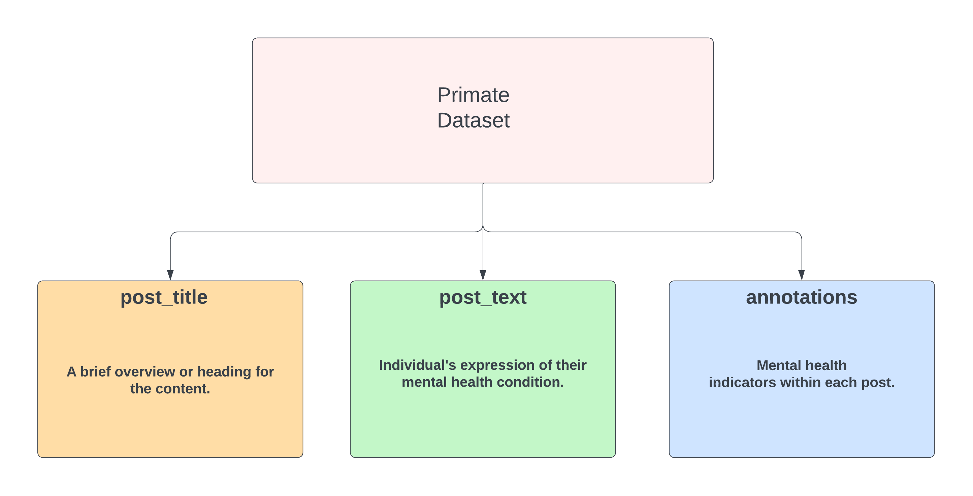
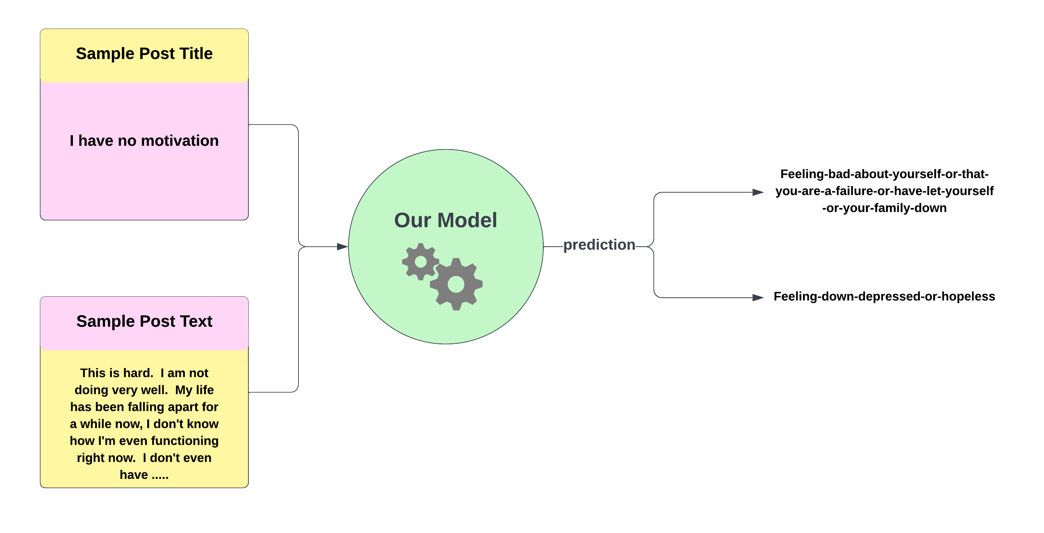
Problem Statement

Slide 3
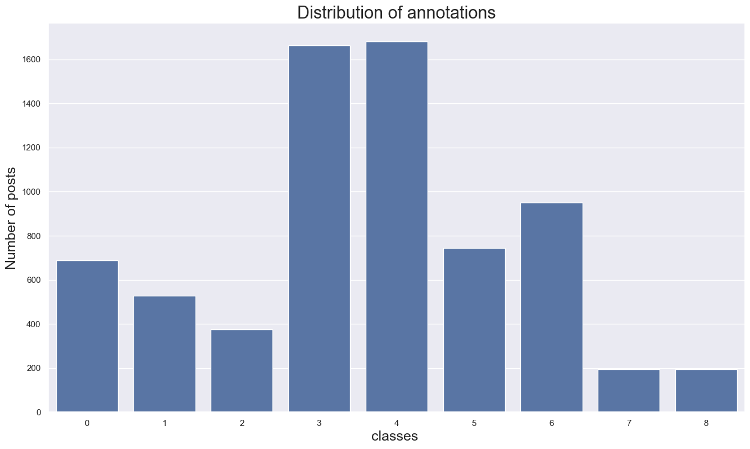
Observations : Class imbalance
Imbalanced Classes: When the classes are imbalanced, meaning some classes have significantly more instances than others, the model may become biased towards the majority class. This can lead to poor performance on the minority classes and inaccurate predictions.
2.Limited Representation: Annotations with fewer instances may not have enough data to accurately learn their patterns and characteristics. As a result, the model may struggle to make accurate predictions for these annotations.
3.Evaluation Metrics: When evaluating the model's performance, metrics such as accuracy may not provide an accurate representation of its effectiveness. For imbalanced datasets, metrics like precision, recall, and F1-score are more informative in assessing the model's performance on individual classes.

Slide 4
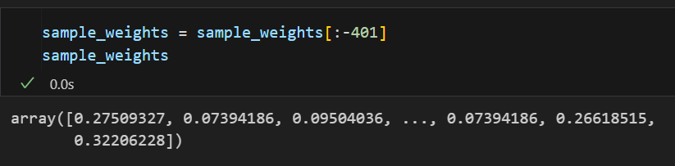
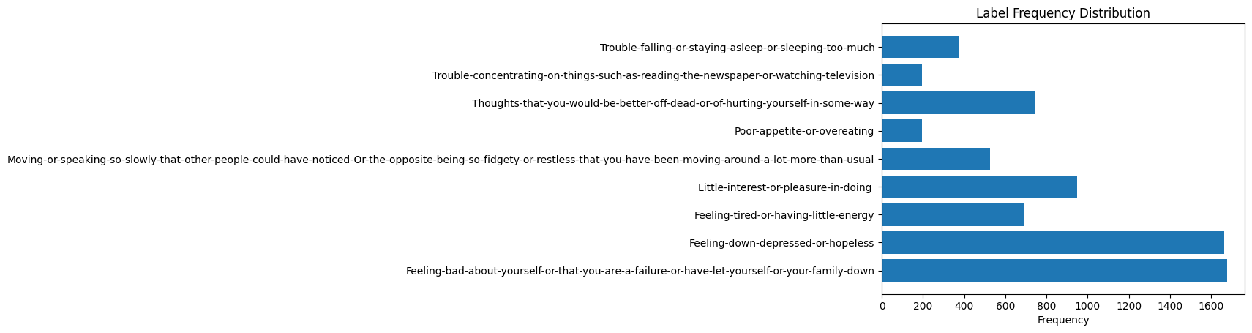
Our Approach
To solve the problem of label/class imbalance we assigned different weights to each label to improve the precision and recall of our model.

Slide 5
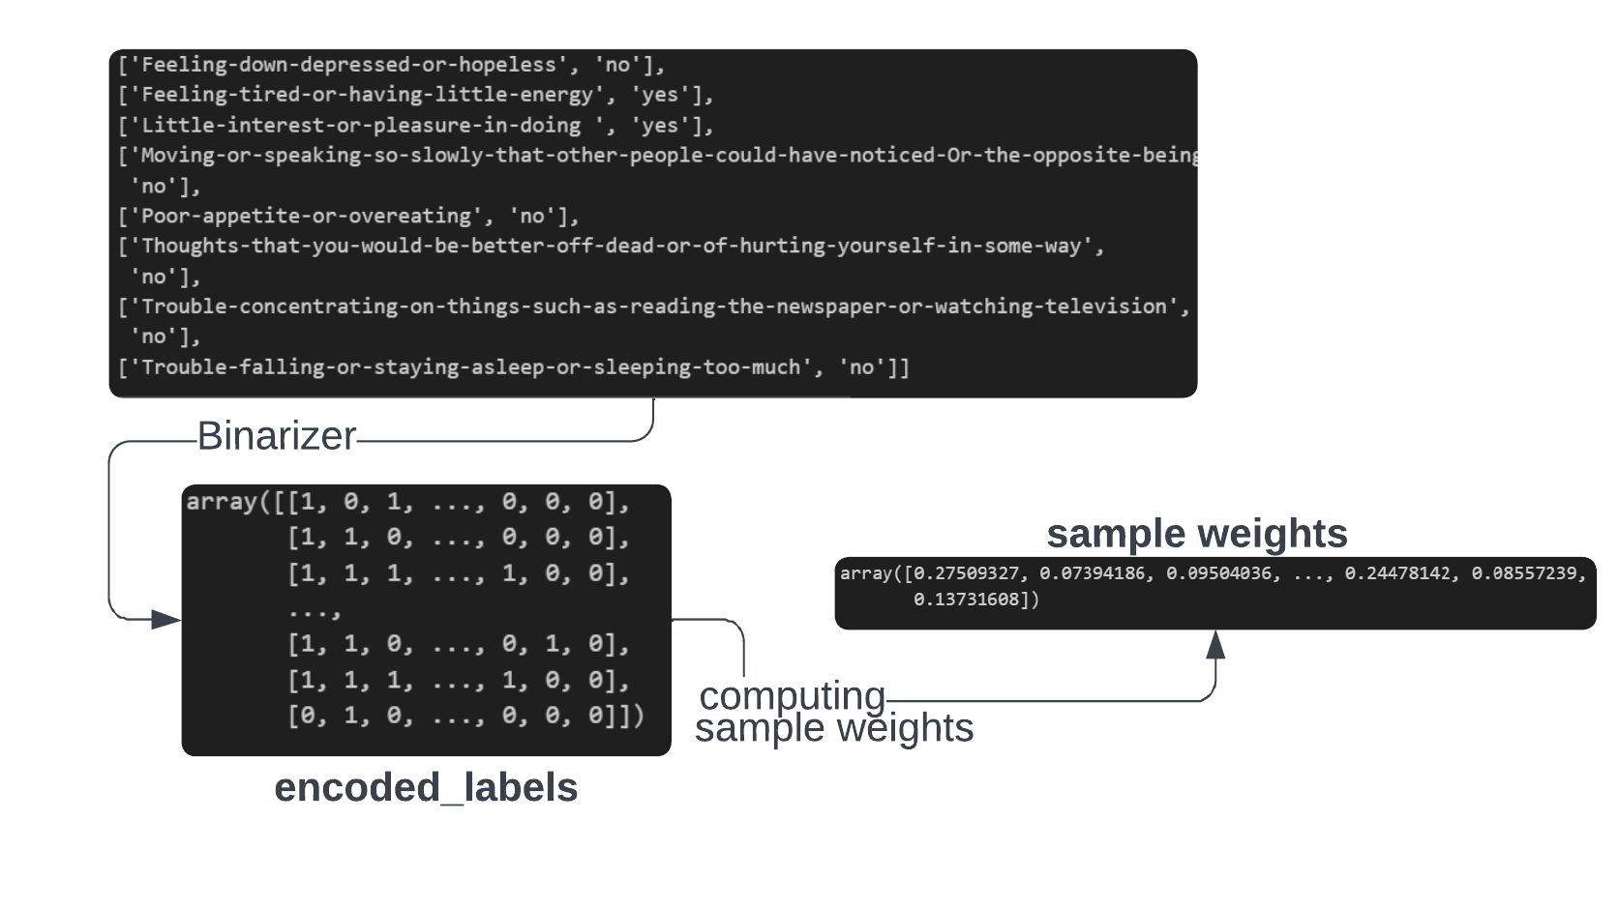
Our workflow(addressing class imbalance)
These are extremely black boxed explanations of the ML models to
know how they were really implemented check out the Jupyter notebooks here!

Slide 6
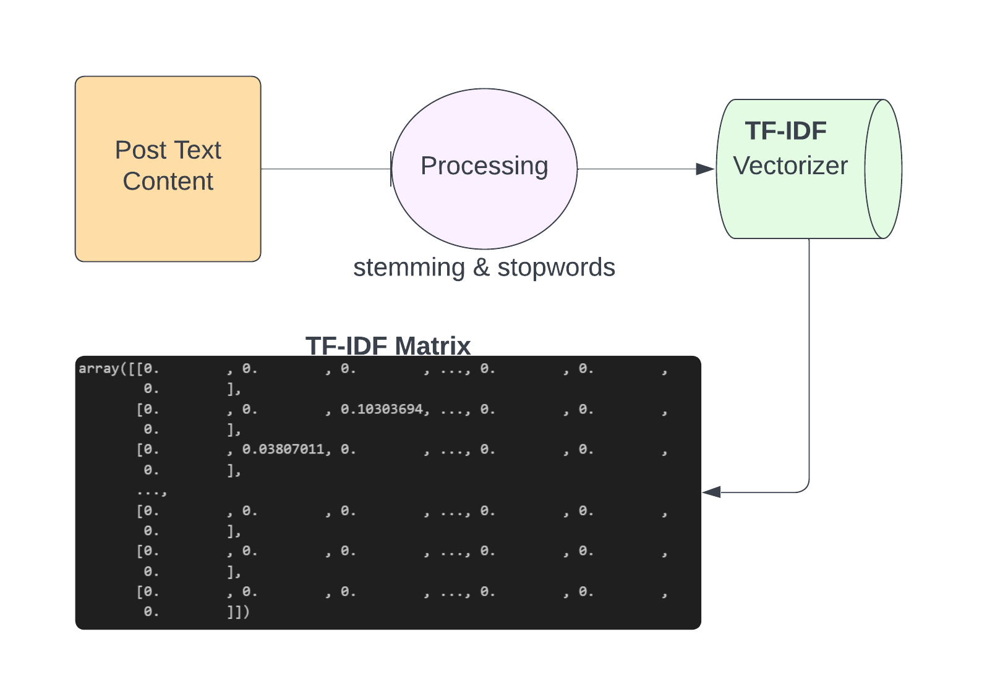
Our workflow(vectorizing data)
These are extremely black boxed explanations of the ML models to
know how they were really implemented check out the Jupyter notebooks here!

Slide 7
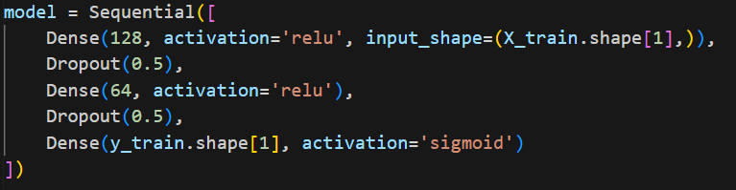
Our workflow(neural network define and train)
TRAIN
Dense layer with 128 units
Dropout : to avoid overfitting
Final Dense layer → Num of target classes
10 EPOCHS
These are extremely black boxed explanations of the ML models to
know how they were really implemented check out the Jupyter notebooks here!

Slide 8
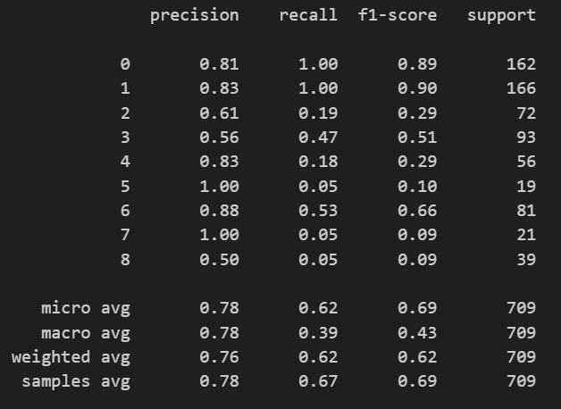
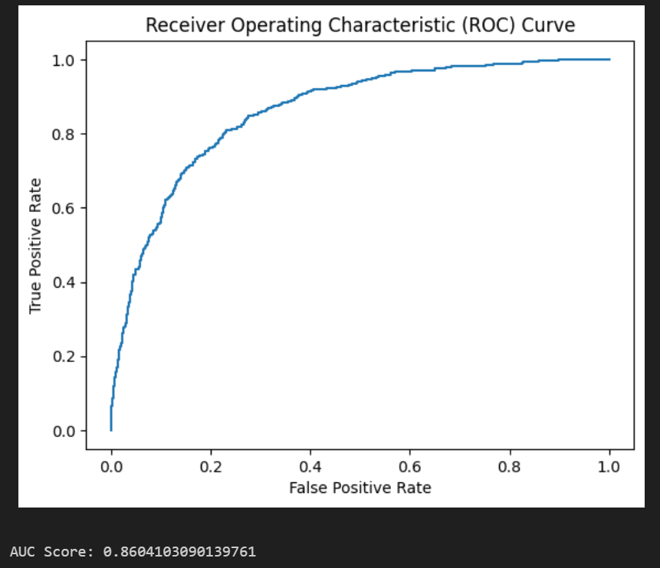
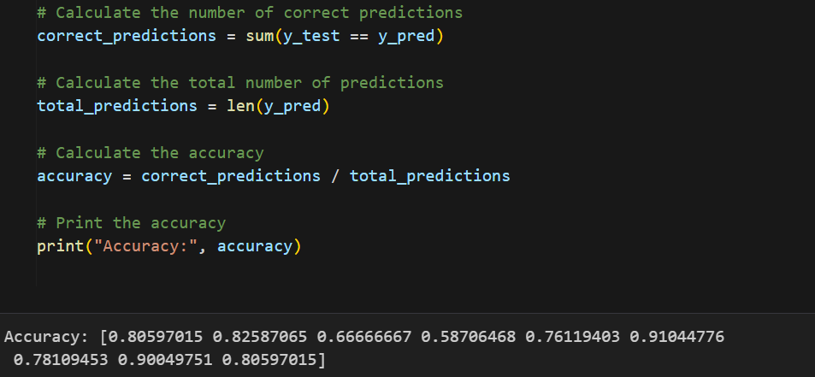
Evaluation metrics
Accuracy of each label

Slide 9
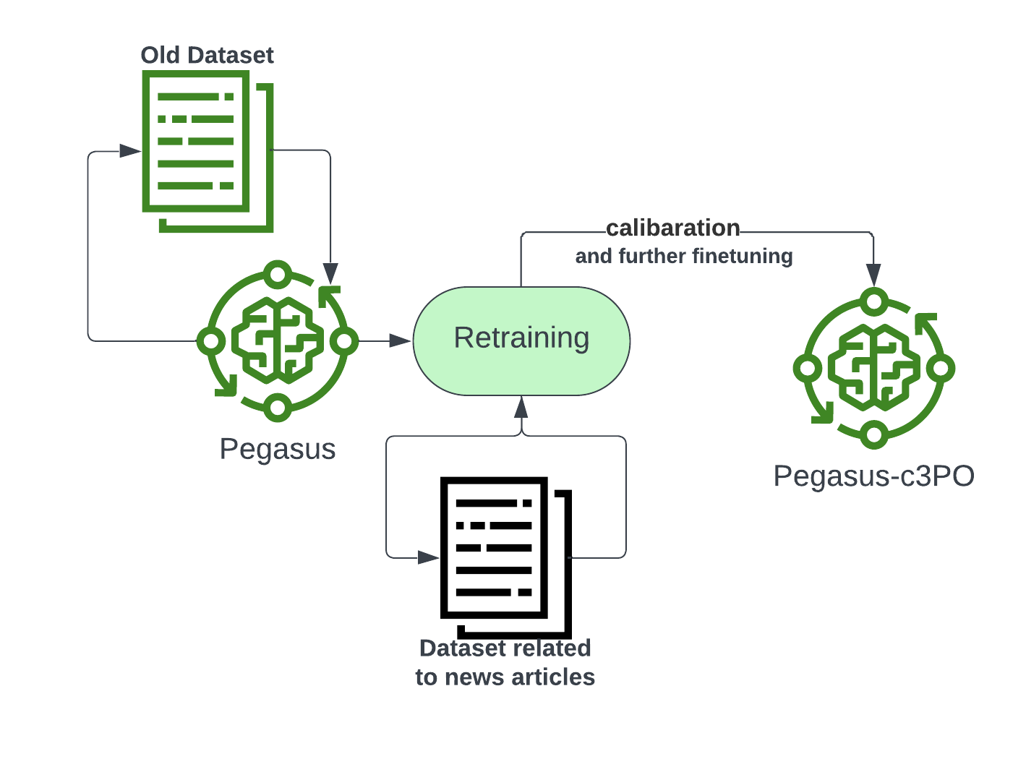
Our Second Approach(Transfer learning)
BERT
BERT-bHUC
Primate_dataset
These are extremely black boxed explanations of the ML models to
know how they were really implemented check out the Jupyter notebooks here!

Slide 10
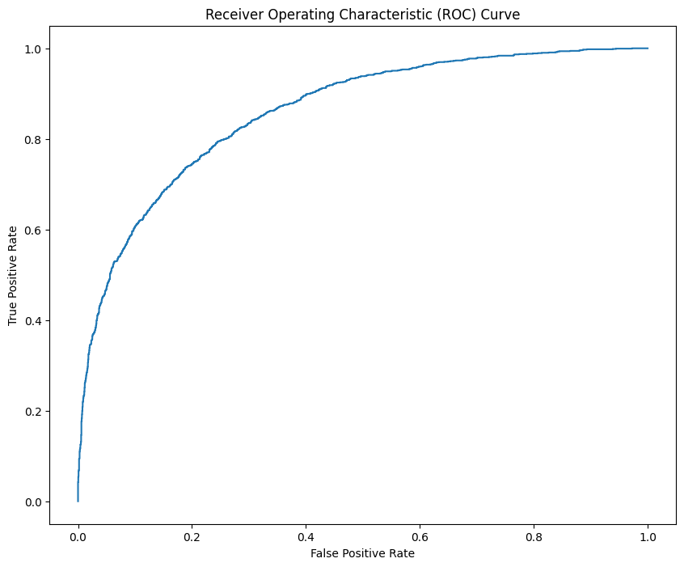
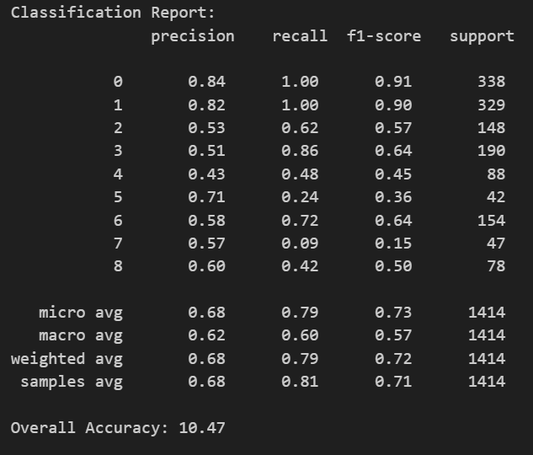
Evaluation metrics
As accuracy is not a great metric in multi-label classification with class imbalance we decided to choose this model as it performs better on other metrics

