Slide 1

JoPACC Data Pipeline
Weekly Progress Check-in
Data Reformatting, Validation & Insights

Slide 2
Where We Left Off
⚠️ Challenge: Stuck on OCR-based Monthly Reports
The Issue
Monthly reports from Aug 2025 and earlier require OCR (no native text layer)
OCR extraction was slower and produced more inconsistencies
Data needed restructuring to match standardized format
Required careful validation to ensure accuracy against source PDFs

Slide 3
This Week: What We Did
1️⃣ Data Reformatting & Restructuring
Split extracted data by payment systems (JoMoPay, CliQ)
2️⃣ Data Cleaning & Validation
2nd pass validation—verified every number against source PDFs
3️⃣ Insight Discovery
Began analyzing patterns and identifying data gaps
4️⃣ Demographics Analysis
Deep dive into gender gaps and data granularity

Slide 4
1. Data Reformatting & Restructuring
Approach
Organized extracted OCR data into system-based structure
Split data into separate workstreams: JoMoPay, CliQ, etc.
Mapped raw OCR fields to standardized schema
Ensured data lineage and traceability at each step
Example Output
Consolidated data tables with System | Category | Metric | Value | Period | Source columns

Slide 5
2. Data Cleaning & Validation (Pass 2)
Validation Process
Cross-referenced every extracted number against source PDF
Identified and corrected OCR errors and misalignments
Validated formulas and calculated metrics (YoY changes, percentages)
Ensured consistency across system-level datasets
✓ Result: 100% accuracy verification achieved—all extracted values now match source PDFs

Slide 6
3. Insights & Data Gaps Discovered
Key Findings
Transaction volumes growing significantly YoY across systems
Money transfers dominate activity (85%+ of CliQ transactions)
Some metrics have inconsistent or missing historical data
Reporting granularity varies by system and time period
Identified Gaps
Some demographic breakdowns missing from older reports
Different systems report at different granularity levels
Potential for deeper sub-category analysis in some areas

Slide 7
4. Demographics Analysis: Gender & Granularity
Gender Gap in CliQ Users
Male users: ~63-65% of user base (consistent across months)
Female users: ~35-37% of user base
Consistent gender distribution suggests stable market composition
Growth is proportional across both genders (no shifting pattern)
Data Granularity Observations
Age bracket breakdown available (18-30, 31-40, 41-50, etc.)
User type segmentation: Individual vs. Legal entities
Transaction type detail: Money Transfers, Purchases, breakdowns

Slide 8
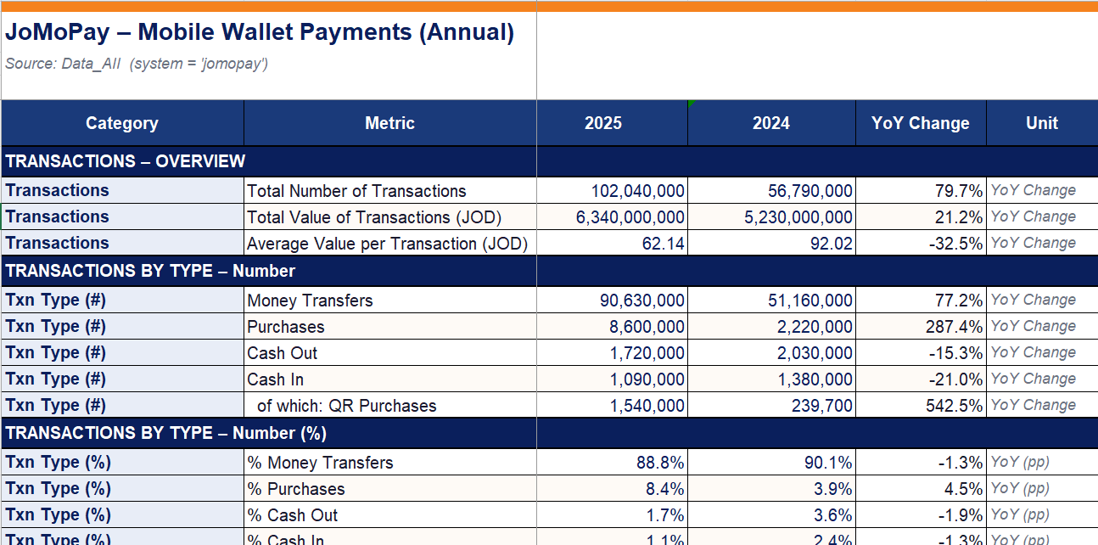
Sample: Cleaned & Structured Data
JoMoPay Annual Report Example

Slide 9
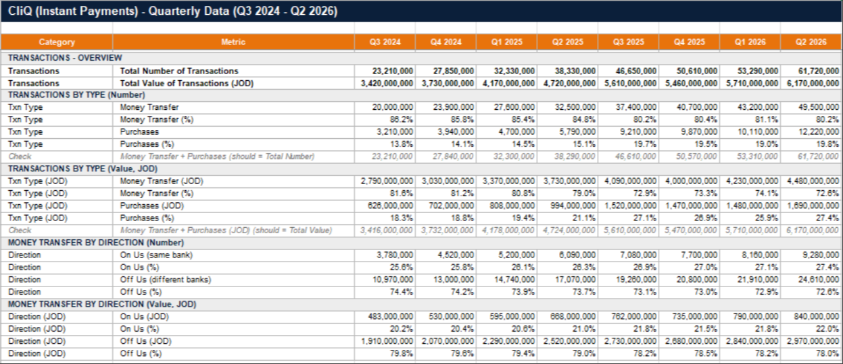
Sample: CliQ Quarterly Data
CliQ Quarterly Report (Q3 2024 - Q2 2026)

Slide 10
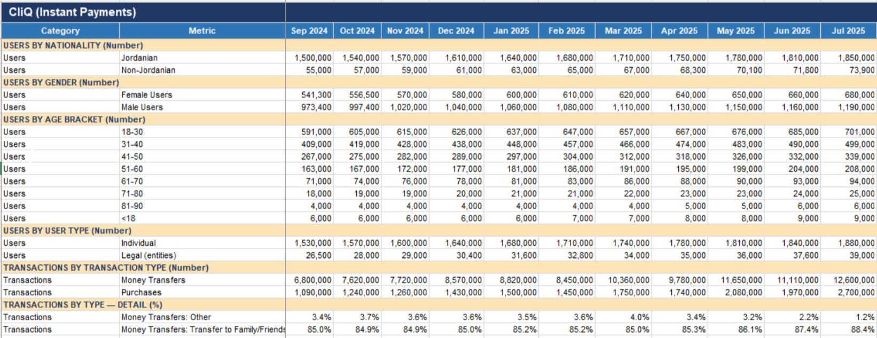
Sample: CliQ Monthly Data with Demographics
CliQ Monthly Report - Users by Demographics (Sep 2024 - Jul 2025)

Slide 11
Quality Assurance Metrics
100%
10K+
4 Layers
24 Months
Data Accuracy
Records Processed
Validation Checks
Time Coverage
Verified against source PDFs
Cross-system metrics & data points
OCR → Structure → Logic → Source
Sept 2024 - Sept 2026

Slide 12
Next Steps
Immediate Priorities
Finalize remaining monthly report extractions
Complete normalization across all three systems
Build analysis-ready master dataset consolidation
Prepare final QA report with quality metrics
Final Handoff
Deliver comprehensive analysis-ready dataset to data team for downstream BI analysis

