Slide 1
JoPACC
Gaps identified and recommendations
The reports show what happened. Readers also need to know why.
Q3 2024 to Q2 2026 quarterly reports
DERIVED = calculated from reports
Unmarked figures come from the JoPACC reports.
Notes:
Open with the one-line promise: the reports are accurate and consistent, but they tell us what happened, not why. Point to the marker key: derived figures were calculated from the published reports.

Slide 2
The reports describe what happened, not why
eFAWATEERcom
Researchers
Investors
-12.0%
No validation
Growth unclear
total value, Q1 2026
trends cannot be checked
sustainability cannot be judged
REPORT
REPORT
REPORT
Value fell. No driver given.
The what, in limited detail.
A reliable record of each quarter.
MISSED
MISSED
MISSED
Biller category or seasonal effect?
Drivers of users, volumes, values.
Whether growth will last.
Why it matters: readers must rely on assumptions, which risks misleading conclusions.
Notes:
The most significant gap is limited analytical depth. Example: eFAWATEERcom's total transaction value fell 12.0% in Q1 2026, and the report gives no sign of what drove it, such as a biller category or a seasonal effect. Researchers cannot validate trends; investors cannot judge whether growth is sustainable. The reports themselves are consistent and well structured.

Slide 3
Four recommendations to close the gap
1
Interactive UI
2
Average transaction value
Static tables > Drill-down by level
Totals only > A standard metric
3
Mode
Average only > Distribution by value range
Only existing data: every recommendation uses figures already in JoPACC's dataset.
Notes:
The plan on one slide: each tile shows how reporting works today and how it should work. All of it uses only data already available in JoPACC's dataset. Recommendation 1 comes first because the others build on it.

Slide 4
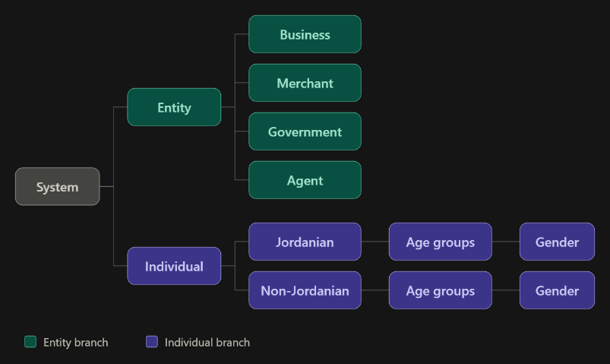
One shared hierarchy to organise IPS reporting
1
Entities and individuals
Entities: business, merchant, government, agent
2
Individuals by nationality
Jordanian and non-Jordanian
3
Age group, then gender
The most detailed level of the breakdown
Applied to the IPS: CliQ and JoMoPay figures combined under one shared structure.
Notes:
To apply the hierarchy to the IPS, the IPS section would be restructured around it. Figures from CliQ and JoMoPay are combined under one shared structure: entities (business, merchant, government, agent) and individuals first, then individuals by nationality, age group and gender.

Slide 5
Every level reports the same three measures
Users
Transactions
Value
number of users
number of transactions
transaction value (JOD)
Drill down
Protect confidentiality
Readers move from the system total to the most detailed breakdown, at the level they need.
Categories with very small counts are grouped together.
Why it matters: one structure, one set of measures, from system total to detail.
Notes:
For each level the report shows users, transactions and transaction value, using only published data. The same structure can power an interactive view so readers drill down from the system total to the most detailed breakdown. Categories with very small counts are grouped to protect confidentiality.

Slide 6
Why the interactive view comes first
Researchers
Build on it
1
Explore the data at the level of detail they need.
The other recommendations can work without an interactive interface.
Investors
2
Drill from the system total to the most detailed breakdown.
Interactivity extends what the reports offer.
Other readers
3
One report that serves a wider range of users.
Notes:
This recommendation is presented first because the others build upon it. The rest can be implemented without an interactive interface, but interactivity greatly extends what the reports can offer, so they can serve a wider range of readers.

Slide 7
Volume more than doubled, but value rose far less
Reading it: 60M to 130M transactions, while value moved from JOD 21.1B to 24.8B.
Notes:
Combining the systems into one trend view: payment volume grew from about 60 million to 130 million transactions per quarter between Q3 2024 and Q2 2026, while total value rose only from JOD 21.1 billion to JOD 24.8 billion. Systems combined: CliQ, JoMoPay, eFAWATEERcom, ECCU and ACH (JOD-denominated only).

Slide 8
The average payment fell about 45% since Q3 2024
JOD 349.8
JOD 190.4
DERIVED
-45%
Q3 2024
Q2 2026
average transaction value
Q3 2025
The most notable movement: transactions were low relative to value, which prompted the manual average calculation.
Notes:
The most notable movement in the quarterly reports came in Q3 2025, when the number of transactions was low relative to value. That led to a manual calculation of the average transaction value for each quarter. Average = total value divided by total volume. It fell from JOD 349.8 to JOD 190.4, roughly 45%. Growth comes from more, smaller payments.

Slide 9
Why average transaction value should be standard
1
2
3
Researchers and investors
Operations and risk teams
Everyone reading totals
Read growth correctly: more, smaller payments, not higher-value ones.
Plan capacity and set monitoring thresholds.
Totals alone hide the shift toward smaller payments.
Takeaway: growth is driven by a larger number of smaller payments.
Notes:
Publishing the average helps researchers and investors interpret growth correctly, and helps operations and risk teams plan capacity and set monitoring thresholds. Totals alone do not reveal that growth is driven by many smaller payments.

Slide 10
The average is not the typical transaction
Average = total value ÷ total volume
A few very large transactions can raise it significantly.
Average
Median
Mode
total value divided by volume
the middle value
the most frequent value
STATUS
STATUS
STATUS
Calculable: the best indicator the data allows.
Not calculable: no individual values published.
Not calculable: no distribution published.
Future improvement: publish mode, median, or a distribution by value range.
Notes:
The average is total value divided by total volume, so a small number of very large transactions can raise it significantly. The mode (most frequent value) or the median (middle value) would better represent a standard transaction, but they cannot be calculated from the published reports, which have no individual transaction values or distribution. So the average is the best indicator available.

Slide 11
Key takeaway
Explain the growth, not just record it.
Interactive view, average value, per-system detail, value distributions.
Open questions the data cannot answer
What drove eFAWATEERcom’s increase in transaction value in Q3 2025?
Is growth from smaller payments sustainable?
What does the typical transaction look like?
Notes:
End on the three open questions to invite discussion.

