Slide 1
Monthly report: proposed changes
JOPACC · MONTHLY REPORT
All Systems, IPS, eFAWATEERcom, ECCU and Visual Design
Data team review · October 2026
Notes:
Purpose: walk the data team through the proposed changes to the monthly report, which follow the order of the report itself: All Systems, IPS, eFAWATEERcom, ECCU and Visual Design. Agree what we build and confirm the open definitions and data requirements on the last slide.

Slide 2
Five sections of change
REPORT STRUCTURE
1
2
3
4
5
All Systems
IPS
eFAWATEERcom
ECCU
Visual Design
Overview, active accounts, and volume, value and ATV on one chart
CliQ, JoMoPay and interoperability in one section
Top 5 categories in the chart, the rest in a table
Top 3 return reasons and successful cheques
Better colour contrast and one consistent look
JOPACC · Monthly report proposal
Notes:
Five sections, in the order the report will follow: All Systems, IPS, eFAWATEERcom, ECCU, then visual design, which applies to the whole report. Successful Cheques sits inside ECCU, not as its own section.

Slide 3
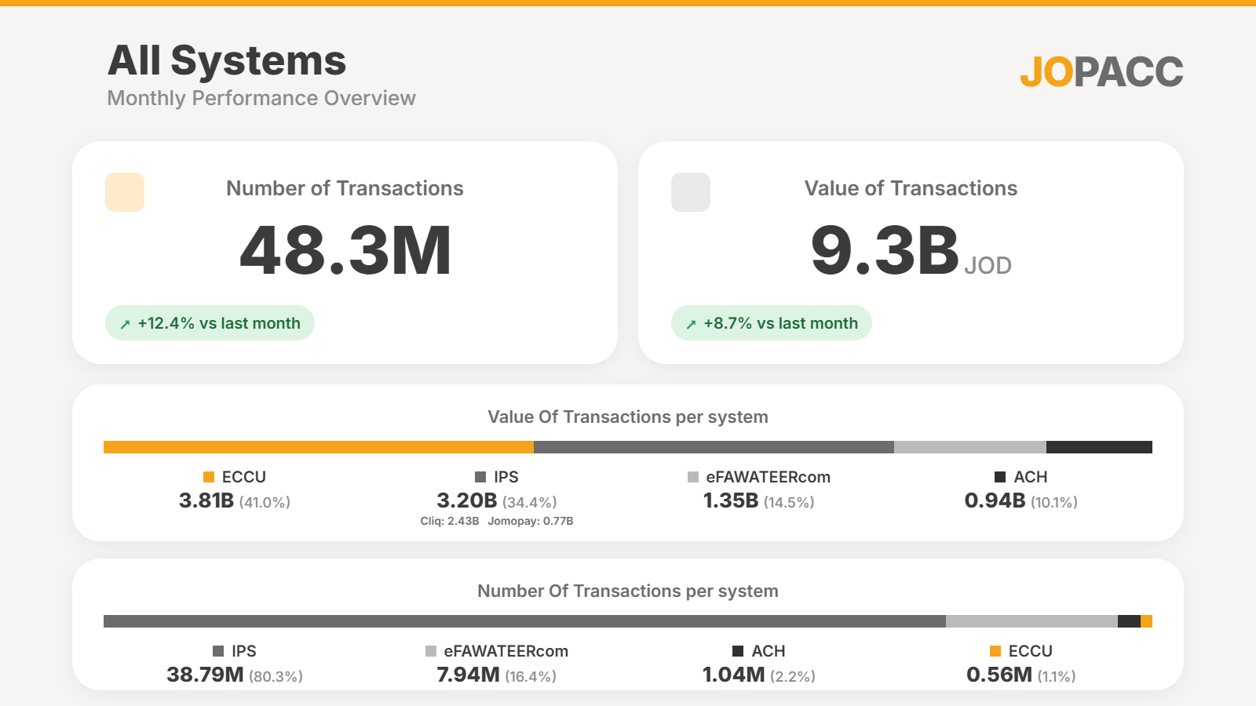
All Systems: start with the overview
1 · ALL SYSTEMS
The report opens with one page that frames the whole month before any system detail.
Transactions, value and average value, each with change vs last month
Value and volume split by system
IPS shown as one block, with CliQ and JoMoPay inside it
Active accounts and rates for relevant systems (next slide)
Mock-up: All Systems overview
JOPACC · Monthly report proposal
Notes:
This is the mock-up page. Headline numbers on top, then value share and volume share per system (ECCU, IPS, eFAWATEERcom, ACH). IPS combines CliQ and JoMoPay, which is the same merge as the IPS section. Active accounts and the Active Accounts Rate are added on the next slide.

Slide 5
1 · ALL SYSTEMS
Annual Comparison: Same Month, Two Diff Years
MoM = growth compared with the month before (Aug vs Jul)
Transactions
Users
Value of transactions
+52.2% vs last year
+21.9% vs last year
+29.3% vs last year
Aug 2025
Aug 2026
Aug 2025
Aug 2026
Aug 2025
Aug 2026
MoM +3.07%
MoM +3.58%
MoM +2.08%
MoM +1.70%
MoM +1.08%
MoM +3.85%

Slide 6
Add active accounts and Rates
1 · ALL SYSTEMS
NEW COUNT
NEW RATE
Active accounts
Rate
Shown alongside transactions and value for each relevant payment system
Such as Active accounts, Successful Cheques
Definition to confirm
Rates make a count readable without context: in the mock-up, IPS is 38.79M transactions, or 80.3% of all transactions.
Data requirement: active and total account counts per system, which systems they apply to, and the definition of an active account.
JOPACC · Monthly report proposal
Notes:
The formula is my proposed wording, not an agreed definition. Ask the data team to confirm what counts as an active account, the denominator (total accounts), and which payment systems the rate applies to. No account counts are available in the current material, so none are shown. The Successful Cheques Rate now sits in the ECCU section.

Slide 7
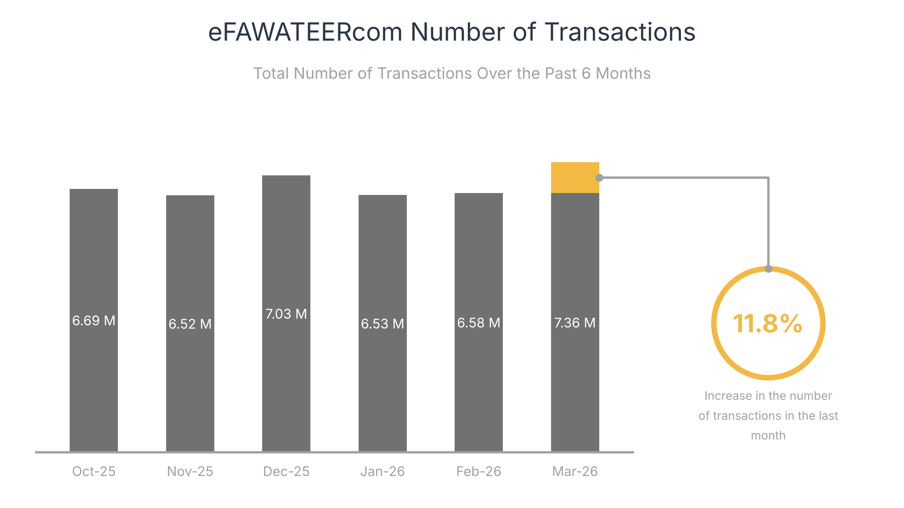
Extend comparisons from 3 months to 6 months
1. ALL SYSTEMS
3 → 6
months of history volume and value trends
A 3-month view (Jan to Mar) shows only a jump to 7.36M
The 6-month view shows Dec-25 also reached 7.03M
Example: eFAWATEERcom transactions, Oct-25 to Mar-26.
JOPACC · Monthly report proposal
Notes:
Why six months: the Mar-26 rise of 11.8% looks like a new trend in a 3-month window, but December was nearly as high. More history lets readers separate a seasonal peak from a real change. The eFAWATEERcom chart is only the example; IPS volume and value trend charts move from three to six months, and the same applies to every other section.

Slide 8
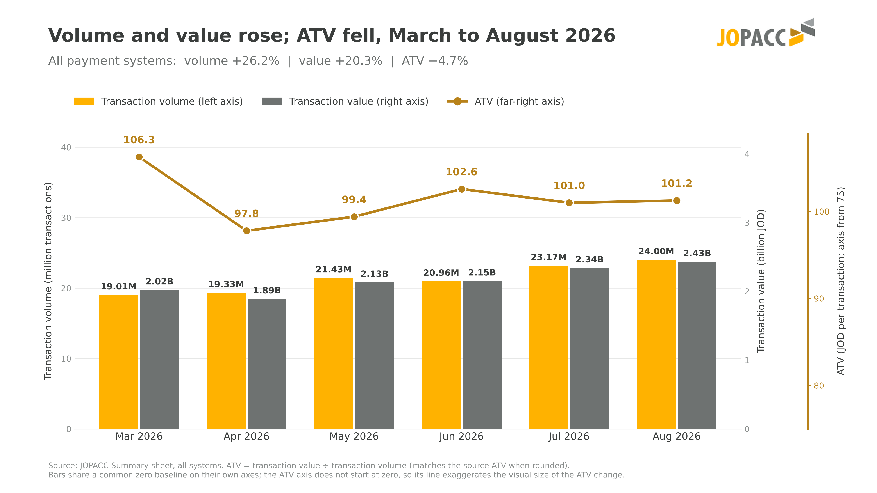
Volume, value and ATV on one chart
1 · ALL SYSTEMS
+26.2%
Transaction volume
+20.3%
Transaction value
−4.7%
Average transaction value (ATV)
Mar → Aug 2026. The ATV axis does not start at zero, so the line exaggerates the ATV change.
JOPACC · Monthly report proposal · Source: JOPACC Summary sheet, all systems
Notes:
Replaces the existing ATV charts. Transaction volume and transaction value are bars; ATV (value divided by volume) is the line on its own labelled axis, so the three are never mixed. Changes shown are March to August 2026 as printed on the chart. The chart is the supplied mock-up image; rebuild it as a native chart once the final data feed is agreed.

Slide 9

IPS: one consolidated section
2 · IPS — INSTANT PAYMENTS & INTEROPERABILITY
1 · OVERVIEW
2 · THEN
3 · THEN
IPS overview
CliQ and JoMoPay
Interoperability
A separate analysis of each. Mock-up value: CliQ 2.43B, JoMoPay 0.77B JOD
On Us vs Off Us, and bank and mPSP flows
All IPS activity, reported once
Instant Payments should be the main section, with CliQ, JoMoPay, and Interoperability as subsections under it.
Reduce Redundancy and Improve Clarity
JOPACC · Monthly report proposal
Notes:
The existing Instant Payments and Interoperability sections become one IPS section: a consolidated overview first, then CliQ, then JoMoPay, then a dedicated Interoperability subsection. Mock-up figures: IPS 38.79M transactions and 3.20B JOD, of which CliQ 2.43B and JoMoPay 0.77B JOD. Duplicated indicators are removed so overall IPS activity and interoperability-specific activity can be told apart.

Slide 10
Top 5 by volume, the rest in a table
3 · eFAWATEERCOM
Bar chart shows only the Top 5 categories
All other categories sit in a table beside it
Same layout for transaction count and transaction value
Top 5 categories
Other categories
Category | Volume
Education | 154K
Travel & Transportation | 69K
Gas And Energy | 39K
Associations and Organizations | 36K
Trading and Services | 36K
Charities | 16K
Banks | 15K
eCommerce | 12K
In the mock-up the Top 5 carry about 95% of listed volume, so the chart stays readable.
JOPACC · Monthly report proposal · Mock-up figures: number of transactions by category
Notes:
Top 5 by transactions in the mock-up: Telecommunication 2.2M, Water and Electricity 2.05M, Government Service 1.71M, Wallets and PSPs 588K, Financial Services 327K. The eight other categories are each 154K or less and are sorted by volume in the table. The 95% figure is the Top 5 share of the categories listed on that page (about 6.88M of 7.25M). Chart and table are native objects built from the mock-up values.

Slide 11
ECCU
4 · ECCU
1-Add a dedicated Successful Cheques subsection within ECCU
2-Top 3 technical reasons for returned cheques
1
[Reason 1]
2
[Reason 2]
Rank the three biggest technical reasons for returned cheques at the top of the ECCU section, so the cause is visible before the detail.
3
[Reason 3]
JOPACC · Monthly report proposal
Notes:
This is a layout sketch with placeholders, not data. Confirm where the technical return reasons come from and whether the monthly report breaks returned cheques down by reason today.

Slide 12
Visual Improvements & Recommendations
5 · VISUAL DESIGN
COLORS
Make some colors lighter.
Sample: (page 33). The Dark Gray text (cash in, cash out, etc..) with Dark Blue Background
1
CHARTS
Make the charts simpler and easier to read.
Samples: CliQ & JoMoPay Transactions and JoMoPay Value of Transactions, on the next two slides.
2
JOPACC · Monthly report proposal

Slide 13
CliQ & JoMoPay Transactions
Total number of transactions between Banks and PSPs
15.81M
8.16M
23.99M
Banks
total
To Bank
To PSP
To Acquirer 23.85K
5.09M
12.27M
17.66M
PSPs
total
To Bank
To PSP
To Acquirer 302.81K

Slide 14




JoMoPay Value of Transactions
Percentage based on transaction type
Transfers issued by mobile wallets
Money transfers
75.6%
582.3M JOD
Purchases
22.7%
770.2M
174.5M JOD
JOD total
Cash out
1.2%
9.5M JOD
Cash in
0.5%
3.9M JOD
36
* Some data displayed in this page is based on the data shared by the system participants.
08.2026

