Slide 1

JoPACC Reports Analysis
Weekly Progress Check-in
Data Reformatting, Validation & Insights

Slide 2
Where We Left Off
⚠️ Challenge: Stuck on OCR-based Monthly Reports
The Issue
Monthly reports from Aug 2025 and earlier require OCR (no native text layer)
OCR extraction was slower and produced more inconsistencies
Data needed restructuring to match standardized format
Required careful validation to ensure accuracy against source PDFs

Slide 3
This Week: What We Did
1️⃣ Data Reformatting & Restructuring
Split extracted data by payment systems (JoMoPay, CliQ)
2️⃣ Data Cleaning & Validation
2nd pass validation—verified every number against source PDFs
3️⃣ Insight Discovery
Began analyzing patterns and identifying data gaps
4️⃣ Demographics Analysis
Deep dive into gender gaps and data granularity

Slide 4
1. Data Reformatting & Restructuring
Approach
Organized extracted OCR data into system-based structure
Split data into separate workstreams: JoMoPay, CliQ, etc.
Mapped raw OCR fields to standardized schema
Ensured data lineage and traceability at each step
Example Output
Consolidated data tables with System | Category | Metric | Value | Period | Source columns

Slide 5
2. Data Cleaning & Validation (Pass 2)
Validation Process
Cross-referenced every extracted number against source PDF
Identified and corrected OCR errors and misalignments
Validated formulas and calculated metrics (YoY changes, percentages)
Ensured consistency across system-level datasets
✓ Result: 100% accuracy verification achieved—all extracted values now match source PDFs

Slide 6
3. Insights & Data Gaps Discovered
Key Findings
Transaction volumes growing significantly YoY across systems
Money transfers dominate activity (85%+ of CliQ transactions)
Reporting granularity varies by system and time period
Identified Gaps
Some demographic breakdowns missing from older reports
Wrong KPI’s values in two months a cross two systems
Potential for deeper sub-category analysis in some areas

Slide 7
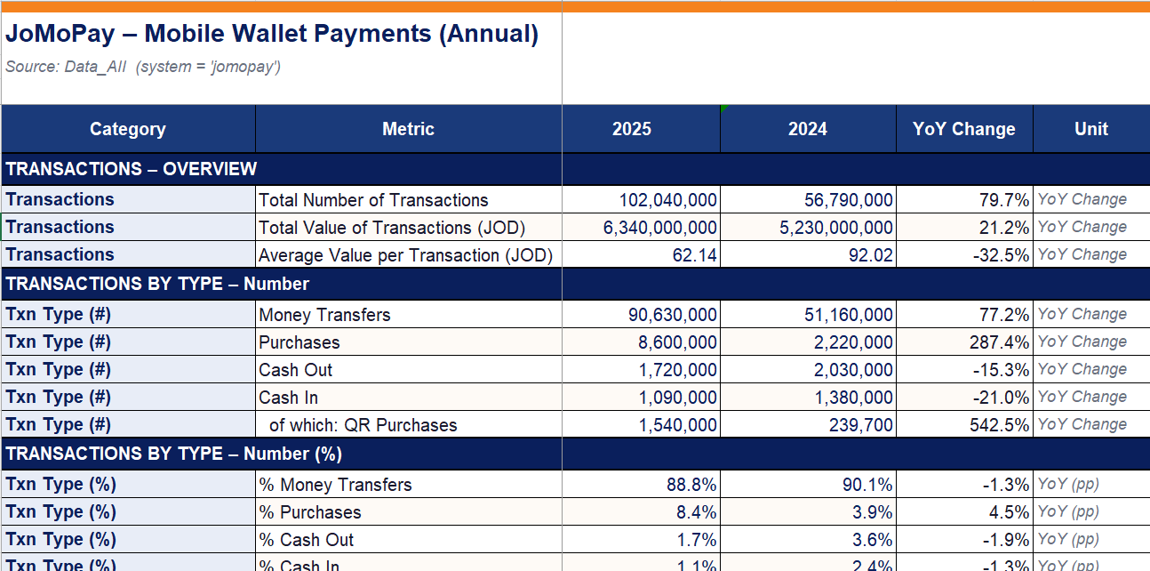
Sample: Cleaned & Structured Data
JoMoPay Annual Report Example

Slide 8
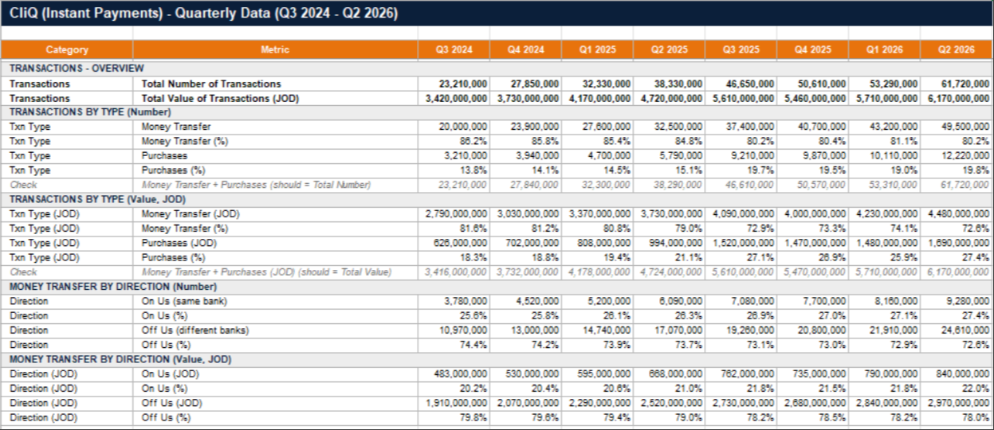
Sample: CliQ Quarterly Data
CliQ Quarterly Report (Q3 2024 - Q2 2026)

Slide 9
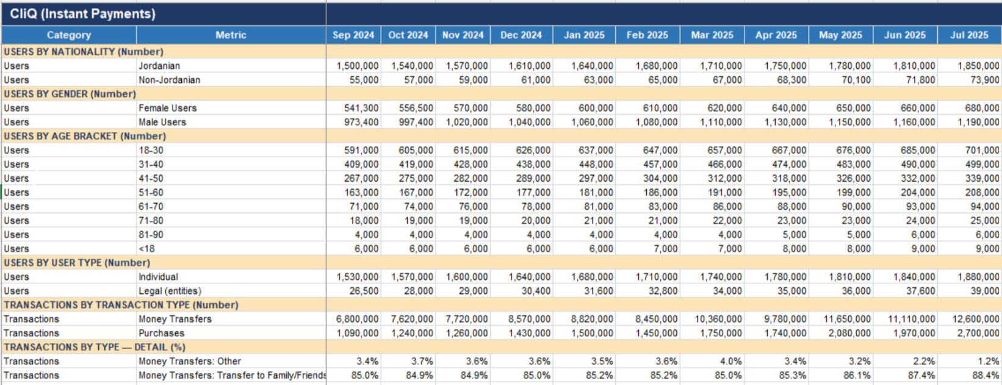
Sample: CliQ Monthly Data
CliQ Monthly Report - Users by Demographics (Sep 2024 - Jul 2025)

Slide 10
4. Demographics Analysis: Gender & Granularity
IPS
CliQ
JoMoPay
Gender
Gender
GAP
OK
M 61.0%
F 36%
M 52.8%
F 46.8%
IPS Gender
M 56.3%
F 42.1%
OK gap collapses at IPS

Slide 11
Next Steps
Immediate Priorities
Finalize remaining monthly report extractions
Complete normalization across all three systems
Build analysis-ready master dataset consolidation
Prepare final QA report with quality metrics
Final Handoff
Deliver comprehensive analysis-ready dataset to data team for downstream BI analysis

