Slide 1
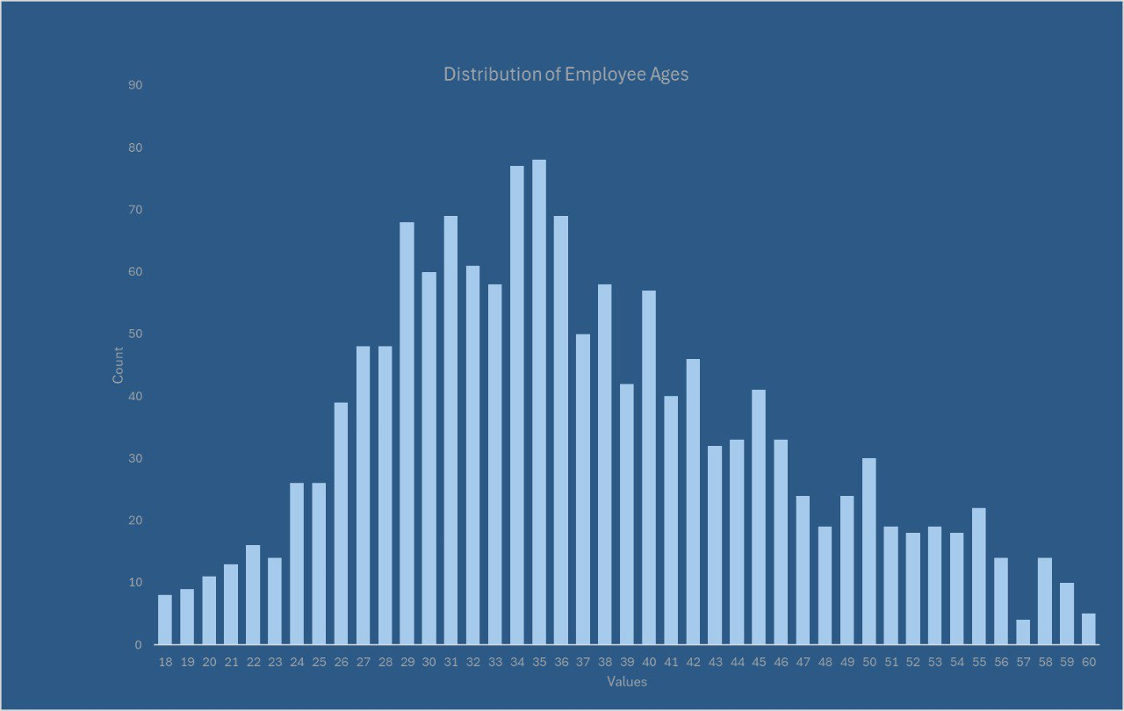
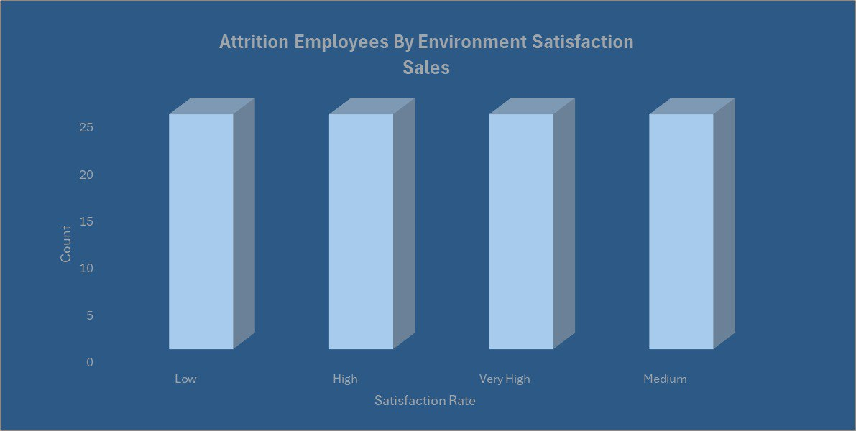
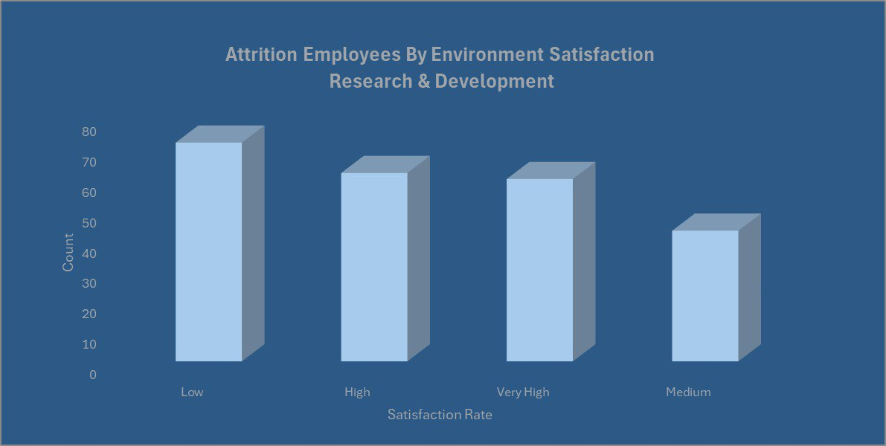
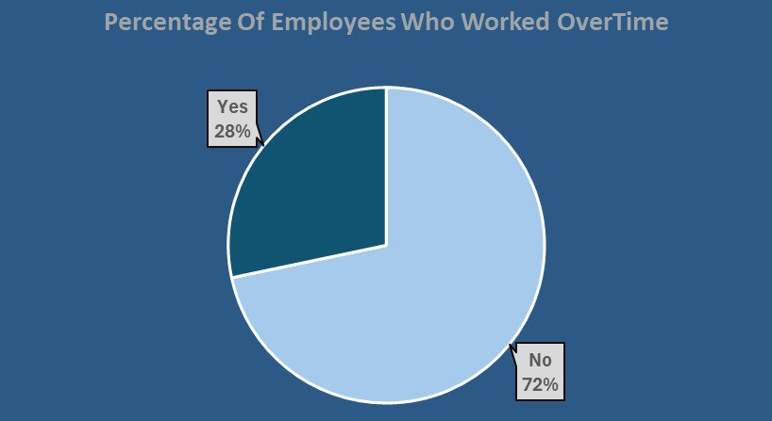
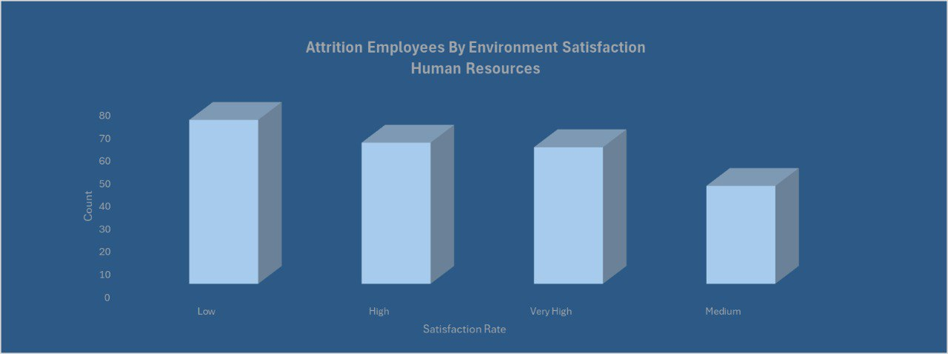
Employee Attrition
By Emam Mohsen
Fellow at Correlation One: Tech for jobs
Average Age 37
Attrition Count 237
Active Employees 1,233
Total Employees 1,470
Business Context
Why Attrition Matters ?? Employee attrition impacts more than HR — it affects productivity, culture, and profitability High turnover leads to: Increased hiring and training costs Loss of knowledge and experience Disruption in operations and team morale Replacing one employee can cost 30–150% of their annual salary.
Highlights
Employee attrition is a major challenge for organizations, impacting productivity, morale, and financial stability. High turnover rates can lead to increased hiring costs, lost expertise, and disruptions in business operations..
NEXT STEPS
Build a Predictive Attrition Model (Classification)
Goal: Predict the probability of attrition for each employee.
Use models like Logistic Regression, Random Forest, or XGBoost
Train on historical data (Attrition as target)
Value: Enables HR to proactively retain high-risk employees.
Problem statement
The percentage of employees who leave (attrition) is 16%, which is lower than the 84% who stay a positive sign. However, it's essential to understand the causes behind this attrition.
Data
The dataset, sourced from Kaggle, Uncover the factors that lead to employee attrition and explore important questions such as ‘show me a breakdown of distance from home by job role and attrition’ or ‘compare average monthly income by education and attrition’. This is a fictional data set created by IBM data scientists.
Conclusion
Improve workplace conditions and work-life balance to boost employee satisfaction.
Develop structured career progression plans to support employees in early- to mid-career stages.
Review salary structures to ensure fair compensation across job levels.
Strengthen employee recognition programs to enhance engagement.
Implement department-specific interventions, particularly in Sales and Research & Development, to address unique attrition challenges.
For more information from the Interactive Dashboard.

