Slide 1



Introduction
Employee attrition is a major challenge for organizations, impacting productivity, morale, and financial stability. High turnover rates can lead to increased hiring costs, lost expertise, and disruptions in business operations.
This project focuses on analyzing key factors contributing to employee attrition, such as: ✅ Work-life balance ✅ Salary levels ✅ Employee Engagement ✅ Tenure & career growth ✅ Departmental impact
Notes:
This slide contains the editable pieces that were used to build infographic sample
Icons – Eye, PC

Slide 2

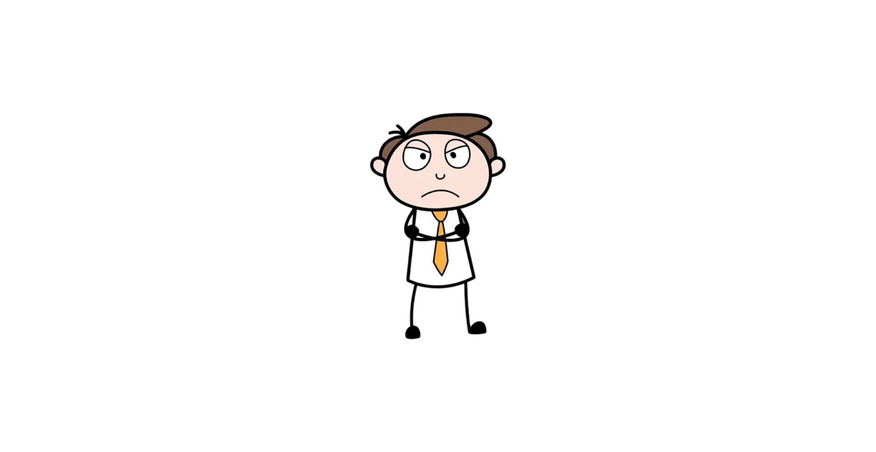
Employee Attrition
Business Context
Employee attrition is a critical issue for organizations, as it leads to increased costs and disruptions in operations. In the HR analytics domain, understanding why employees leave and predicting future attrition can help organizations take proactive measures to retain talent. This project will analyze the IBM HR Analytics Attrition Dataset to identify patterns and factors contributing to employee turnover and provide actionable insights for HR decision-making.
Notes:
This slide contains the editable pieces that were used to build infographic sample
Icons – Eye, PC

Slide 3

Data Set
IBM HR Analytics Attrition Dataset:
Source: https://www.kaggle.com/datasets/pavansubhasht/ibm-hr-analytics-attrition-dataset
Size: 1,470 rows and 35 columns.
Features: Includes employee demographics (e.g., Age, Gender), job-related factors (e.g., Job Role, Department), and performance metrics (e.g., Monthly Income, Years at Company).
Target Variable: "Attrition" (Yes/No).
Strengths:
The dataset is well-structured and contains a variety of features relevant to employee attrition.
It includes both categorical and numerical variables, allowing for comprehensive analysis.
The dataset is publicly available and widely used, making it easier to validate results.
No null or duplicated values, which simplifies data preprocessing.
Weaknesses:
The data set may not capture all the factors that influence attrition (e.g., external job market conditions).
The dataset is relatively small, which could limit the generalizability of the predictive model.
Notes:
This slide contains the editable pieces that were used to build infographic sample
Icons – Eye, PC

Slide 4
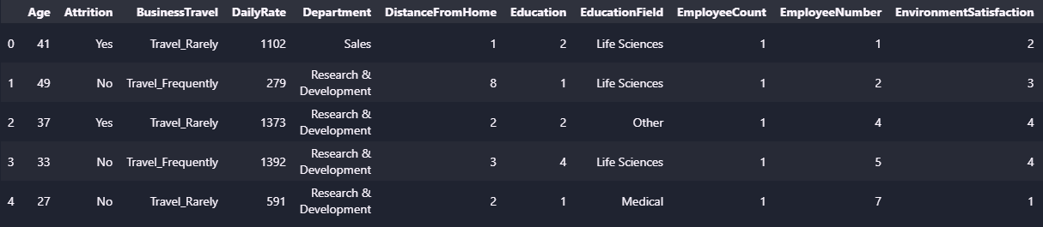
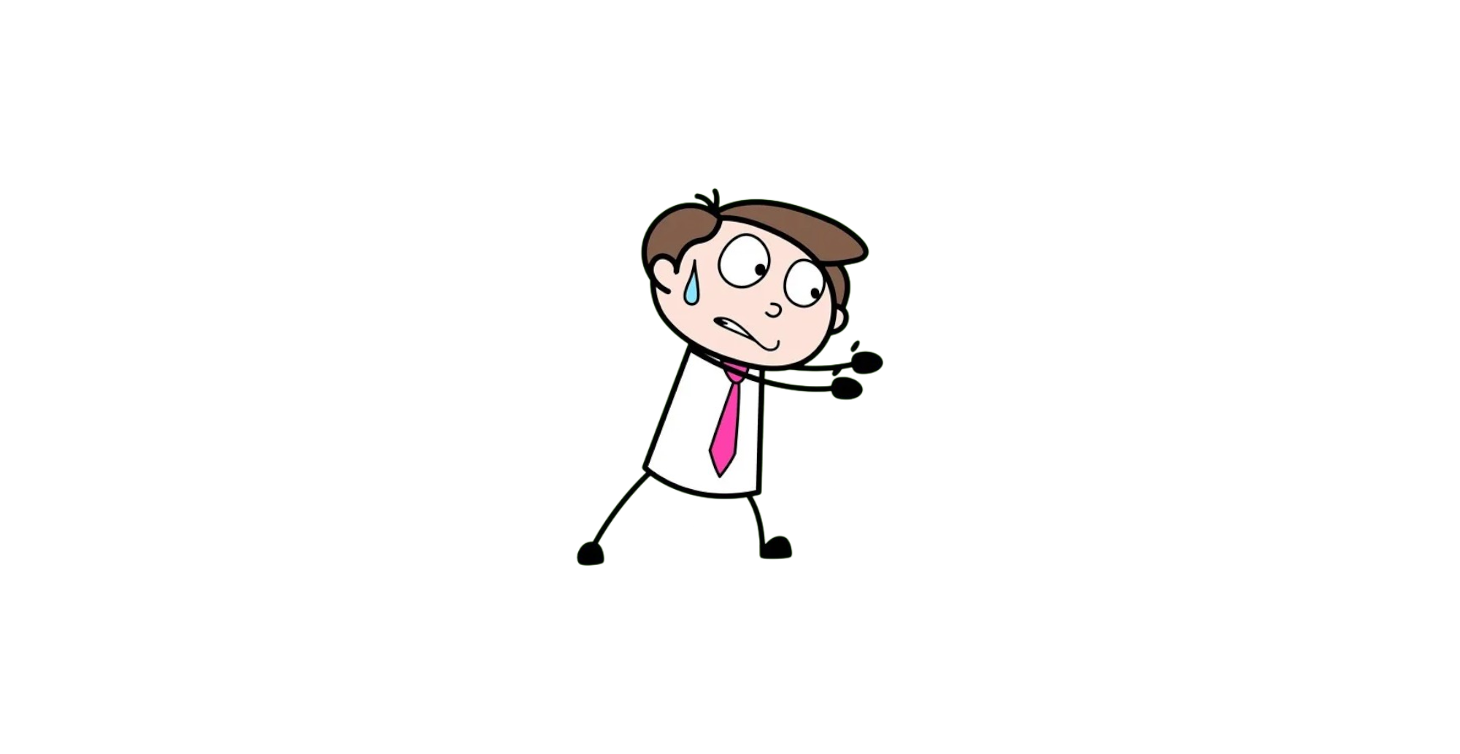
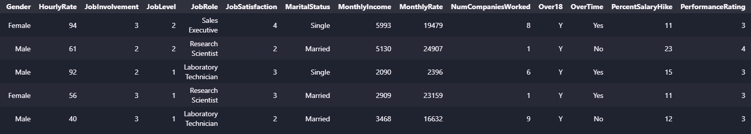
Data Set
Notes:
This slide contains the editable pieces that were used to build infographic sample
Icons – Eye, PC

Slide 5

Data Curation
Null Values: 0
Duplicated Values: 0
Job Level
1 543
2 534
3 218
4 106
69
Entry 543
Junior 534
Mid 218
Senior 106
Executive 69
Environment Satisfaction
3 453
4 446
2 287
1 284
High 453
Very High 446
Medium 287
Low 284
Job Involvement
3 868
2 375
4 144
83
High 868
Medium 375
Very High 144
Low 83
Work Life Balance
3 893
2 344
4 153
80
Better 893
Good 344
Best 153
Bad 80
Notes:
This slide contains the editable pieces that were used to build infographic sample
Icons – Eye, PC

Slide 6
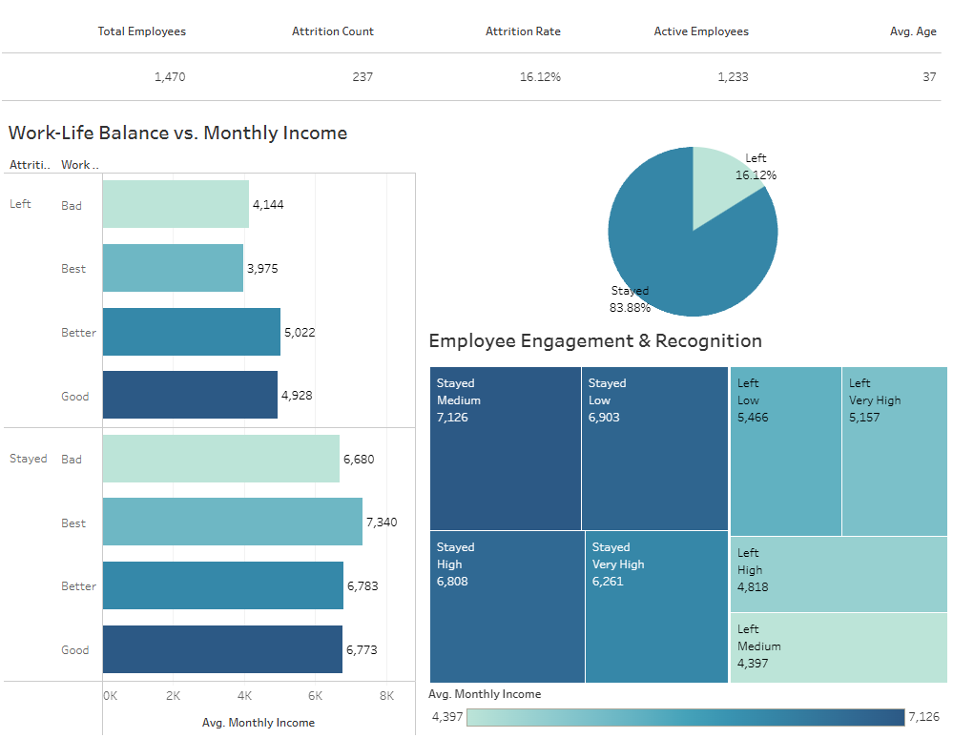
Dashboard
Notes:
This slide contains the editable pieces that were used to build infographic sample
Icons – Eye, PC

Slide 7
Conclusion
Key Takeaways:
Overall Attrition Rate: 16.12% of employees have left, indicating a moderate level of turnover that requires attention.
Gender Disparity in Attrition: Male employees have a higher attrition count than females
Departmental Impact: The Research & Development and Sales departments experience the highest attrition, emphasizing the need for targeted retention strategies.
Tenure and Attrition Risk: Employees with 1-7 years at the company face the highest attrition risk, suggesting potential issues with career growth and job satisfaction.
Work-Life Balance Matters: Employees with lower work-life balance ratings are more likely to leave.
Compensation & Job Level Influence: Entry-level and junior employees show higher attrition rates
Employee Recognition is Crucial: Employees who feel less recognized and engaged are more likely to leave.
Notes:
This slide contains the editable pieces that were used to build infographic sample
Icons – Eye, PC

Slide 8

Conclusion
The analysis provides a comprehensive view of employee attrition, highlighting key factors such as gender, department, tenure, work-life balance, income levels, and recognition. Understanding these trends is crucial for reducing turnover and fostering a more stable workforce.
Final Strategic Recommendations:
To reduce attrition and enhance retention, the company should: ✔ Improve workplace conditions and work-life balance to boost employee satisfaction. ✔ Develop structured career progression plans to support employees in early- to mid-career stages. ✔ Review salary structures to ensure fair compensation across job levels. ✔ Strengthen employee recognition programs to enhance engagement. ✔ Implement department-specific interventions, particularly in Sales and Research & Development, to address unique attrition challenges.
Notes:
This slide contains the editable pieces that were used to build infographic sample
Icons – Eye, PC

