Slide 1
Robotics algorithms
Lee Yongseok, Jung Hyunseo
dldydtjr2000@postech.ac.kr

Slide 2
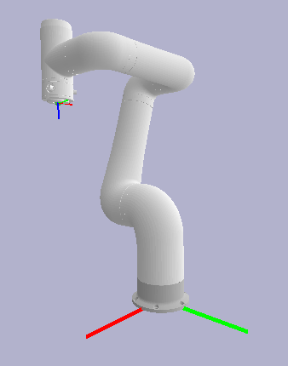











1. Numerical IK
Inverse kinematics (IK)
The inverse kinematics (IK) is to find the joint position (called as joint variables) $q∈ℝ^{n}$ for a given transformation matrix $T∈SE\left(3\right)$.
The IK problem is a nonlinear problem; the existence and uniqueness of the solution are not always guaranteed, while the forward kinematics (FK) is surjective.
$$q∈ℝ^{n}$$
$$T∈SE\left(3\right)$$
$$q_{1}$$
$$T∈SE\left(3\right)$$
$$T_{1}$$
$$q_{2}$$
$$T_{2}$$
$$q_{3}$$
FK
IK
$$T_{3}$$
$$q_{4}$$
$$q∈ℝ^{n}$$
Forward kinematics (FK)
Inverse kinematics has two approaches: closed-form solutions and numerical methods. The closed-form solution uses geometry and polynomial equations, but there is no general solution for a 6-dof robotic system due to its complex structure. The numerical method has a computational burden but is easy to apply, and we will deal with the numerical methods in this lecture.

Slide 3
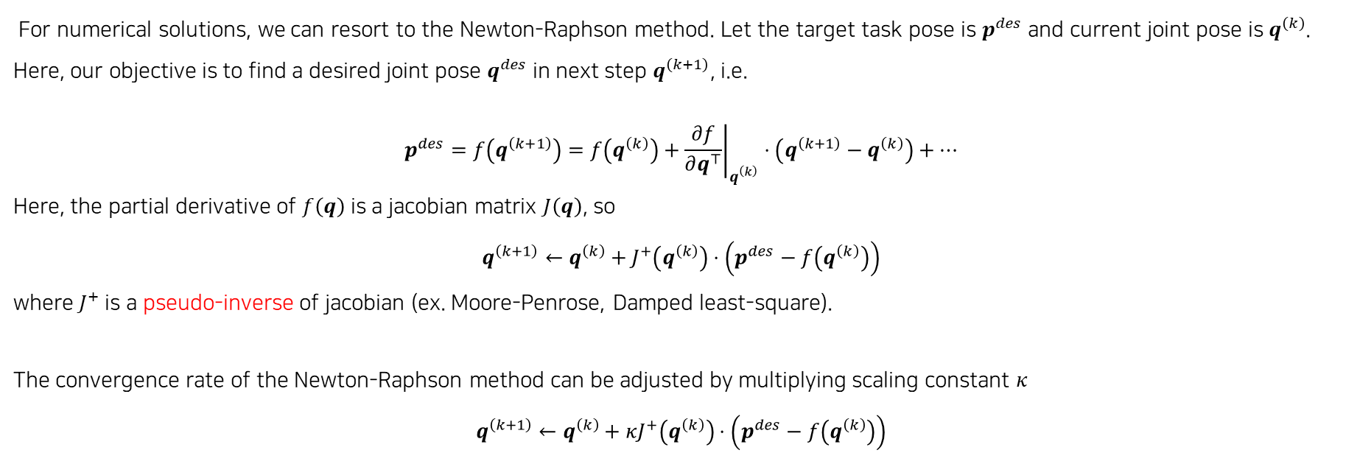
1. Numerical IK
Numerical IK: Newton-Raphson method
For numerical solutions, we can resort to the Newton-Raphson method. Let the target task pose is $p^{des}$ and current joint pose is $q^{\left(k\right)}$. Here, our objective is to find a desired joint pose $q^{des}$ in next step $q^{\left(k+1\right)}$, i.e.
$$p^{des}=f\left(q^{\left(k+1\right)}\right)=f\left(q^{\left(k\right)}\right)+{\left.\frac{∂f}{∂q^{⊤}}\right|}_{q^{\left(k\right)}}⋅\left(q^{\left(k+1\right)}−q^{\left(k\right)}\right)+…$$
Here, the partial derivative of $f\left(q\right)$ is a jacobian matrix $J\left(q\right)$, so
$$q^{\left(k+1\right)}←q^{\left(k\right)}+J^{+}\left(q^{\left(k\right)}\right)⋅\left(p^{des}−f\left(q^{\left(k\right)}\right)\right)$$
where $J^{+}$ is a pseudo-inverse of jacobian (ex. Moore-Penrose, Damped least-square).
The convergence rate of the Newton-Raphson method can be adjusted by multiplying scaling constant $κ$
$$q^{\left(k+1\right)}←q^{\left(k\right)}+κJ^{+}\left(q^{\left(k\right)}\right)⋅\left(p^{des}−f\left(q^{\left(k\right)}\right)\right)$$

Slide 4
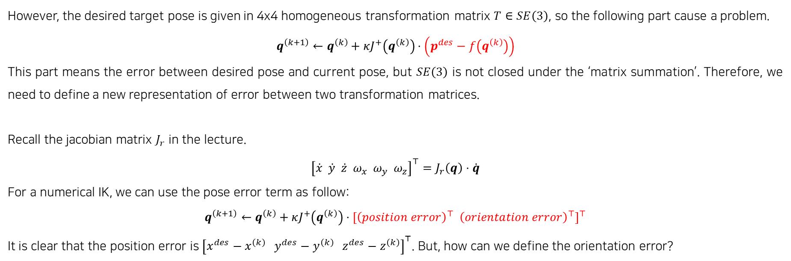
1. Numerical IK
Numerical IK: Newton-Raphson method
However, the desired target pose is given in 4x4 homogeneous transformation matrix $T∈SE\left(3\right)$, so the following part cause a problem.
$$q^{\left(k+1\right)}←q^{\left(k\right)}+κJ^{+}\left(q^{\left(k\right)}\right)⋅\left(p^{des}−f\left(q^{\left(k\right)}\right)\right)$$
This part means the error between desired pose and current pose, but $SE\left(3\right)$ is not closed under the ‘matrix summation’. Therefore, we need to define a new representation of error between two transformation matrices.
Recall the jacobian matrix $J_{r}$ in the lecture.
$${\left[\dot{x} \dot{y} \dot{z} ω_{x} ω_{y} ω_{z}\right]}^{⊤}=J_{r}\left(q\right)⋅\dot{q}$$
For a numerical IK, we can use the pose error term as follow:
$$q^{\left(k+1\right)}←q^{\left(k\right)}+κJ^{+}\left(q^{\left(k\right)}\right)⋅{\left[{\left(position error\right)}^{⊤} {\left(orientation error\right)}^{⊤}\right]}^{⊤}$$
It is clear that the position error is ${\left[x^{des}−x^{\left(k\right)} y^{des}−y^{\left(k\right)} z^{des}−z^{\left(k\right)}\right]}^{⊤}$. But, how can we define the orientation error?

Slide 5
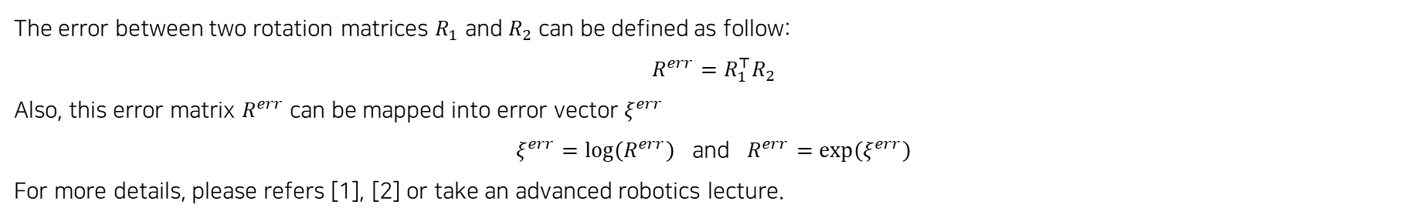
1. Numerical IK
Error in SO(3): matrix exponential/logarithm (Out of the course)
The error between two rotation matrices $R_{1}$ and $R_{2}$ can be defined as follow:
$$R^{err}=R_{1}^{⊤}R_{2}$$
Also, this error matrix $R^{err}$ can be mapped into error vector $ξ^{err}$
$ξ^{err}=\log\left(R^{err}\right)$ and $R^{err}=\exp\left(ξ^{err}\right)$
For more details, please refers [1], [2] or take an advanced robotics lecture.
[1] Lynch, Kevin M., and Frank C. Park. Modern robotics. Cambridge University Press, 2017.
[2] Murray, Richard M., Zexiang Li, and S. Shankar Sastry. A mathematical introduction to robotic manipulation. CRC press, 2017.

Slide 6
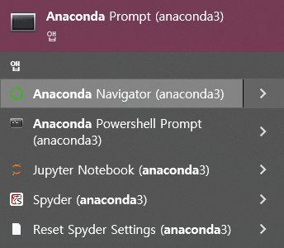
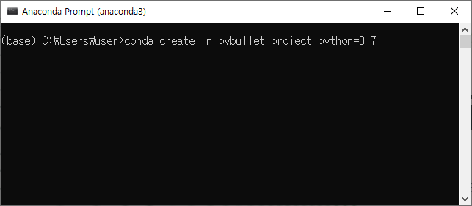
1. Installation
1) Anaconda
② Open anaconda prompt, and create new environment
①
②
>conda create -n [env name] python=[python version]

Slide 7
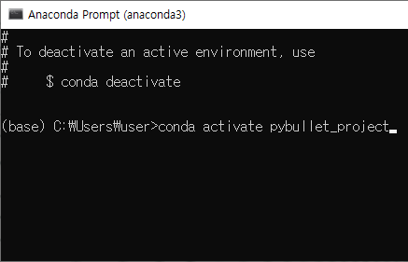
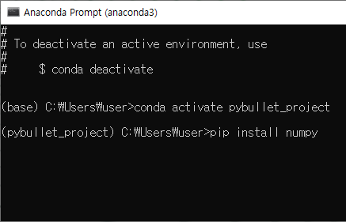
1. Installation
1) Anaconda
② Activate new environment, and install libraries
①
②
>conda create activate [env name]
>pip install numpy matplotlib jupyter pybullet

Slide 8

1. Installation
2) Pycharm (or any python IDE)
① Install pycharm from https://www.jetbrains.com/ko-kr/pycharm/
①

Slide 9
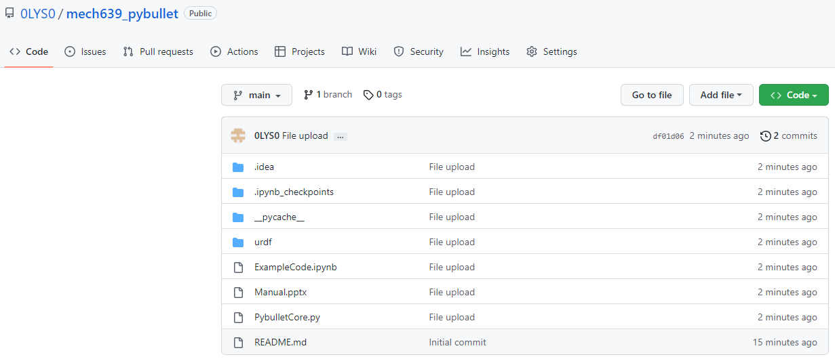
1. Installation
2) Pycharm
② Download source code from https://github.com/0LYS0/mech639_pybullet

Slide 10
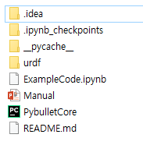
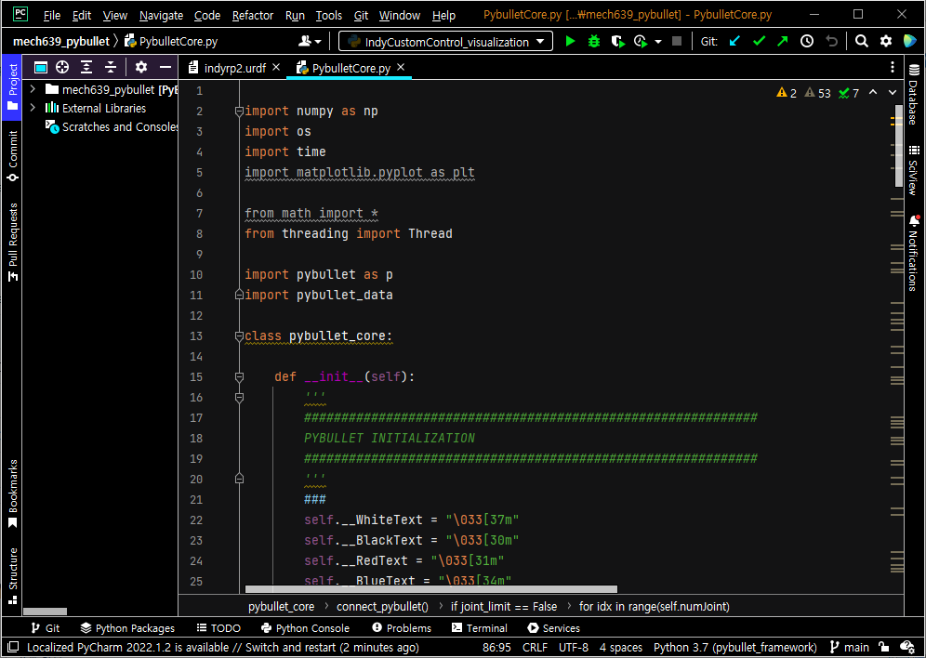
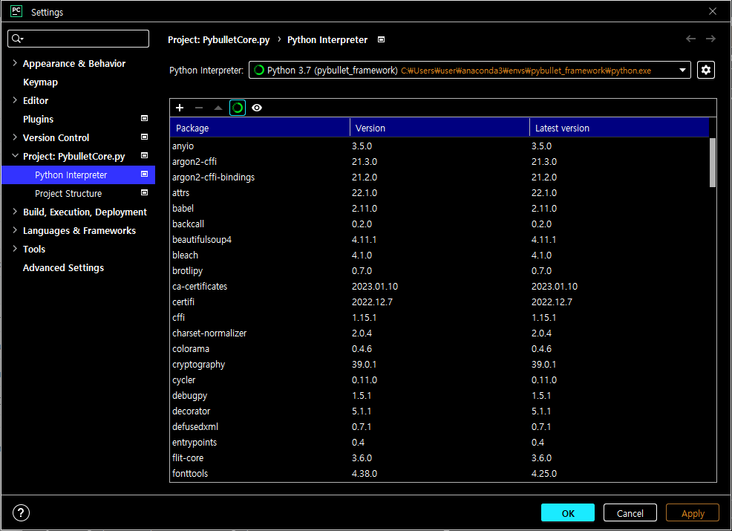
1. Installation
2) Pycharm
③ Open PybulletCore.py with Pycharm and set Python Interpreter
①
③
②

Slide 11
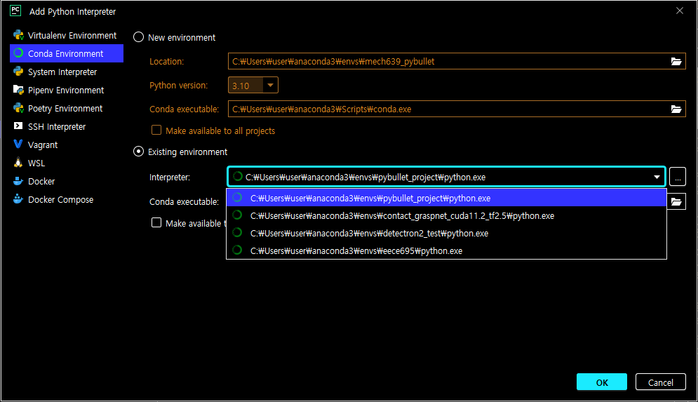
1. Installation
2) Pycharm
③ Open PybulletCore.py with Pycharm, and set Python Interpreter
④
⑤
⑥

Slide 12
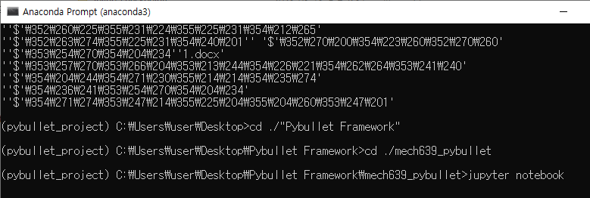
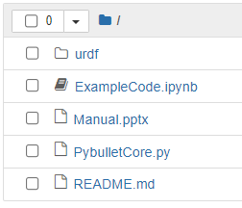
2. Code Implementation
1) Jupyter notebook
① Open jupyter notebook in project directory, and open ExampleCode.ipynb

Slide 13
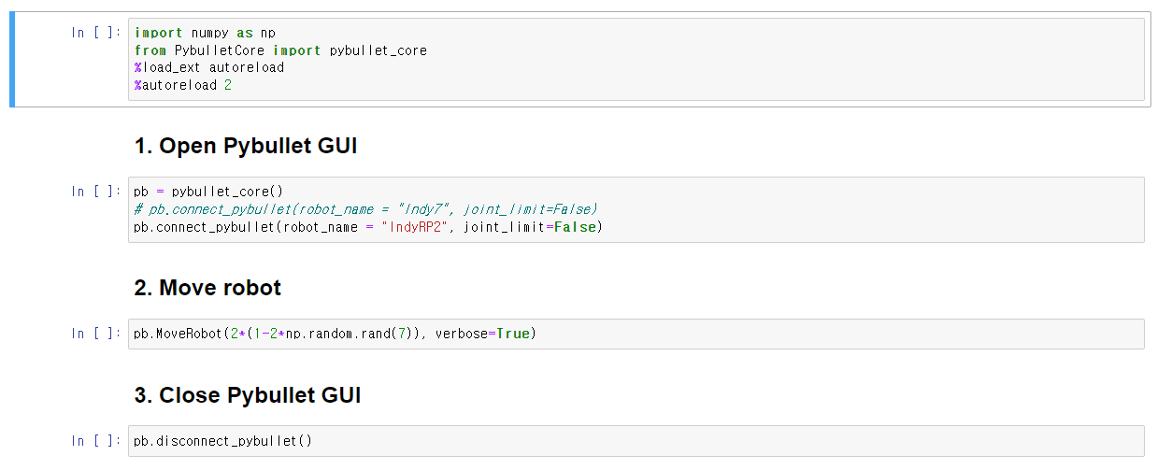
2. Code Implementation
1) Jupyter notebook
Import libraries
Create pybullet instance and start simulation
Move robot with random joint states
Close pybullet

Slide 14
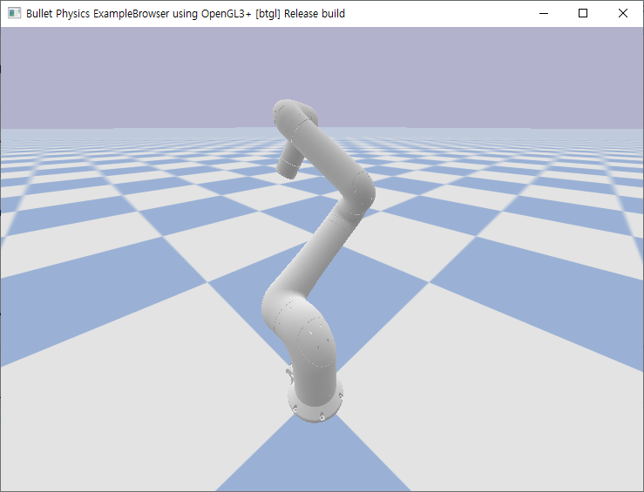
2. Code Implementation
2) Pycharm
Some base codes are defined in PybulletCore.py.
def connect_pybullet(self, robot_name = 'IndyRP2', joint_limit = True)
Open pybullet GUI and load robot.
Run simulation thread
def disconnect_pybullet(self)
Close pybullet GUI
def _SetRobotJoint(self)
This function is run in thread.
The position controller makes the robot the desired joint angle.
def MoveRobot(self, angle, verbose=False)
Change the desired joint angle.

Slide 15
2. Code Implementation
3) To do list
For a term project, you need to implement a basic robotics tools such as [Adjoint], [Jacobian], [Forward Kinematics] and etc.
Maybe this material will help you to implement them.
https://github.com/NxRLab/ModernRobotics
Additionally, the following manual provides example code and functions for simulating Pybullet.
https://docs.google.com/document/d/10sXEhzFRSnvFcl3XxNGhnD4N2SedqwdAvK3dsihxVUA/edit#
https://github.com/bulletphysics/bullet3/tree/master/examples/pybullet/examples

Slide 16
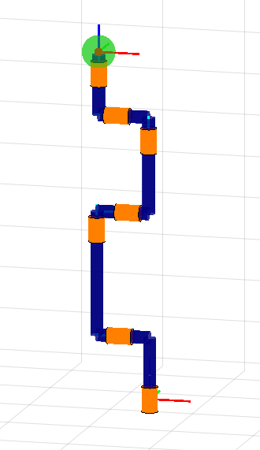
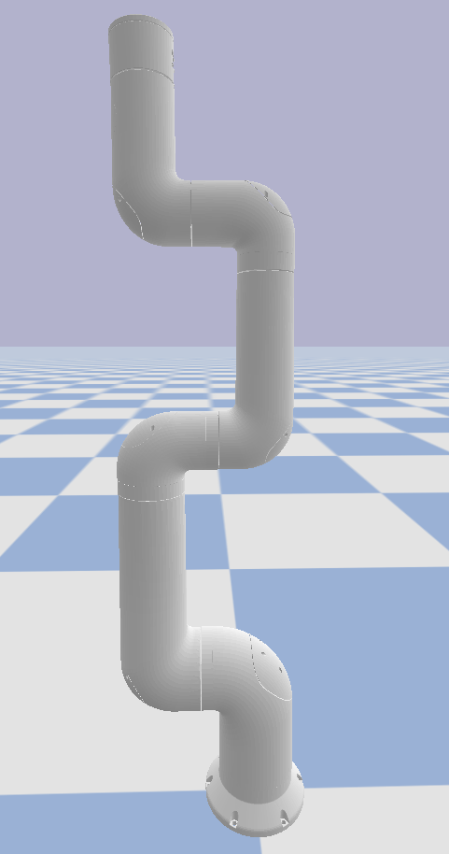













3. IndyRP2
$$h_{7}$$
$$h_{6}$$
$$h_{5}$$
$$w_{6}$$
$$w_{5}$$
$$h_{4}$$
$$h_{3}$$
$$w_{3}$$
$$w_{4}$$
$$w_{2}$$
$$h_{2}$$
$$w_{1}$$
$$h_{1}$$
To define screw of each joints, the robot’s parameters are needed. This information can be obtained using p.getLinkStates() function.

