Slide 1
PyBullet Framework Guide
Lee Yongseok, Jung Hyunseo
dldydtjr2000@postech.ac.kr
hsjung02@postech.ac.kr

Slide 2
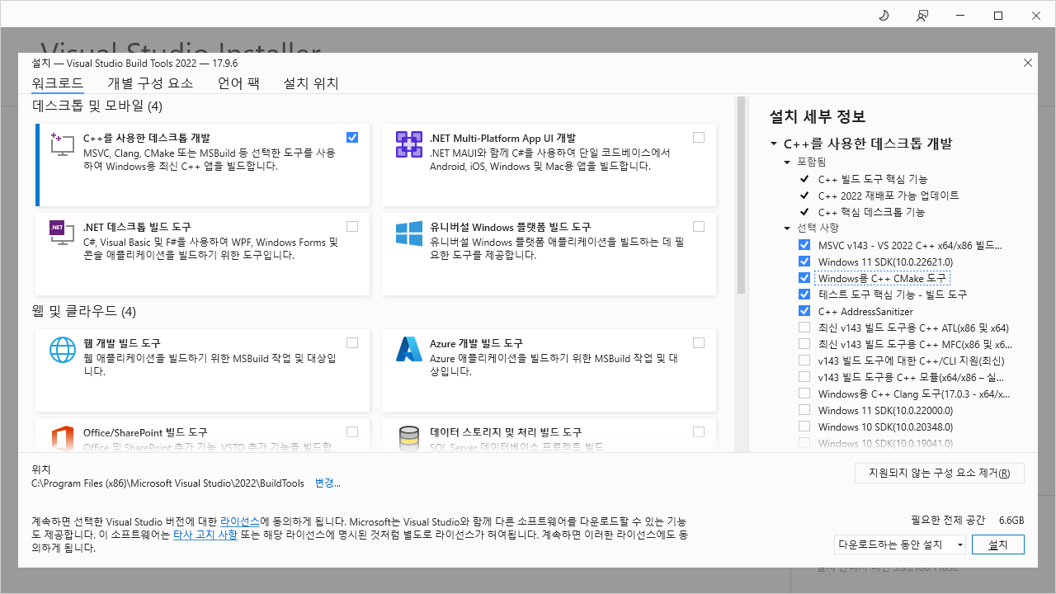
1. Installation
1) Visual Studio C++ Build Tools
① Install buildtools from https://aka.ms/vs/17/release/vs_BuildTools.exe

Slide 3
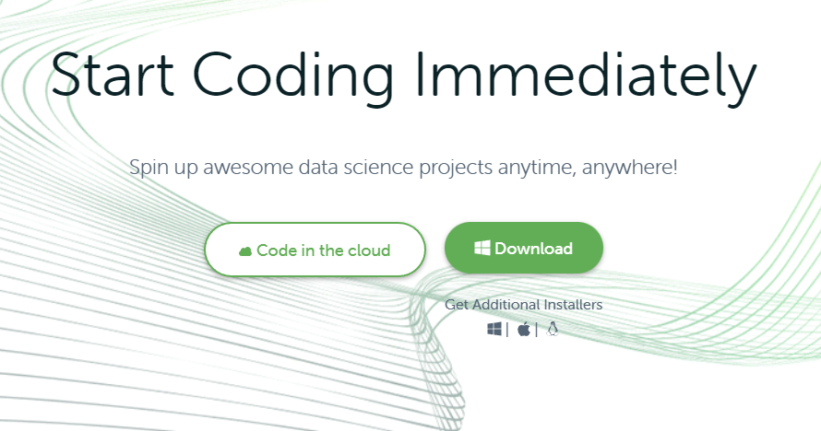
1. Installation
2) Anaconda
① Install anaconda from https://www.anaconda.com/
①

Slide 4
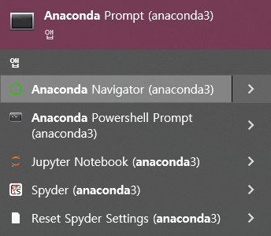
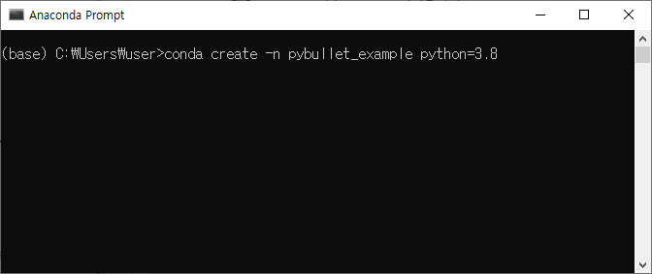
1. Installation
2) Anaconda
② Open anaconda prompt, and create new environment
①
②
>conda create -n [env name] python=3.8

Slide 5
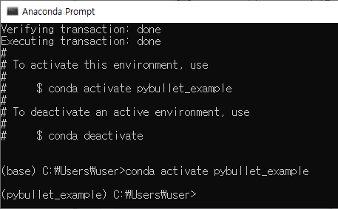
1. Installation
2) Anaconda
② Activate new environment
①
>conda create activate [env name]

Slide 6
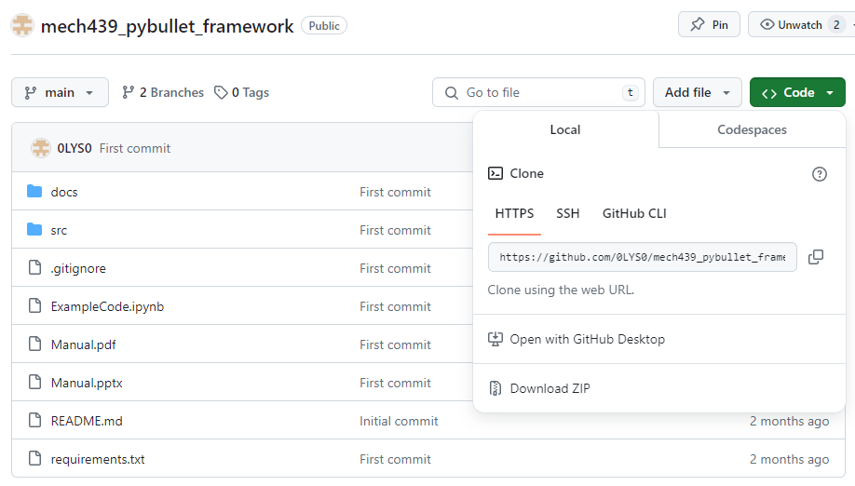
1. Installation
3) Source Code
① Download source code from https://github.com/0LYS0/mech439_pybullet_framework
* Place the folder in a path without special characters (ex. Korean).
* download ZIP or clone repository

Slide 7
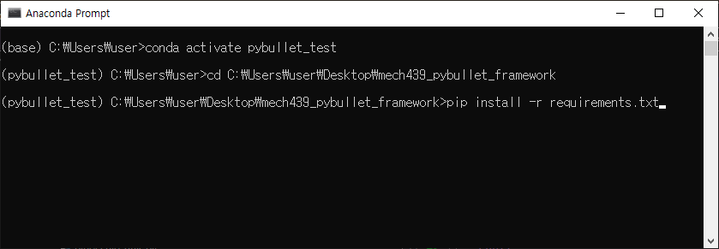
1. Installation
4) Install python packages (dependencies)
① Install the required dependencies via “pip install” and “conda install”.
> cd [YOUR PATH]
> pip install –r requirements.txt
> conda install Pinocchio –c conda-forge

Slide 8
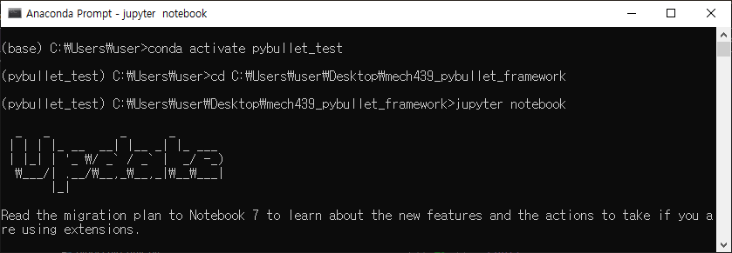
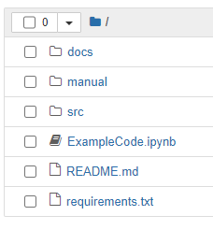
2. Run example code
Jupyter notebook
① Open jupyter notebook in project directory, and open ExampleCode.ipynb

Slide 9
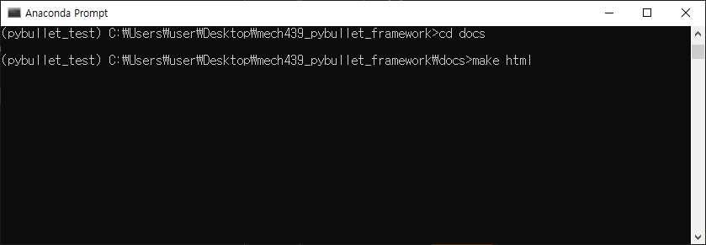
3. Source Code Manual
Build docs (.html) file via sphinx
① Open jupyter notebook in project directory, and open ExampleCode.ipynb
> cd docs
> make html

Slide 10
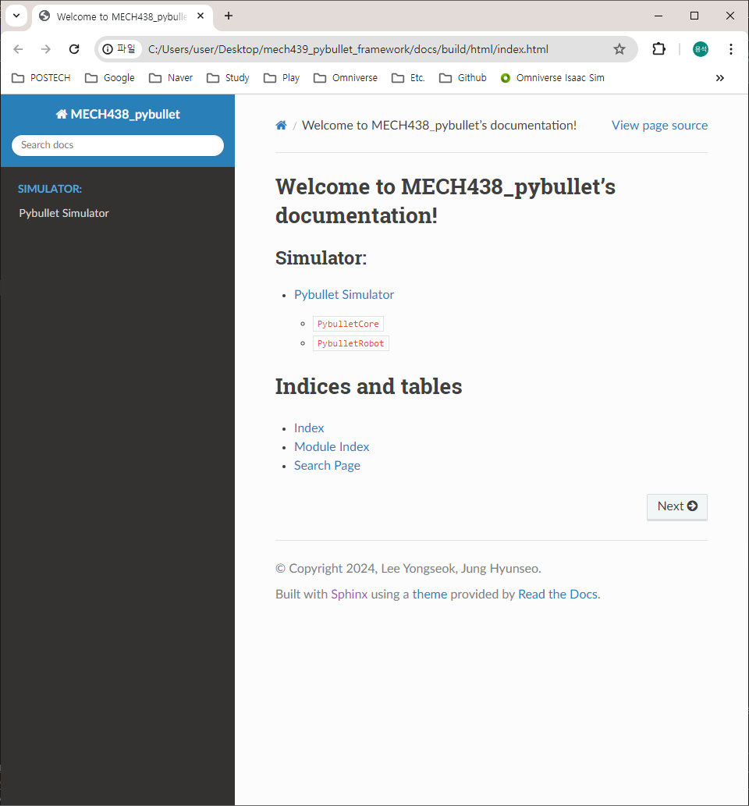
3. Source Code Manual
Build docs (.html) file via sphinx
② Then, you can open the source code manual in “docs/build/html/index.html”

