Slide 1
Pybullet Simulator Manual
Lee Yongseok, Jung Hyunseo
dldydtjr2000@postech.ac.kr
Notes:
git clone하기
anaconda 설치
가상환경 설정
vscode 또는 pycharm 설치`

Slide 2

1. Installation
1) Anaconda
① Install anaconda from https://www.anaconda.com/
①

Slide 3
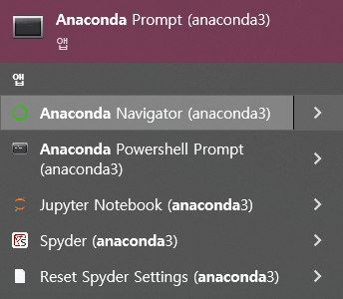
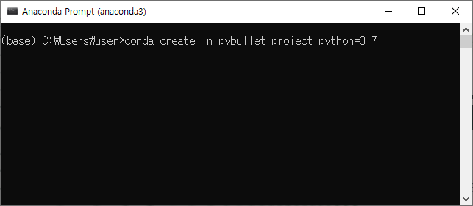
1. Installation
1) Anaconda
② Open anaconda prompt, and create new environment
①
②
>conda create -n [env name] python=[python version]

Slide 4
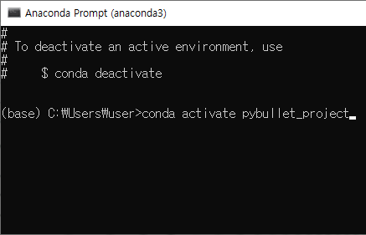
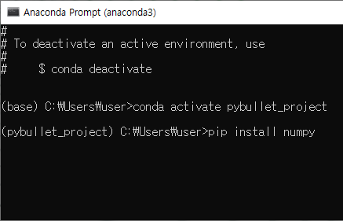
1. Installation
1) Anaconda
② Activate new environment, and install libraries
①
②
>conda create activate [env name]
>pip install numpy matplotlib jupyter pybullet

Slide 5

1. Installation
2) Pycharm (or any python IDE)
① Install pycharm from https://www.jetbrains.com/ko-kr/pycharm/
①

Slide 6
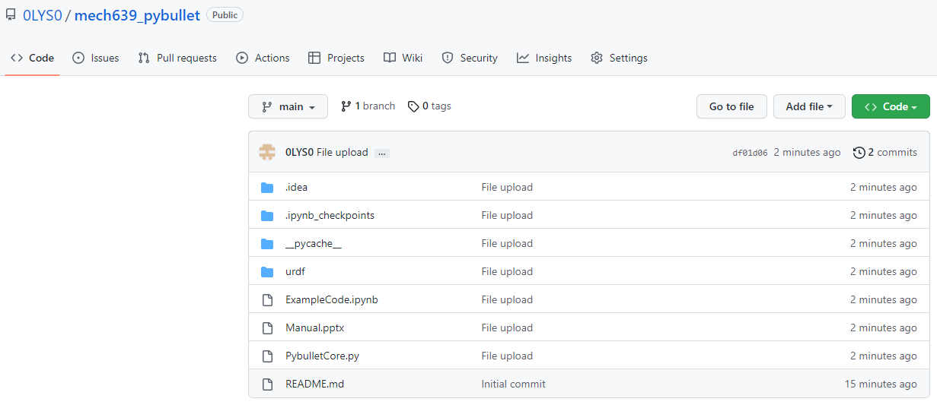
1. Installation
2) Pycharm
② Download source code from https://github.com/0LYS0/mech639_pybullet

Slide 7
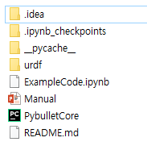
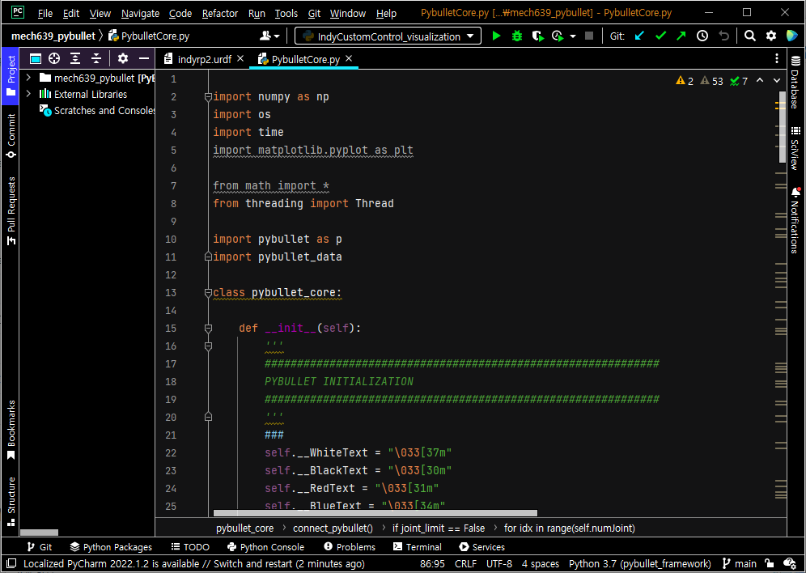
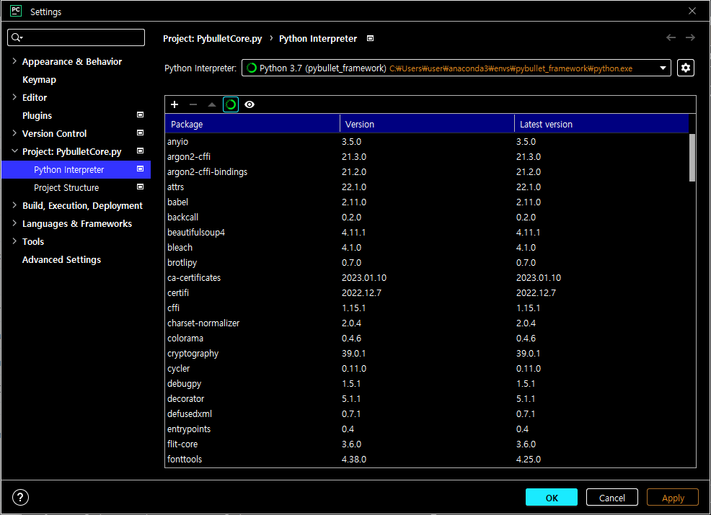
1. Installation
2) Pycharm
③ Open PybulletCore.py with Pycharm and set Python Interpreter
①
③
②

Slide 8
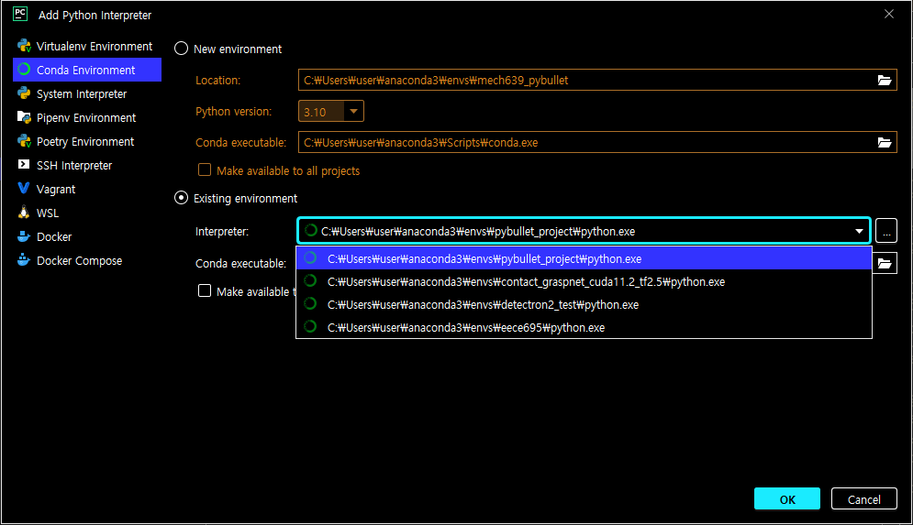
1. Installation
2) Pycharm
③ Open PybulletCore.py with Pycharm, and set Python Interpreter
④
⑤
⑥

Slide 9
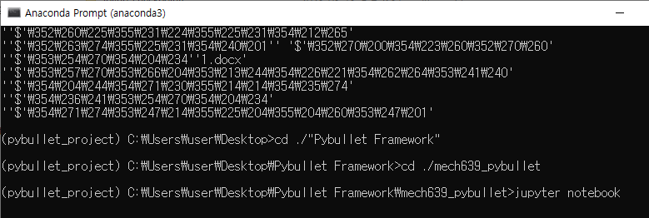
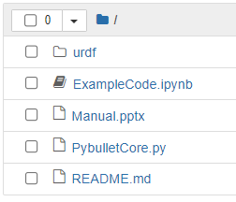
2. Code Implementation
1) Jupyter notebook
① Open jupyter notebook in project directory, and open ExampleCode.ipynb

Slide 10
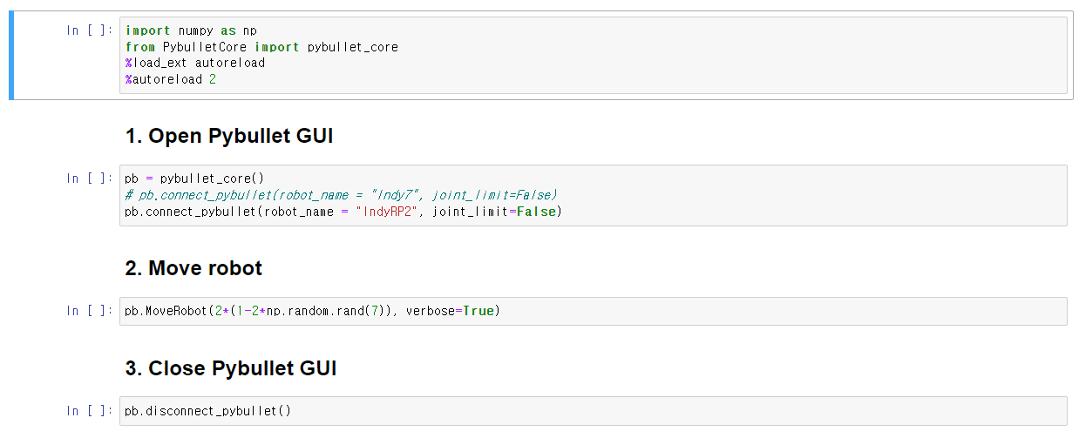
2. Code Implementation
1) Jupyter notebook
Import libraries
Create pybullet instance and start simulation
Move robot with random joint states
Close pybullet

Slide 11
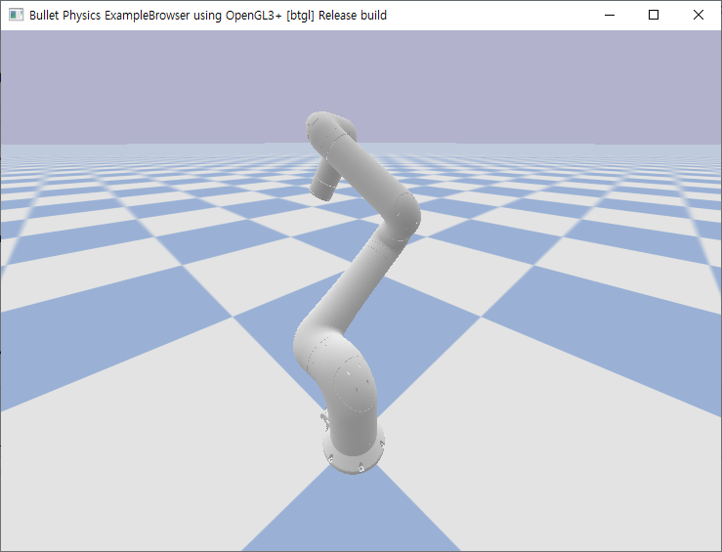
2. Code Implementation
2) Pycharm
Some base codes are defined in PybulletCore.py.
def connect_pybullet(self, robot_name = 'IndyRP2', joint_limit = True)
Open pybullet GUI and load robot.
Run simulation thread
def disconnect_pybullet(self)
Close pybullet GUI
def _SetRobotJoint(self)
This function is run in thread.
The position controller makes the robot the desired joint angle.
def MoveRobot(self, angle, verbose=False)
Change the desired joint angle.

Slide 12
2. Code Implementation
3) To do list
For a term project, you need to implement a basic robotics tools such as [Adjoint], [Jacobian], [Forward Kinematics] and etc.
Maybe this material will help you to implement them.
https://github.com/NxRLab/ModernRobotics
Additionally, the following manual provides example code and functions for simulating Pybullet.
https://docs.google.com/document/d/10sXEhzFRSnvFcl3XxNGhnD4N2SedqwdAvK3dsihxVUA/edit#
https://github.com/bulletphysics/bullet3/tree/master/examples/pybullet/examples

Slide 13
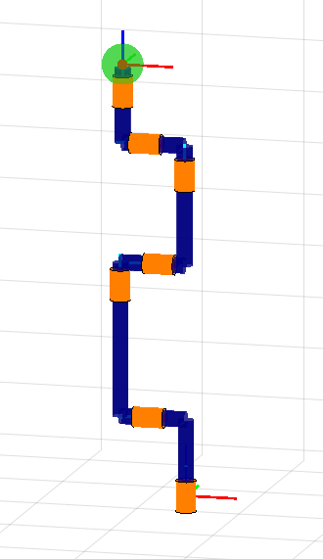
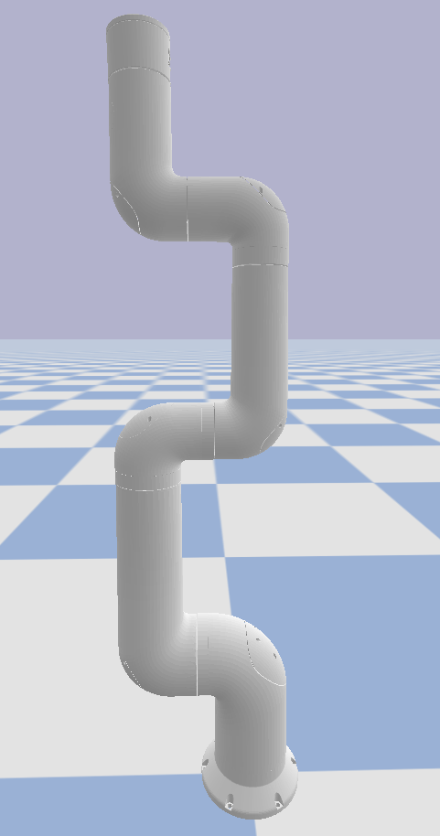













3. IndyRP2
$$h_{7}$$
$$h_{6}$$
$$h_{5}$$
$$w_{6}$$
$$w_{5}$$
$$h_{4}$$
$$h_{3}$$
$$w_{3}$$
$$w_{4}$$
$$w_{2}$$
$$h_{2}$$
$$w_{1}$$
$$h_{1}$$
To define screw of each joints, the robot’s parameters are needed. This information can be obtained using p.getLinkStates() function.

