Slide 1
PyBullet Guide
Lee Yongseok, Jung Hyunseo
dldydtjr2000@postech.ac.kr
hsjung02@postech.ac.kr

Slide 2
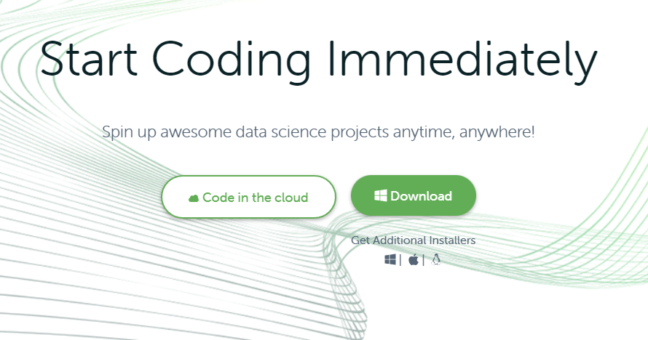
1. Installation
1) Anaconda
① Install anaconda from https://www.anaconda.com/
①

Slide 3
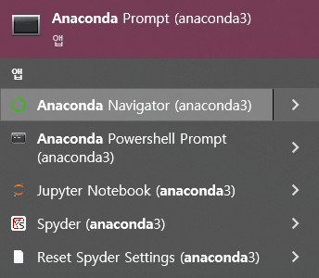
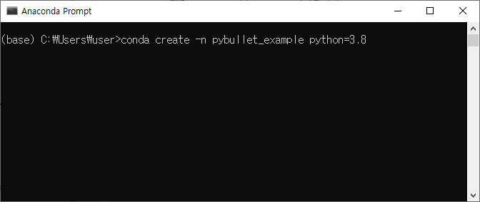
1. Installation
1) Anaconda
② Open anaconda prompt, and create new environment
①
②
>conda create -n [env name] python=3.8

Slide 4
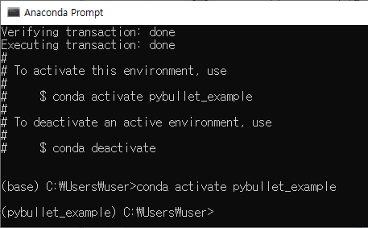
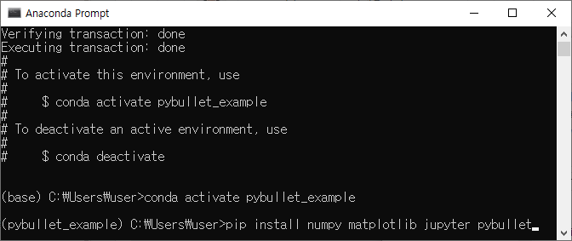
1. Installation
1) Anaconda
② Activate new environment, and install libraries
①
②
>conda create activate [env name]
>pip install numpy matplotlib jupyter pybullet

Slide 5
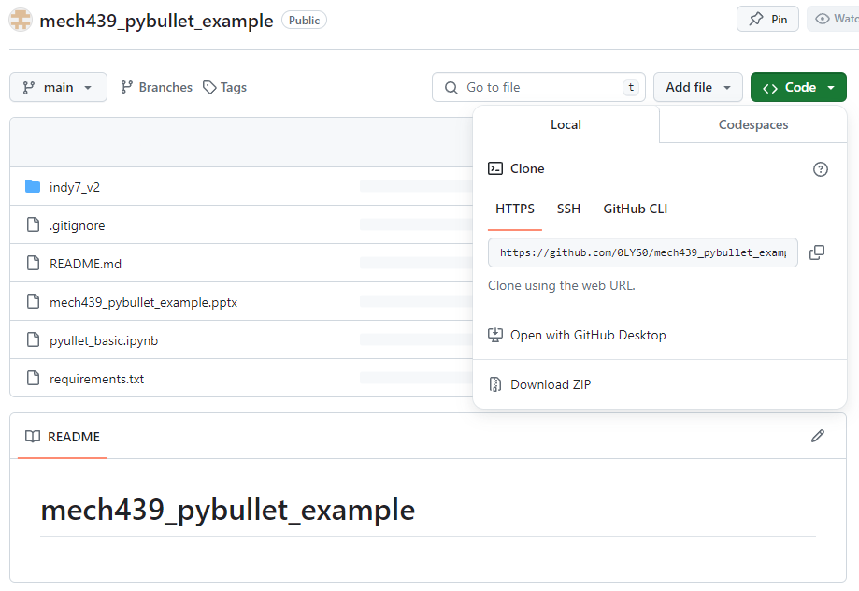
1. Installation
2) Source Code
② Download source code from https://github.com/0LYS0/mech439_pybullet_example
* Place the folder in a path without special characters (ex. Korean).
* download ZIP or clone repository

Slide 6
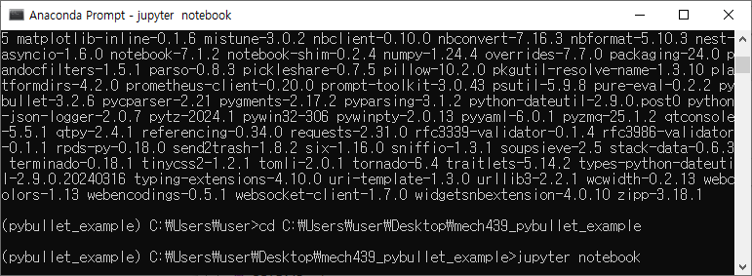
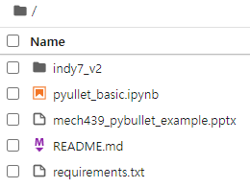
2. Run example code
1) Jupyter notebook
① Open jupyter notebook in project directory, and open ExampleCode.ipynb
>cd [YOUR PATH]
> jupyter notebook

