Slide 1
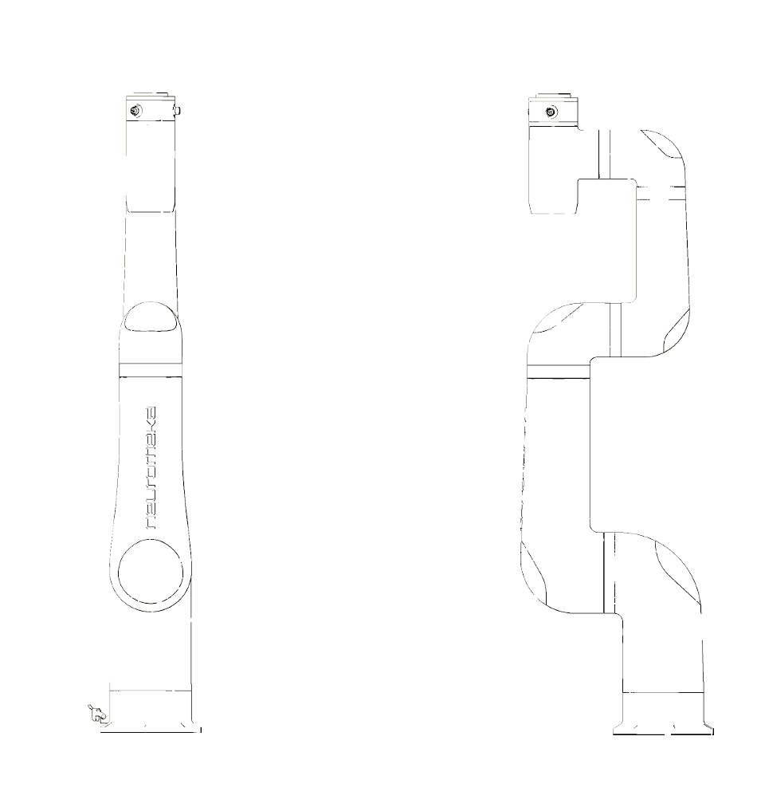
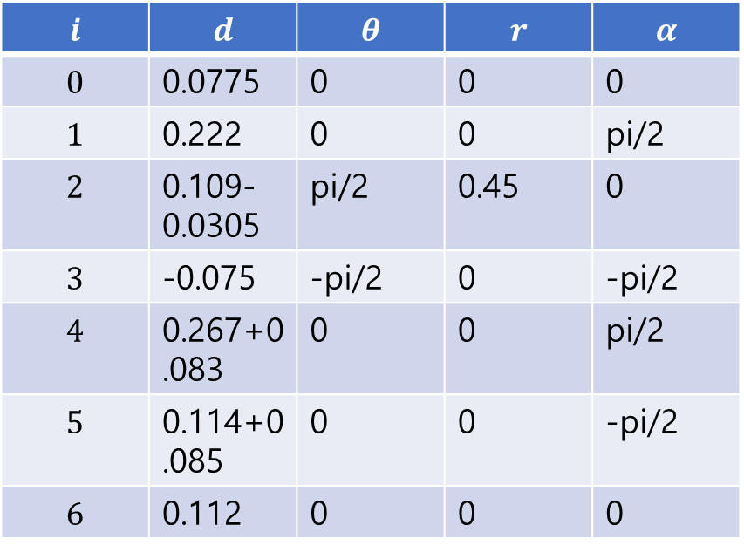
{6}
{5}
0.112
0.083
Tz
Rz
Tx
Rx
0.114
0.085
$$i$$ | $$d$$ | $$θ$$ | $$r$$ | $$α$$
$$0$$ | 0.0775 | 0 | 0 | 0
$$1$$ | 0.222 | 0 | 0 | pi/2
$$2$$ | 0.109-0.0305 | pi/2 | 0.45 | 0
$$3$$ | -0.075 | -pi/2 | 0 | -pi/2
$$4$$ | 0.267+0.083 | 0 | 0 | pi/2
$$5$$ | 0.114+0.085 | 0 | 0 | -pi/2
$$6$$ | 0.112 | 0 | 0 | 0
0.075
0.0305
0.267
{3}
{4}
0.45
{2}
0.222
{1}
0.0775
{0}
0.109

