Slide 1


PREDICTIVE MAINTENANCE
FOR AIRCRAFT ENGINES
NASA Turbofan Engine RUL Prediction
PROJECT TEAM
Mariam Salem
Yousef Hatata
Mohamed Alaa
Milad Ashraf
Hager Mahmoud
PROJECT SUPERVISOR
Dr. Rana Sobhy

Slide 2

Table of Contents
01
Problem definition
02
Project Idea
03
Project Scope
04
Dataset Understanding
05
Deep Learning Approach
06
Model Architecture
07
Database Implementation
08
Power bi Dashboard
09
Future Work

Slide 3




Problem Definition
Aircraft engine maintenance is commonly performed based on fixed time intervals rather than the actual health condition of the engine resulting in:
Operational and Safety Impact
Such failures increase costs, reduce efficiency, and compromise safety
Limited Maintenance Strategy
Maintenance schedules ignore engine-specific usage patterns and degradation trends.
Inefficient Maintenance Decisions
This can cause unnecessary servicing or unexpected engine failures.

Slide 4
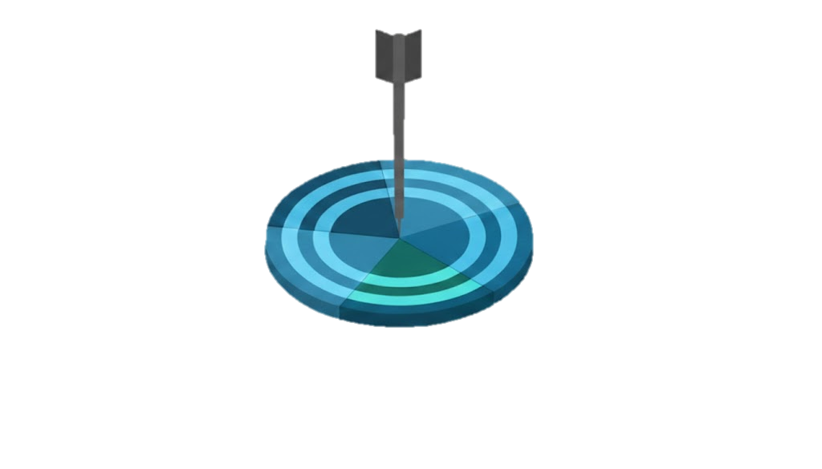
PROPOSED SOLUTION
An AI-powered predictive maintenance system that estimates the Remaining Useful Life (RUL) of aircraft engines using deep learning.
Motivation
Traditional maintenance often causes unnecessary servicing or unexpected failures, increasing costs and safety risks
Expected Outcome
Accurate RUL predictions, improved safety, and cost-efficient engine operations
Objective
Predict engine failures in advance to reduce downtime, lower maintenance costs, and improve operational reliability
Methodology
Apply Ai Model on time-series sensor data to forecast RUL.
Dataset
Use NASA Turbofan Engine dataset , containing sensor data and operational conditions for multiple engines

Slide 5
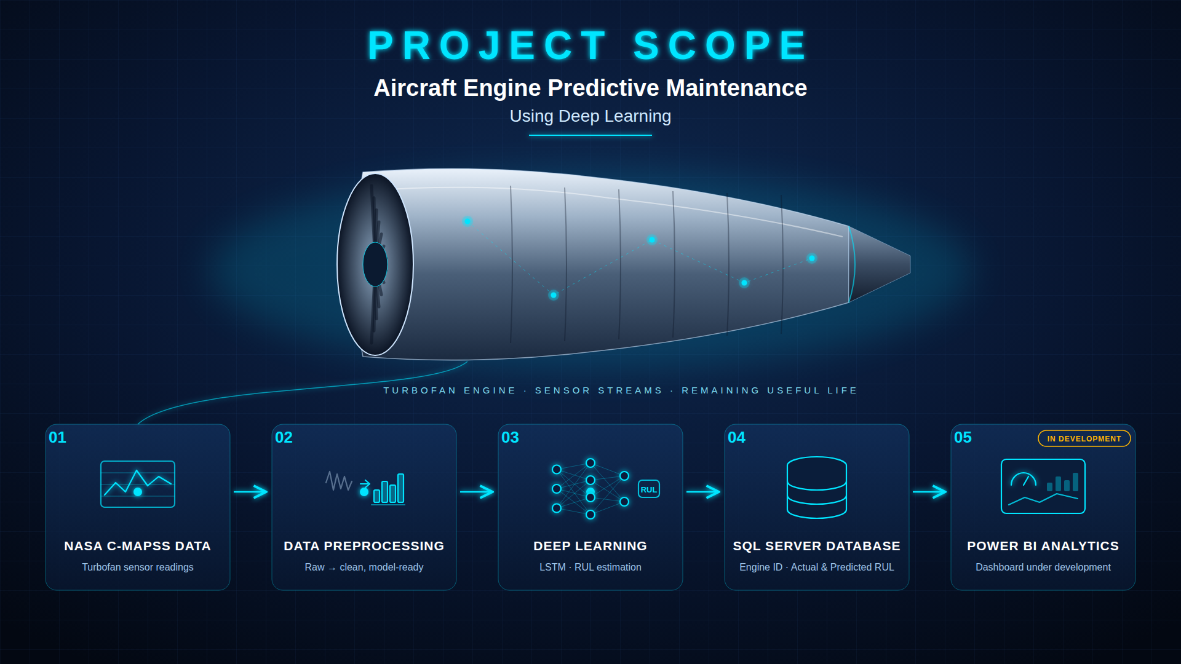

Slide 6


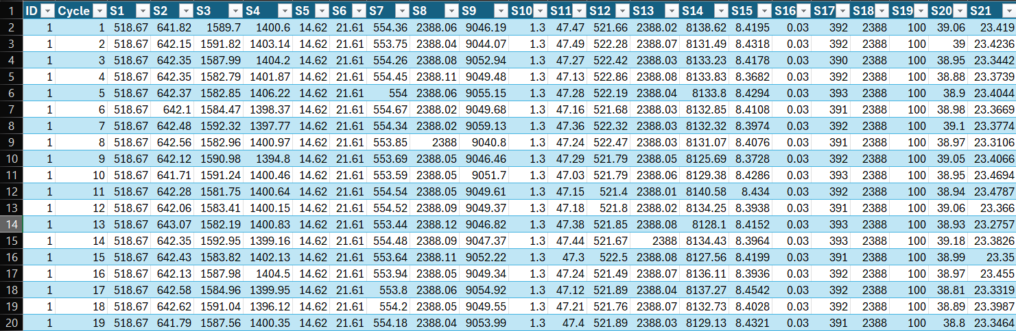




Dataset: NASA Turbofan Engine Degradation (FD001)
NASA C-MAPSS
DATASET)FD001(
Type: Multivariate Time-Series Data
Engines: Multiple independent engine units
Records:
- Training set: 20,631 cycles
- Test set: 13,096 cycles
Features (26 total):
- Engine ID & Cycle
- 21 Sensor Measurements
Objective: Remaining Useful Life (RUL) Prediction
Partial View of dataset sample

Slide 7
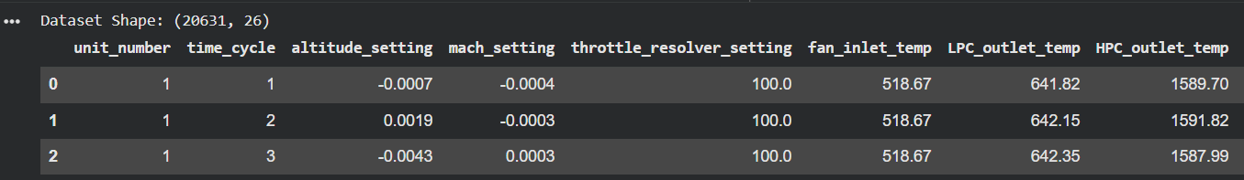
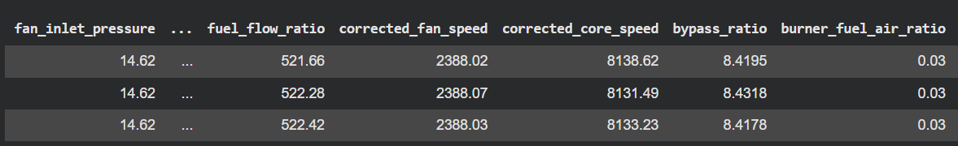
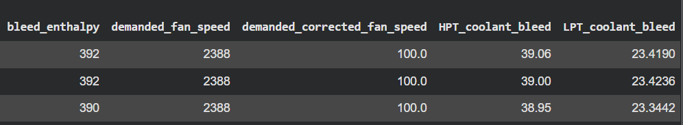
Dataset: NASA Turbofan Engine Degradation (FD002)
NASA C-MAPSS
DATASET)FD002(
Type: Multivariate Time-Series Data
Engines: 260 training engines and 259 test engines
Records:
Training set: 53,759 cycles
Test set: 33,991 cycles
Features (26 total):
Engine ID & Cycle
21 Sensor Measurements
6 Operating Settings
Objective: Remaining Useful Life (RUL) Prediction
Partial View of dataset sample

Slide 8
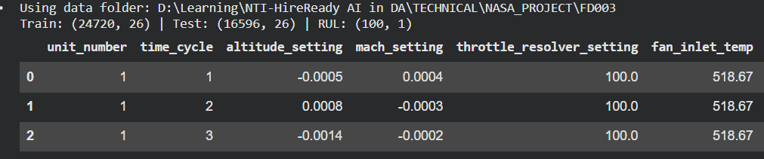
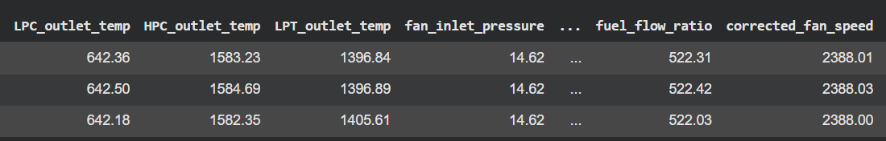
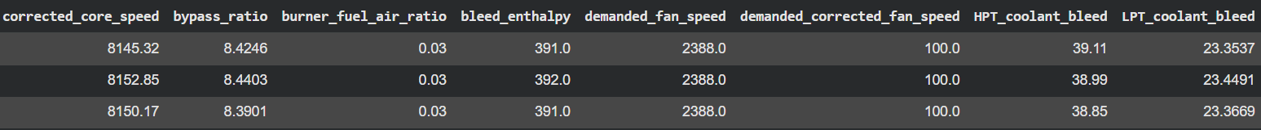
Dataset: NASA Turbofan Engine Degradation (FD003)
NASA C-MAPSS
DATASET)FD003(
Type: Multivariate Time-Series Data
Engines: 100 training engines and 100 test engines
Records:
Training set: 24,720 cycles
Test set: 16,596 cycles
Features (26 total):
Engine ID & Cycle
21 Sensor Measurements
6 Operating Settings
Objective: Remaining Useful Life (RUL) Prediction
Partial View of dataset sample

Slide 9
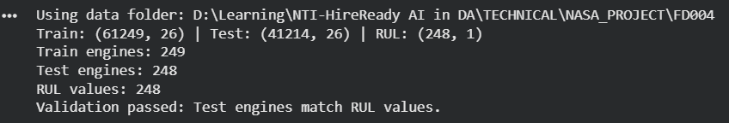
Dataset: NASA Turbofan Engine Degradation (FD004)
NASA C-MAPSS
DATASET)FD004(
Type: Multivariate Time-Series Data
Engines: 248 training engines and 249 test engines
Records:
Training set: 61,249 cycles
Test set: 41,214 cycles
Features (26 total):
Engine ID & Cycle
21 Sensor Measurements
6Operating Settings
Objective: Remaining Useful Life (RUL) Prediction
Partial View of dataset sample

Slide 10





DEEP LEARNING APPROACH
01
02
03
04
Sensor Data
Sequence Preparation
Deep Learning Models
RUL Prediction
Engine sensor readings from NASA C-MAPSS
Time-series readings organized into sequences
LSTM and BiLSTM learn engine degradation patterns
Estimating the Remaining Useful Life of each engine
Notes:
Walk through the pipeline left to right: sensor data from NASA C-MAPSS (FD001-FD004), sequence preparation, LSTM and BiLSTM models, and RUL prediction. Replace the placeholder box with a real Jupyter Notebook screenshot.

Slide 11
MODEL ARCHITECTURES
Four separate models, one for each NASA C-MAPSS dataset · Cyan values stand out from the other models
FD001
BiLSTM
FD002
BiLSTM
FD003
LSTM
FD004
LSTM
SEQUENCE LENGTH
SEQUENCE LENGTH
SEQUENCE LENGTH
SEQUENCE LENGTH
30
50
30
30
HIDDEN UNITS
HIDDEN UNITS
HIDDEN UNITS
HIDDEN UNITS
64 / 32
100 / 50
64 / 32
64 / 32
DROPOUT
DROPOUT
DROPOUT
DROPOUT
0.3
0.2
0.2
0.2
Notes:
Four separate models were developed, one per C-MAPSS dataset. FD001 and FD002 use BiLSTM; FD003 and FD004 use LSTM. FD004 uses an LSTM with two layers (64 and 32 units), a 16-neuron ReLU dense layer and a single RUL output, trained with Adam, MSE loss, batch size 64 and up to 50 epochs with Early Stopping and ReduceLROnPlateau. Evaluation metrics are covered on the next slide.

Slide 12
MODEL RESULTS & EVALUATION
Dataset | Model | MAE | RMSE | R² | NASA Score
FD001 | BiLSTM | 11.4270 | 15.4801 | 0.8612 | 492.39
FD002 | BiLSTM | 10.98 | 16.52 | 0.8412 | 538
FD003 | LSTM | 8.72 | 12.17 | 0.9035 | 258.3
FD004 | LSTM | 13.23 | 18.02 | 0.8242 | 842.2
EVALUATION METRICS
MAE
RMSE
R²
NASA Score
Average prediction error
Penalizes larger errors more heavily
How well predictions fit actual values
Asymmetric penalty on prediction errors

Slide 13
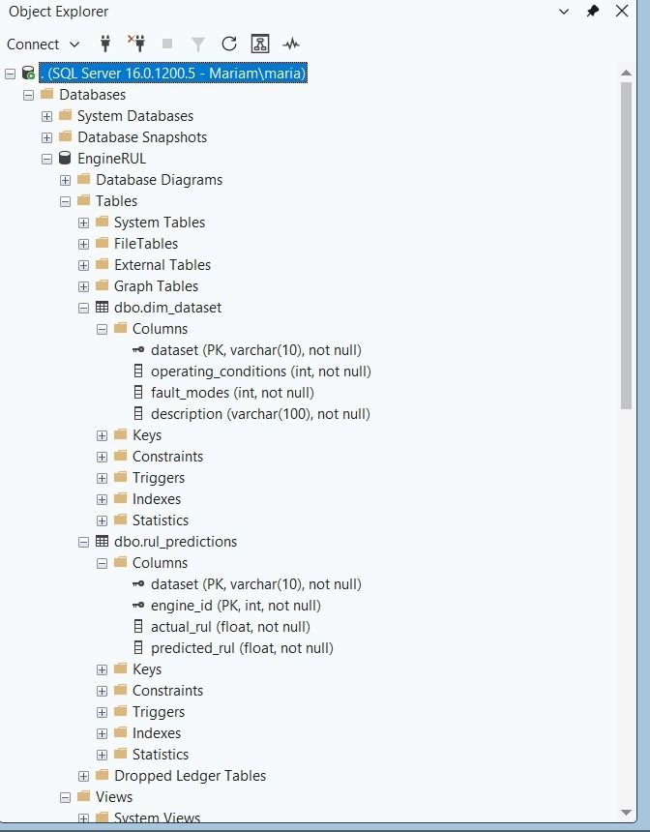
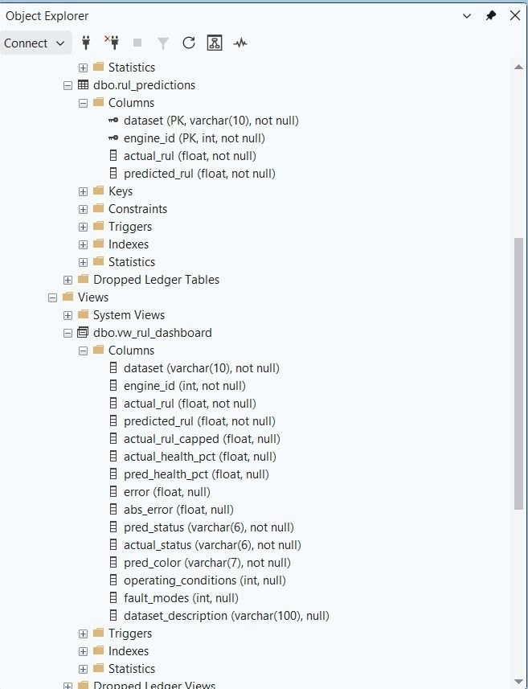
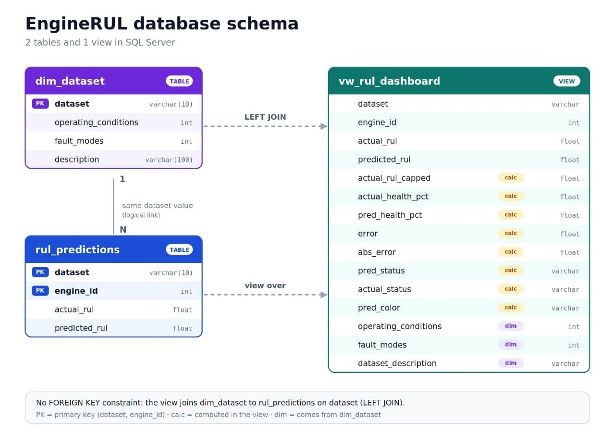
SQL SERVER DATABASE IMPLEMENTATION

Slide 14
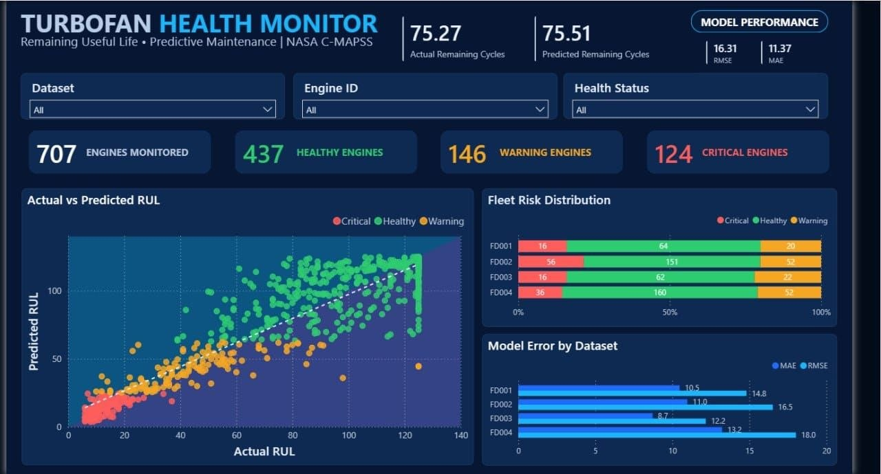
POWER BI DASHBOARD
Interactive visualization of engine health and RUL predictions

Slide 15
Future Work
Sensor Fault Identification and Explainability
LLM-Based Maintenance Chatbot
Maintenance Recommendation System
Automated Alerts and Notifications

Slide 16
Thank
You!
for your attention. Any questions?

