Slide 1
CSE PROJECT · AGENTIC AI
AdaptED
An Intelligent Multi-Agent Adaptive Education Assistant
A supervisor-orchestrated system of cooperating AI agents — RAG, a persistent student memory, and an OBE course-outline validator — that personalizes learning and supports outcome-based education.
Presented to: Dr. Md. Iftekharul Mobin
Team: 13· Date: 30.08.2026
Presented by:
1.Najmus Saquib Aurko (26-94142-2)
2.Saida Binta Alam (26-94136-2)
3.Anindita Roy (26-94077-2)
4.Tasnim Sultana Sintheia (26-93981-1)
Notes:
Introduce the project name and the one-line pitch: AdaptED is a multi-agent AI education platform. It has two sides — adaptive learning for students, and an OBE course-outline validator for faculty. Fill in your team names and date.

Slide 2
Agenda
01
The problem we solve
02
Objectives
03
What is AdaptED?
04
System architecture
05
The agents
06
OBE subsystem (our focus)
07
Agent Console & tech stack
08
Testing, future work, Q&A
Notes:
Walk through the flow of the talk in ~10 seconds.

Slide 3
The Problem
S
For students
F
For faculty
One-size-fits-all teaching doesn’t work for everyone. Students have different strengths, weaknesses, and learning needs. But traditional learning content is often static, and each session starts from the beginning, without remembering what a student already knows, what they struggle with, or where they need more support.
Mapping Outcome-Based Education (OBE), including Course Outcomes (COs), Program Outcomes (POs), Bloom’s Taxonomy levels, and Knowledge, Practice, and Attitude (K-P-A), is often done manually using lengthy templates. This process takes a lot of time, involves repetitive tasks, and can easily lead to mistakes.
AdaptED tackles both — with AI agents that adapt to the learner, and a deterministic validator that checks OBE mappings.
Notes:
Frame the two real problems. The OBE one is the part we contributed most to.

Slide 4
Objectives
Personalize learning
Automate teaching work
1
2
Adapt lessons, quizzes and study plans to each student's measured strengths and weaknesses.
Generate curriculum structure, lessons, quizzes, grading and recommendations for teachers.
Validate OBE mappings
Observe & control agents
3
4
Check CO to PO, Bloom levels and K-P-A against the AIUB CS OBE Manual and author compliant outcomes.
Full visibility into the pipeline with human-in-the-loop approval, pause, cancel and retry.
Notes:
Four objectives. Note objective 3 is our main contribution.

Slide 5
What is AdaptED?
Instead of one large prompt doing everything, the work is split across many cooperating AI agents, each with one job, coordinated by a central Supervisor — with shared memory, RAG grounding, and full logging.
1
2
3
4
Multi-Agent
RAG
Student Memory
OBE Tools
Supervisor + 8 specialists over a LangGraph pipeline
Answers grounded in the teacher's own uploaded material
Persistent mastery, history, misconceptions, preferences
Validate and author outcome-based course outlines
Notes:
The four pillars. Emphasize 'agentic' = separation of concerns, each agent testable and observable.

Slide 6
System Architecture
Client
Streamlit web UI · API client
API — FastAPI
auth · courses · curriculum · lessons · quizzes · students · agent · obe · logs (JWT + roles)
Orchestration
Supervisor · LangGraph runtime · Message bus · retries + savepoints
Agents
Supervisor + 8 specialized agents
Knowledge · Memory · Services · LLM
RAG (parse·chunk·embed·retrieve) · student memory · services · LLM provider (mock / OpenRouter)
Persistence
PostgreSQL + pgvector · observability tables
Notes:
Read top to bottom: UI to API to Supervisor/LangGraph to agents to knowledge+memory to PostgreSQL. A message bus and observability tables record every step.

Slide 7
The Agents — Supervisor + 9 Specialists
Curriculum
Study Planner
Lesson
Parses docs; builds chapters/topics; indexes RAG
Personalized, prerequisite-aware schedules
Curriculum-grounded lessons & explanations
Quiz
Grading
Performance
Assessments and adaptive reassessments
Scores answers and gives feedback
Weak/strong topics, mastery, misconceptions
Recommendation
OBE Mapping *
OBE Authoring *
Decides the next action for the student
Validates CO-PO-Bloom-K/P/A vs the manual
Generates & rewrites Course Outcomes
* Our two OBE-domain agents — an analyze-and-author pair.
Notes:
Nine agents total (Supervisor coordinates). Agents never call each other directly — the Supervisor routes work over a persisted message bus. Highlight the two OBE agents as our contribution.

Slide 8
How It Adapts — the Quiz-Submit Loop
One student action fans out into a linear multi-agent pipeline that grades, diagnoses and adapts:
Submit
quiz
Grade
Analyze
Recommend
Adapt
plan
Re-teach
Reassess
student
grading
performance
recommend
planner
lesson
quiz
Closed feedback loop
Measure -> diagnose -> adapt the plan and lesson to the gaps -> re-measure. If the student has mastered the material, the Recommendation agent chooses 'advance' and the pipeline short-circuits. Each agent's output is chained forward as context to the next.
Notes:
This closed loop is what makes the system adaptive rather than a static content generator. Retries + savepoints keep partial progress safe on failure.

Slide 9
OBE Subsystem — Two Cooperating Agents
1 · OBE Mapping (Validation)
2 · OBE Authoring (Generation)
Extract the CO matrix, PO indicators, K-P-A, weekly plan & assessment (reads DOCX tables).
Author OBE-compliant Course Outcomes for a course/topic set, with a proper Bloom spread + suggested PO & K-P-A.
Validate with 7 deterministic rules; Suggest fixes; Summarize the mapping methodology.
Improve a flagged CO — rewrites the verb to match the Bloom level and proposes the right PO.
Deterministic & offline · non-destructive (never edits the source).
Closes the loop: the validator finds problems, the author fixes them.
Real defects caught on an actual outline (CSC 2209):
PO-J-2 referenced but never defined · CO4's PO differs between the matrix and the assessment table · CO1 verb “Explain” (L2) tagged as Bloom L5.
Notes:
This is our focus. Two agents: one analyzes/validates, one generates/fixes. Give the concrete defect example — examiners like a real finding. Checks are deterministic so verdicts are reproducible and testable; the LLM is optional.

Slide 10
Agent Console — Observability & Control
1
Dashboard
2
Execution graph
3
Live trace
Active agents, run stats, cost
LangGraph pipeline, path taken
Auto-refreshing agent hops
4
Messages
5
Tokens & cost
6
Logs & errors
Full agent-to-agent history
Per-run token use & estimate
Failed runs + audit log
7
Memory viewer
8
Human-in-the-loop
9
Report viewer
Student mastery & preferences
Approve · pause · cancel · retry
Final per-agent output
Notes:
Everything is observable and controllable. Human-in-the-loop: approval gate + pause/cancel/retry. Token & cost tracking per run.

Slide 11
Technology Stack
LangGraph
FastAPI + Uvicorn
Streamlit
Agent orchestration (state graph)
Async, typed backend API
Teacher / student web UI
PostgreSQL + pgvector
SQLAlchemy 2.0
Pydantic
Relational store + vector search
ORM + nested-transaction savepoints
Validates every agent's output
OpenRouter / mock LLM
pypdf · python-docx
PyJWT · bcrypt
Real models, deterministic offline
Document & DOCX-table parsing
Auth: tokens + hashed passwords
Notes:
Group answer: Multi-agent AI + RAG + shared memory + PostgreSQL/pgvector + structured logging. LangGraph for orchestration; mock provider makes it fully offline-testable.

Slide 12
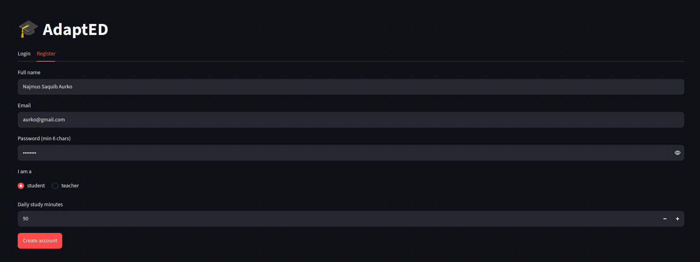
The Application (Registration & Login)
Notes:
Replace each framed area with a real screenshot: registration, document upload & analyze, OBE Mapping results, and the Agent Console. During the demo, show the live app for these.

Slide 13
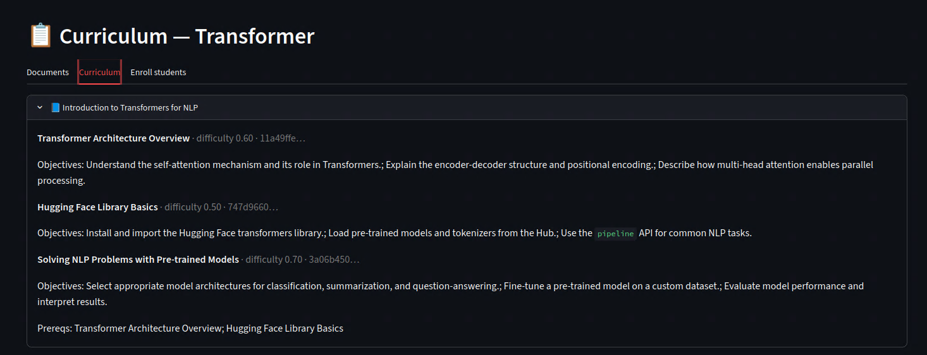
The Application (Upload & Analyze Documents)
Registration & login
Upload & analyze curriculum
Agent Console
Notes:
Replace each framed area with a real screenshot: registration, document upload & analyze, OBE Mapping results, and the Agent Console. During the demo, show the live app for these.

Slide 14
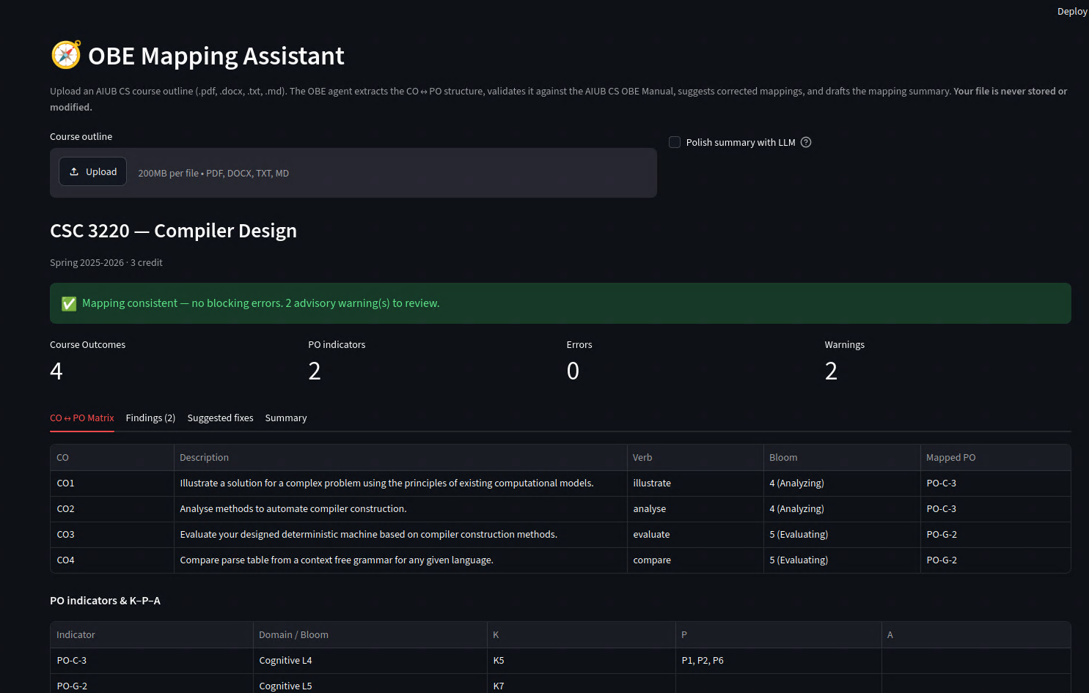
The Application (OBE MAPPING)
Notes:
Replace each framed area with a real screenshot: registration, document upload & analyze, OBE Mapping results, and the Agent Console. During the demo, show the live app for these.

Slide 15
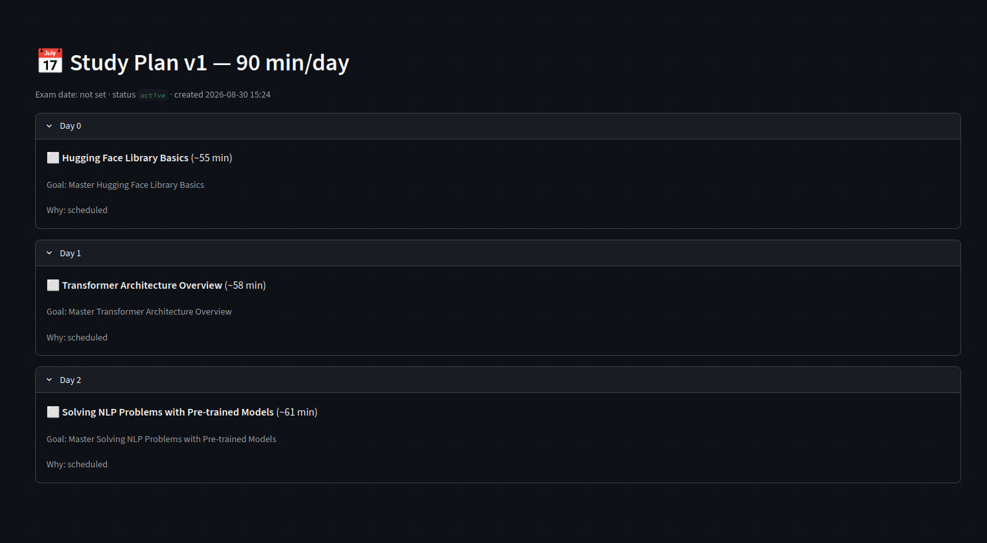
The Application (Study Plan Generation)
Notes:
Replace each framed area with a real screenshot: registration, document upload & analyze, OBE Mapping results, and the Agent Console. During the demo, show the live app for these.

Slide 16
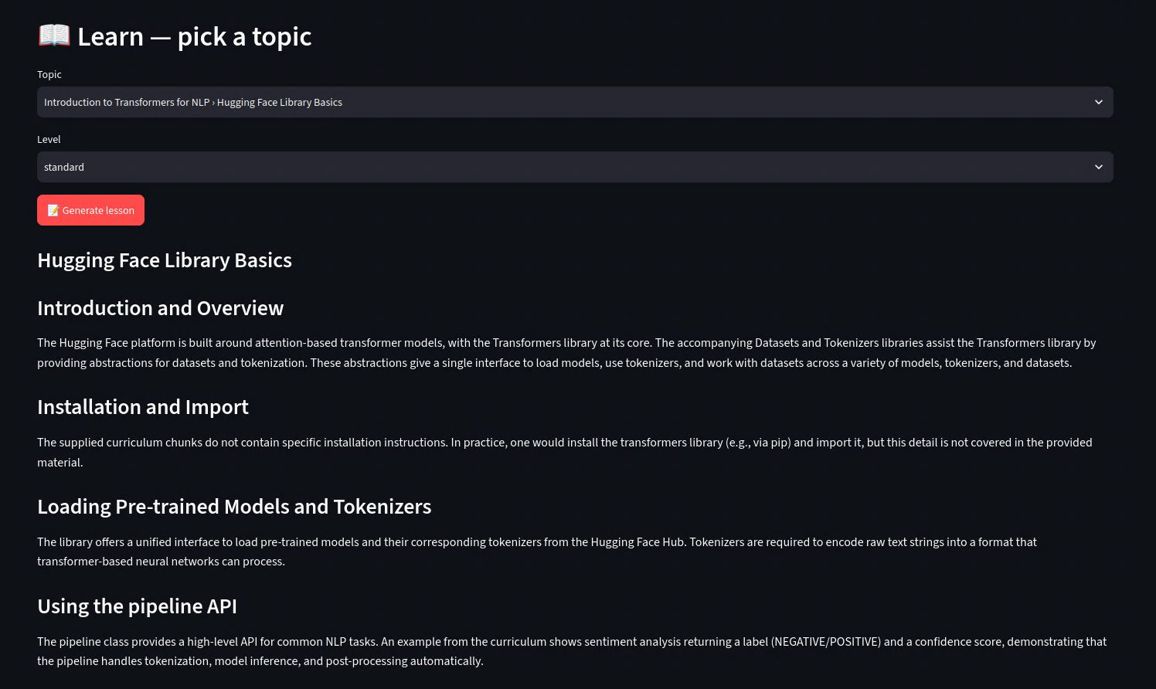
The Application (Lesson Generation)
Notes:
Replace each framed area with a real screenshot: registration, document upload & analyze, OBE Mapping results, and the Agent Console. During the demo, show the live app for these.

Slide 17
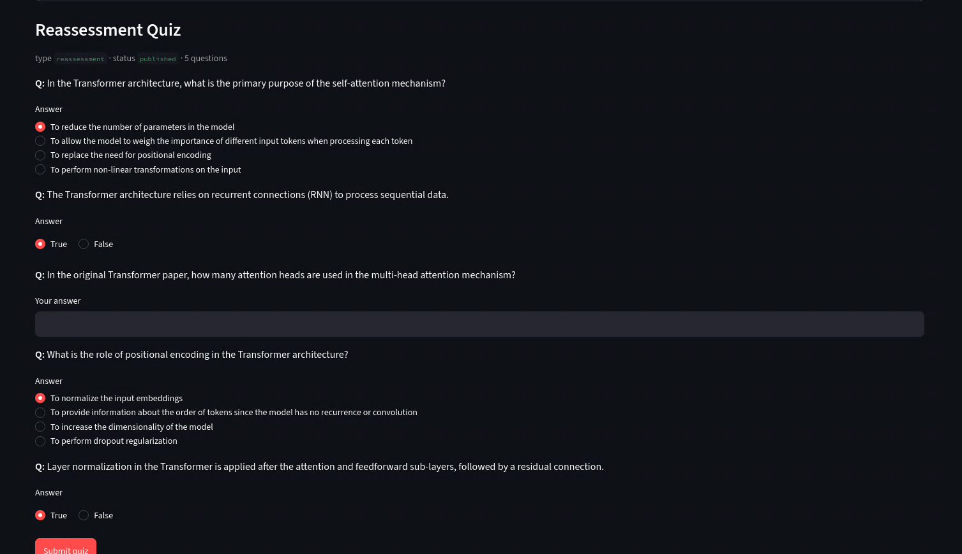
The Application (Quiz Generation)
Notes:
Replace each framed area with a real screenshot: registration, document upload & analyze, OBE Mapping results, and the Agent Console. During the demo, show the live app for these.

Slide 18
Reliability, Security & Testing
42
9
7
0
automated tests passing
cooperating agents
deterministic OBE rules
cost in offline mock mode
Bounded retries + savepoints
Full observability
A failed agent attempt rolls back only its own writes, never earlier agents' work.
Every task, message hop and audit event is persisted and queryable.
Security
Offline-capable
JWT auth, role-based access (teacher/student), bcrypt-hashed passwords, secrets in .env.
Deterministic mock LLM & OBE rules the whole system runs and is tested with no API key.
Notes:
Lead with the numbers. Then reliability: retries + savepoints, observability, security, offline testing. Good answer to 'how did you test it with an LLM and a DB'.

Slide 19
Challenges & Future Work
Challenges
Future Work
Reliable orchestration of many agents without corrupting state on failure.
Extracting data from messy real-world outlines (DOCX tables, page-split matrices).
Free LLM tiers rotate and rate-limit; forced-JSON support varies by model.
Streamlit resets session on hard refresh (auth persistence).
LLM polish for the OBE Authoring agent's rewrites.
A PO-Attainment agent for accreditation reporting.
OCR for scanned PDF outlines.
True mid-graph pause/resume via a LangGraph checkpointer.
Write validated fixes back into the Word template.
Notes:
Be honest about limitations — examiners respect it. Each future item is a concrete next step.

Slide 20
THANK YOU
Questions?
AdaptED — a Supervisor agent routes each request through a LangGraph pipeline of specialized agents that share a memory and a message bus; RAG grounds content in the uploaded material; and two OBE agents validate and author outcome-based course outlines.
Team: 13· Repository: github.com/0NJS0/AdaptEd
Notes:
Close with the one-sentence pitch, then invite questions. Have the Viva Guide's Q&A ready.

