Slide 1
Burp Suite
from First Run to Website Hack in 60 min

Slide 2
About
Application Security Engineer
Bug Bounty Hunter
Web, Mobile, Network pentests
eWPT, eCPPT, CEH, CCNA, OSCP(in progress)
Cyberpolice Teacher

Slide 3
What you need
Laptop (Any OS)
Burp Suite: https://portswigger.net/burp
Larry_Lau :) https://t.me/burpsuite
Lab: http://173.212.213.238:8{1-9}
Challenge http://173.212.213.238:89/ HackIT tickets
GitHub https://github.com/0NtgO/Owasp-Kyiv

Slide 4

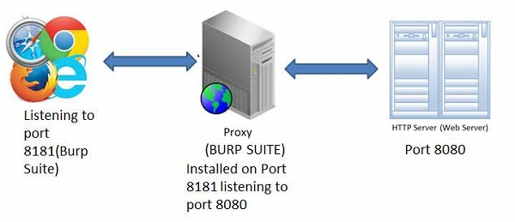
What can it do?
Everything
Modules
Public Extensions
Write your functionality!

Slide 5
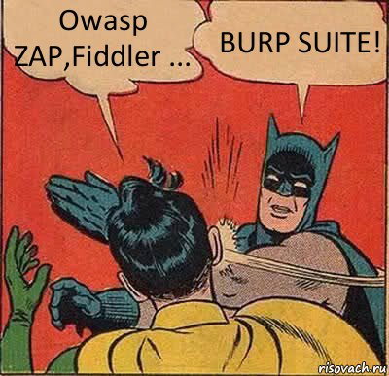
Why Burp Suite?
OWASP ZAP
Postman
WebScarab
Fiddler
Poster
Charles proxy

Slide 6
Burp Suite Editions
Community – FREE | Professional – 400$ | Enterprise – 4,000$
Web scanner | Web scanner | Web scanner
Scheduled and repeat scans | Scheduled and repeat scans | Scheduled and repeat scans
Unlimited scalability | Unlimited scalability | Unlimited scalability
CI integration | CI integration | CI integration
Advanced manual tools | Advanced manual tools | Advanced manual tools
Essential manual tools | Essential manual tools | Essential manual tools

Slide 7
How to start
Run FF
Run Burp Suite: java –jar burpsuite.jar
Set up proxy in FF
Set up CA Certificate
n00b: Intercept off -> Spider –> Scanner -> Analyze for FP -> Report
r00t: Scope, Spider, Proxy, Repeater, Intruder, Extensions, Macros

Slide 8









Burp Suite Modules
Target | Sequencer
Proxy | Decoder
Scanner | Extender
Repeater | Comparer
Intruder | Collaborator

Slide 9

Top Extensions
Reflector
CO2
Sentinel
Random IP Address Header
Json Beautifier
XSS Validator
Vulners Scanner
ActiveScan++
AuthMatrix

Slide 10

Let's start practice!

Slide 11

Contacts
Eduard Babych
@j0ns1k
linkedin.com/in/eduard-babych/
e.babych@hacken.io

